Slide 1
attP region and attB regions
Yordanos Teferra

Slide 2
attP region and attB regions
Yordanos Teferra

Slide 3
Article 1
Hatful, Graham. "Characterization of the Mycobacteriophage L5 Attachment Site, attp."
- attP sites are located in intergenic region around an integrase gene. An integrase gene needs to be present to have an attP region within a phage and to have site-specific recombination event between attP site and attB site
- "M. smegmatis involves an integrase-mediated site-
specific recombination event between specific
attachment sites on the phage genome (attP) and
on the bacterial chromosome (attB;)"

Slide 4
Article 2
- Bryan Julien "Characterization of the Integrase Gene and Attachment Site for the Myxococcus xanthusBacteriophage Mx9"
- attB region need to be only one in a bacteria and mostly have tRNA gene that they are located in. These region usually are the same sequence as the phage (attP) that is attaching into the bacteria.
"Both phages contain attP within the int gene and integrate within a tRNA gene."

Slide 5
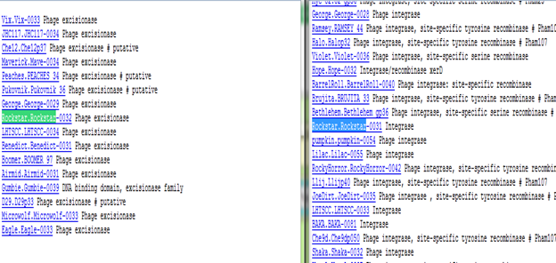
Experiment

Slide 6
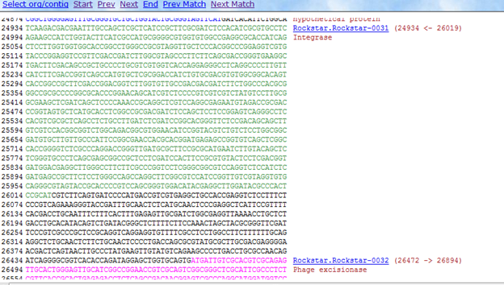

Slide 7
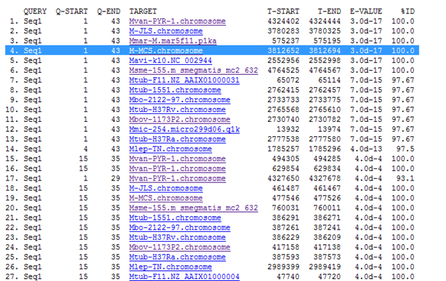
attB

Slide 8
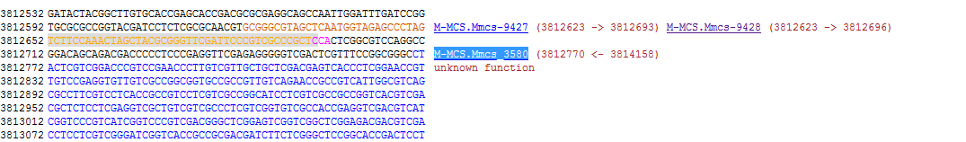

Slide 9
Importance
These findings add on to the idea of where attP sites and attB sites are located.

Slide 10
Article 1
Hatful, Graham. "Characterization of the Mycobacteriophage L5 Attachment Site, attp."
- attP sites are located in intergenic region around an integrase gene. An integrase gene needs to be present to have an attP region within a phage and to have site-specific recombination event between attP site and attB site
- "M. smegmatis involves an integrase-mediated site-
specific recombination event between specific
attachment sites on the phage genome (attP) and
on the bacterial chromosome (attB;)"

Slide 11
Article 2
- Bryan Julien "Characterization of the Integrase Gene and Attachment Site for the Myxococcus xanthusBacteriophage Mx9"
- attB region need to be only one in a bacteria and mostly have tRNA gene that they are located in. These region usually are the same sequence as the phage (attP) that is attaching into the bacteria.
"Both phages contain attP within the int gene and integrate within a tRNA gene."

Slide 12
Experiment

Slide 14
attB

Slide 16
Importance
These findings add on to the idea of where attP sites and attB sites are located.

