Slide 1
Identifying New Motifs in Class 3 Inteins
Mobile Elements

Slide 2
Inteins – What? Where? Why?
Protein equivalents of introns
Sandwiched between extein regions
Mobile elements in a genome
Many found in helicase, terminase proteins

Slide 3
A Closer Look at Intein Structure.
N-terminal Splicing Domain
C-terminal Splicing Domain
N-terminal
Extein
Homing Endonuclease Domain
C-terminal
Extein
INTEIN

Slide 4
Splice Sites and Endonuclease Domains.
Inteins contain splice sites which autocatalyze excision from host extein
2 known kinds of splicing mechanisms exist – Class 1 and Class 2 Inteins
Tori et al. suggest a third – Class 3 Inteins
Endonuclease domain responsible for spread of intein

Slide 5
Conserved Motifs in Splice Sites.
N-terminal Splicing Domain
Homing Endonuclease Domain
C-terminal Splicing Domain
A
B
F
G
Class 1: N-terminal Nucleophilic residue (cys, ser)
Class 3: No N-terminal nucleophilic residue
Class 3: Obligatory WCT triplet within splicing motifs

Slide 6
The Problem.
Are there any other conserved motifs in Class 3 inteins besides the WCT triplet that may be used as an identification method?

Slide 7
The Model.
PHAGE: Mycobacteriophage Bethlehem
INTEIN: Mp-Be DnaB Intein
SOURCE: Tori et al. 2010. Splicing of the Mycobacteriophage Bethlehem DnaB Intein. Journal of Biological Chemistry 285(4): 2515-2526.

Slide 8
Methods.
Find similar sequences to DnaB Intein by looking for similarity in intein region in all mycobacteriophage
Align sequences
Identify WCT
Identify new motifs
Compare new motifs found with those of class 1 inteins

Slide 9
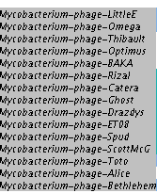
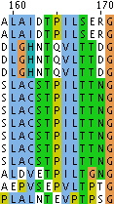
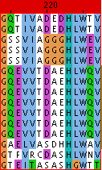
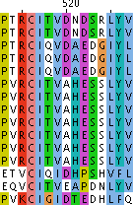
Observations.
W
C
T
Notes:
GG********H***********************HN

Slide 10
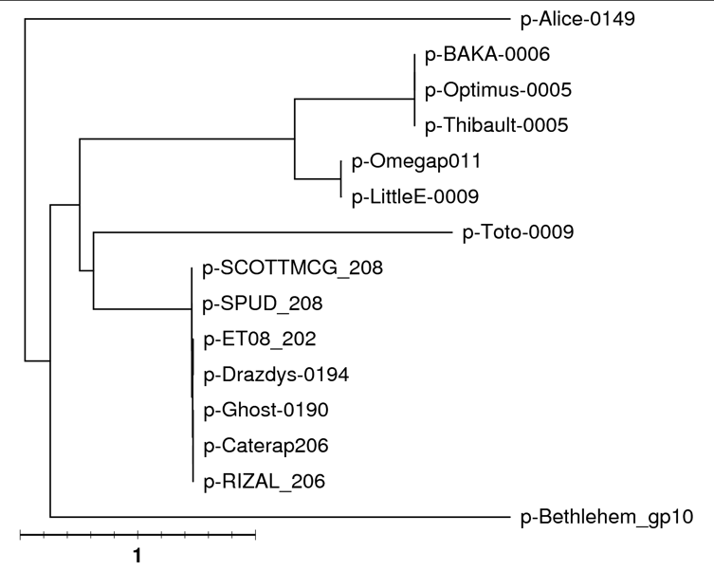
How Similar Are they?

Slide 11
Results.
New obligatory motif in splice site in addition to WCT triplet
GG********H***********************HN
Inteins from SCOTT, SPUD, ET08, Drazdys, Ghost, Catera, RIZAL are closely related
Inteins from Omega, LittleE are closely related
Inteins from BAKA, Optimus, Thibault are closely related

Slide 12
Next Steps.
Is this motif conserved in Class 1 inteins?
→Why I care: if it is = poor diagnostic tool
Are the other mycobacteriophage that were similar to Mp-Be intein but lacked similarity within the intein region, related?
→ Why I care: Perhaps inteins prefer some host proteins to others

Slide 13
Acknowledgements.
This work would not have been possible without the support of:
Dr. Jeff Elhai
Mobile Elements Group

