Slide 1
[Rz/Rz1, LysB/LysC, gp u/v] proteins of Lytic Cassette
Lawangin Khan

Slide 2
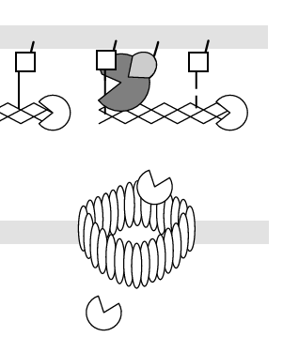
What are [Rz/Rz1, LysB/LysC, gp u/v] proteins and their purpose?
Outer Membrane bound protein, which helps disintegrate the membrane
Proteins involved in the last stages of lytic cycle
Cleaves the links between the murein and outer membrane
(Young et al)

Slide 3
Question
What is the purpose of the protein sequence gp u/v and how are they similar to other gp u/v like proteins in other phages?

Slide 4
Sequence of protein v (Rz1, LysC)
Krupovic’s experiment, PSI-BLAST (Krupovic et al)
MKLNKFLIVLCLPMFAACSTTAPKIETVYLVPPSSLLTECAAPVYPFITWRDLVEAYAKEKAARESCGLQIQEIKNWFKETVPSESRKFQ

Slide 5
Gp v in BioBIKE
Tried to find gp u and gp v using Matches of pattern, Matches of item, sequence similar to in the translation of genome, translating some of annotated genes, but could not find sequence in PRD1 through BioBIKE
protein blast, NCBI website on the sequence of protein v obtained from Krupovic

Slide 6
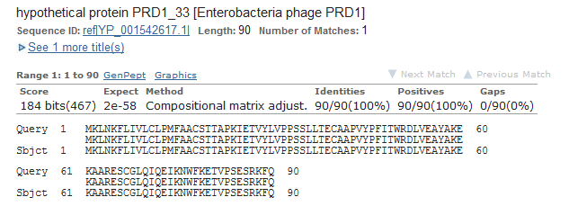
Blast results
Deteremined sequence of gene v using Gene ID: 5729505

Slide 7
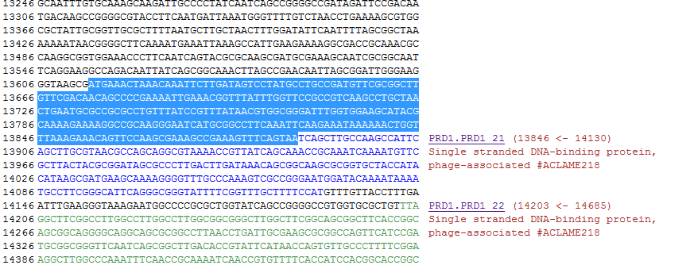
Gp v in PRD1
Searched for sequence in biobike sequence of PRD1 which was located upstream and a few beginning nucleotides of gene PRD1.PRD1_21
13614 -> 13886

Slide 8
Gp u (Rz/LysB)
The Gene ID from NCBI also helped me determine location of gp u
Repeated same steps to locate gene u on biobike, 13329 -> 13687

Slide 9
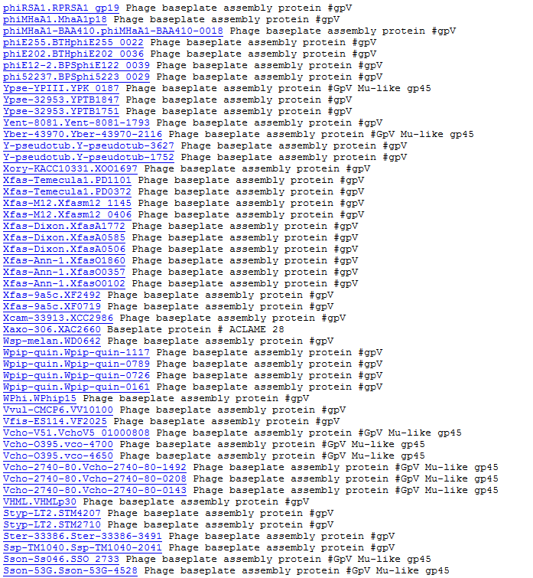
Genes similar to gp v

Slide 10
Similar Proteins
Most are similar protein which makes sense they are similar to PRD1

Slide 11
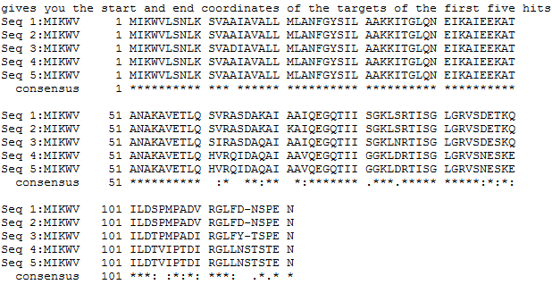
Similar proteins analysis
In the alignment sequence I noticed beginning of the sequence mainly similar
Domain of function predicted it to be transmembrane domain

Slide 12
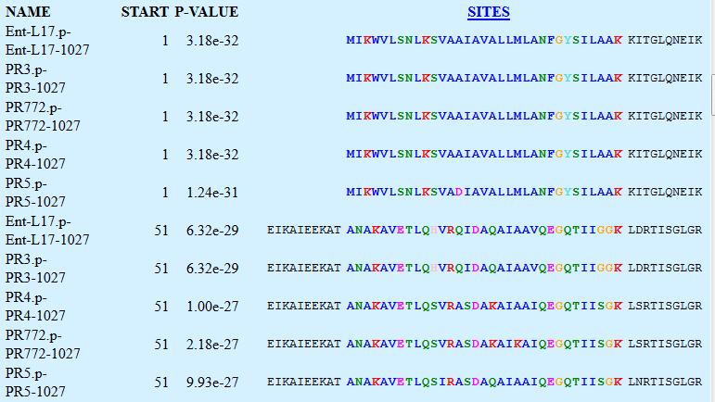
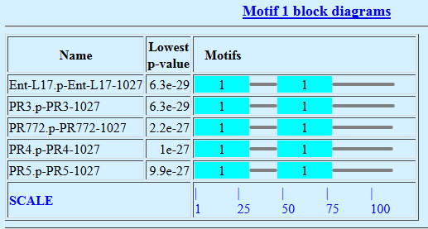
Analysis Continued

Slide 13
Analysis Continued
Krupovic’s experiment: Transmembrane domain was determined by TMHMM (Krupovic et al)
(http://www.cbs.dtu.dk/services/TMHMM-2.0/)
Single transmembrane domain predicted at beginning of the sequence of gene u. Gene v did not have a transmembrane domain

Slide 14
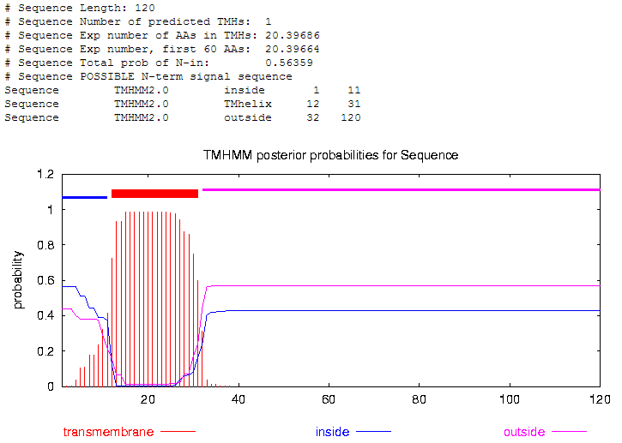

Slide 15
Peptidase II cleavage site
Peptidase II cleavage site was determined by LipoP (Krupovic et al)
(www.cbs.dtu.dk/services/LipoP/).
The consensus peptidase II cleavage site predicted by Kropuvic is L(A/S)(G/A)C
Graph indicats high probability of a cleavage II site for gp v. Gp u did not have a cleavage II site.

Slide 16
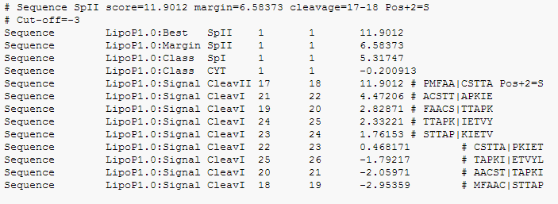
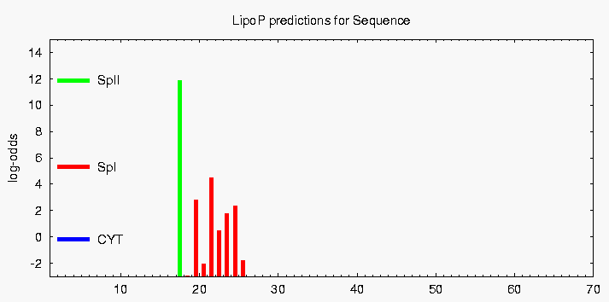

Slide 17
Final thoughts
Similar domains (transmembrane domain, coiling coil) between similar gp u/v proteins
Location of genes in genome
Predicted sequence function
Transmembrane region
Cleavage site
Coiling coil
Do same study on VCU phage Maverick or Cluster A phages depending on difficulty

