Slide 1
Superinfection Exclusion Proteins in Mycobacteriophages
Keith Herbert

Slide 2
What is Superinfection Exclusion (SIE)?
Phage infects a cell
Doesn't want to share cell
Blocks other phages from cell
Variety of mechanisms used

Slide 3
SIE in Mycobacteriophages
Searches revealed very few SIE genes across all mycobacteriophage genomes
Many genes unlabeled for function
My goal: find, describe, and annotate SIE genes in mycobacteriophages based on similarities to known SIE genes from other phages

Slide 4
Finding SIE Genes
Compared list of SIE genes from all gram-positive bacteria against mycobacteriophages
Results were poor
Compared list of SIE genes from all other phages against mycobacteriophages
Two close matches from enterobacteriophages IME08 and vB_Ecom-VR7
Compared these to proteins of different SIE mechanisms

Slide 5
What Was Found

Slide 6
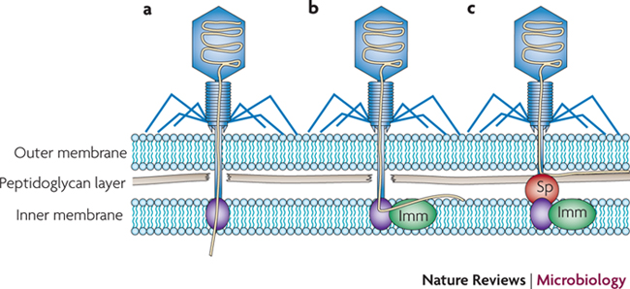
Labrie, Simon J. (2010) Bacteriophage resistance mechanisms. http://www.nature.com/nrmicro/journal/v8/n5/full/nrmicro2315.html

Slide 7
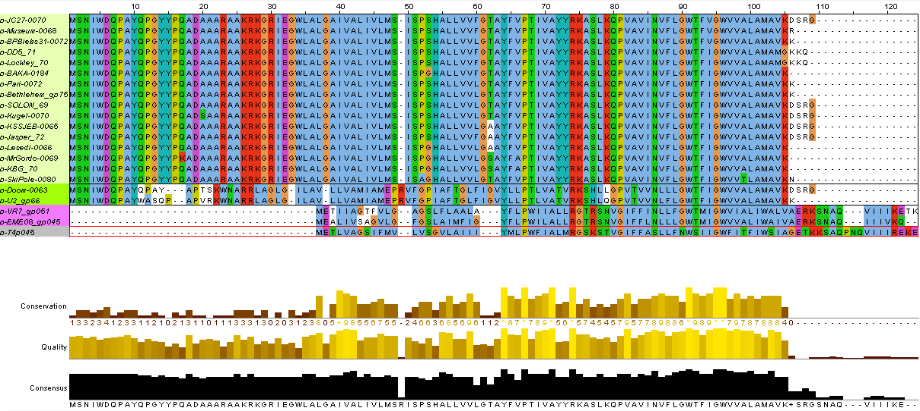

Slide 8
