Slide 1
Incomplete Repressors in Phages
Mandi Feinberg
BNFO 301
Spring 2013

Slide 10
Phages
Bacteria

Slide 11
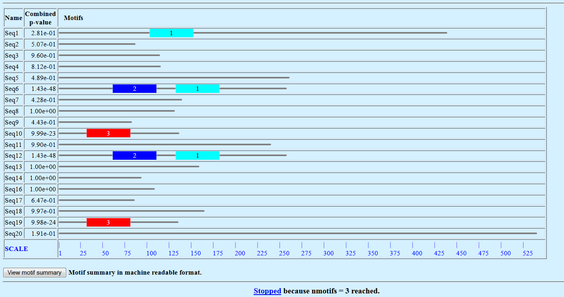
Phages

Slide 12
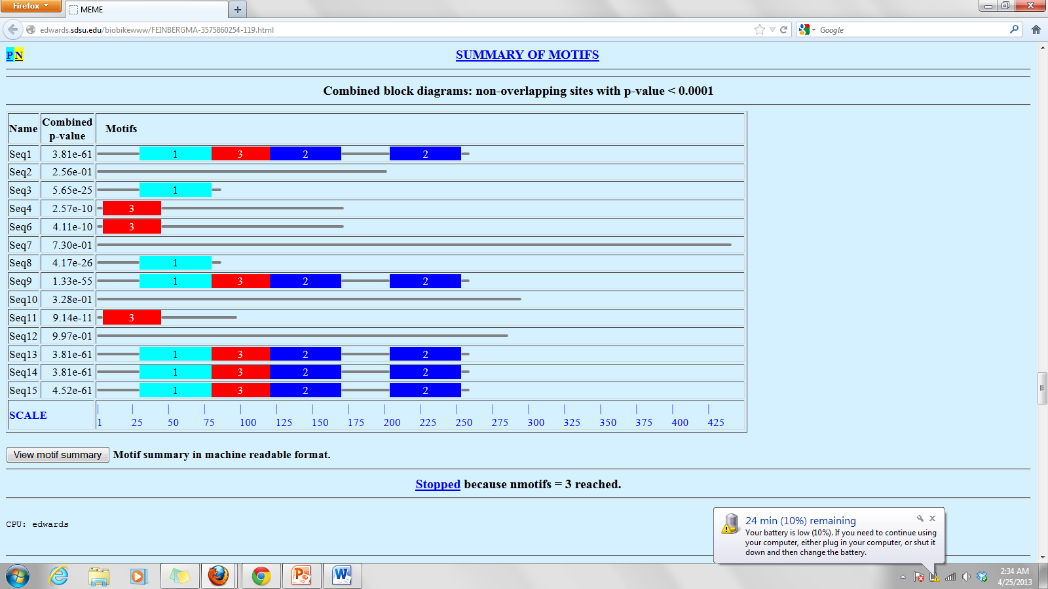
Mycobacteria Phages

Slide 14
Limitations
When I find motifs that may be incomplete– won’t know what phage it belongs to since I used randomization and MEME only gives sequence numbers so its impossible match it back
Have to go through in sections and label them and find motifs in order
Limited to about 20 before times out
No matter how fix it, it will be a long, complicated process

Slide 15
Works Cited
http://www.sciencedirect.com/science/article/pii/S1097276512009434
Broussard, Gregory W., Lauren M. Oldfield, Valerie M. Villanueva,
Bryce L. Lunt, Emilee E. Shine, and Graham F. Hatfull. "Integration-Dependent Bacteriophage Immunity Provides Insights into the Evolution of Genetic Switches." Molecular Cell 49 (2013): 237-48.
http://biobike.phantome.org/ajax/vpl.html?PKG=FEINBERGMA39619
Intro to BNFO 301 Exam 2
http://www.ncbi.nlm.nih.gov/pmc/articles/PMC94198/
The Genetic Switch Regulating Activity of Early Promoters of the Temperate Lactococcal Bacteriophage TP901-1
Peter Lynge Madsen, Annette H. Johansen, Karin Hammer, Lone Brøndsted
J Bacteriol. 1999 December; 181(24): 7430–7438.

