Slide 1
Reverse transcriptase insertions in Bordetella phages
Abdallah Abdelmaksoud

Slide 2
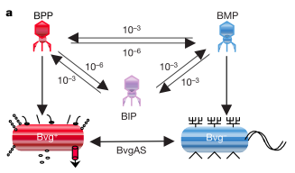

Slide 3
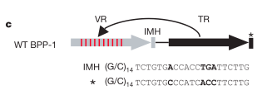
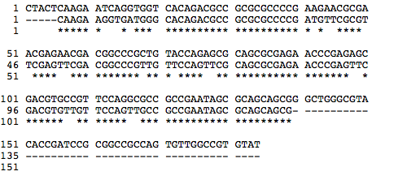

Slide 4
BPP
BPP

