Slide 1
Danielle Bartholomew
Viral Metagenome Final Report

Slide 2
The goal:
Retrieve an (original) viral DNA sequence.
Determine whether or not it contains genes.
Predict the function of any encoded proteins.
Fully engage myself with my sequence; keep an open mind; this is a sequence that has not yet been analyzed!

Slide 3
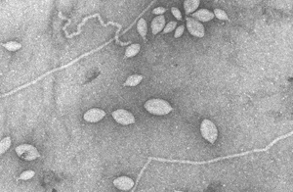
Chuck
My sequence was once a little guy, (we’ll call him Chuck) minding his own business, and doing what viruses do best: infecting!
One life-altering morning, as he exited one of his bacterial hosts, he wondered “why am I here? Is this all there is for me?! What else is out there?”
So, Chuck did the unthinkable- he ventered to the water’s edge, where no virus had EVER been (or at least seen again after going)!

Slide 4
Poor guy, he was scooped up by some biologists and led to his death bed. What he didn’t know is that he was about to receive the answers to the questions that led him there in the first place…

Slide 5
Obtaining my sequence (Chuck):
Using bioBIKE- a database equipped with commonly used tools that uses a graphical language easily understood by the non-programmer.
A 955 nucleotide fragment of DNA, from the Octopus Hot Spring in Yellowstone National Park.

Slide 6
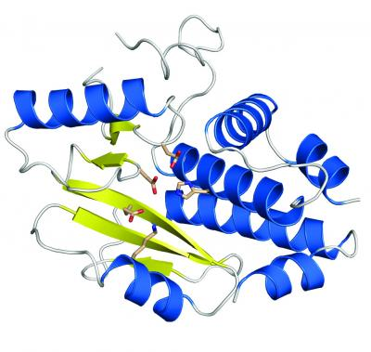
At first glance:
Chuck’s boring. He probably didn’t serve a real purpose…Sorry Chuck.
Not enough info to predict a shape, not enough of a sequence to predict anything.
While I’m getting frustrated because Chuck’s boring, so that makes my life boring, Chuck is reincarnated and screams at me, “DUH! This is only a little part of me, they chopped me all up after they scooped me from Yellowstone so they could clone me…could you please locate my other parts? This kind of hurts…”

Slide 7
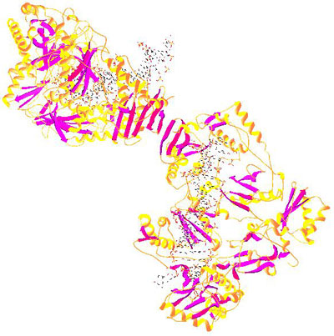
I listened to Chuck…
Using biobike, I searched within the database for any other reads from Yellowstone that had significant similarity to, in hopes of piecing my new friend back together.
I found a lot of them. Chuck must have been(is?) a big guy!

Slide 8
Overlaps..
BioBIKE- 8 sequences with significant overlap
<- Chuck
Pieces of chuck ->
The new and improved Chuck the virus!! (Almost 4000 nt long)!

Slide 9
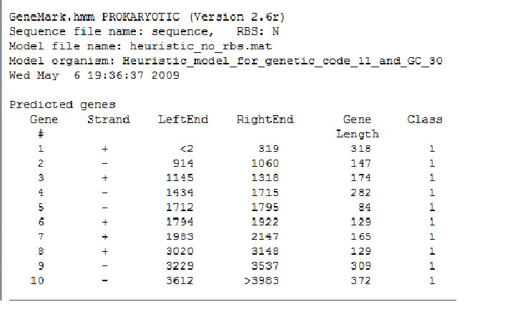
…now what?
I still need to help this poor guy out. On with it!
To predict whether or not he contains genes, I used genemark.hmm. Genemark needs a nucleotide sequence input, and WALA! Genemark predicts the genes.
Here are my results:

Slide 10
Open Reading Frames
10 predicted proteins! Not bad, chuck!
Except…we are only going to use 4 of them.
Predicted genes that are <150-200 are usually considered “garbage.”
So, we have 4 genes with coordinates:
from 0 to 319 (orange)
from 1434 to 1715(green)
from 3229 to 3537(blue)
from 3612 to 3983(purple)

Slide 11
BLAST!!!
So, where DID Chuck come from…? To find out I used blastx, blastn, and blast protein database.
Basic Local Alignment Search Tool, or BLAST, is a web-based program for comparing biological sequence information, such as the amino-acid sequences of different proteins or the nucleotides of DNA sequences. A BLAST search enables someone to compare a sequence with a library or database of sequences, and identify library sequences that resemble the query sequence above a certain threshold.
Blastx: compares translated DNA to known proteins.
Blastn: compares DNA to DNA.
Blast PDB (protein database): compares a protein sequence to known protein sequences.

Slide 12
Blastx Results Open reading Frame 3- translated nucleotide bases to known proteins
protein of unknown function DUF205
[Thermotogales bacterium TBF 19.5.1] E=1e-12
Blastx Results Open reading Frame 2- translated nucleotide bases to known proteins
hypothetical protein aq_765 [Aquifex aeolicus VF5] E=8e-22
hypothetical protein HG1285_06445 E=8e-19
dolichyl-phosphate-mannose-protein mannosyltransferase
[Persephonella marina EX-H1] E=2e-14
Blastx Results Open reading Frame 2- translated nucleotide bases to known proteins
hypothetical protein HG1285_17085
[Hydrogenivirga sp. 128-5-R1-1] E=1e-13

Slide 13
Blastx Results Open Reading Frame 4 - translated nucleotide bases to known proteins
hypothetical protein aq_676
[Aquifex aeolicus VF5] Evalue = 2e-32
hypothetical protein HG1285 06440
[Hydrogenivirga sp. 128-5-R1-1] E= 2e-29
protein of unknown function DUF205 [Hydrogenobaculum sp. Y04AAS1] E= 6e-22
hypothetical protein Pmob_1616
[Petrotoga mobilis SJ95] E=2e-21
hypothetical protein TTHA1203
[Thermus thermophilus HB8] E= 9e-19
protein of unknown function DUF205
[Geobacter bemidjiensis Bem] E= 5e-19
acyl-phosphate glycerol 3-phosphate acyltransferase [Sulfurihydrogenibium azorense Az-Fu1] E=1e-18

Slide 14
Blastn…
NO RESULTS!

Slide 15
Proteins..
The next step is to turn Chuck into a sequence of amino acids. I did this in biobike, using a function that allows you to input a sequence and it outputs a direct amino acid translation of your sequence.
Next, I used Blast’s PDB, and found one protein.
protein of unknown function DUF458 [Sulfurihydrogenibium sp. YO3AOP1] Length=145 E=5e-09

Slide 16
Before I tell Chuck what the purpose of his life is…I do some research.

Slide 17
Protein match:
protein of unknown function DUF458
[Sulfurihydrogenibium sp. YO3AOP1]
Bacteria; Aquificae; Aquificales; Hydrogenothermaceae; Sulfurihydrogenibium.
thermophilic bacterium that gets energy through the oxidation of hydrogen or reduced sulfur compounds.

Slide 18
Info..
The protein of unknown function DUF205 (Bacteria; Thermotogales) is found only in bacteria. It is hypothesized that it may be a multi-pass membrane protein.
The hypothetical protein HG1285_06445 is related to Hydrogenivirga sp. 128-5-R1-1 (which I also have another match with.) there is no known information about this protein.
The hypothetical protein aq_765: Aquifex are nonsporeforming, gram-negative, generally rod-shaped organisms. As autotrophic organisms, Aquifex fix carbon dioxide from the environment to get the carbon that they need. They are chemolithotrophic, which means that they draw energy for biosynthesis from inorganic chemical sources.

Slide 19
Info Cont’d..very interesting, Chuck…you have my attention.
dolichyl-phosphate-mannose-protein mannosyltransferase: Bacteria; Aquificae; Aquificales; Hydrogenothermaceae; Persephonella. Autotrophic nitrate reducers that have cytoplasmic membrane-bound nitrate reductases (Nar) and nitrite reductases (Nir), nitric oxide reductases (NOR), and nitrous oxide reductases (Nos).
The hypothetical protein HG1285_17085 [Hydrogenivirga sp. 128-5-R1-1]:
Another one! I see a pattern!
forms a lineage within the Aquificaceae
deep-sea vents
related to other marine microbes with genome sequence information (Persephonellas)
uncertain phylogenetic and taxonomic affiliation
thermophilic or mesophilic chemolithoautotrophs, or facultative heterotrophs

Slide 20
hypothetical protein Pmob_1616 [Petrotoga mobilis SJ95] : Bacteria; Thermotogae; Thermotogales; Thermotogaceae; Petrotoga
Related to DUF205!!
a member of the Thermotogales,
characteristic morphology of one or more cells contained in a sheath-like envelope which extends beyond the cell wall.
Petrotoga species appear to be common members of the oil well microbial community (high temperatures and abundant organic matter).
SJ95:an anaerobic thermophile, isolated from the production waters of a North Sea oil reservoir
hypothetical protein TTHA1203
Bacteria ; Deinococcus-Thermus; Deinococci; Thermales; Thermaceae; Thermus
Unknown function, but hypothesized function has been localized to a multi-pass membrane!!!
protein of unknown function DUF205 [Geobacter bemidjiensis Bem]
Unknown protein

Slide 21
Mmm, I love the taste of information…
acyl-phosphate glycerol 3-phosphate acyltransferase biosynthetic pathway to initiate phosphatidic acid formation in bacterial membrane phospholipid biosynthesis involves the conversion of acyl-acyl carrier protein to acylphosphate by PlsX and the transfer of the acyl group from acylphosphate to glycerol 3-phosphate by an integral membrane protein, PlsY

Slide 22
Conclusion
My seuquence is probably a virus that usesbudding or any other means to introduce itself into the cell. All of the proteinsare related to membtanes.
Any other ideas?
Thanks!!

