Slide 1
Regulating CRP protein levels with the use of sRNA
Jada Wilson

Slide 2
Bubonic plague

Slide 3
Yersinia Pestis

Slide 4
Plasminogen Activator

Slide 5
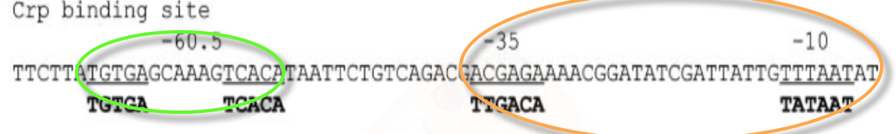
CRP regulates plasminogen production
CRP binds upstream of the plasminogen promoter activation trasnscription

Slide 6
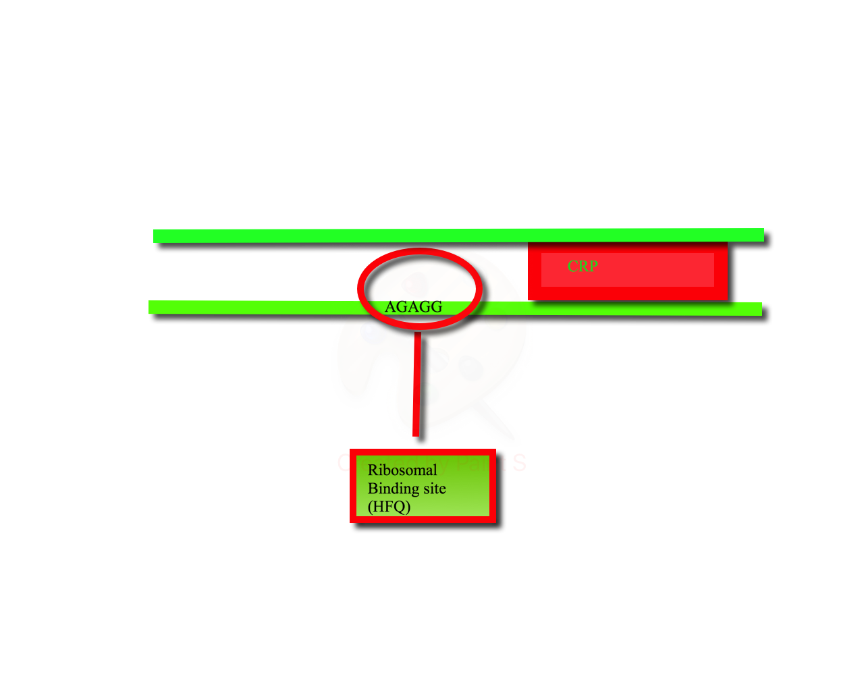
How is CRP controlled

Slide 7
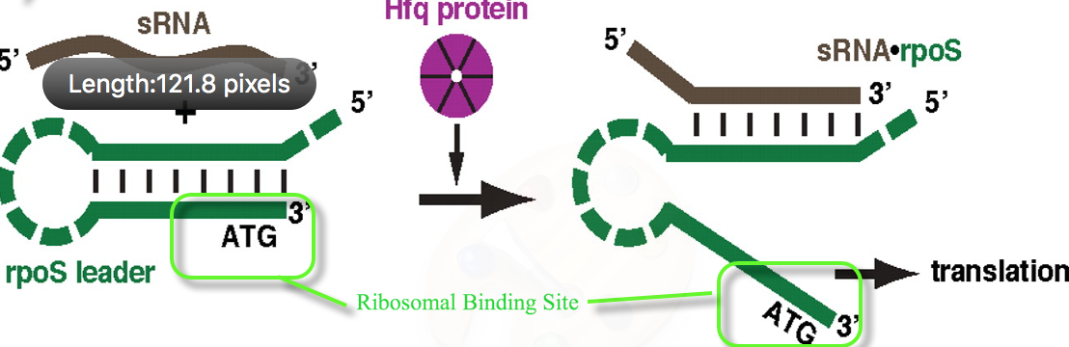
sRNA assisted regulation

Slide 8
CRP related sRNA?
Question: Is there an sRNA that directly relates to CRP?
Experiments
  RNA sequencing
  Co-Immunoprecipitations

Slide 9
RNA sequencing
Western Blot
Sequencing by machine (SOLEXA or SOLiD)

Slide 10
Immunoprecipitations

Slide 11
References
Kim, Tae-Jong, Chauhan, Sadhana, Motin, Vladimir L., Goh, Ee-Been, Igo, Michele M., and Young, Glenn M. "Direct Transcriptional Control of the Plasminogen Activator Gene of Yersinia Pestis by the Cyclic AMP Receptor Protein." The Journal of Bacteriology 189.24 (2007):
Lathem, W. W. et. al. “Posttranscriptional Regulation of the Yersinia pestis Cyclic AMP Receptor Protein Crp and Impact on Virulence”. mBio, 5(1), pp.e01038–13. (2014)

