Slide 1
Disruption of Angiopoietin-1 and α_{v}β₃ Integrin Interaction in Tie2, Ang-1 and α_{v}β₃ Integrin complexes
BY: KYLE VO
MENTOR: WILLIAM BARTON, PHD

Slide 2
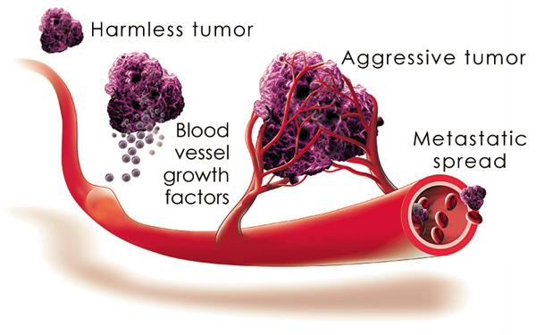
Cancer development

Slide 3
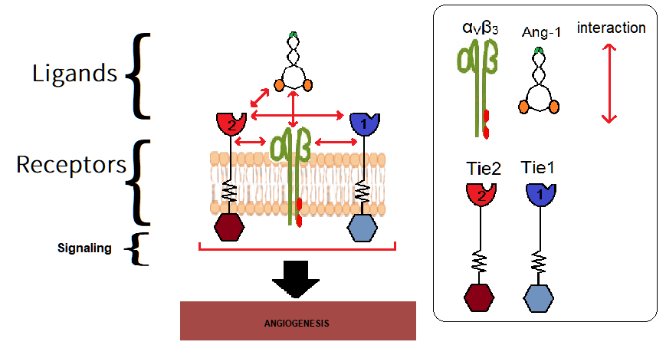
Schematic Pathway & Available Drug
Drugs that are broad-spectrum inhibitors of RTKs (including Tie2): Cabozantinib, Lenalidomide, Regorafenib…
Inhibiting Angiopoietin 1 & 2 interaction with their receptor Tie2: Trebananib.
More drug target, compound medicine?
How about Integrin role in Tie2 activation?

Slide 4
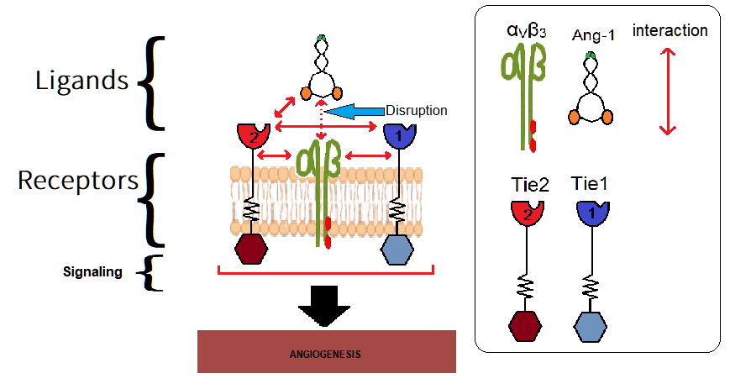
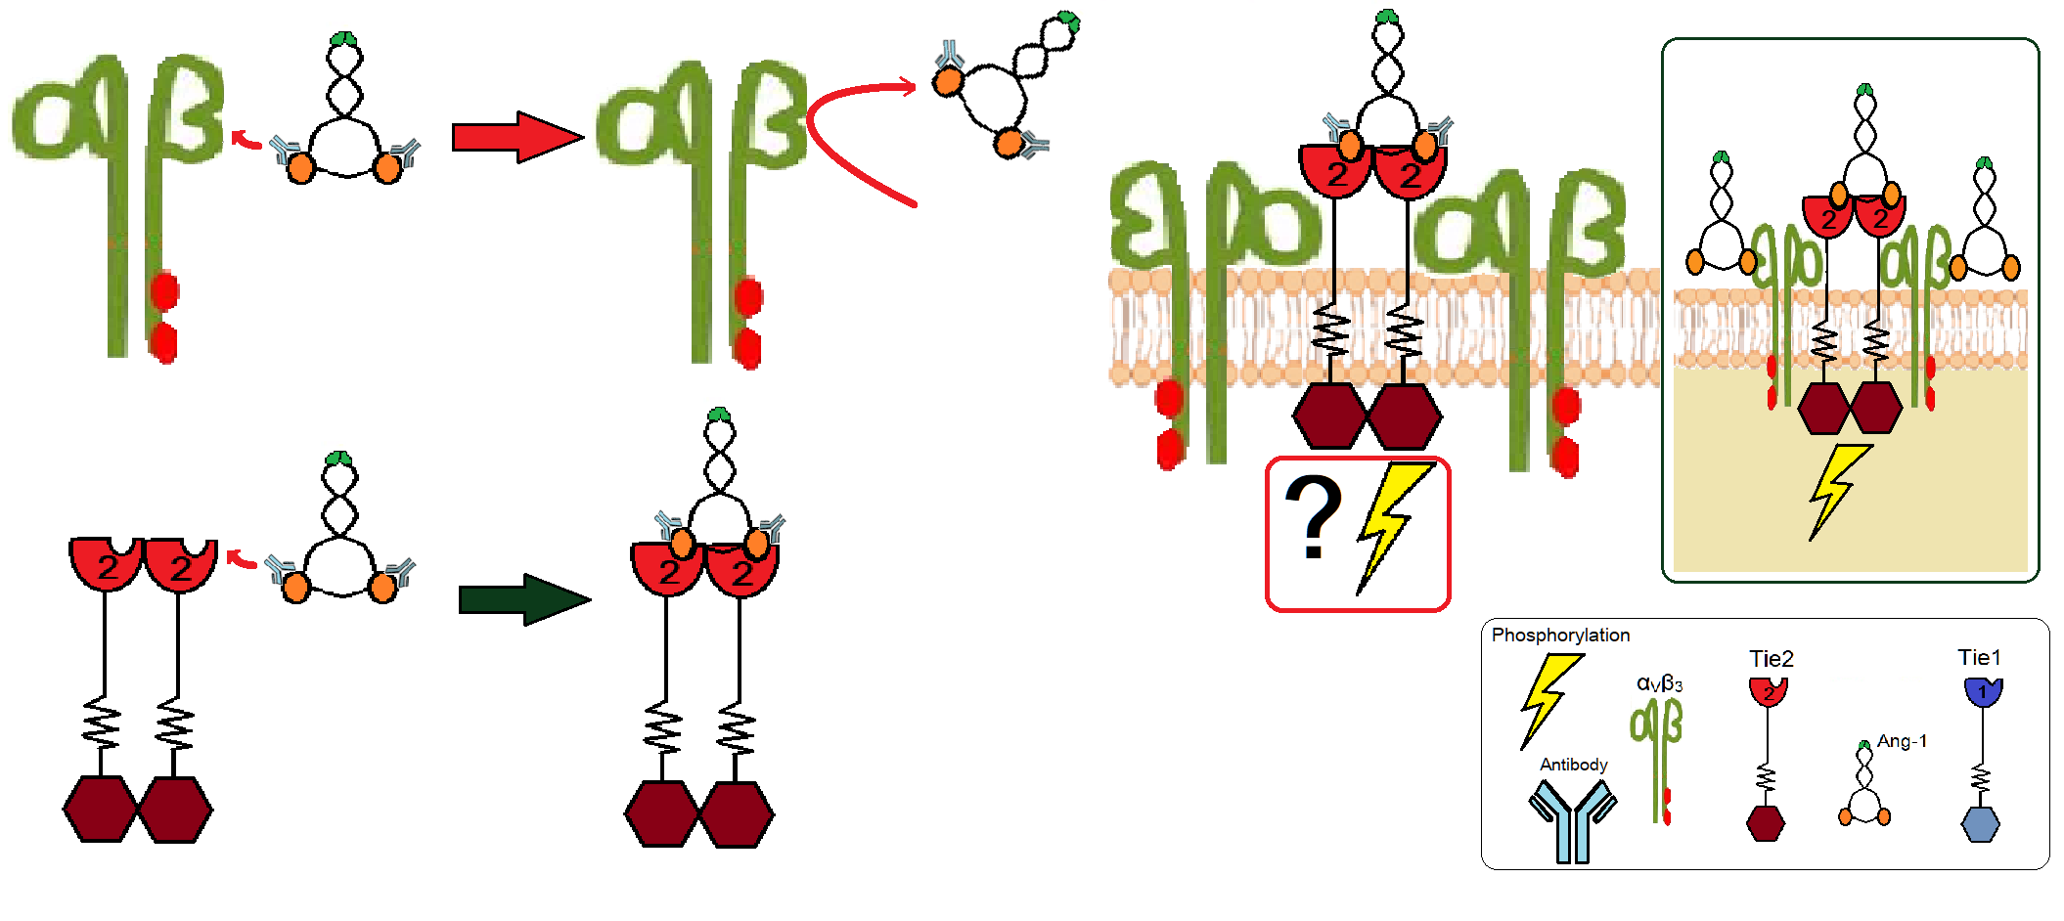
Schematic diagram of experiment

Slide 5
Making Antibodies against Ang-1

Slide 6
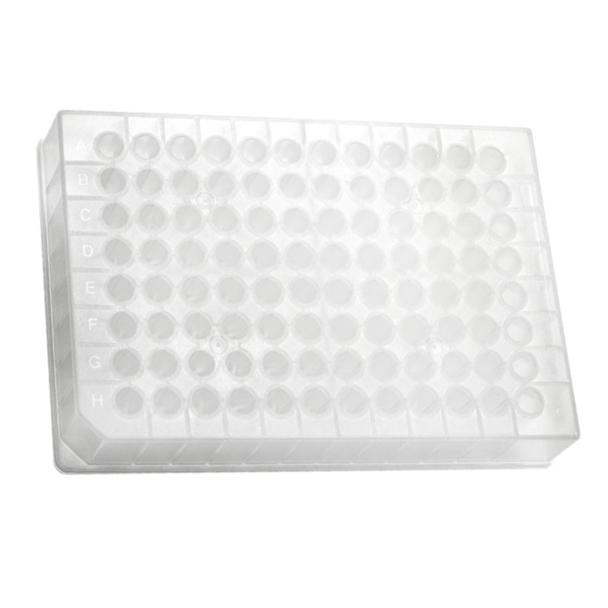
Step I: Find antibodies that bind Ang-1
Attach angiotensin to wells
Attach Ang1 to wells

Slide 7
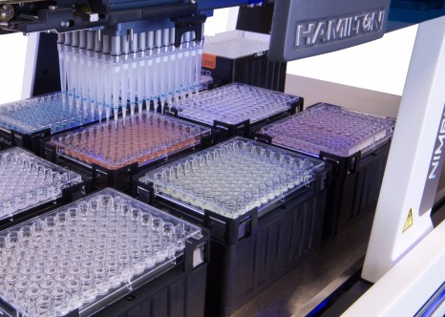
Step I: Find antibodies that bind Ang-1
Add antibodies, separately, then wash

Slide 8
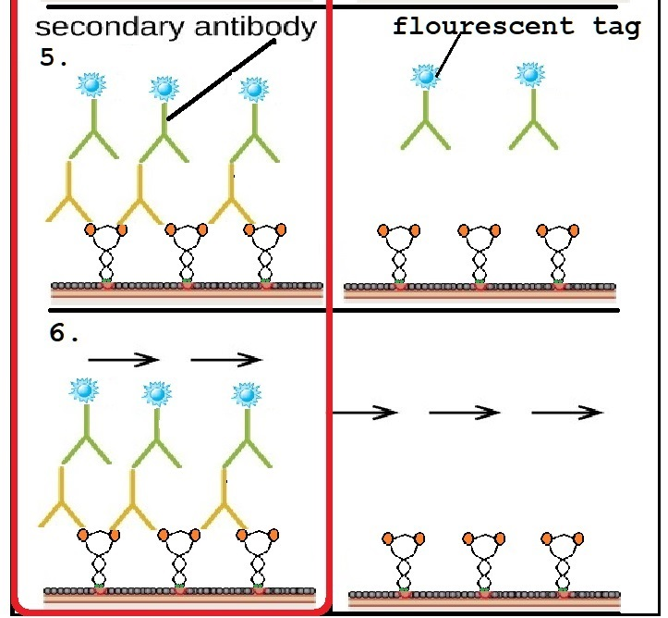
Step I: Find antibodies that bind Ang-1
Add secondary antibody, and wash

Slide 9
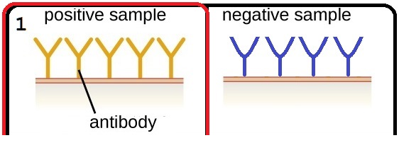
Step II: Find antibodies that allow Ang-1 binding to Tie2
Attach 96 antibodies to wells, separately

Slide 10
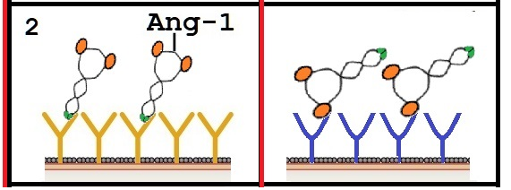
Step II: Find antibodies that allow Ang-1 binding to Tie2
Add Ang-1 to wells

Slide 11
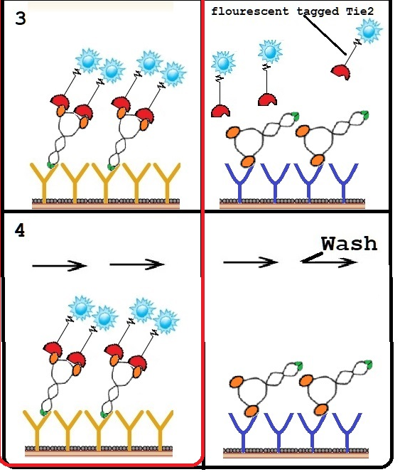
Step II: Find antibodies that allow Ang-1 binding to Tie2
Add Tie-2 to wells and wash

Slide 12
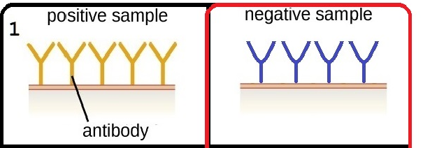
Step III: Find antibodies that prevents Ang-1 binding to Integrin α_{V}ß₃
Attach 96 antibodies to wells, separately

Slide 13
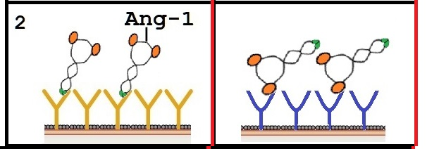
Step III: Find antibodies that prevents Ang-1 binding to Integrin α_{V}ß₃
Add Ang-1 to wells

Slide 14
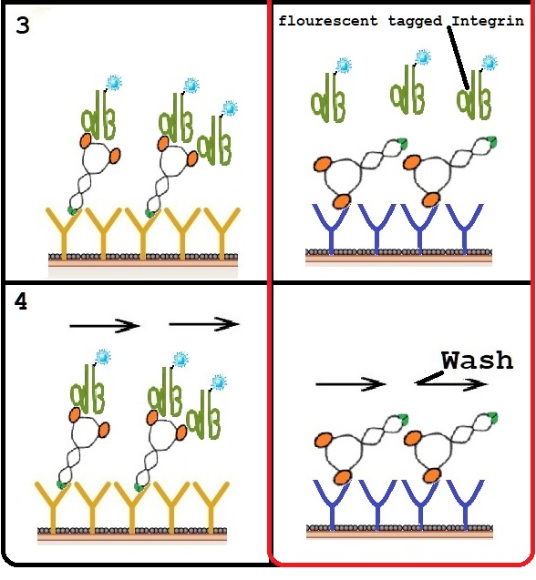
Step III: Find antibodies that prevents Ang-1 binding to Integrin α_{V}ß₃
Add fluorescent tagged Integrin to wells, then wash

Slide 15
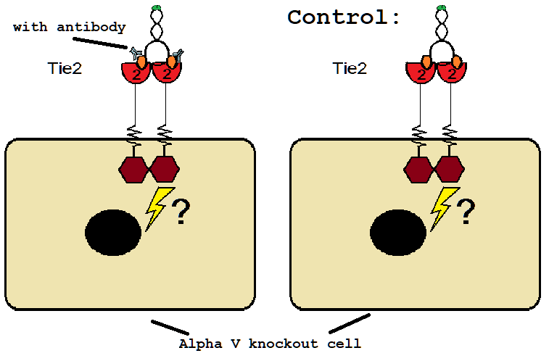
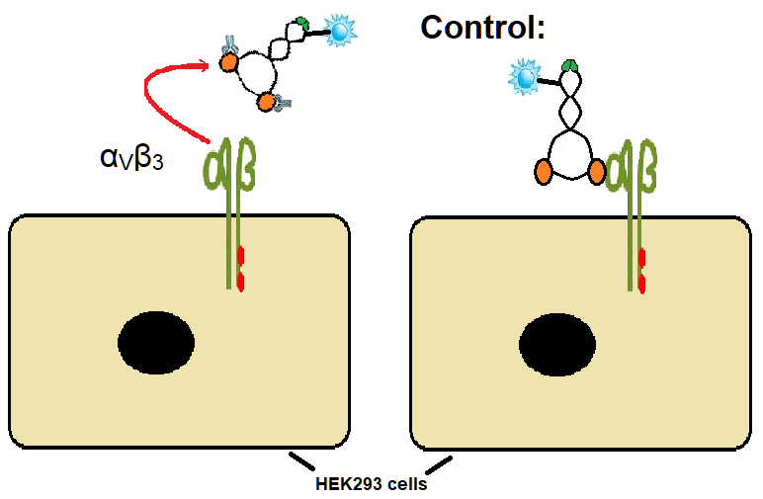
(Optional) In vivo: Association between Tie2 – Ang-1 and α_{V}ß₃ - Ang-1 with presence of antibodies.

Slide 16
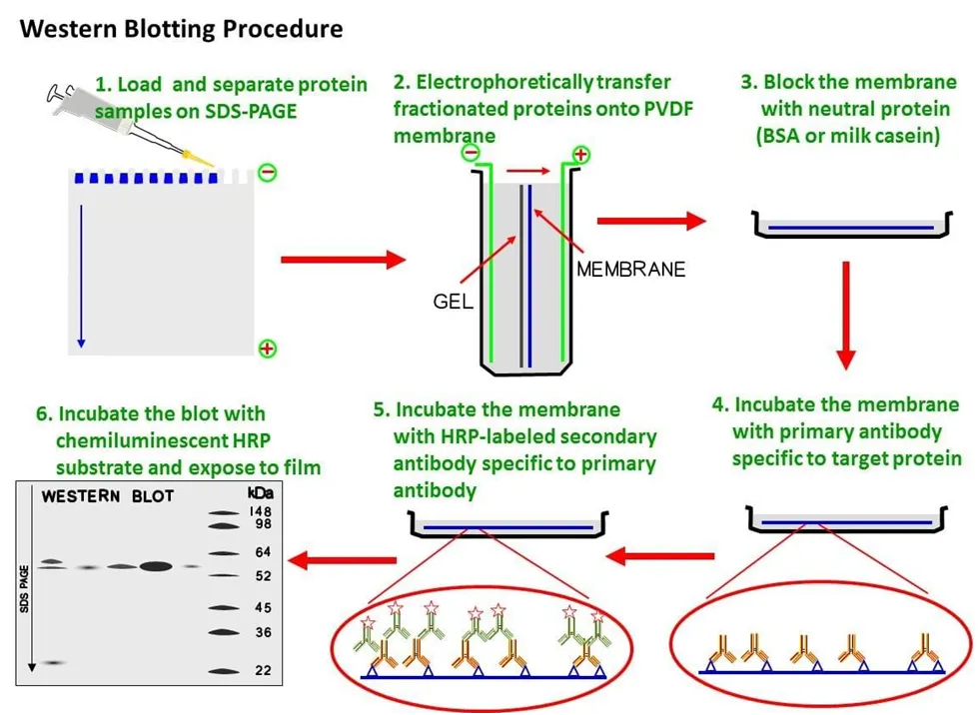
Measure Tie2 activity in presence of Ang-1 antibody and Integrin α_{V}ß₃
Control columns:
Column 1: Tie2
Column 2: α_{V}ß₃
Column 3: α_{V}ß₃ + Tie2
Column 4: Ang-1
Column 5: Ang-1 + α_{V}ß₃
Column 6: Ang-1 + Tie2
Column 7: α_{V}ß₃ +Tie2 with Ang-1
Test column:
Column 8: Integrin+Tie2 with Ang-1
and the antibody selected from step V-VI (or step III-IV )
Primary antibody:
Anti-phosphotyrosine immunoprecipitates
..

