Slide 1
Assessing the relative functions of two putative collagenase genes extracted from a clinically-relevant vaginal microbe
Nana Afia Twumasi-Ankrah, Jennifer Fettweis, PhD, Nicole Jimenez
Microbiology & Immunology (Vaginal Microbiome Consortium)
Molecular Biology Through Discovery
Fall 2019
Notes:
Hello, today I will be proposing an experiment which focuses on verifying the functions of two putative collagenases genes.

Slide 2
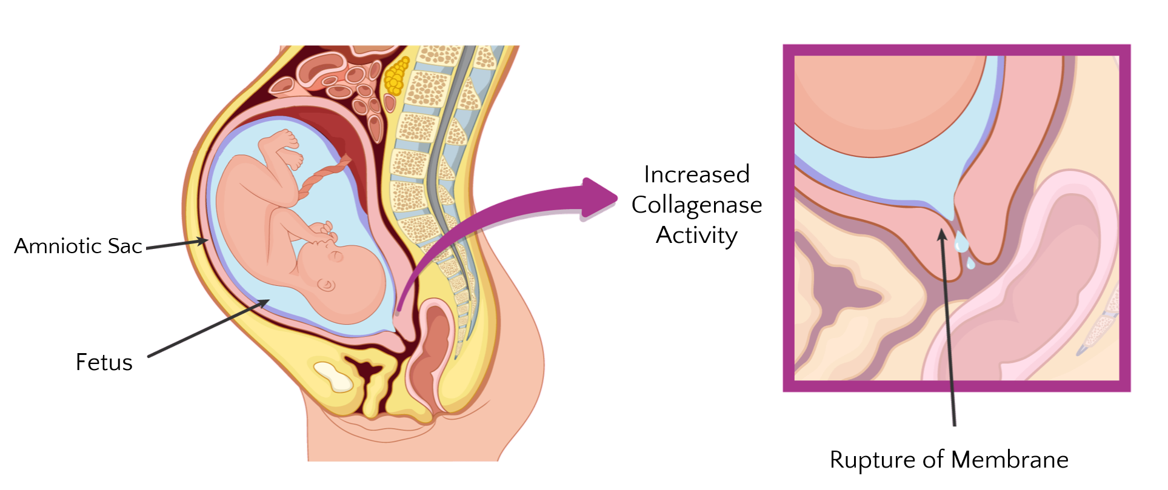
Labor is Induced by the Degradation of the Amniotic Sac
Increase in collagenase
activity
Labor Ensues
Image adapted from: https://www.invitra.com/en/amniotic-fluid-leakage/
Notes:
Collagenases are enzymes which catalyze the breakdown of collagen.
During pregnancy, they are used to degrade the amniotic sac so that labor can be induced.

Slide 3
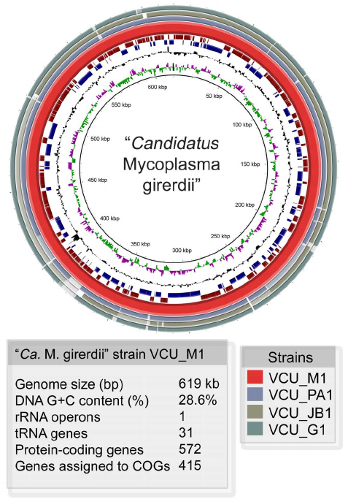
The Discovery of a Novel Vaginal Microbe
“Candidatus Mycoplasma girerdii” encodes two putative collagenase genes belonging to the U32 peptidase family.
Potentially associated with an increased risk for preterm birth.
Image adapted from: Fettweis et. al (2014). An Emerging Mycoplasma Associated with Trichomoniasis, Vaginal Infection and Disease. PLoS One. 9(10): e110943. Published online 2014 Oct 22. doi: 0.1371/journal.pone.0110943
Notes:
In 2014, a novel vaginal microbe referred to as “Candidatus Mycoplasma girerdii” was characterized.
While the microbe hasn’t been cultivated yet, genomic analyses have revealed the presence of two putative collagenase genes belonging to the U32 peptidase family.
The presence of genes suggest that “Candidatus Mycoplasma girerdii” may be associated with preterm delivery.

Slide 4
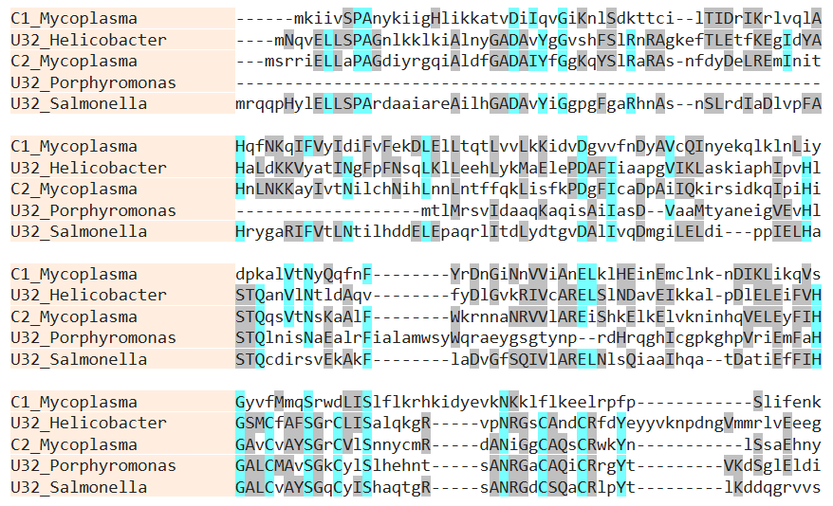
Gene function cannot be inferred from sequence homology
Sequence alignment of putative collagenase genes against well-studied collagenases.
Low sequence homology observed.
Gene function cannot be inferred.
Blue – Exact match
Gray – Similarity
Notes:
Sequence alignments of the genes against experimentally verified U32 collagenases showed low genetic identity.
The results of this analysis justifies the need for an experiment which asks the following question.

Slide 5
Proposal Question
Do the putative collagenase genes present in “Ca. Mycoplasma girerdii” encode enzymes capable of catalyzing the breakdown of collagen?

Slide 6
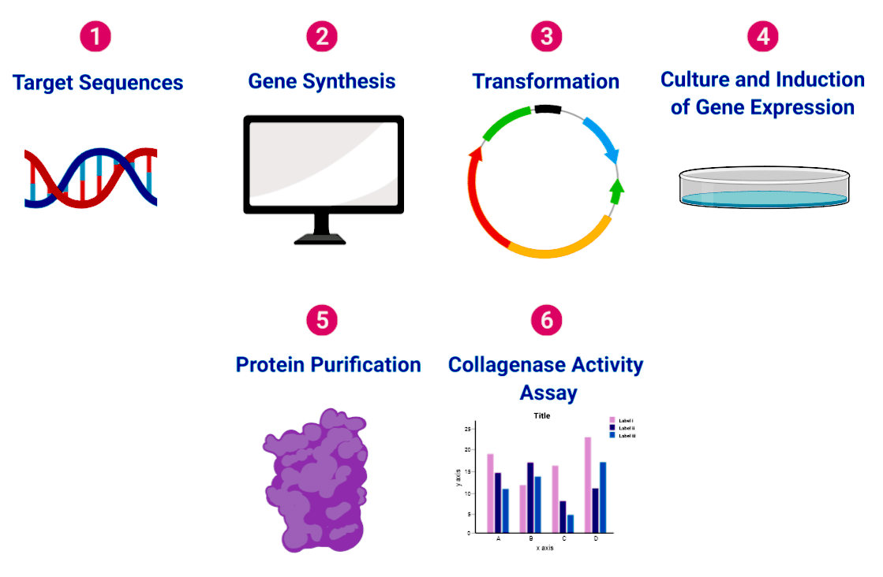
Overview of Experimental Design

Slide 7
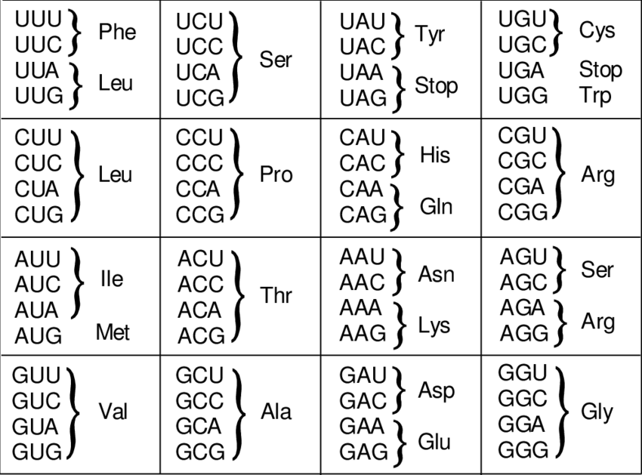
Genetic Synthesis of Collagenase Genes
Codes for Trp in Mycoplasma
Avoid premature translational termination.
Notes:
The first part of the experiment consists of ordering the target genes from a gene synthesis company.
Because “Candidatus Mycoplasa girerdii” uses a slightly modified gene table, synthesis will be required to avoid translational errors incurred during cloning.

Slide 8
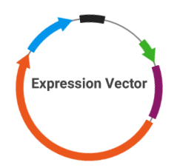
Insertion of Gene into Expression Vector
Notes:
The synthesized genes will have Sgf1 and PmeI restriction sites incorporated into them.
The genes will be digested using a proprietary Pme1 and Smf1 enzyme blend.
Sticky ends will form as a result of digestion, and through complementary base pairing the target genes will be ligated into their respective expression vectors.

Slide 9
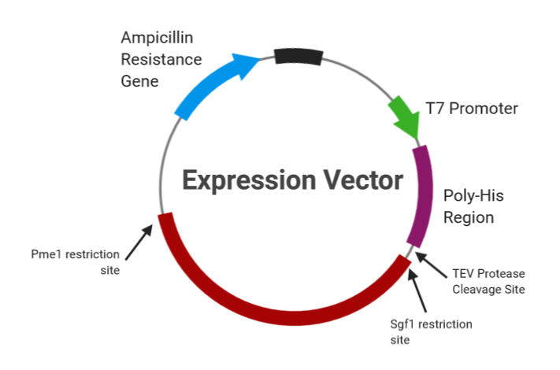
Features of Expression Vector
Notes:
The expression vector will consist of an inducible T7 phage promoter which will allow over-expression of the target genes in the presence of a T7 RNA polymerase.
A poly-His tag region with its respective TEV cleavage site for protein purification.
Pme1 and Smf1 restriction sites for gene ligation.
And an ampicillin resistance gene for selection during transformation.

Slide 10
Transforming JCM159 E. coli Host Cells
Heat Shock
Notes:
The ligated plasmids will be into to JCM159 E. coli host cells using a heat shock transformation procedure.
When grown on an ampicillin agar plate, only transformed cells containing the recombinant plasmid will be able to grow.
The resulting culture will be incubated until a high volume of transformed bacteria is grown.

Slide 11
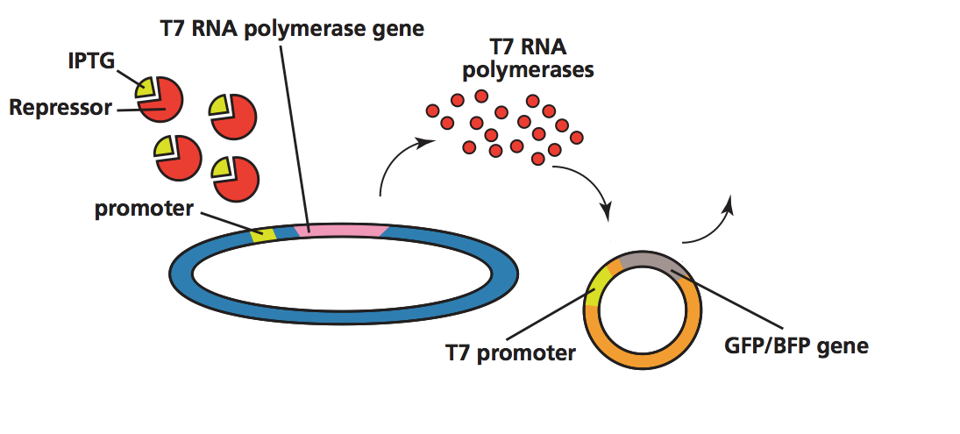
An active T7 RNA Polymerase is required to synthesize target gene
Target Proteins

Slide 12
Preparing Cell Lysate for Protein Purification
Lysate contains a various proteins including target enzyme.
Cell Pellet
Notes:
The target protein will be harvested using following methods. <Click twice>
Afterwards, nickel-coated metal beads will be added to the lysate solution.

Slide 13
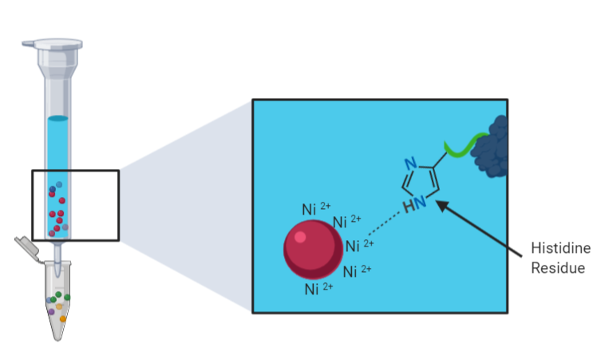
Nickel Coated Metal Beads Bind to Target Proteins
Histidine residues bind to Nickel ions.
Notes:
When these beads are added they will bind to the poly-His regions of the target protein.
These regions were incorporated into the target protein during transcription of the expression vector.

Slide 14
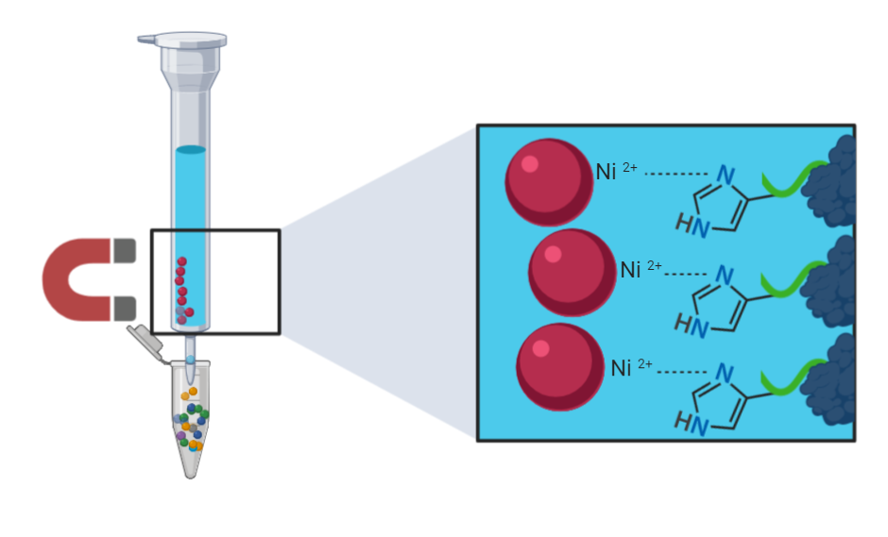
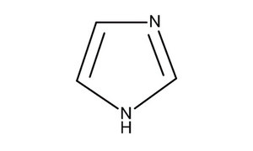
Magnet used to separate target enzymes from other proteins
Target proteins retained in column
Purified Protein
Elute with Imidazole
Notes:
A magnet will be used to bind the metal beads to the side of the elution column.
Using this method the target proteins will be retained within the column while all other molecules flow through.
After this has occurred, imidazole buffer will added.
The target proteins will be displaced by imidazole molecules and will be able to flow through the column.

Slide 15
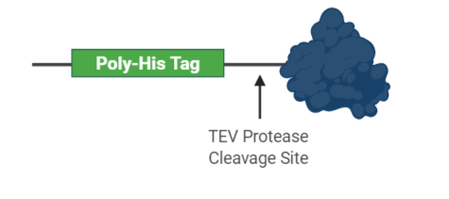
Removal of His-Tags from Purified Protein
TEV Protease
Elute
His-Tag Removed
Notes:
Following purification, a TEV protease will be used to remove the Poly-His tags.

Slide 16
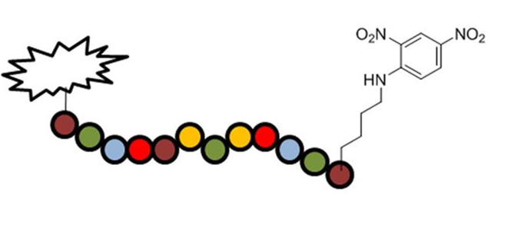
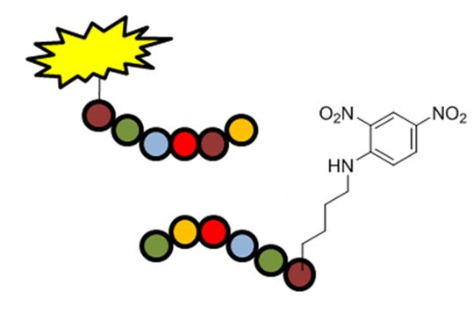
Collagenase Activity Assay
Modified Collagen Substrate
Light Emitted
Collagenase Enzyme
Quencher
Inactive
Fluorescence Group
Images modified from: Poreba, M., Szalek, A., Rut, W., Kasperkiewicz, P., Rutkowska-Wlodarczyk, I., Snipas, S. J., … Drag, M. (2017). Highly sensitive and adaptable fluorescence-quenched pair discloses the substrate specificity profiles in diverse protease families. Scientific Reports, 7(1). doi:10.1038/srep43135
Notes:
The purified enzymes will be applied to modified collagen substrates.
The collagen is comprised of repeating peptide units containing fluorescent and quencher groups.
When the fluorescent group is in close proximity to the quencher group, fluoresce is quenched or inhibited.
However, when the peptide is cleaved and the fluorescent and quencher groups are separated, light is emitted.
Through this process, fluoresensce is directly related to enzyme activity.
As a result, The more active the enzyme, the more fragmented the substrate becomes, and the more light is emitted.

Slide 17
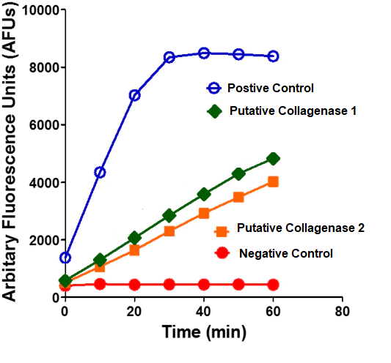
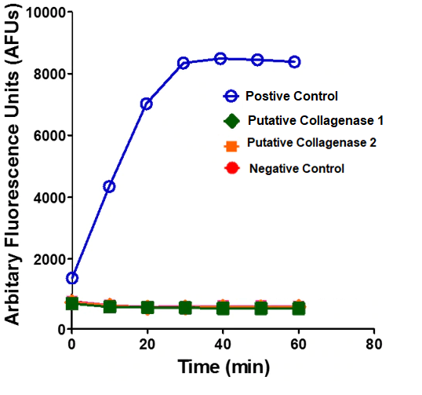
Sample Results
Active Collagenase Enzymes
Inactive Collagenase Enzymes
Images adapted from: https://www.rndsystems.com/products/mca-rppgfsafk-dnp-oh-fluorogenic-peptide-substrate_es005
Notes:
Fluorescence can be measured using a fluorescent plate reader.
The reader will measure the amount of light emitted and the data collected can be plotted in graphs as shown here.
Positive and negative controls will be used to enable an accurate interpretation of the results.
The negative control will consist of the modified substrate alone without any enzyme added.
While the positive will consist of a proven collagenase enzyme taken from the well-studied bacteria clostridium histolyticum.
Depending on the results we obtain from this assay

Slide 18
Potential implications of “Ca. M. girerdii” colonization
Hypothesized Interaction
Premature Delivery
Increase in collagenase
activity
Labor Ensues
“Ca. M. girerdii” collagenases.
Notes:
This hypothesized association with preterm birth is modeled as follows.

Slide 19
Supplementary Materials

Slide 20
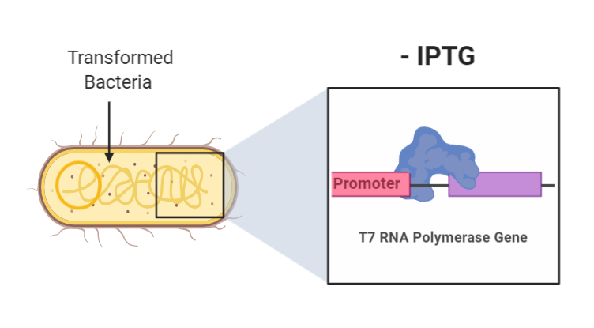
IPTG signals the expression of the T7 RNA Polymerase
Repressor Protein
Target Gene Not Expressed
Notes:
Once this occurs, gene expression will be induced using IPTG.
In the image above, IPTG is not present so the T7 RNA polymerase is blocked from being synthesized.

Slide 21
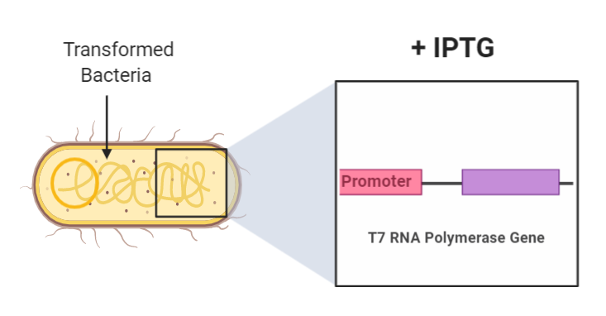
An active T7 RNA Polymerase is required to synthesize target gene
IPTG-Repressor Complex
Notes:
In the presence of IPTG the T7 Polymerase gene is able to be expressed.
After the newly synthesized polymerase binds to the T7 promoter on the plasmid, the target gene is able to be expressed.

Slide 22
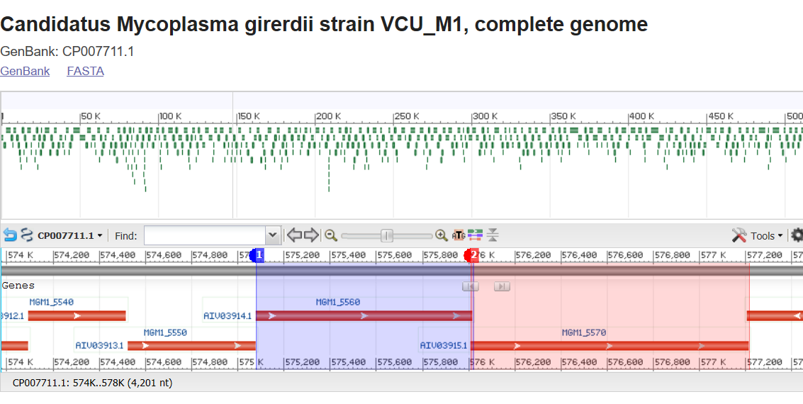
“Ca. M. girerdii” collagenases may function within an operon
U32 Peptidase Family - Introduce Doubt = low sequence homology
Collagenase genes are in close proximity to one another.

