Slide 1
Determining the Gene Regulatory Network Responsible for Craniofacial Development
Nathaniel Smith

Slide 2
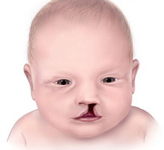
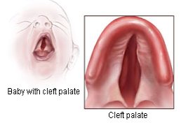
Cleft Lip and Palate One of the Most Common Birth Defects 1 in 600 children affected
Bloomfield, V., & Liao, C.H. (2015)

Slide 3
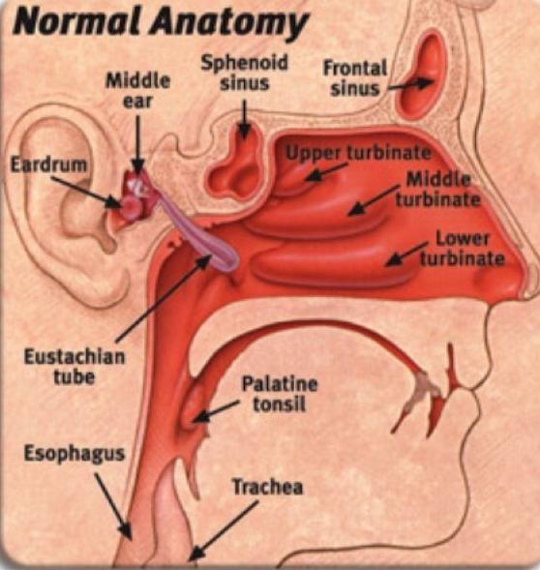
Cleft Lip and Palate Anatomy
Jugessur, A., & Murray, J. C. (2005)

Slide 4
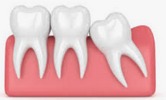
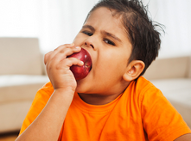
Cleft Lip and Palate Implications
Jugessur, A., & Murray, J. C. (2005)

Slide 5
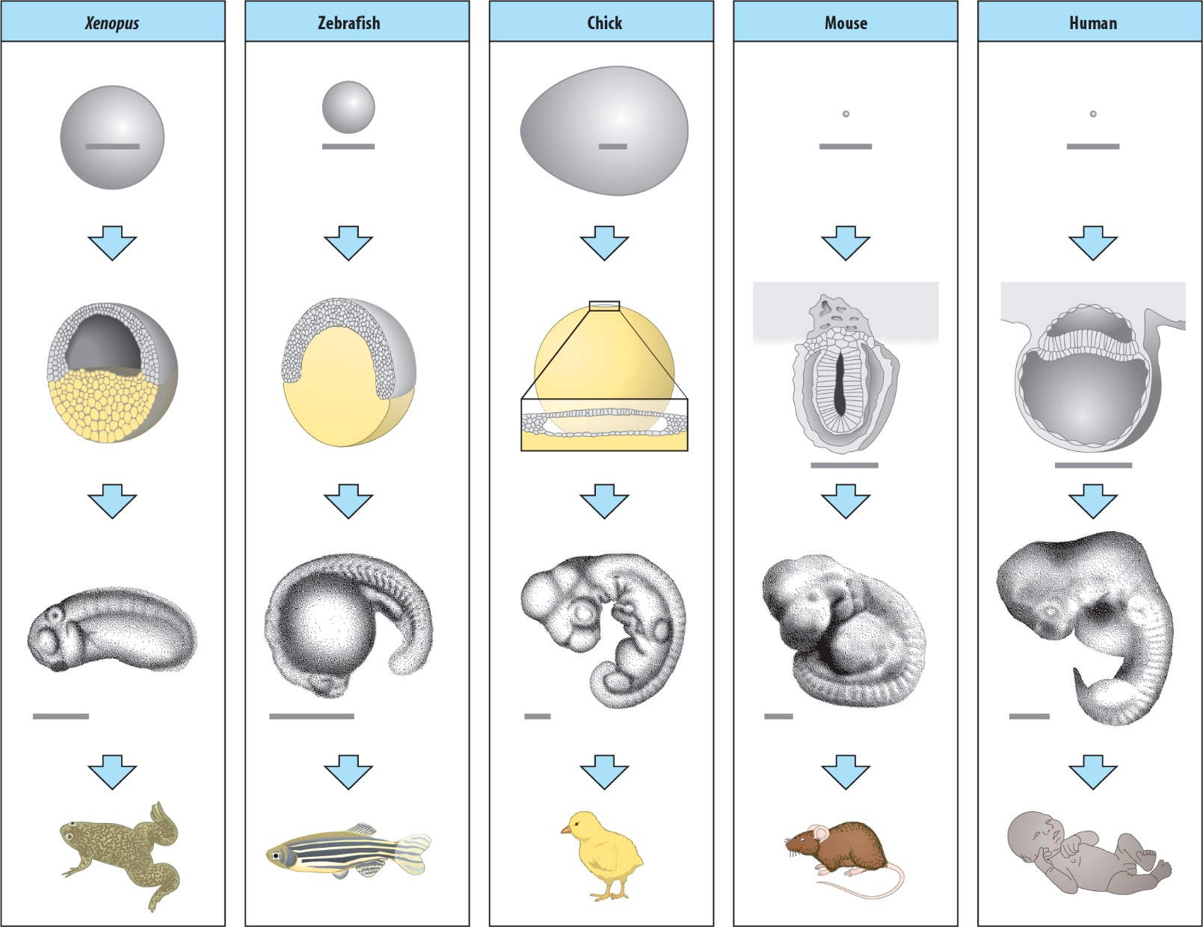
Understanding Mechanisms of Clefts Xenopus laevis – African Clawed Frog

Slide 6
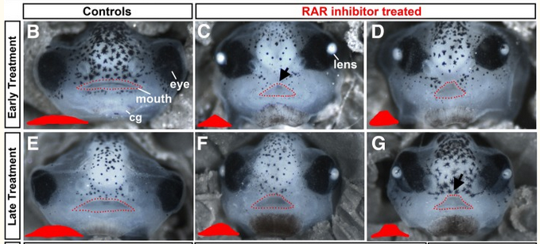
In Dickinson Lab, Frog Embryos with Clefts BMP-2 gene expression levels most altered
Wahl et al (2018)

Slide 7
BMP-2 Gene Functions Known for bone and cartilage development Mutations in BMP-2 gene in humans causes cleft phenotypes
Sahoo et al (2011)

Slide 8
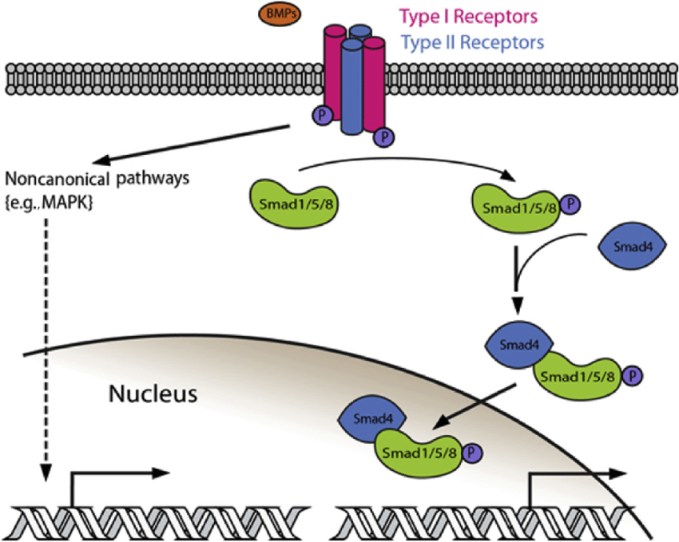
BMP-2 Signaling Pathway BMP-2 Ligand → Receptors → SMADs → Target Genes (ID1-4) → alters ID expression
BMP-2
ID1-4
Notes:
ID = inhibitor of differentiation gene.

Slide 9
Wnt1 and RARg Genes Crucial in Proper Craniofacial Development Also altered in frog embryos with clefts

Slide 10
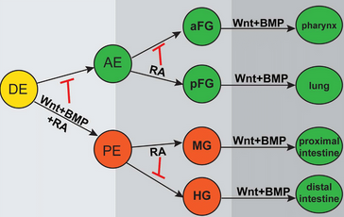
Proper Craniofacial Development Requires precise combination & regulation of many different genes at once = Gene Regulatory Network

Slide 11
Experimental Question: Does Loss of BMP-2 affect Wnt1 and RARg expression?

Slide 12
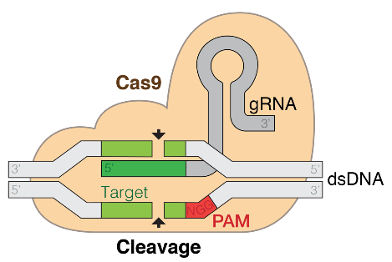
Knockout of BMP-2 Gene Using CRISPR/Cas9 Mechanisms of gRNA and Cas9
Notes:
Target sequence based on lowest # of off target mutations, highest GC content, zero self-complementarity, guanine at position 20, position in the gene

Slide 13
Map of BMP-2 Gene modeled after Xenbase Genome Browser Note the target sequence location in Exon 1
Exon 1
Exon 2
5’
Cas9
Start Codon
Stop Codon
TARGET SEQUENCE
TGTCCGCAGGTCGACCATGGTGG
A
G
C
T
G
C
sgRNA sequence
A
G
T
C
C
T
A
C
C
A
C
A
G
G
C
C
C
Notes:
Genscript OR Integrated DNA Technologies --- orders sgRNA’s bmp2.S class=Sequence position=chr5S:26315555..26325503 (+ strand)

Slide 14
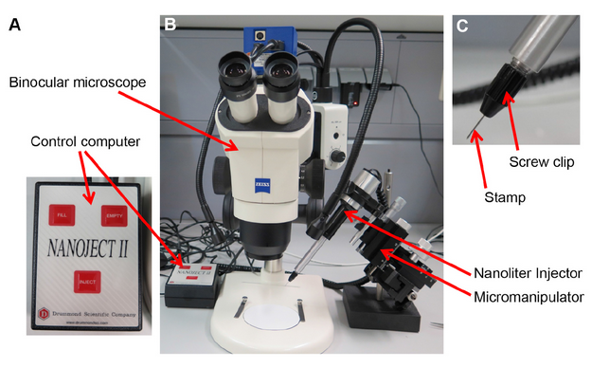
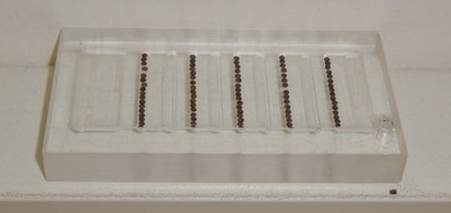
Microinjection of CRISPR/Cas9 in embryos at 1-cell-stage Embryos then incubated for 3 days → RNA Isolation
Notes:
Genscript OR Integrated DNA Technologies --- orders sgRNA’s

Slide 15
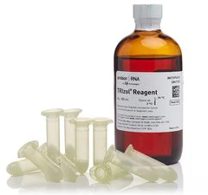
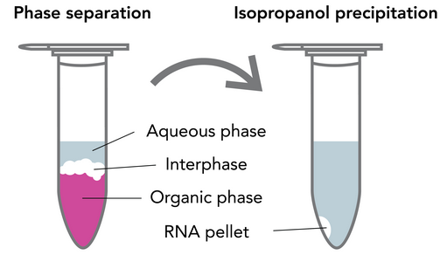
RNA Isolation for RT-PCR Faces Dissected and treated with TRIzol reagent

Slide 16
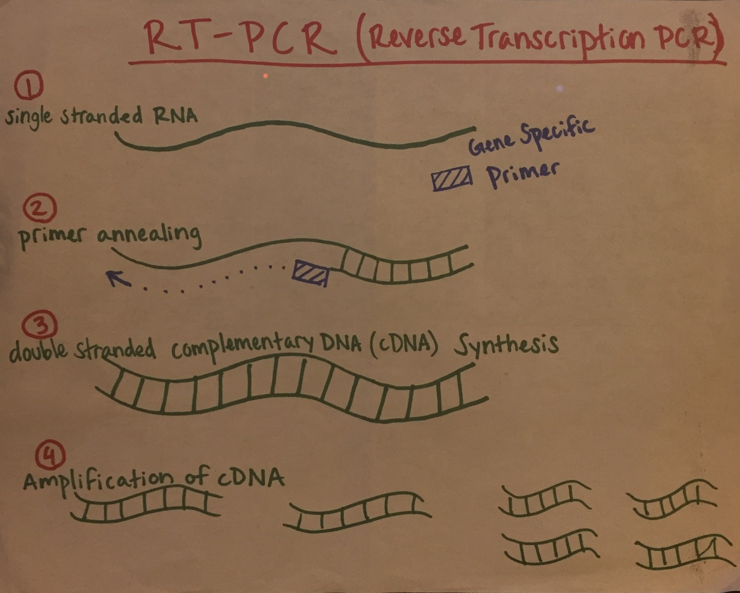
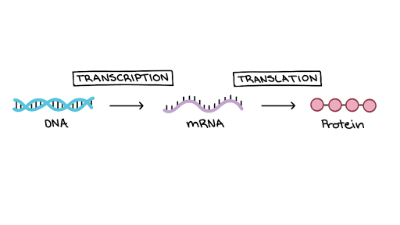
RT-PCR (Reverse Transcription PCR) Gene Expression affects creation of mRNA’s RNA + Gene Specific Primers → cDNA
Central Dogma of Biology
Gene
Notes:
Use visual aid of drawing of RT-PCR!!

Slide 17
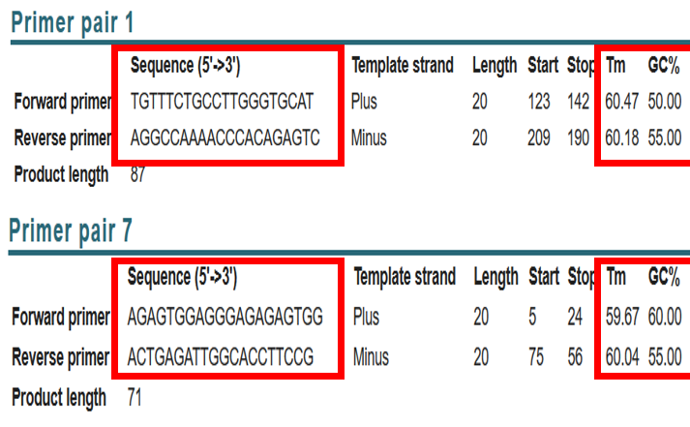
Designing Gene Specific Primers for RT-PCR Sequence quality, Melting Temp, GC %
Wnt1
RARg
Notes:
Using NCBI Primer BLAST, Primers selected based on 18-22bp’s, Tm of 55-65, GC% of 40-60, no hairpin DNA, no more than 4 di-NT repeats (ATATATAT), no more than 4 sequential NTs (AAAAA), and avoiding GC rich 3’ ends

Slide 18
qPCR (Quantitative PCR) for Measuring Gene Expression PCR + Fluorescent Dye Binds to cDNA Duplication of DNA = Duplication of fluorescence
SYBR Green Fluorescent Dye
Notes:
Regular PCR results in the same # of end products, making it not useful for this experiment. SYBR Dye binds to minor groove of DNA. To what??? I don’t know, I could not find out even after reading 3 research articles.

Slide 19
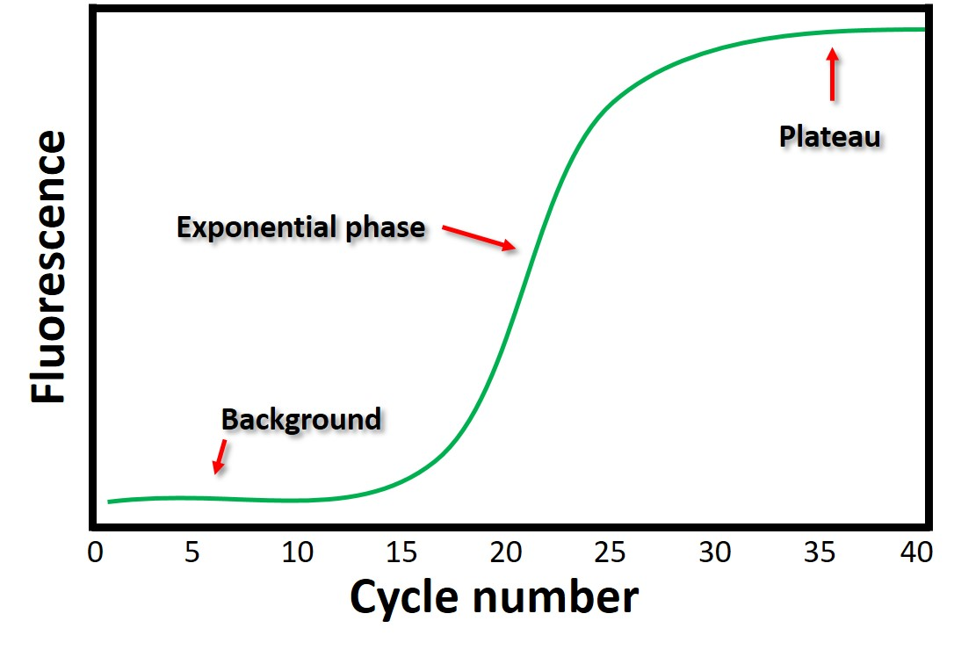
qPCR Cycle Threshold (Ct) value Ct value = point at which fluorescence is detected Interpreted with Spectrofluorimeter
Ct value
Notes:
At high concentrations, fluorescent dye inhibits PCR amplification process, which is the plateau.

Slide 20
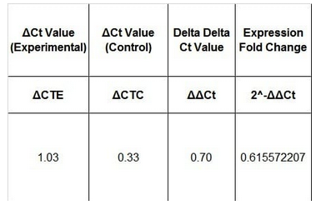
Delta-Delta Ct Analysis Uses Ct values to quantify gene expression

Slide 21
Potential results of BMP-2 Knockout Blue – No interaction between BMP-2 and Wnt1/RARg Red – Interaction between BMP-2 and Wnt1/RARg

Slide 22
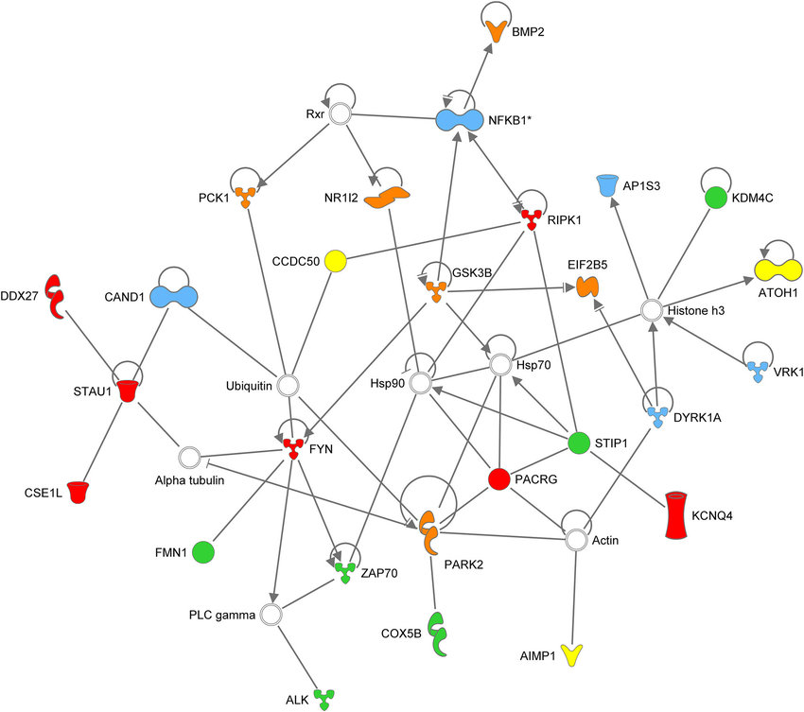
Potential results of BMP-2 Knockout Uncovers Gene Regulatory Network Responsible for Cleft Lip and Palate Provides valuable insight into causes

