Slide 1
Effects of disease-causing mutations on human HCN4 channel functionality
Arashpreet Singh
Mentor: Lei Zhou PhD

Slide 2
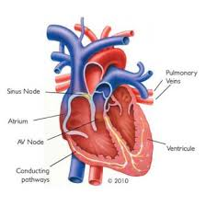
What is Bradycardia?
Heart beats too slow
Heart Arrhyhmias
Familiar Bradycardia Runs in families and suggests a genetic link
Linked to mutations in proteins in the heart: HCN4
heartrhymalliance.org

Slide 3
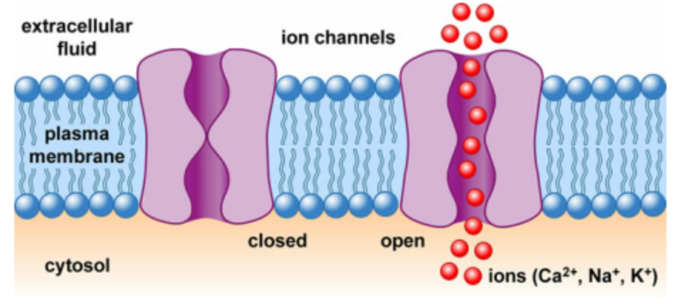
What is an HCN channel?
HCN channels regulate the rhythm of the heart
Ion channel

Slide 4
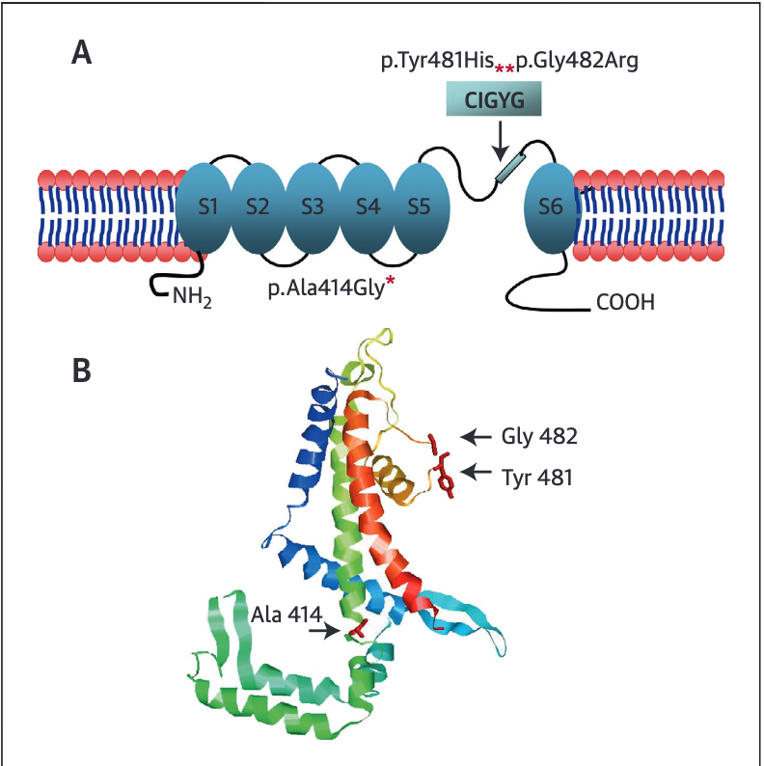
Mutations within the pore-region of the channel
Nonpolar to charged amino acid mutations

Slide 5
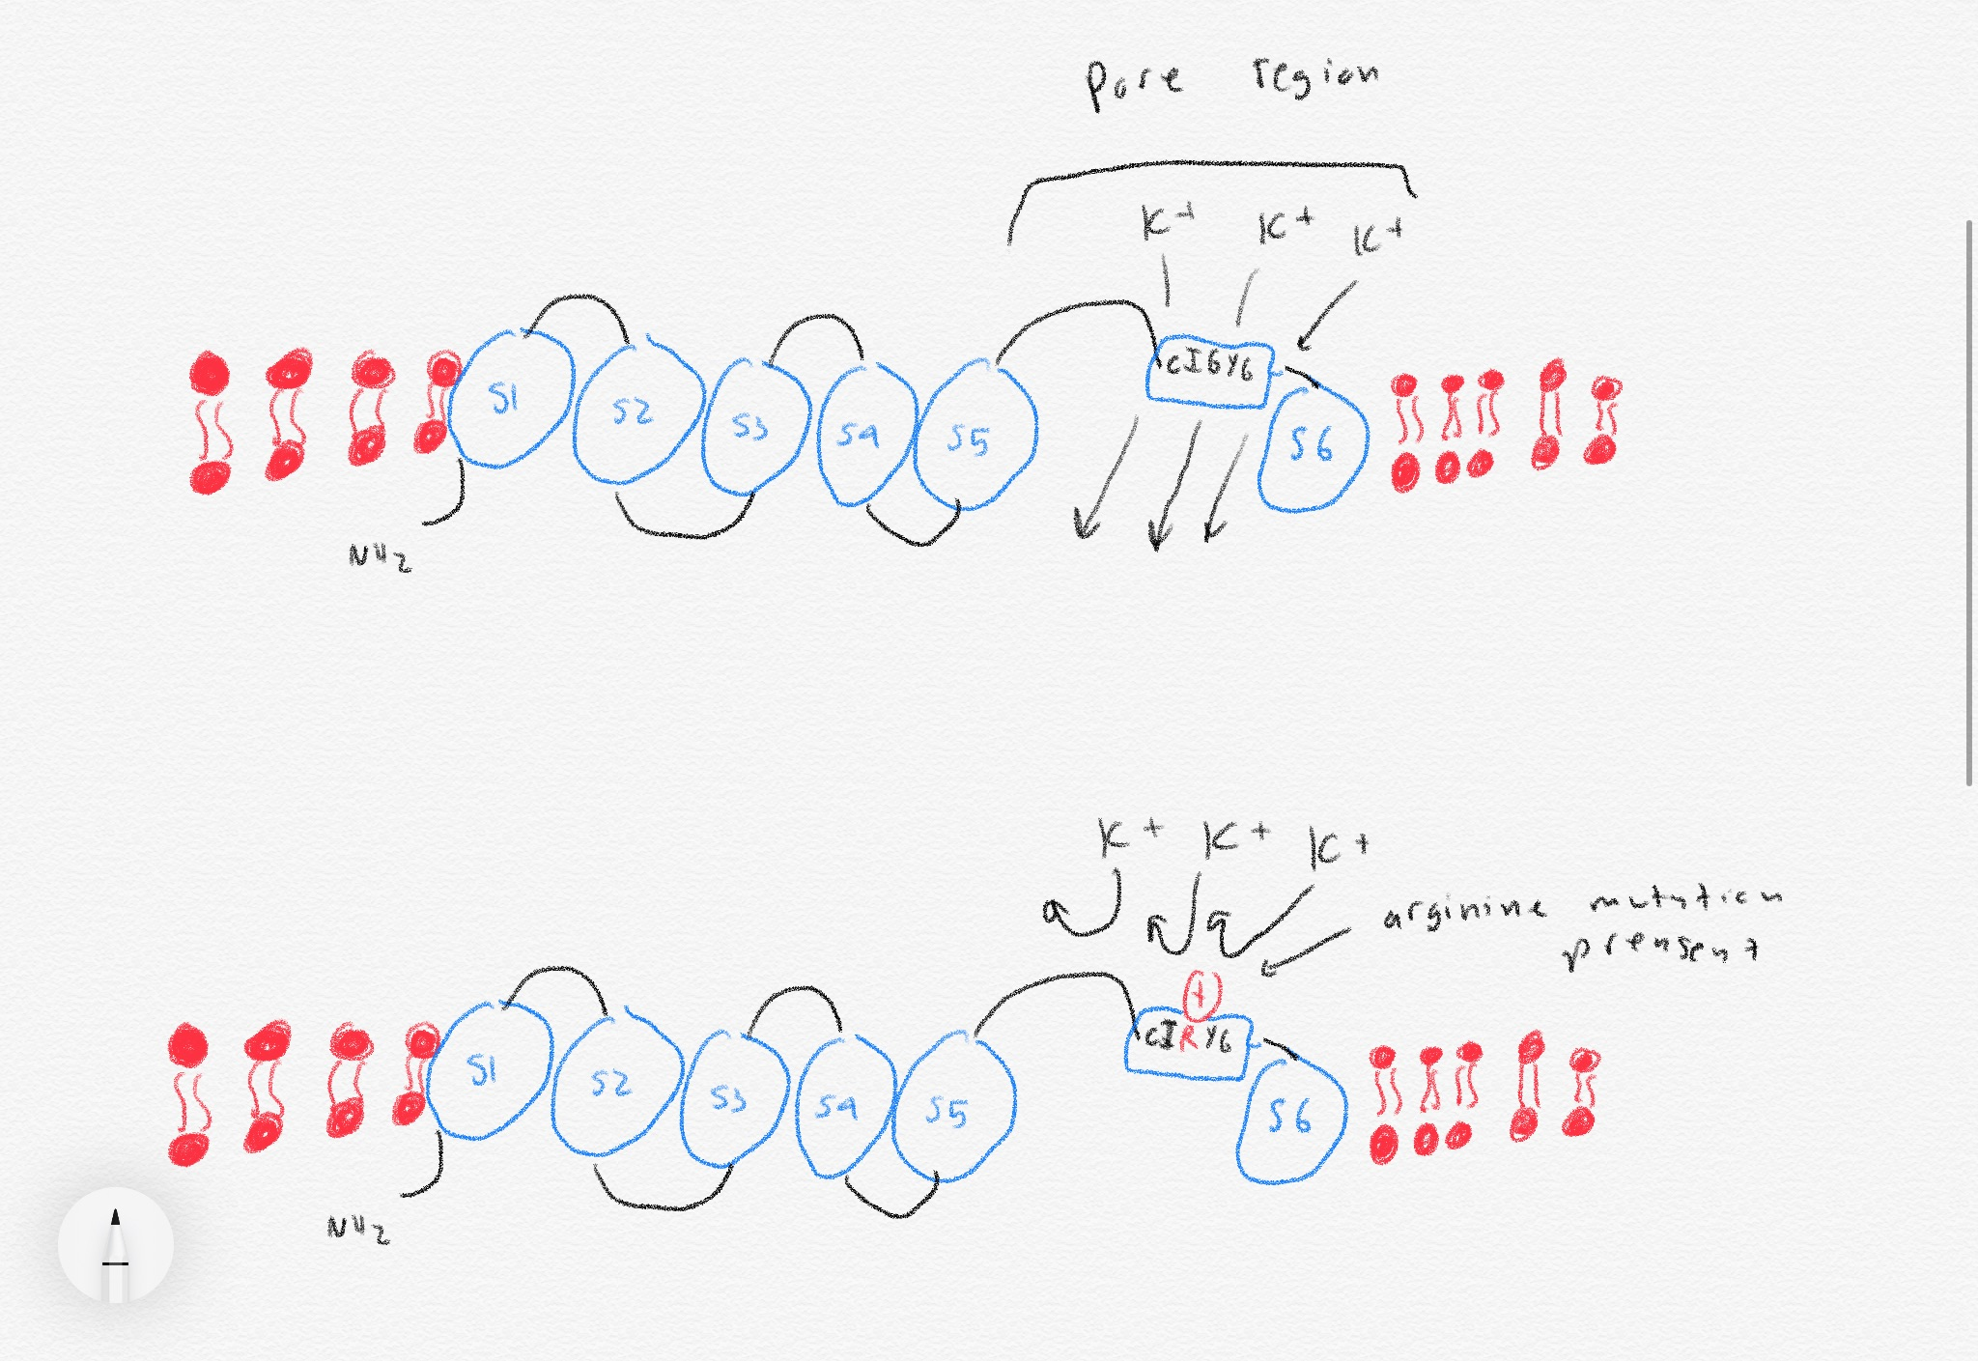
Effects of mutations on the channel
Less ions are able to pass through effectively
Creates a less efficient channel
Like-charge repulsion

Slide 6
Goal of experiment
Compare a mutant HCN4 channel with an arginine mutation with a wild-type channel
Polar to charged amino acid mutation effects on channel

Slide 7
Overview of the Experiment

Slide 8
Vector and Site-directed Mutagenesis
Original vector obtained from The ORFeome Collaboration

Slide 17
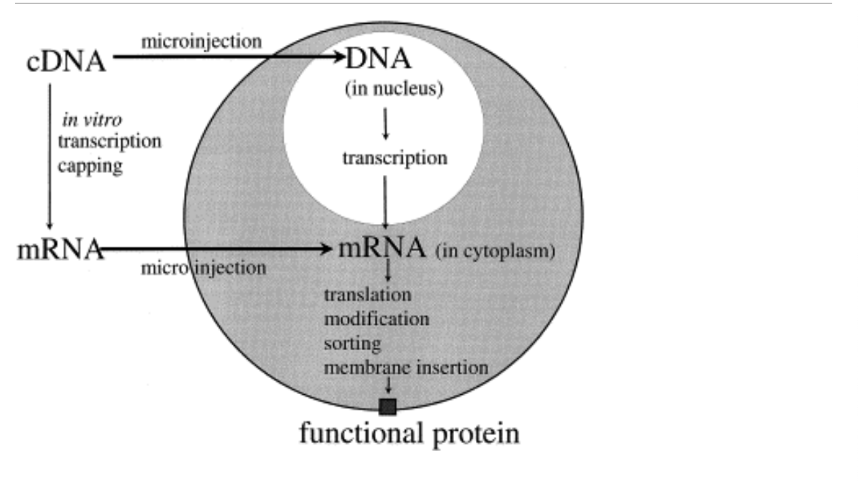
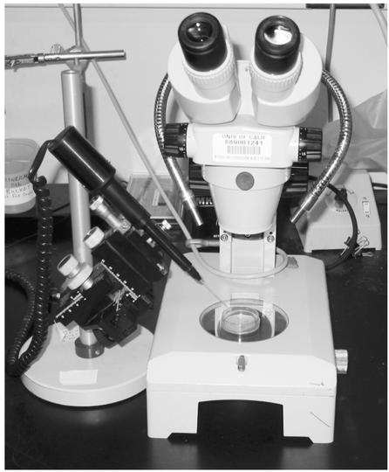
Microinjection
New cDNA is injected within the nucleus of the oocyte to create a functioning protein
Goldin, Alan L. “Expression of Ion Channels in Xenopus Oocytes.” Expression and Analysis of Recombinant Ion Channels, 2006, pp. 1–25., doi:10.1002/3527608095.ch1.
Miller, A.j, and J.j Zhou. “Xenopus Oocytes as an Expression System for Plant Transporters.” Biochimica Et Biophysica Acta (BBA) - Biomembranes, vol. 1465, no. 1-2, 2000, pp. 343–358., doi:10.1016/s0005-2736(00)00148-6.

Slide 18
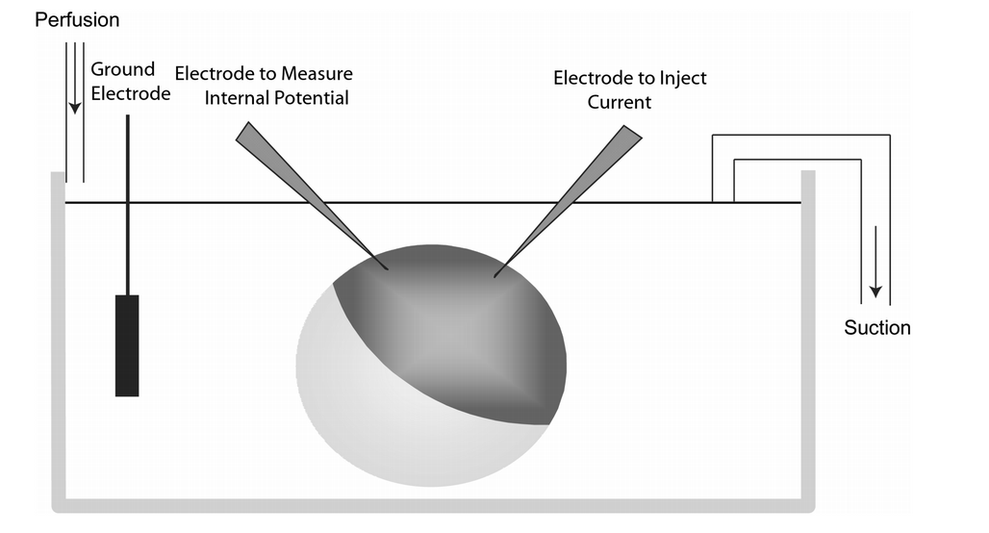
Measuring effects of mutation by TEVC
Whole cell voltage clamping of oocytes involves using two electrodes inserted into the oocyte with one measuring the internal potential of the oocyte and the other electrode being used to inject current
Goldin, Alan L. “Expression of Ion Channels in Xenopus Oocytes.” Expression and Analysis of Recombinant Ion Channels, 2006, pp. 1–25., doi:10.1002/3527608095.ch1

Slide 19
Boltzman equation figures out the activation curve
Describes the statistical behavior of a thermodynamic system not in equilibrium
y =1/{1 +exp (V-V_{1/2} /s ) (Reference 11). Where y is the fractional activation, V is the voltage in millivolts, V_{1/2} is the half-activation voltage in millivolts, and s is the inverse slope factor in millivolts
Determines the half-maximum activation voltage (V1/2) and the slope factor 50% of the maximum

Slide 21
Discussion
The results of the experiment may show whether the point mutation would have a detrimental impact on the HCN4 channel, or it may show that there was no impact at all on the mutation
The experiment may show that a mutation from a cystine to an arginine makes the channels behave differently when compared to the wild-type channel
A limitation of this experiment is that since there have been no experiments looking into the effects of a polar to a positive charged amino acid mutation it is difficult to say how the channel will respond

