Slide 1
Measurement of TGIF1 expression levels due to TGF-β overexpression in pancreatic cells

Slide 2
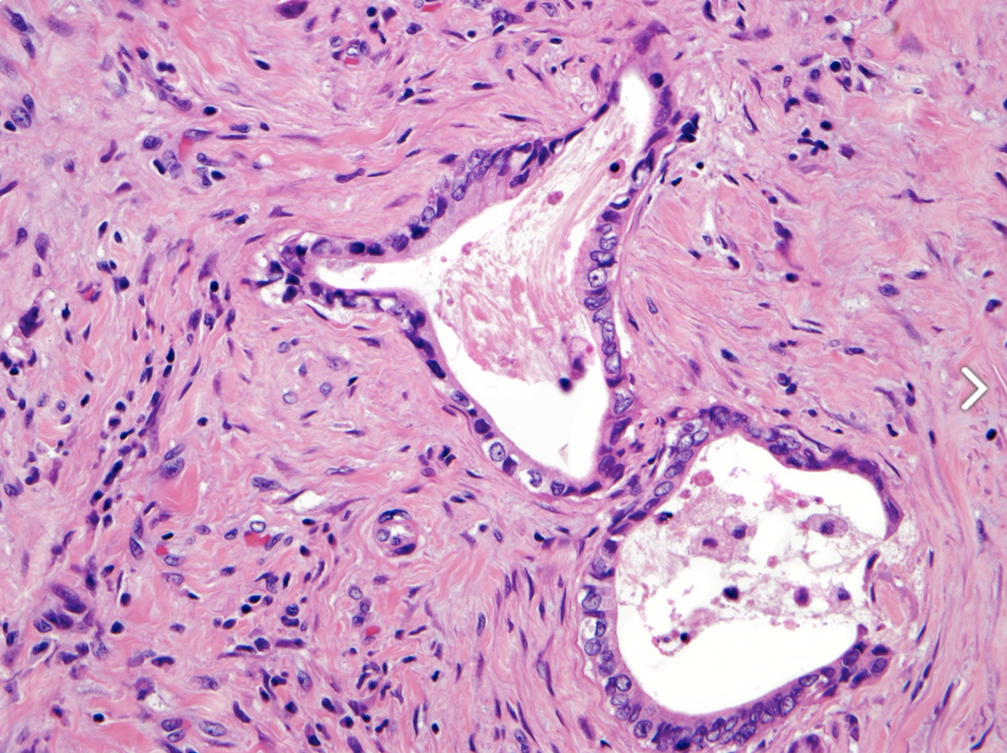
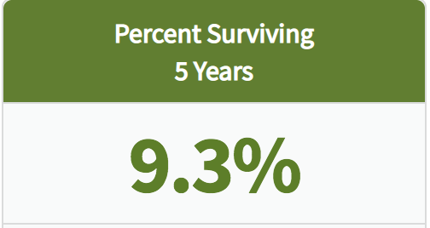
Pancreatic Ductal Adenocarcinoma (PDAC)
Notes:
Pancreatic Ductal Adenocarcinoma (PDAC), is a form of pancreatic cancer. PDAC is the fourth leading cause of cancer related death and is characterized by the formation of ducts that line the cell wall of the pancreas. The 5- year survival rate for PDAC patients is estimated to be about 9.3%

Slide 3
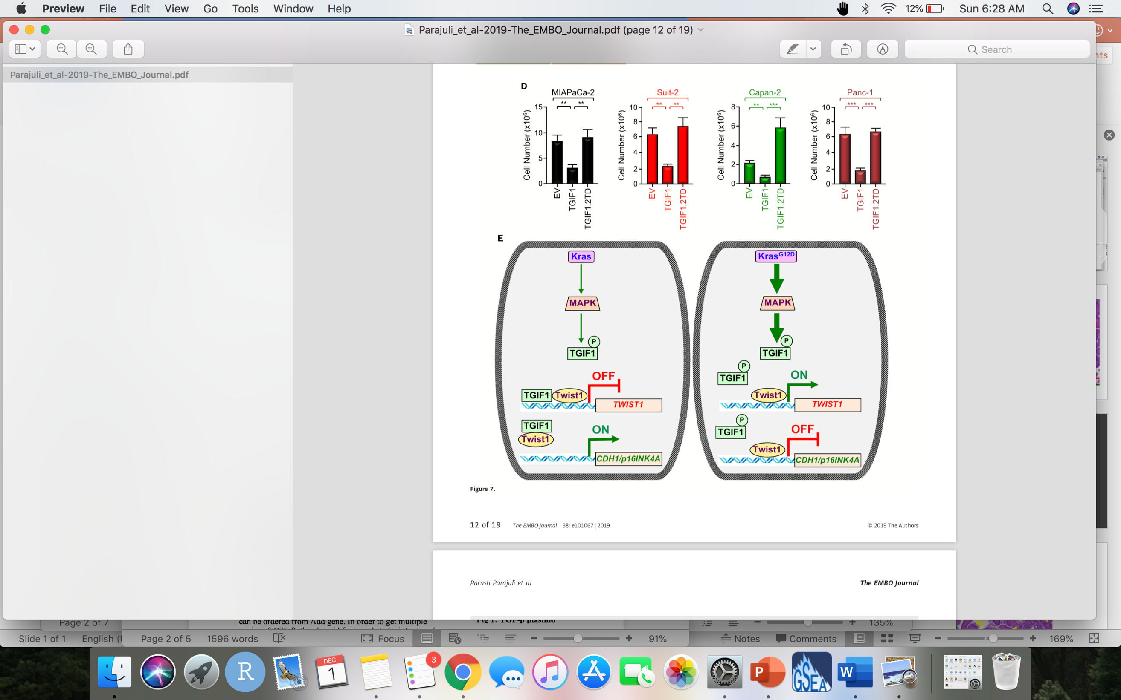
glycine 12 to aspartic acid
MAPK phosphorylates TGIF1
TGIF1 loses its tumor suppressor function when phosphorylated
Notes:
PDAC forms when a proto oncogene, a normal cell, is mutated, making it an oncogene that can cause cancer. Kras is mutated into an oncogene when glycine 12 is switched aspartic acid. This then activates MAPK, a type of protein kinase that regulates the activity of other proteins through phosphorylation. When MAPK phosphorylates TGIF1, the function of TGIF1 as a tumor suppressor is inhibited, accelerating the formation of PDAC.

Slide 4
TGF-β
Notes:
In an experiment, Parash and others explored how TGF-β played a role in PDAC, TGF-β is a transcription factor that is involved in cell regulation. Their finding showed that TGF-β levels of expression were high during the final stages of PDAC, this indicated that it also interacted with TGIF1.

Slide 5
Does overexpression of TGF-β inhibit the expression of TGIF1?
Amplify the amount of TGF-β
Analyze TGIF1 protein content
If TGF-β were to be overexpressed, low protein levels for TGIF1 is to be expected
Notes:
The question that we want to answer is, does the overexpression of TGF-β inhibit the function of TGIF1 as a tumor suppressor. This can be done by amplifying the amount of TGF-β and analyzing TGIF1 protein content.

Slide 6
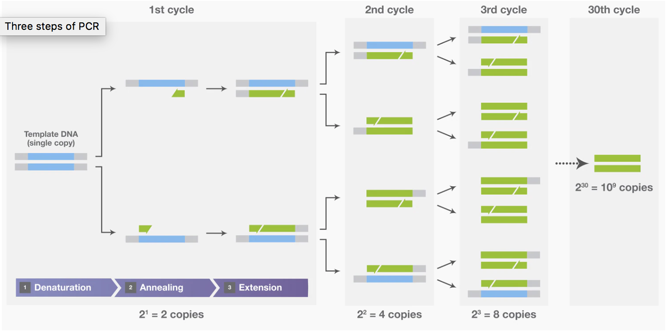
PCR to obtain the gene of interest
GCAGCCTGGATGGTTGTAGT (forward primer)
GGGTCACTGCCAGAGTACAG (reverse primer)
Notes:
To obtain the gene of interest, TGF-B, PCR can be performed. PCR is a technique that can be used to isolate specific DNA fragments by selectively amplifying a specific region. There are three steps during this process.
Step 1: Denaturation is when the two strands in DNA are separated by increasing the temperature of the mixture, this breaks the hydrogen bonds between the strands.
Step 2: Annealing, primers attach to each strand. The primers used for this step were obtained by entering a reference sequence for TGF-b into primer blast.
Step 3: Extension, new strands are made by DNA polymerase

Slide 7
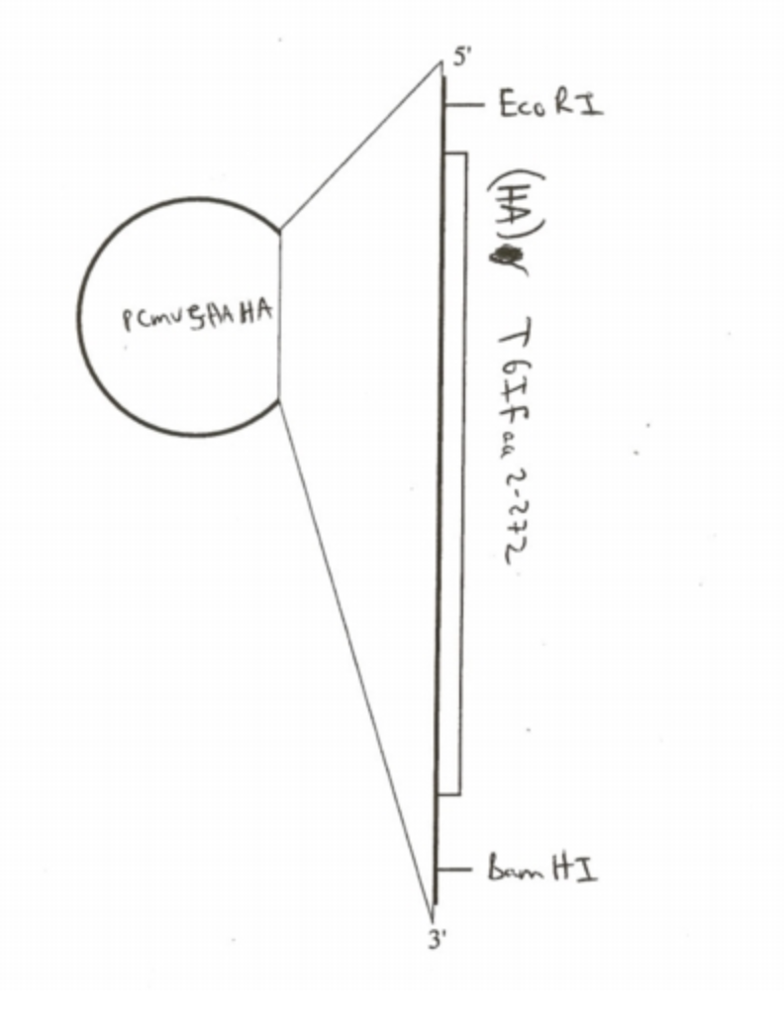
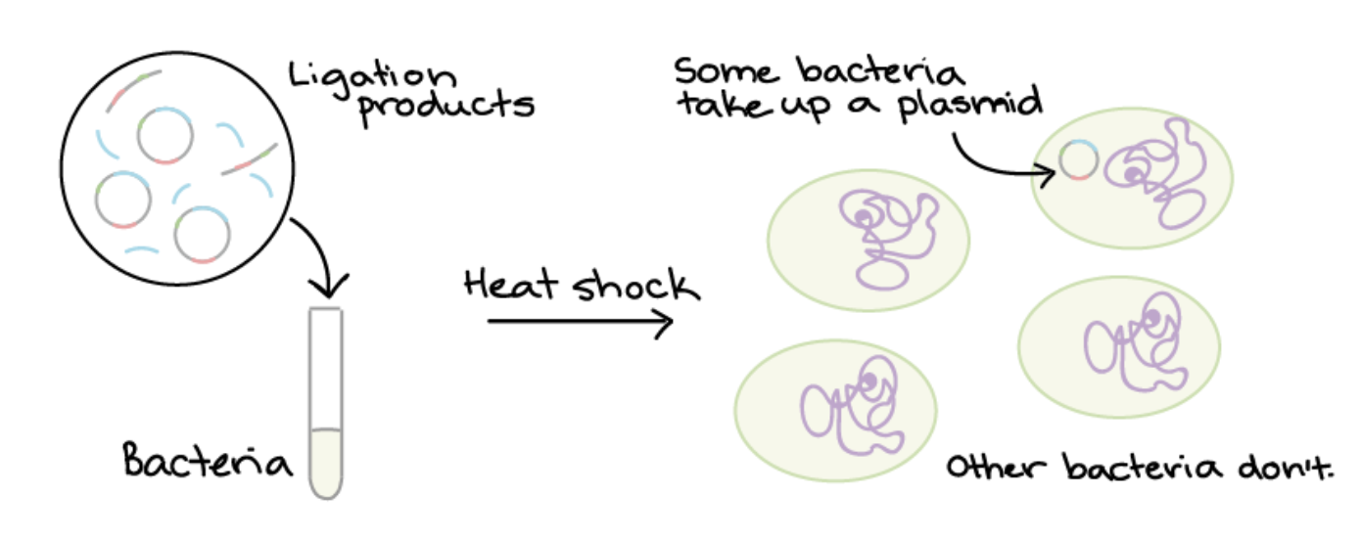
TGF-Beta plasmid
Notes:
In order to increase the expression of TGF-β, a plasmid needs to be created. A plasmid is a small circular double stranded piece of DNA, where a target gene can be inserted in order to create recombinant DNA (DNA assembled out of fragments), in this experiment it will be TGF-β that will be inserted into the plasmid.
The plasmid that is going to be used for this experiment is , pCMV5 HA. This plasmid can be cut at restriction sites EcoR1 and BamH1. TGF-beta can then be inserted using DNA ligase.
The TGF-β plasmids then need to be introduced into cells. This process is called bacterial transformation, it’s when the plasmids are mixed with bacteria, go through a heat shock, and then plated on antibiotic plates. Bacteria that contain plasmids will survive, because plasmids contain an antibiotic resistant gene

Slide 8
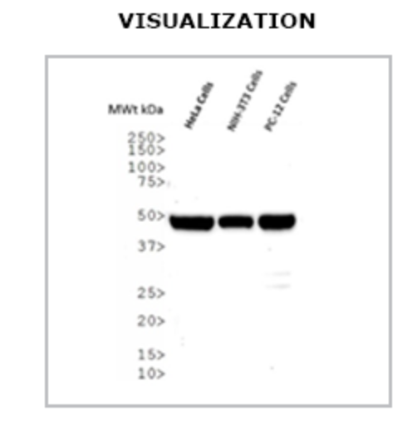
Amplify and analyze TGF-Beta overexpression
Notes:
PCR can be used where the DNA sequence of interest is amplified to make millions of copies. The three steps mentioned before will need to be repeated multiple times to get millions of copies of TGF-β (Fig 3), leading to overexpression.
Western blot can be employed to measure the protein content of TGF-β. It does this by employing antibodies and fluorophores that attach to the target protein of interest. After imaging, where fluorophores are detected, bands become visible to indicate the amount of protein content. In this experiment, the band for TGF-β should be the thickest and darkest among other bands, showing that overexpression of TGF-β has occurred.

Slide 9
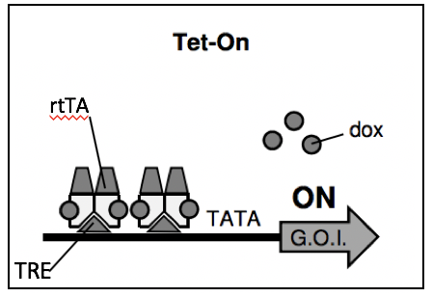
Tet-On inducible system
Notes:
The tet on system can be used to induce the expression of TGF-Beta.
In the Tet-On system, doxycycline (dox), binds to the reverse tetracycline transactivator (rtTA) binding it to the promoter, this allows for TGF-β to be expressed . When doxycycline doesn’t bind to the rtta, TGF-β is not expressed.

Slide 10



Analyze TGIF1 protein content
Dox (+) + TGF-β plasmid
Dox (-) + TGF-β plasmid
Dox (+) + empty plasmid
Dox(-) + empty plasmid
TGIF1
Dox(+) = overexpression
Dox(-)= no overexpression
Notes:
Western blot can be employed to analyze protein content of TGIF.
When TGF-B is overexpressed, the protein content of TGIF1 is low. When TGF-B is not overexpressed, the protein content of TGIF1 is high.
The bands for the empty plasmids are the same, this shows that the plasmids in the experiment work.
In conclusion, the results show that when TGF-β is overexpressed, the expression of TGIF1 is inhibited. Knowing this, it allows for insight on the relationship between TGF-β and TGIF1, and how TGIF1 functions as a tumor suppressor. Hopefully, this experiment can help researchers to further understand the mechanisms of how PDAC accelerates.

Slide 11
References
Parajuli, Parash, Purba Singh, Zhe Wang, Lianna Li, Sailaja Eragamreddi, Seval Ozkan, Olivier Ferrigno, Celine Prunier, Mohammed S Razzaque, Keli Xu, and Azeddine Atfi (2019). "TGIF1 Functions as a Tumor Suppressor in Pancreatic Ductal Adenocarcinoma." EMBO Journal 38.13
Hingorani, Sunil R, Lifu Wang, Asha S Multani, Chelsea Combs, Therese B Deramaudt, Ralph H Hruban, Anil K Rustgi, Sandy Chang, and David A Tuveson (2005). "Trp53 R172H and Kras G12D Cooperate to Promote Chromosomal Instability and Widely Metastatic Pancreatic Ductal Adenocarcinoma in Mice." Cancer Cell 7.5: 469-83. Web.
Yeh, Hsi-Wen, Hsu, En-Chi, Lee, Szu-Shuo, Lang, Yaw-Dong, Lin, Yuh-Charn, Chang, Chieh-Yu, Lee, Suz-Yi, Gu, De-Leung, Shih, Jou-Ho, Ho, Chun-Ming, Chen, Chian-Feng, Chen, Chiung-Tong, Tu, Pang-Hsien, Cheng, Ching-Feng, Chen, Ruey-Hwa, Yang, Ruey-Bing, and Jou, Yuh-Shan (2018). "PSPC1 Mediates TGF-β1 Autocrine Signalling and Smad2/3 Target Switching to Promote EMT, Stemness and Metastasis." Nature Cell Biology 20.4: 479-491. Web.
Das, Atze, Tenenbaum, Liliiane, & Berkhout, Ben (2016). Tet-On Systems For Doxycycline-inducible Gene Expression. Current gene therapy, 16(3), 156–167. doi:10.2174/1566523216666160524144041
Garibyan, L., & Avashia, N. (2013). Polymerase chain reaction. The Journal of investigative dermatology, 133(3), 1–4. doi:10.1038/jid.2013.1
Lee, P., Costumbrado, J., Hsu, C., & Kim, Y. (2012). Agarose Gel Electrophoresis for the Separation of DNA Fragments. Journal of Visualized Experiments, (62), Journal of Visualized Experiments, 2012, Issue 62.

