Slide 1
GRP78 inhibition by subtilase cytotoxin and interleukin-6 gene expression
Perraychudhan Saravanane
BNFO 300

Slide 2
Cancer and ER Stress
Uncontrolled cell growth, World’s 3rd leading cause of death
Rapid growth of tumor cells leads to shortage of oxygen and nutrients , resulting in the activation of the defense mechanism by the ER called UPR (Unfolded Protein Response)
The signaling cascade of the UPR pathway leads to apoptosis
ER stress inducing agents are potential anticancer therapies

Slide 3
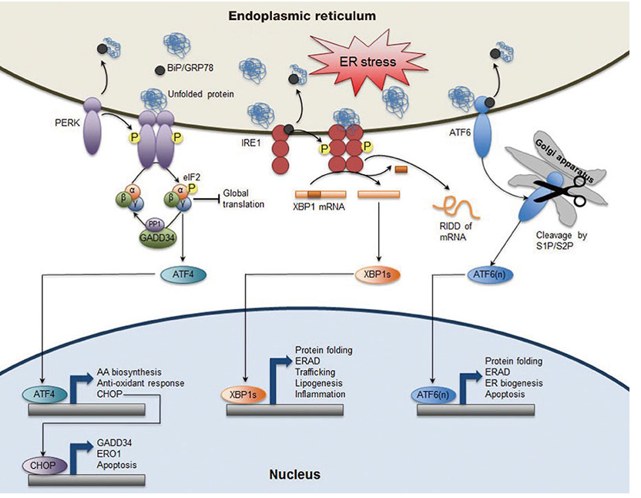
UPR: GRP78 Pathway
GRP78 is the master controller of pathway, disassociates with prolonged ER stress
Releases ATF6, IRE1, PERK signaling cascades
All 3 of the cascades lead to apoptosis
Useful as a potential cancer treatment

Slide 4
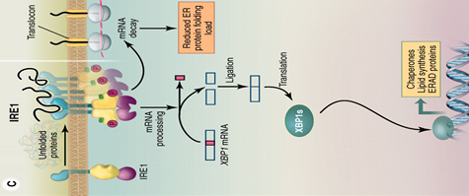
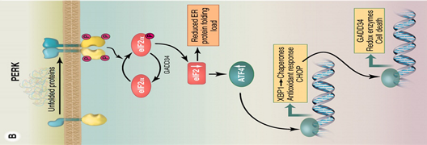
Nucleus
Nucleus

Slide 5
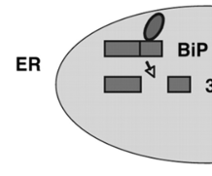
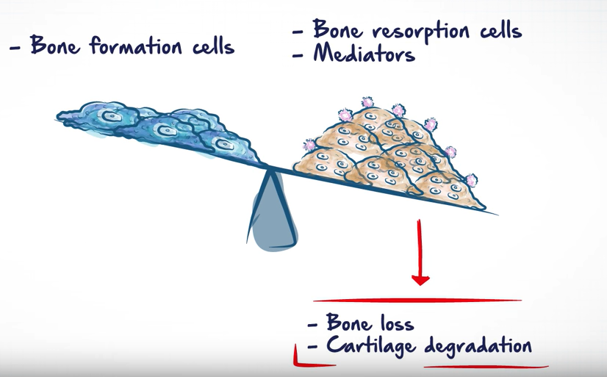
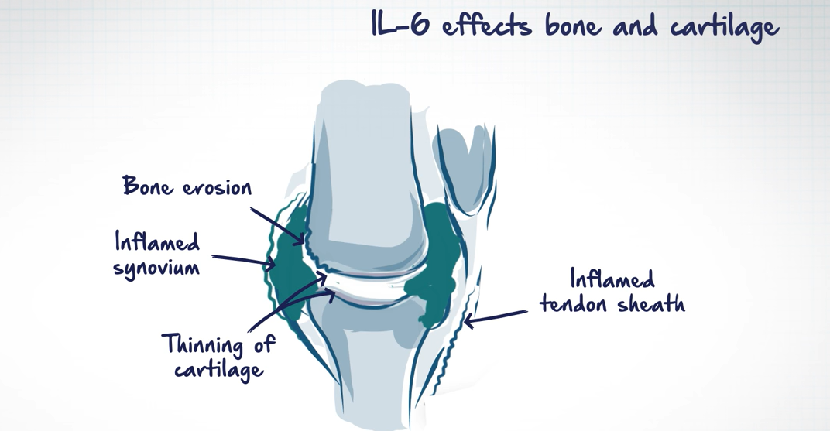
Subtilase cytotoxin (SubAB) and DON
Known GRP78 inhibitors
SubAB cleaves GRP78 at Leu 416-Leu 417 w/ catalytic triad of Asp-His-Ser
DON has shown to upregulate the cytokine Interleukin-6
Has inflammatory properties, secreted by macrophages, stimulates osteoclast formation
Causes several autoimmune diseases (ex: RA)

Slide 6
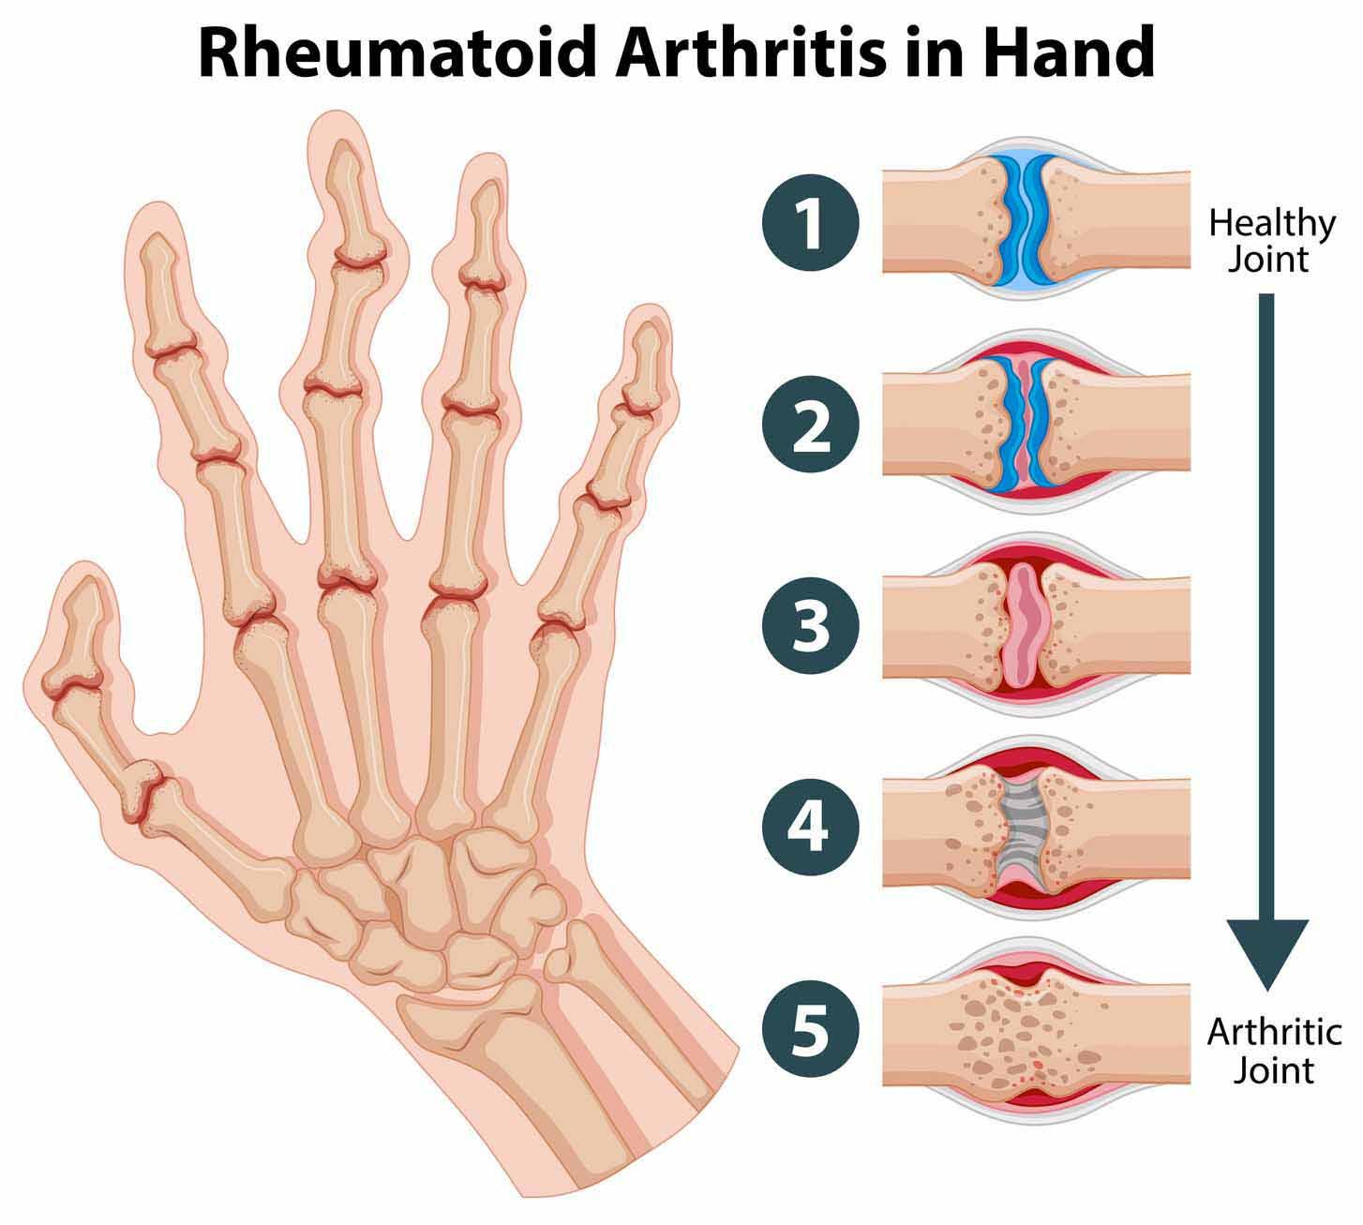
Rheumatoid Arthritis
An autoimmune disease in which the body’s immune system mistakenly attacks the joints
Commonly attacks the joints of hands, feet, wrist, knees, elbows, ankles
Causes inflammation of the tissue inside joints
Resulting in the swelling and pain around joints
Joint damage after unchecked inflammation (cannot be reversed)
Brought upon through upregulation of IL-6 occuring

Slide 7
Experimental Goals
Experiment Overview
Confirm GRP78 inhibition by DON and SubAB
Figure out which one of the three UPR signaling pathways cause upregulation in IL-6
Previously done using DON (ATF-6 found as culprit)
Cell culture growth
RNAi Treatment
Western Blot

Slide 8
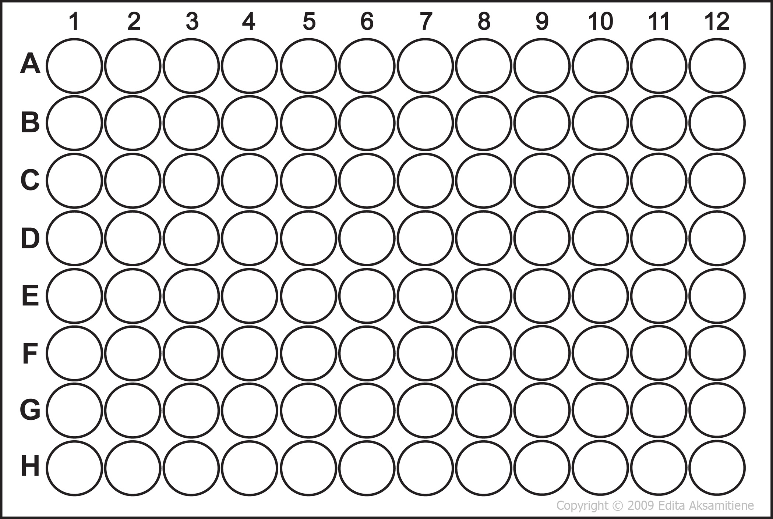
Cell Growth
SubAB Normal Treatment Group
DON Normal Treatment Group
Mice grown for 6-8 weeks
Peritoneal macrophages collected through lavage
Macrophages cultured in medium and plated on 96 well plate
SubAB ATF6 Knockout Treatment Group
DON ATF6 Knockout Treatment Group
SubAB IRE1 Knockout Treatment Group
DON IRE1 Knockout Treatment Group
SubAB PERK Knockout Treatment Group
DON PERK Knockout Treatment Group

Slide 9
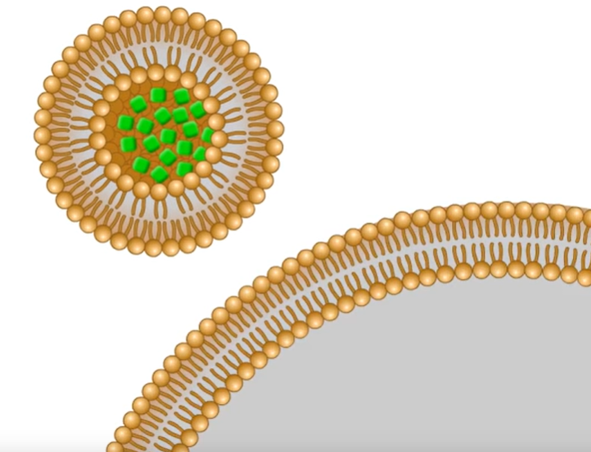
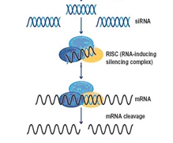
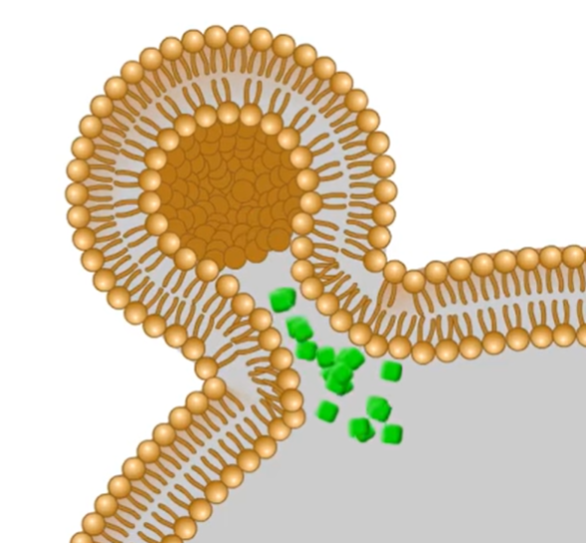
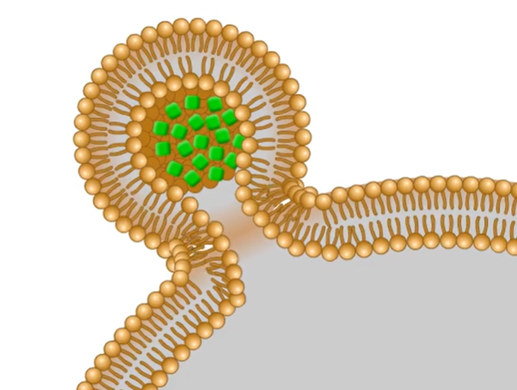
RNA Interference
Mechanism of silencing gene expression after the gene has been transcribed
Uses short interfering RNA (siRNA) specific to the mRNA that translates for either the ATF6 protein, IRE1 protein, PERK protein
The antisense strand of the siRNA attaches to RNA-induced silencing complex (RISC)
RISC binds to the complementary mRNA strand that has not yet been translated into protein and cleave it (therefore “knocking out” the gene)

Slide 10
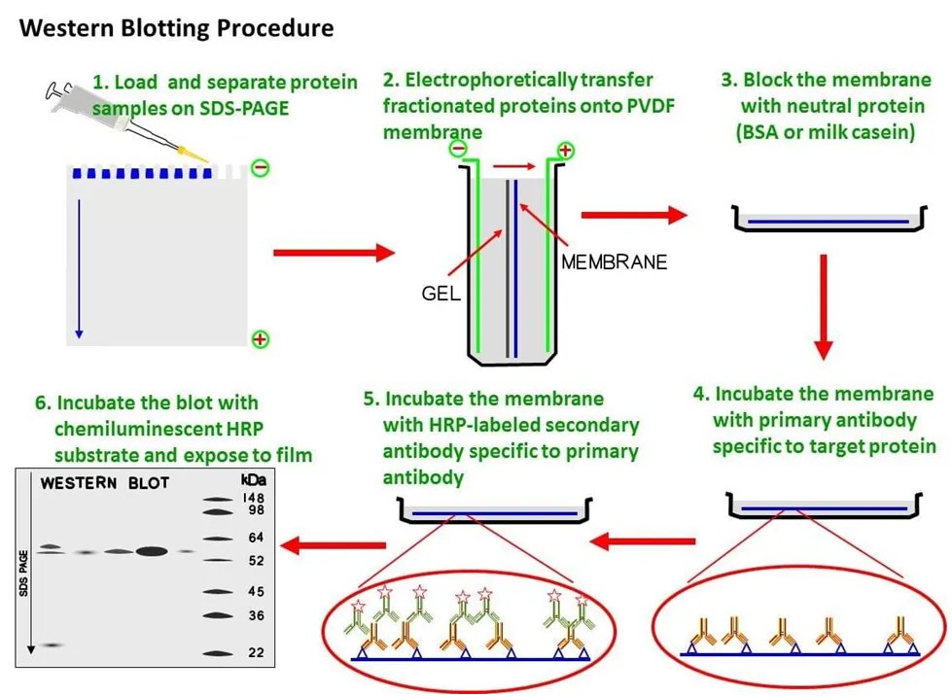
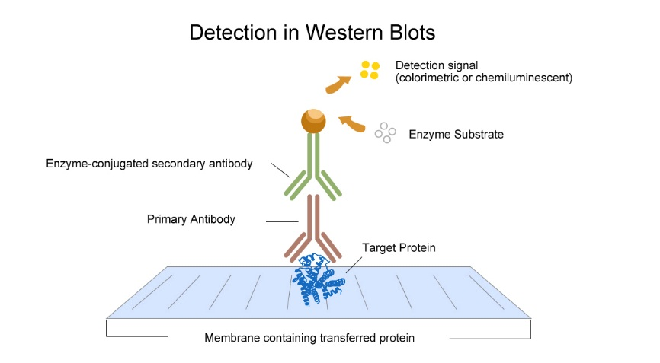
Western Blotting
Allows researchers to detect the protein of interest from a pool of proteins
Specific proteins looked at in this experiment are GRP78, ATF6, IRE1, PERK, IL-6

Slide 11
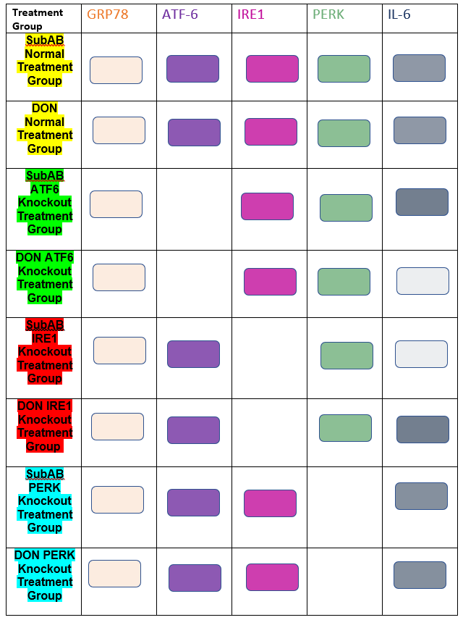
Western Blot Results (predictions)
-When macrophages were induced with DON, there were higher levels of expressivity when PERK and IRE1 were knocked down, indicating the ATF-6 pathway is the upregulator of IL-6
When macrophages were induced with SubAB, there were higher levels of expressivity when PERK and ATF-6 were knocked down, indicating the IRE1 pathway is the upregulator of IL-6

Slide 12
Implications of the experiment
Understanding which signaling pathway in UPR causes the upregulation of interleukin-6 can allow for scientists to experiment more with toxins like SubAB and DON
SubAB and DON can be possible anti-cancer treatments by knocking out their IL-6 inducing pathway to reduce chance of autoimmune disease occurrence

Slide 13
Questions???

