Slide 1
The regulation of γ- globin and LRF/ZBTB7A by Krüppel-like Transcription Factor KLF1 in Human Erythroid Cells
Rashmi Naidu
Mentor: Dr. Joyce Lloyd
Professor: Dr. Jeffrey Elhai, BNFO 300

Slide 2
What is Sickle Cell Anemia?
Caused By: mutation which affects Chromosome 11 of HBB (encodes beta chain of hemoglobin)
What is the result of this mutation?
Sickle cells de-oxygenate → form polymers
Rigid Polymers distort the cell (“sickle” shape)
Blockage of vessels
Infarcts
Lower Oxygen delivery to Tissues
Fig. 7.14
Victor Hoffbrand and Paul A.H. Moss. Essential Haematology. WILEY Blackmail. 2011.
Notes:
Sickle Cell Anemia is actually considered a subset of Sickle Cell Disease, the previously mentioned group of inherited red blood cell disorders.
It is caused by a mutation which affects Chromosome 11 of HBB. This mutation encodes for the beta chain of hemoglobin and furthermore synthesizes the beta globin protein.
The actual mutation is considered a point mutation that occurs in the 17th nucleotide in the beta chain, which ends up changing the amino acid at the 6th position from a Glutamic Acid to a Valine (Since Thymine → Adenine).
The now sickle cells, once they release oxygen (de-oxygenate) from peripheral tissues, they tend to adhere together and form long chains of fibers, or polymers. The rigid polymers distort the cell, giving it the marked sickle cell shape.
Some of the treatments for Sickle Cell Anemia include caring of current symptoms and even blood transfusions. However, one complication that is arising with transfusions is the overload of iron that occurs due to a high presence of iron in donated blood. This happens even when strict regimens are pursued to remove heavy metals from the body using chelating agents.
Scientists, specifically my mentor’s lab are looking to focus on the crucial developmental switch from fetal to adult hemoglobin at the time of birth.

Slide 3
Increased γ-globin expression: Could it be a solution?
Hereditary Persistence of Fetal Hemoglobin (HPFH):
Fetal hemoglobin present after developmental switch
Reduced symptoms of SCD → increased expression of fetal hemoglobin (γ-globin)
Point Mutations in the promoters of γ-globin genes
Promoters of γ-globin genes interact with factors that repress/silence expression!
Notes:
the maintenance of fetal
hemoglobin levels well beyond
the point in which hemoglobin is
switched from fetal to adult (γ- to β-
globin).
Those
diagnosed with hereditary
persistence of fetal hemoglobin,
in addition to sickle cell disease,
exhibit reduced symptoms of
the disease due to the increased
expression of fetal hemoglobin
in the form of the γ-globin.
the promoters of gamma globin genes interact
with factors that repress/silence expression so that even though gamma globin is present, it is
being modulated simultaneously with the adult beta globin.

Slide 4
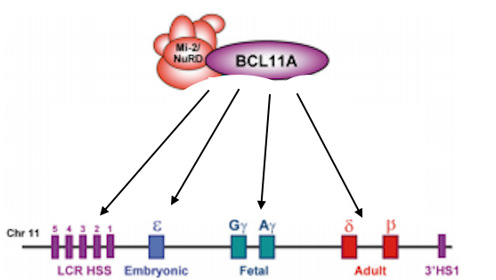
LRF/ZBTBTA – A Repressor of γ- globin
LRF/ZBTB7A:
Not as studied
Works independently of other repressors
Recruits NuRD Complex
REGULATION of LRF/ZBTB7A can lead to more γ- globin
Regulation by KLF1!
LRF

Slide 5
Does a Knockdown of KLF1 affect the expression levels of LRF/ZBTB7A and γ- globin?

Slide 6
Experiment Rundown
Knockdown of KLF1 (achieved by Lentiviral Infection)
qRT-PCR to measure expressions levels in:
KLF1, LRF/ZBTB7A, γ- globin

Slide 7
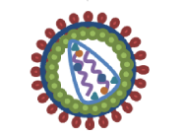
Lentiviral Knockdown of KLF1
Normalized control: Scramble
K1V1 knockdown
293T packaging cells
Collect virus particles
(use about 6 viruses to infect)
Virus infects HUDEP-2 cell Line
qRT-PCR used to measure from there
Notes:
Two KLF1-targeted shRNA vectors (pRRL_K1V1 and pRRL_K1V2) as well as a scrambled shRNA vector (pRRL_Scr) were acquired. In addition to the shRNA-coding sequence they carry a GFP-coding sequence, which aids in identification and recovery of successfully infected cells by FAC. Out of the five shRNAs tested, only two, K2sh_206 and K2sh_1529, successfully knocked down KLF2 mRNA.

Slide 8
KLF1 targeted shRNA (K1V1)
KLF1 targeted shRNA (K1V1)

Slide 9
What are shRNAs?
Short hairpin RNA that is introduced by a viral vector
For this experiment…
1. KLF1-targeted shRNA:
Human klf target 1(sense) 5′-gatcccgcggcaagagctacaccaattcaagagattggtgtagctcttgccgctttttggaaa-3′
Human klf target 1 (antisense) 5′ agcttttccaaaaagcggcaagagctacaccaatctcttgaattggtgtagctcttgccgcgg-3′
2. Scramble shRNA:

Slide 10
qRT-PCR
Same steps as PCR…
Denaturation
Annealing
Extension
But qRT-PCR…
Injects a fluorescent dye (SYBR Green)
over replication cycles...
more product = more fluorescent dye.

Slide 11
qRT-PCR Primer Sequences
Primer Sequences obtained from Table 2 – Kovilakath (2017)
KLF1:
LRF/ZBTB7A:
γ-GLOBIN:

Slide 12
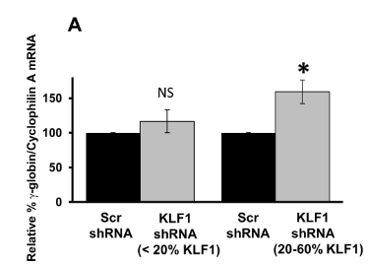
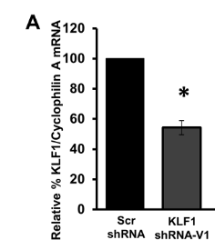
Hypothetical Results

Slide 13
Hypothetical Results Cont.
100
Relative % LRF/ZBTB7A/Cyclophilin A mRNA
?
50
Scr shRNA
KLF1 shRNA-V1

Slide 14
References
Victor Hoffbrand and Paul A.H. Moss. Essential Haematology. WILEY Blackmail. 2011.
Yawn BP, Buchanan GR, Afenyi-Annan AN, et al; Management of sickle cell disease: summary of the 2014 evidence-based report by expert panel members. JAMA. 2014 Sep 10312(10):1033-48. doi: 10.1001/jama.2014.10517.
Porter JB, Shah FT 2010. Iron overload in thalassemia and related conditions: Therapeutic goals and assessment of response to chelation therapies. Hematol Oncol Clin North Am 24: 1109–1130
Sankaran VG & Orkin SH (2013). The Switch from Fetal to Adult Hemoglobin. Cold Spring Harb Perspect Med. 3(1):a011643. doi: 10.1101/cshperspect.a011643
https://www.cdc.gov/ncbddd/sicklecell/treatments.html
Sokolova A, Mararenko A, Rozin A, Podrumar A, Gotlieb V (2019). Hereditary persistence of hemoglobin F is protective against red cell sickling. A case report and brief review. Hematol Oncol Stem Cell Ther. 215-219. doi: https://doi.org/10.1016/j.hemonc.2017.09.003
Orkin S, Bauer D (2019). Emerging Genetic Therapy for Sickle Cell Disease. Annual Review of Medicine. 70:257-271. Doi: https://doi.org/10.1146/annurev-med-041817-125507
Xu J, Sankaran VG, Ni M, Menne TF, Puram RV, Kim W, Orkin SH. 2010. Transcriptional silencing of y-globin by BCL11A involves long-range ineractions and cooperation with SOX6. Genes & Dev. 24:783-798.
Zhou, D., Liu, K., Sun, C. et al. KLF1 regulates BCL11A expression and γ- to β-globin gene switching. Nat Genet 42, 742–744 (2010) doi:10.1038/ng.637
Masuda et al (2016). Transcription factors LRF and BCL11A independently repress expression of fetal hemoglobin. Science. 351(6270): 285-289.
Keefe E. Nucleic Acid Delivery: Lentiviral and Retroviral Vectors. Materials and Methods. ISSN:2329-5139. doi: //dx.doi.org/10.13070/mm.en.3.174
Vinjamur DS, Alhashem YN, Mohamad SF, Amin P, Williams DC, Jr., Lloyd JA (2016) Krüppel- Like Transcription Factor KLF1 Is Required for Optimal γ- and β-Globin Expression in Human Fetal Erythroblasts. PLoS ONE 11(2): e0146802. doi:10.1371/journal.pone.0146802
Garibyan L, Avashia N. (2013). Research Techniques Made Simple: Polymerase Chain Reaction (PCR). J Invest Dermatol. 133(3):e6. doi:10.1038/jid.2013.1.
Norton LJ, Funnell APW, Burdach J, et al. KLF1 directly activates expression of the novel fetal globin repressor ZBTB7A/LRF in erythroid cells. Blood Adv. 2017;1(11):685–692. Published 2017 Apr 25. doi:10.1182/bloodadvances.2016002303
Kovilakath, A. (2017). The Role of KLF1 in Regulating y-globin gene repressors.

Slide 15
Notes:
The slides following are only to aid me in answering post presentation questions

Slide 16
The Switch of Expression from Fetal to Adult Hemoglobin
Fig. 1 – The fetal to adult hemoglobin switch. This diagram depicts the normal timing of the developmental hemoglobin switches in adults. Sankaran VG & Orkin SH (2013). The Switch from Fetal to Adult Hemoglobin. Cold Spring Harb Perspect Med. 3(1):a011643. doi: 10.1101/cshperspect.a011643
Notes:
The hemoglobin molecule is a tetramer composed of two subunits of a-like globin peptide chains and two subunits of the b-like globin peptides, along with heme moieties necessary for this molecule’s oxygen-carrying capacity
A variety of beta globin like molecules are produced due to the fact that the human beta globin locus on chromosome 11 is regulated as human development occurs.
the predominant b-like globin molecule produced is g-globin, This molecule is encoded by two duplicated g-globin genes found within the b-globin gene cluster. This ends up combining the two gamma globin chains with with adult globin forming fetal hemoglobin tetramer (HbF)
At time of birth, there is a switch of expression from fetal hemoglobin to hemoglobin as we know it (adult expression). This switch relies mainly on the transcriptional switch from gamma to beta globin.

Slide 17
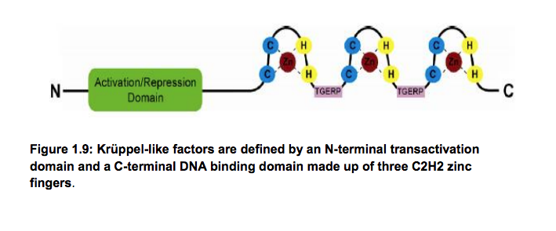
KLF1
Molecular Regulator of Hemoglobin Switching
Derived from a family of Cys2-His2 zinc finger transcription factors
Notes:
KLF1 has emerged as a key regulator of almost all aspects of erythrocyte development:
bet a globin
Cell cycle
Heme synthesis enzymes
Membrane formation
Previous studies in mouse models showed that a reduction of KLF1 resulted in lower hemoglobin (in general)

Slide 18
Relative Quantification Method
Relative Quantification Method:
(E^Ctendogenous gene/E^Cttest gene)
Used analyze changes in gene expression in KLF1-shRNA treated samples compared to Scr-shRNA controls

Slide 19
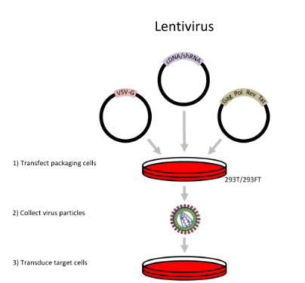
Lentiviral Infection Technique
Taken from Fig. 1 Keefe E. Nucleic Acid Delivery: Lentiviral and Retroviral Vectors. Materials and
Methods. ISSN:2329-5139. doi: //dx.doi.org/10.13070/mm.en.3.174

