Slide 1
The effect of RNA splicing on opioid tolerance
Suha Minai

Slide 2
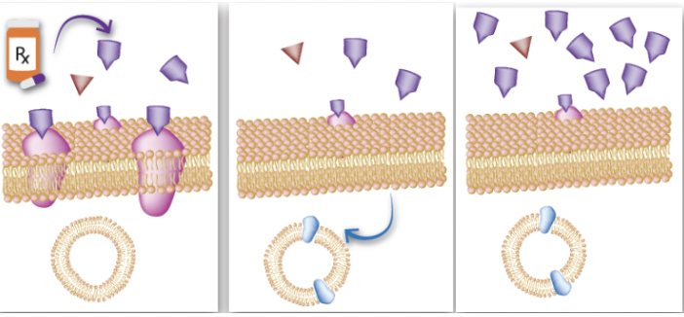
Opioid Tolerance
Opioids=strong pain relief → incentive to consume
Over time, receptors are desensitized, which makes them internalize → more opioids consumed
Source: https://medium.com/dr-ming-kao/opioid-tolerance-dependence-and-withdrawal-821ef0ec7dd7
Notes:
Opioid receptors degraded or recycled, but not enough are recycled to compensate for so many opioids, hence tolerance

Slide 3
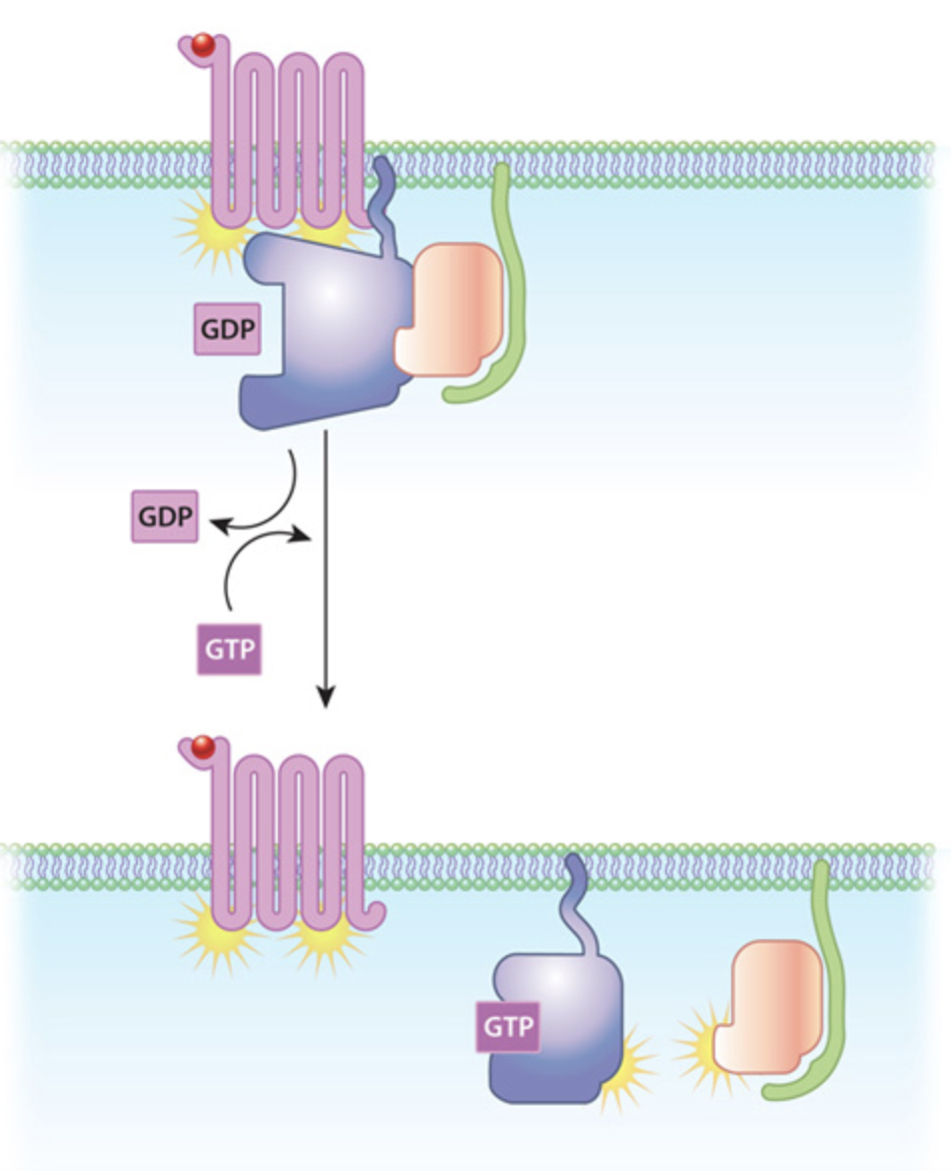
GPCRs
GPCRs=alpha, beta, gamma subunits
Activated by GTP
Opioid receptors=subunit of GPCR
Splicing mRNA of receptors→ different rate of tolerance?
Source: https://www.nature.com/scitable/topicpage/gpcr-14047471/
Notes:
GPCRs=three subunits, alpha uncouples from beta and gamma during tolerance, stimulated by a molecule called GTP that activates the GPCR
Opioid receptors are a subset of GPCRs
GPCRs are proteins, direct translations of mRNA, so splicing could create different variants of mRNA and also impact the rate of opioid tolerance

Slide 4
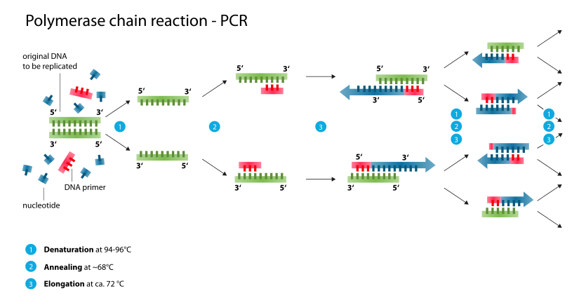
qPCR
Same procedure as PCR but amplified DNA labeled with fluorescence
PCR and qPCR also analyze sequences for differences
For RNA, use qRT-PCR
Product=double stranded DNA segment analogous to target RNA segment
Source: https://en.wikipedia.org/wiki/Polymerase_chain_reaction
Notes:
In PCR, DNA denatured via heat, primers and nucleotides are attached, and DNA replicates in cycles that repeat very quickly, hence rapid amplification
dNTP=deoxyribonucleotide triphosphate, a type of nucleotide used often in PCR
In qPCR, amplified DNA is fluorescently labeled and fluorescence is released proportional to the amount of amplified DNA

Slide 5
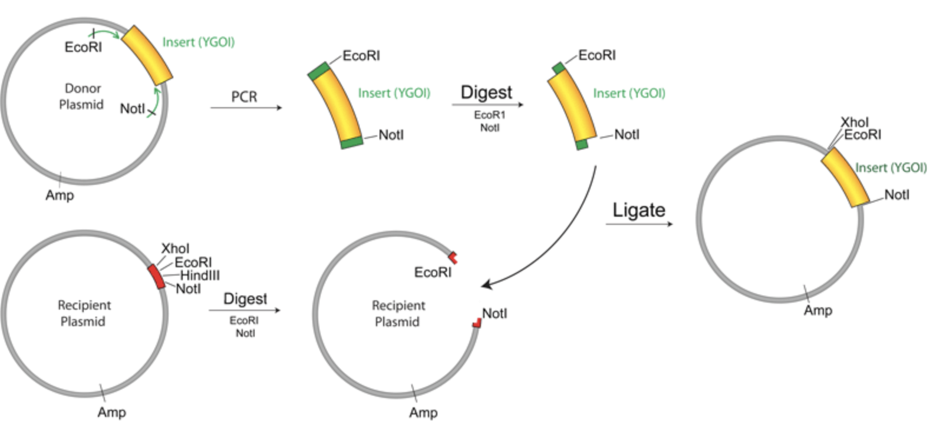
RNA Splicing (pre-tolerance)
Cloning into vector (method to allow direct manual splicing) shown in figure
Aim of the experiment and why cloning into vector won’t be done
Splices analyzed via qPCR assays for composition and possible changes
Source: https://www.addgene.org/protocols/pcr-cloning/
Notes:
Cloning into vector=run PCR first → use restriction digests on RNA product and receiving plasmid → isolate RNA via gel purification → fuse the RNA to the plasmid (RNA ligation) → introduce the RNA into the cell via transformation (like a transfusion)
Aim of the experiment is not to create splices but to explore how splice variants impact opioid tolerance so splices will only be analyzed
How many, composition, and how they might change

Slide 6
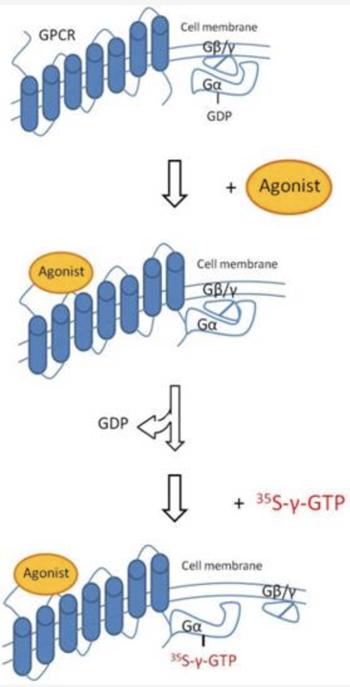
Opioid Tolerance Measurement
mRNA used in experiment: one region from brain and one region from ileum of mouse
Inject mRNA w/ morphine then into empty cells
G-protein gamma assay
Specific to GPCRs
Uses GTPase to produce [35S]GTPγS
Assessment/ranking of binding
Source: https://www.perkinelmer.com/lab-products-and-services/application-support-knowledgebase/radiometric/35s-gtp-binding-assays.html
Notes:
-The mRNA used here will be from one mouse. One region from their brain, and one region from their ileum. Both regions will be separately injected with morphine and placed into empty cells
-G-protein gamma assay is specific to GPCRs and uses GTPase to produce the weaker counterpart of GTP: [35S]GTPγS. The binding will be assessed by determining how often the binding of the morphine causes [35S]GTPγS to bind as well (GPCR activation)

Slide 7
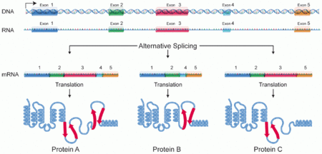
RNA Splicing (post-tolerance)
mRNA splices analyzed w/ qPCR assays similar to pre-tolerance
Post-tolerance and pre-tolerance splices compared–composition, changes, and why
Source: https://en.wikipedia.org/wiki/Alternative_splicing

Slide 8
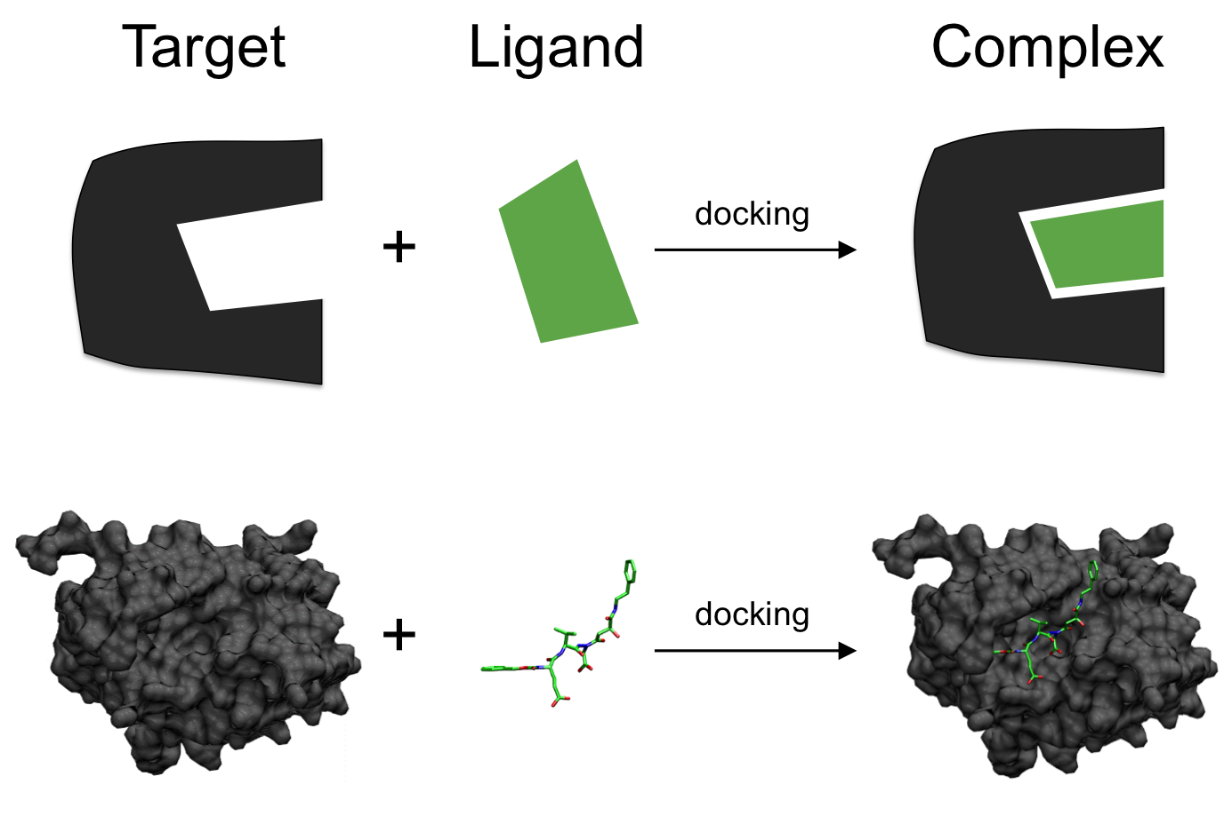
Possible Alternate Method
Molecular docking
Can assess binding affinity of ligands to receptors in different binding positions
G-protein gamma assay=more specific
Source: https://en.wikipedia.org/wiki/Docking_(molecular)
Notes:
Molecular docking=a type of drug identification computational protocol

Slide 9
Why Should We Care?
Main cause of opioid addiction=lack of knowledge of how tolerance works
Exploring the relationship between splicing and tolerance can be very helpful medically

Slide 10
References
1. Allouche, S; Noble, F; Marie, N (2014). Opioid receptor desensitization: mechanisms and its link to tolerance. Frontiers in Pharmacology, 5:280. <https://doi.org/10.3389/fphar.2014.00280>
2. Johnson, KA; Lovinger, DM (2016). Presynaptic G Protein-Coupled Receptors: Gatekeepers of Addiction? Frontiers in Pharmacology, 10:264. <https://doi.org/10.3389/fncel.2016.00264>
3. Xu, J; Lu, Z; Xu, M; Rossi, GC; Kest, B; Waxman, AR; et al (2014). Differential Expressions of the Alternatively Spliced Variant mRNAs of the µ Opioid Receptor Gene, OPRM1, in Brain Regions of Four Inbred Mouse Strains. PLoS ONE, 9(10): e111267. <https://doi.org/10.1371/journal.pone.0111267>
4. Baralle, D; Buratti, E (2017). RNA splicing in human disease and in the clinic. Clin Sci, 131 (5):355-368. <https://doi.org/10.1042/CS20160211>
5. Lee, Y; Rio, DC (2015). Mechanisms and Regulation of Alternative Pre-mRNA Splicing. Annual Review of Biochemistry, 84:291-323. <https://doi-org.proxy.library.vcu.edu/10.1146/annurev-biochem-060614-034316>
6. Ebrahimi, G; Asadikaram, G; Akbari, H; Nematollahi, MH; Abolhassani, M; Shahabinejad, G (2017). Elevated levels of DNA methylation at the OPRM1 promoter region in men with opioid use disorder. The American Journal of Drug and Alcohol Abuse: Encompassing All Addictive Disorders, 44(2). <https://doi.org/10.1080/00952990.2016.1275659>
7. Refke, M; Pasternack, SM; Fiebig, B; Wenzel, S; Ishorst, N; Ludwig, et al (2011). Functional analysis of splice site mutations in the humanhairless (HR) gene using a minigene assay. British Journal of Dematology, 165(5):1127-32. <https://doi-org.proxy.library.vcu.edu/10.1111/j.1365-2133.2011.10495.x>
8. Čepin, U. (2017). Real-Time PCR (qPCR) Technology Basics. Biosistemika. <https://biosistemika.com/blog/qpcr-technology-basics/>
9. Mischel, RA.; Dewey, WL.; Akbarali, HI. (2018) Tolerance to Morphine-Induced Inhibition of TTX-R Sodium Channels in Dorsal Root Ganglia Neurons Is Modulated by Gut-Derived Mediators. iScience, 2:193-209. <https://doi.org/10.1016/j.isci.2018.03.003>
10. Kang, M; Mischel, RA; Bhave, S; Komla, E; Cho, A; Huang, C; et al (2017). The effect of gut microbiome on tolerance to morphine mediated antinociception in mice. Scientific Reports, 7: 42658. <https://doi.org/10.1038/srep42658>
11. Ellis, CR; Kruhlak, NL; Kim, MT; Hawkins, EG; Stavitskaya, L. (2018). Predicting opioid receptor binding affinity of pharmacologically unclassified designer substances using molecular docking. PLoS ONE, 13(5): e0197734. <https://doi.org/10.1371/journal.pone.0197734>
12. Guruatma "Ji" Khalsa. (2010, April 12). PCR (polymerase chain reaction). ASU - Ask A Biologist. https://askabiologist.asu.edu/pcr-polymerase-chain-reaction
13. Bidlack J.M., Parkhill A.L. (2004). Assay of G Protein-Coupled Receptor Activation of G Proteins in Native Cell Membranes Using [35S]GTPγS Binding. G Protein Signaling: Methods in Molecular Biology, 237. <https://doi.org/10.1385/1-59259-430-1:135>

