Slide 1
BK Channel Clustering in slo-1 Mutants
By Dylan Lee

Slide 2
Ethanol Targets C. elegans and The BK Channel
Alcohol abuse is a large problem in society
The intoxicating effect of ethanol are not well understood and there are a variety of ethanol targets
The BK Channel is one of those targets
The BK Channel is a voltage- and calcium-gated ion channel.

Slide 3
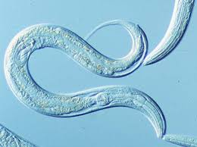
Caenorhabditis elegans
Lives on E. coli
Hermaphrodite and Male
Produces about 100 offspring a day
Can be grown on Petri Dishes
Shares 60% of the human genome
Transparent
Experiences ethanol intoxication
Has BK Channels

Slide 4
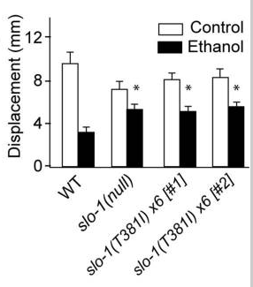
slo-1(lf) & slo-1(T381)I
The BK Channel is encoded by the slo-1 gene.
slo-1 loss-of-function displays a highly ethanol resistant phenotype
There is a highly conserved cytosolic threonine at the 381st position that when mutated to isoleucine in a WT animal gives said animal an ethanol resistance comparable to a slo-1(lf) mutant
Davis et al 2012

Slide 5
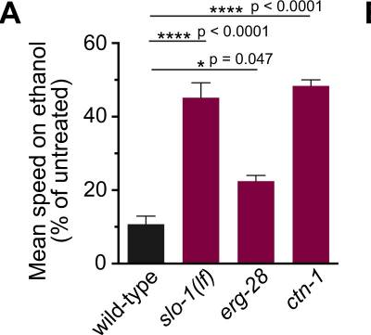
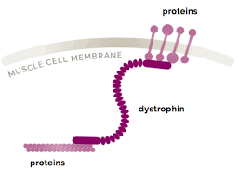
Ctn-1
Oh et al 2019
There exists a dystrophin mutation ctn-1 that is resistant to ethanol
ctn-1 acts on the BK Channel
The ctn-1 mutation causes the BK channel to form a diffuse phenotype on muscle cells and neurons
Worms with the ctn-1 mutation express an alcohol resistant phenotype comparable to slo-1(lf).
Wikipedia

Slide 6
Oh et al 2019

Slide 7
Hypothesis
The important amino acid at 381 is on the cytosolic side of the protein; dystrophin is inside the cell, so AA381 is in the right place to be used by dystrophin to localize SLO-1.
I hypothesize that the amino acid at 381 is important in the function of dystrophin to localize SLO-1.
I will use the T381I mutation to test the function of this AA in clustering. Does a SLO-1 BK channel with T381I have a clustered or nonclustered phenotype?

Slide 8
Proposed Methods
Select a strain of worms with GFP illuminated BK Channels. Oh et al 2019
Use CRISPR-Cas9 and HDR to change the 381st Threonine to an Isoleucine
Confirm that CRISPR-Cas9 was successful using a PCR screen
Use microscopy to observe a clustered or non clustered phenotype.

Slide 9
CRISPR-Cas9 Methods
Create a sgRNA template to select the location for Cas9 to cut.
Create a ssDNA sequence with homology arms flanking both sides of the edit
Obtain the Cas9 plasmid Peft-3::Cas-9::tbb-23’UTR
ssDNA Edit
CACATAGTGGTCTGTGGCCATATCATCTACGATTCGGTGTCCCATTTTN
Original
CACATAGTGGTCTGTGGCCATACCATCTACGATTCGGTGTCCCATTTT
Homology arms= blue
crRNA=GAAGCACAUAGUGGUCUGUG

Slide 10
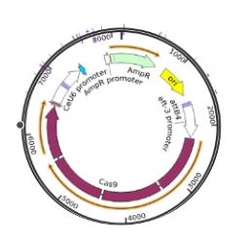
Peft-3::Cas-9::tbb-23’UTR

Slide 11
CRISPR Cas9 Methods cont.
Micro inject the Peft-3::Cas-9::tbb-23’UTR ssRNA and ssDNA into the C.elegans gonad.
Transfect the C.elegans gonad using Peft-3::Cas-9::tbb-23’UTR so that the transfected worm produces Cas9.
The Cas9 that is produced will bind to the sgRNA and be guided to the cut site.
Once the cut is made homologous repair will take place using the oligo repair template that was created.

Slide 12
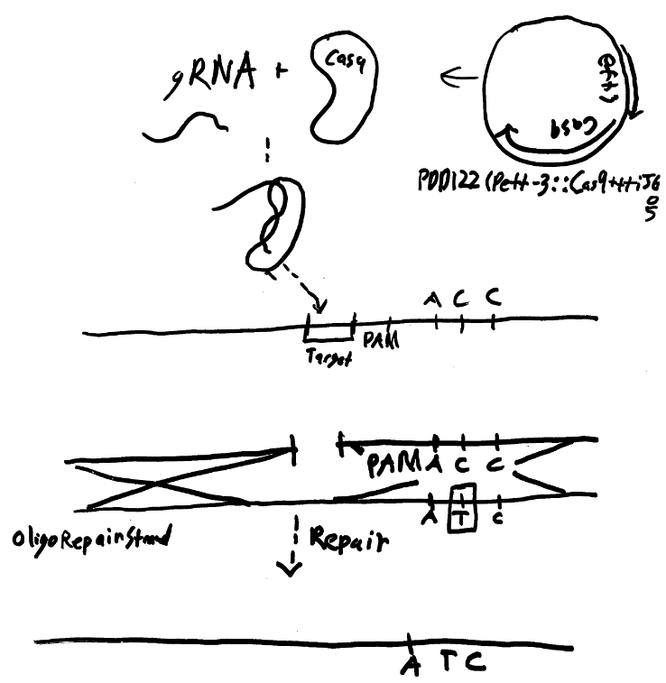

Slide 13
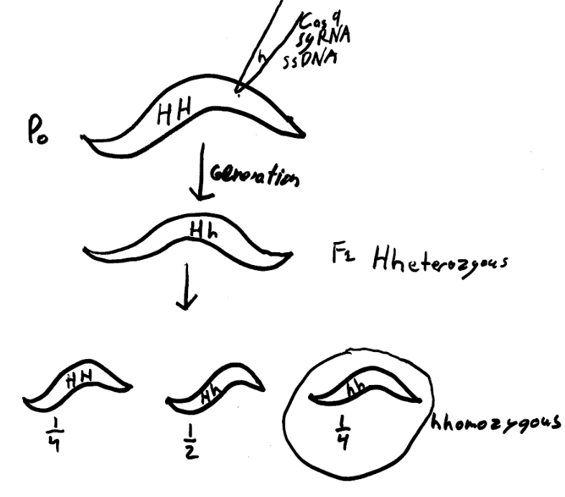

Slide 14
PCR Screen
Lyse a C. elegans worm from the F₂ generation after allowing it to lay eggs.
Design PCR primers to copy a stretch of DNA from unmutated worms such that the start primer overlaps with the mutation.
If the primer works then the mutation was not successful
If the primer doesn’t work the mutation was successful
start primer : TGTGGCCATATCACC
end primer :taagaagaaaatcttaaaa
Primers were designed with biobike
blue = mutation point

Slide 15
Microscopy
Magnify a dorsal ridge neuron sacrolemma and egg laying nerve using a microscope.
Illuminate ctn-1(eg1167)I;cimEx100[odr-1p::slo-1::gfp, unc-122p::mCherry]
slo-1[T381I]::gfp worm, slo-1::gfp with fluorescenct light.
Zoom in look and see.
Count the number of puncta in a 150 pixel box one each of the different strains

Slide 16
Interpretation
If the number of puncta of slo-1[T381I]::gfp is nearer the number of puncta displayed by. slo-1::gfp then it will have been confirmed that the 381st threonine does not have a role in the anchoring of the BK Channel.
If the number of puncta of slo-1[T381I]::gfp is near the number of puncta displayed by ctn-1(eg1167)I;cimEx100[odr-1p::slo-1::gfp, unc-122p::mCherry] then there will be evidence to show that the 381st threonine has a role in the anchoring of the BK Channel.

Slide 17
Bibliography
Davies AG, Pierce-Shimomura JT, Kim H, et al. A Central Role of the BK Potassium Channel in Behavioral Responses to Ethanol in C. elegans. Cell. 2003;115(6):655-666. doi:10.1016/s0092-8674(03)00979-6.
Davis SJ, Scott LL, Hu K, Pierce-Shimomura JT. Conserved single residue in the BK potassium channel required for activation by alcohol and intoxication in C. elegans. J Neurosci. 2014;34(29):9562–9573. doi:10.1523/JNEUROSCI.0838-14.2014
Dickinson DJ, Ward JD, Reiner DJ, Goldstein B. Engineering the Caenorhabditis elegans genome using Cas9-triggered homologous recombination. Nat Methods. 2013;10(10):1028–1034. doi:10.1038/nmeth.2641
Oh KH, Kim H. BK channel clustering is required for normal behavioral alcohol sensitivity in C. elegans. Sci Rep. 2019;9(1):10224. Published 2019 Jul 15. doi:10.1038/s41598-019-46615-9
5 https://benchling.com/protocols/wTQojorb/option-1-clone-grnas-into-plasmids

