Slide 1
Comparison of FGL2 protein and IGFBP2 protien in order to create a new antibody for Glioblastoma
Hanna Kwon

Slide 2
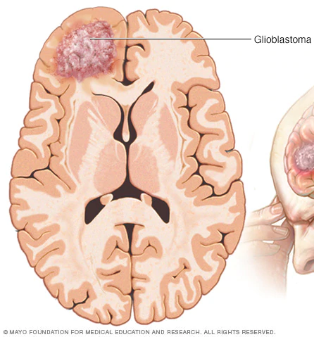
Glioblastoma
Common brain cancer in adults
Hard to treat

Slide 3
About Fibrinogen-Like Protein 2 (FGL2) Protein
Degenerates LGG to HGG
Immunosuppressive
Tumor progression & FGL2 expression have direct relationship
What happens if this protein is blocked?

Slide 4
Conducted Experiment
Control Group: Injected with IgG antibodies
Experimental Group: Injected with anti-FGL2 antibodies
Result: Experimental group had longer survival rates

Slide 5
Goal
Determine if creating and antibody for IGFBP2 Protein will be effective for treatment
Will determine by comparing CD44 receptors and Treg cells

Slide 6
Effectiveness of IGFBP2
Does IGFBP2 protein play the same role as FGL2 protein in glioblastoma progression?

Slide 7
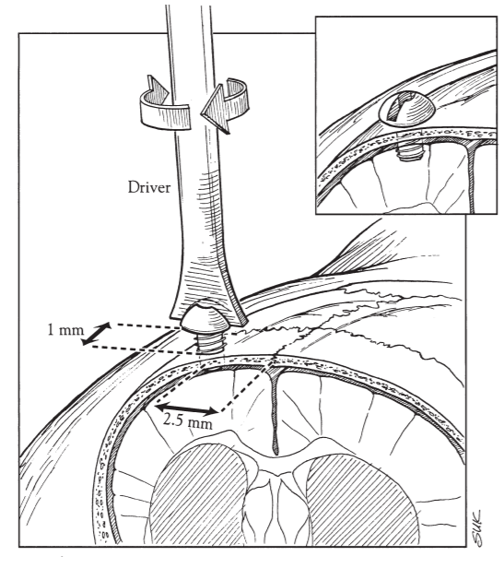
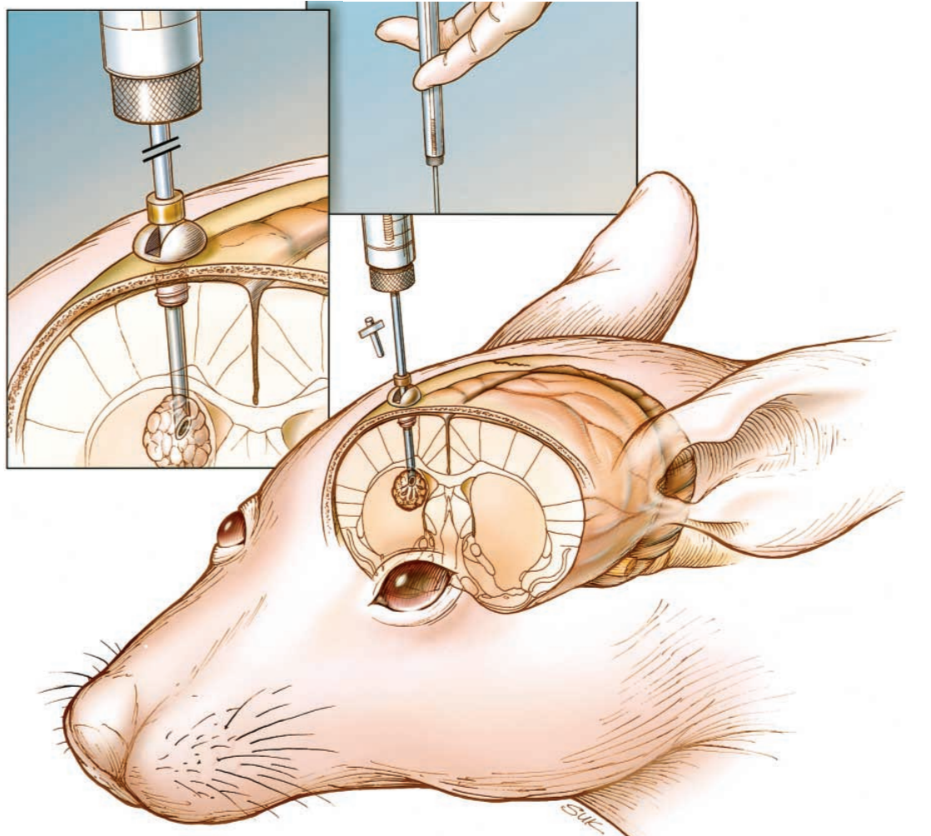
Control group: Injected with Glioma
Experimental Group: Injected with Glioma + IGFBP2 protein
Result: Experimental Group has shorter life span

Slide 8
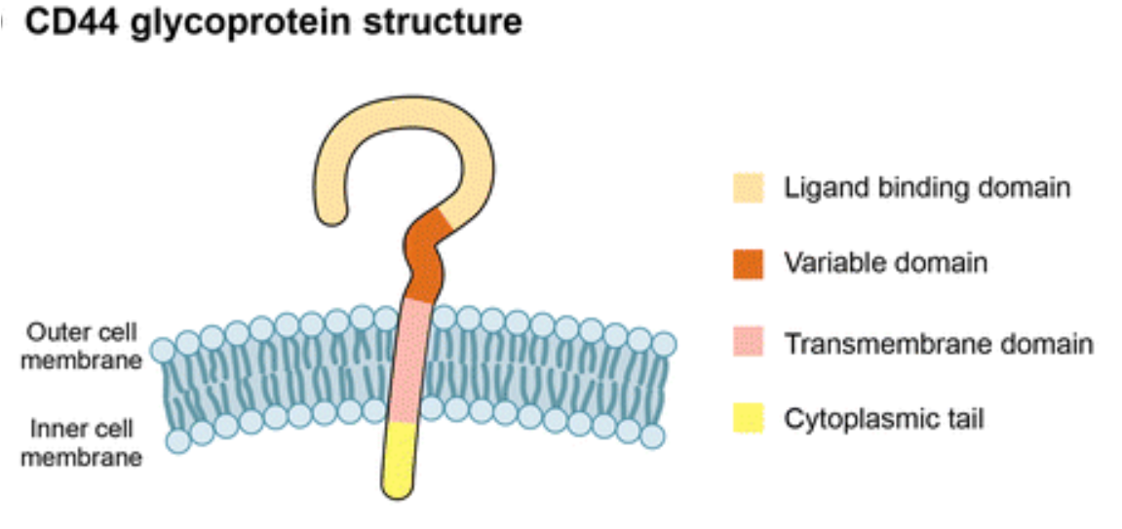
CD44 Receptors
Transmembrane glycoprotein
Common around cancer cells
Carries angiogenesis characteristic

Slide 9
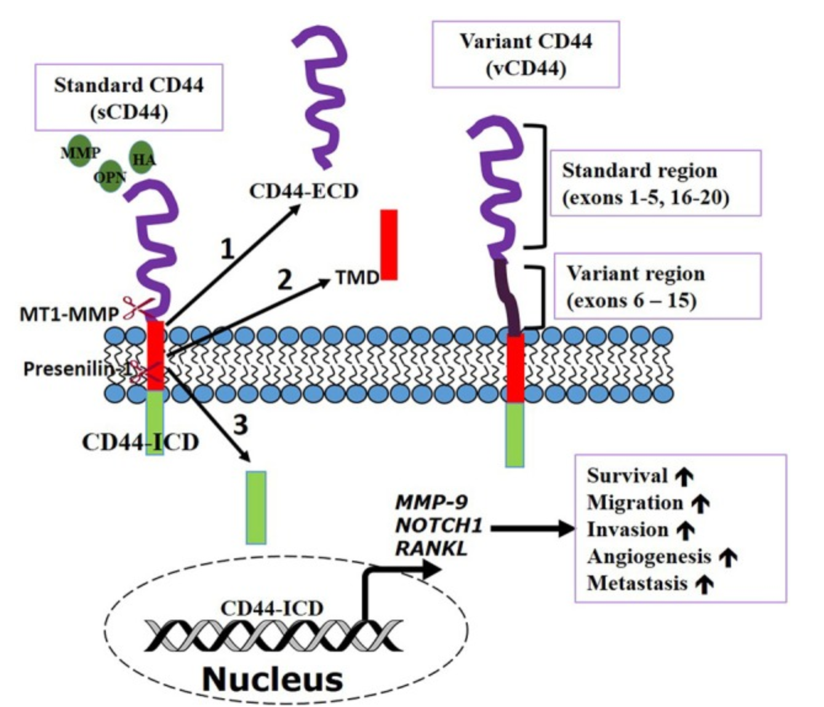
How CD44 helps cancer cells spread
ECD(purple): extracellular domain
TMD(red): transmembrane domain / hydrophobic residue
ICD(green): activate transcription important for metastasis
Metastasis: spreading of cancer cell
Notes:
ECD: extracellular domain / above surface
TMD: transmembrane domain / can form H bond between carbonyl oxygen and amide nitrogen / contain hydrophobic residue
ICD: translocates nucleus to activate transcription important to metastasis

Slide 10
Western Blotting
Specific protein will be the only band showing
More thick the band is, the more protein present

Slide 11
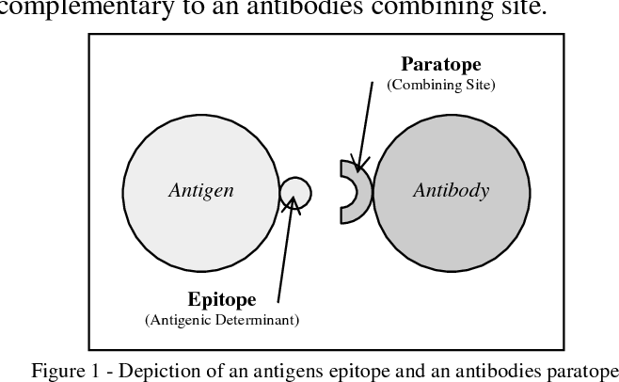
Antigen-Antibody Reaction
Epitope: part of the antigen recognized by antibody
Paratope: Part of the antibody that attaches to the antigen

Slide 12
Treg Cells
Immunosuppressive
Suppress T cells from doing their job
Prevents autoimmunity
More Tregs, Faster Tumor growth

Slide 13
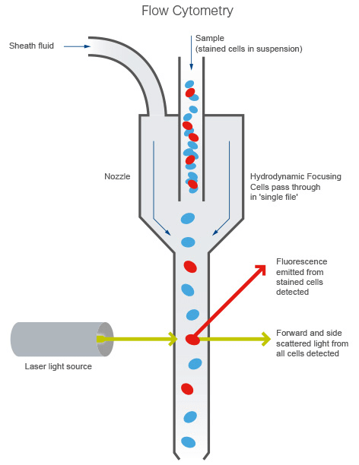
Flow Cytometry
Fluorochrome is used to dye the cell (using antibodies)
When cell is inserted, will be separated by the laser and the fluorochrome

Slide 14
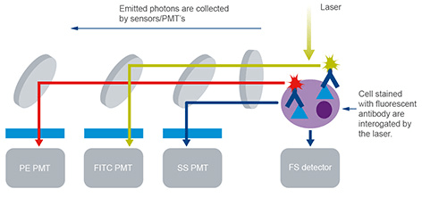
How the sensors work
Depends on the fluorochrome the cells are stained
Collected by sensors

Slide 15
Graph from Flow Cytometry
FoxP3 protein: Expressions are restricted to CD4 proteins; Treg markers
CD4 protein: Suppress T cell activities

Slide 16
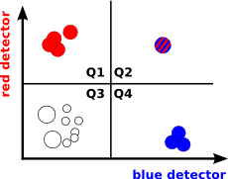
How to read the Graph
Q1: Only Red receptor present
Q2: Both Red & Blue receptor present
Q3: Least or none of Red & Blue receptor present
Q4: Blue receptor present

Slide 17
My Experiment
Anti-IGFBP2 antibody

Slide 18
Conclusion
CD44 receptors & Treg cell level should be higher in the control group than the experimental group
anti-IGFBP2 antibodies will be useful to cancer therapy
Maybe combining anti-FGL2 antibodies and anti-IGFBP2 antibodies will boost the medication effect

Slide 19
THANK YOU

