Slide 1
A possible treatment for breast cancer using adenovirus modified with the Nur77 gene
A proposal by Evan Korade

Slide 2
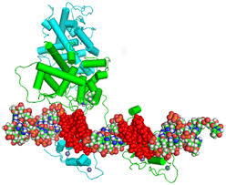
Nur77 is a hormone activated nuclear receptor
Binds to DNA pre-gene sequence upon activation.
Lang et Al, 2015

Slide 3
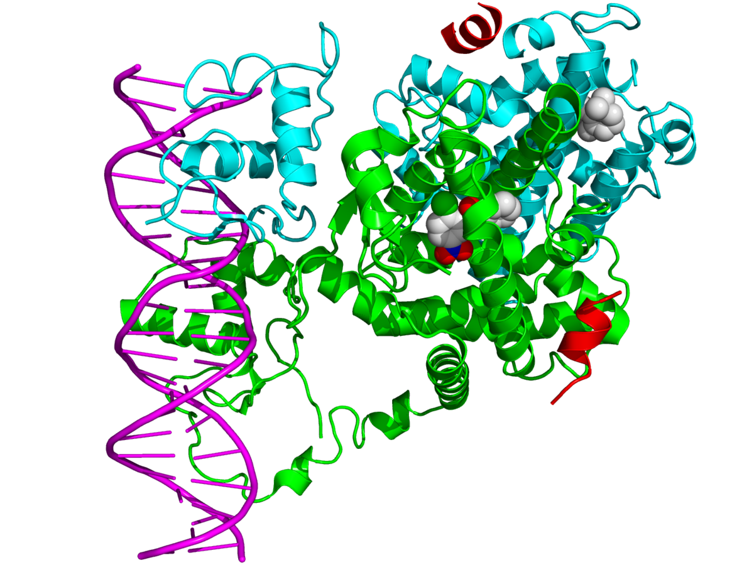
Binding sequence can be modified through heterodimerization or homodimerization
Wikipedia, “Nuclear Receptors”

Slide 4
RXRα
MAPK
Nur77
Nur77 also can play a role in apoptosis under the right conditions
Mitogen-activated protein kinase phosphorylates Nur77
Nur77 dimerizes with retinoid X receptor alpha
Nucleus
Mitochondria
= phosphorus

Slide 5
MAPK
RXRα
Nur77
In cancerous breast tissue, MAPK is inhibited
Thus, Nur77 is unable to pass through nuclear envelope

Slide 6
Though adenovirus modification, I hope to create a cancerous treatment using mitochondrial-targeting Nur77

Slide 7
Experiment outline
The experiment requires four steps:
Isolation of the Nur77 gene
Plasmid creation
Integration into adenovirus virion
treatment

Slide 8
Gene isolation – RNA extraction
Tissue sample
1 mL Chloroform
Incubate
Centrifuge
5 mL Trizol
Trizol
solution
Tissue sample lysed in Trizol reagent and incubated
The resulting sample will form layers, and the topmost aqueous layer will be extracted
RNA pellet will be precipitated
RNA extract
Extract
Isopropyl
alcohol
RNA pellet

Slide 9
Gene isolation – cDNA formation
RNA-Primer mix
Random hexamer primers
Oligo(dT) primers
dNTP mix
RNA sample
Buffer-enzyme mix
cDNA synthesis buffer
0.1 M dithiothreitol (DTT)
RNaseOut
Superscript III

Slide 10
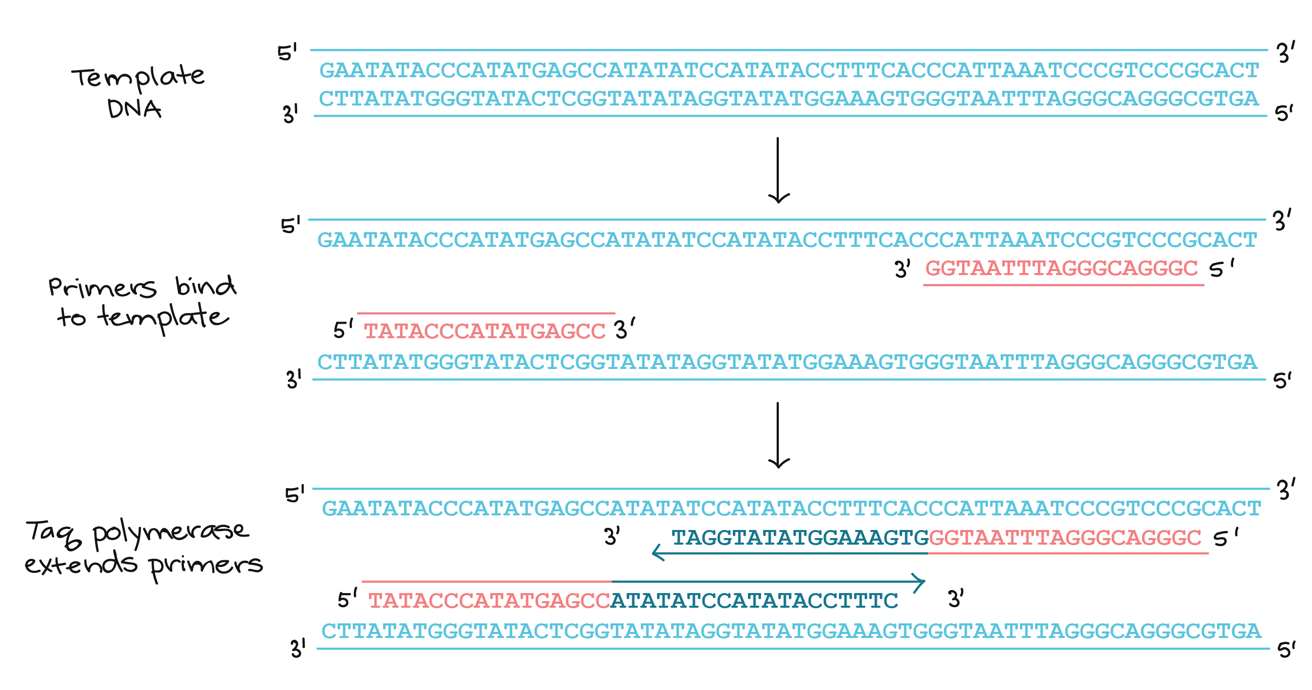
Gene isolation - PCR
Primers will be ordered from Thermo-Fisher with the following sequences
3’ – 5’: GAGCCCCAGTGCAGGAG
5’ – 3’: GACACATTGTCTTTCTGA
Diagram derived from khan academy

Slide 11
Plasmid creation
COX8
Nur77
The first step is the addition of the first 23 amino acids of Cytocrhrome Oxidase subunit 8
Done using T4 DNA ligase enzyme
Nur77COX8
T4 DNA ligase

Slide 12
Plasmid creation
GGATCC
CCTAGG
BamHI
binding site
BamHI ITRs need to be ligated onto the end of the sequence
Provides binding site for attachment into the gene
Nur77COX8
T4 DNA ligase

Slide 13
Plasmid creation
BamHI
BamHI, the pShuttle-CMV plasmid, and the Nur77 gene are combined in a solution
BamHI is rendered ineffective, then T4 DNA ligases is added to form the final product
pShuttle-CMV
T4 DNA ligase
or

Slide 14
Virus development
Plasmid sample
E. Coli
E. Coli with virus
E. Coli will be grown with the plasmid sample incorporated to grow viral samples
The virus will then be extracted using a viral filter
Lyse
Viral filter

Slide 15
Treatment
X
Treatment will occur over multiple trials with varying incubation periods
Treatment will be tested on tumor-prone mice
N
3N
6N

Slide 16
Post-treatment
After time interval has elapsed, a flush of glucocorticoids will be administered
Followed by an injection of strong antivirals to fight off any remaining virus

Slide 17
Analysis
Effectiveness will be monitored by comparing the change in tumor growth rate as well as Ki-67 levels

