Slide 1
Ethanol tolerance and the effect of polyunsaturated fatty acids on the function of the BK channel
By: Amrita kondeti
12/10/19

Slide 2
Background - AUD
Alcohol Use Disorders are a profound and common problems across millions Americans in U.S.
Not well understood
Excess amounts of ethanol can be toxic to behavioral and physical health

Slide 3
Background – BK Channel
Voltage-gated potassium channels that conduct large amounts of potassium ions (K+) across the cell membrane
Their function is to repolarize the membrane potential by allowing K+ to flow outward and trigger the activation of the BK Channel
Several minutes of ethanol exposure can lead to an increased amount of BK

Slide 4
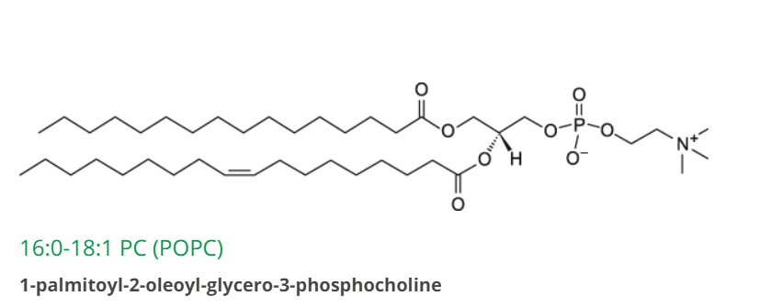
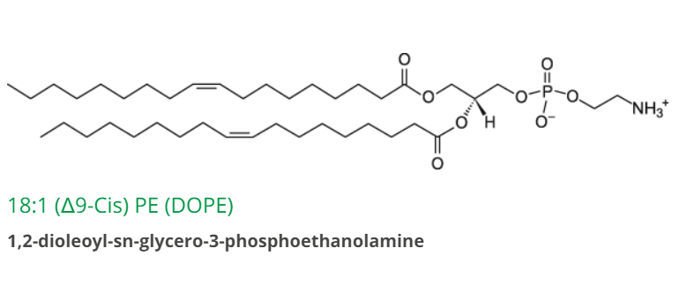
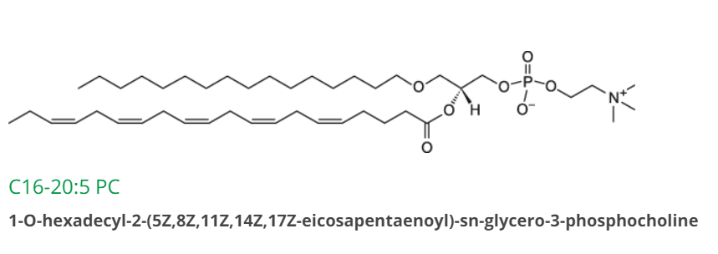
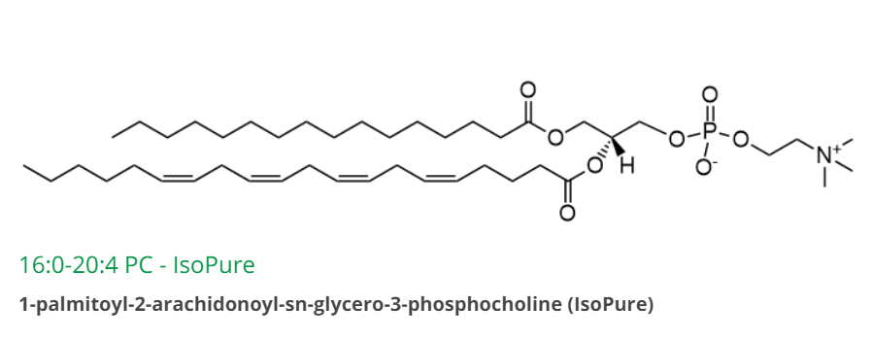
Background - Phospholipids

Slide 5
Hypothesis
LC-PFAs are required for AFT in response to ethanol. EPA is found to be necessary for the normal development of AFT (Raabe et al) so it may affect the BK channel in the lipid membrane.
The BK channel will be tested to see if the presence of EPA can alter the electrical activity.
AA is used as a comparison to test for membrane fluidity

Slide 6
Experiment - 1. Creating Artificial Membranes (Siontorou et al, 2018)
Dipping Method
1. Dip metal wire into lipid solution (3:1)
2. Transfer metal wire into electrolyte solution
3. Lipid drop will self organize into bilayer
4. Tethering – thiolipids or hydrogels for anchoring layer

Slide 7
Experiment - 2. Getting and Inserting the BK Channel into artificial membranes (Crowley et al, 2003)
1. CDNA is expressed to form BK channel proteins in the membrane of HEK 293 cells (Ahring)
2. HEK 293 cells will form into pellets and put them into buffer to get rid of excess media
3. Cell pellets will be resuspended in buffer to keep BK channel proteins from degrading
4. Lyse using 27-gauge needle and ultrasonic vibration of the cell pellets
5. Suspension will be layered on sucrose gradient and centrifuged, a band will be formed
6. Syringe will be used to collect the band with the BK channels
7. Small amount will be inserted into artificial membrane

Slide 8
Experiment - 3. Adding ethanol
Ethanol will be pipetted into the electrolyte solution when creating the artificial membrane.

Slide 9
Measurement - Patch Clamp Method for Electrophysiology
A hollow glass tube such as a micropipette or patch pipette with a very small opening will be used to make tight contact with the tiny area of the artificial membrane so that the ions will flow into the pipette when the BK channel opens.
Resulting electrical current will be measured with an amplified connected to the pipette
Record of the current flowing through the BK channel will reveal when the channel is in an open or closed state.

Slide 10
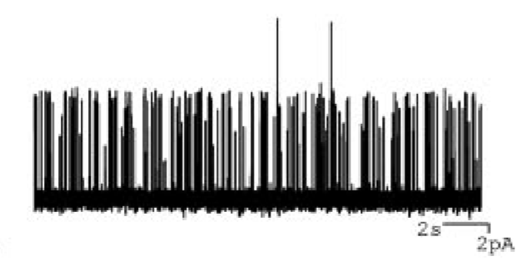
Expected Results
If both EPA and AA have the same affect before and after adding ethanol, then this suggests ethanol effect on membrane fluidity
If EPA and AA have different effects with or without ethanol, then this suggests there is something more specific about EPA or AA for altering BK channel

