Slide 1
The Effect of the A341V Mutation in KCNQ1 Associated with Long QT Syndrome on I_{ks} Channel Trafficking
Sukhleen Kaur

Slide 2
Background
Heart disease is the leading cause of death in the United States
Cardiac arrhythmia disorders account for approximately 200,000-300,000 sudden deaths
Long QT Syndrome is associated with malfunctioning of the I_{ks} channel which consists of two proteins
1
Retrieved from [3] and edited

Slide 3
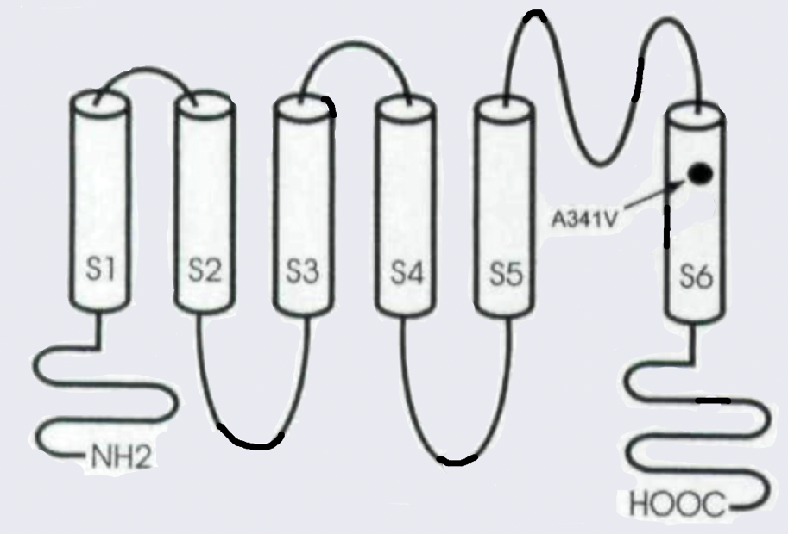
Background
Heart disease is the leading cause of death in the United States
Cardiac arrhythmia disorders account for approximately 200,000-300,000 sudden deaths
Long QT Syndrome is associated with malfunctioning of the I_{ks} channel which consists of two proteins
1
Retrieved from [4] and edited
Retrieved from [3] and edited

Slide 4
Proposed Question
Does the cell surface expression of A341V KCNQ1 differ from that of wild-type KCNQ1?

Slide 5
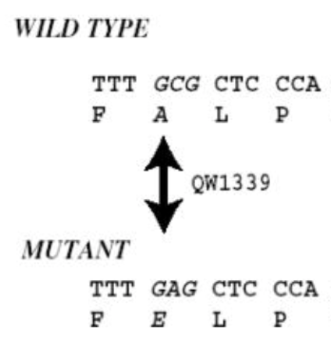
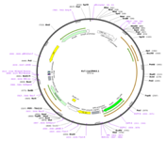
Biotinylation Experiment: Plasmids and Transfection
A341V
U
V
Retrieved from [16] and edited
Retrieved from [8] and edited

Slide 6
Biotinylation
NHS-SS-biotin
Main Steps:
1) Cell surface protein labelling
Cell lysis
Protein purification
Retrieved from [12] and edited
Retrieved from [6] and edited
Retrieved from [11] and edited

Slide 7
Biotinylation Experiment: Western Blot and Densitometry
Retrieved from [13] and edited
Retrieved from [13] and edited
Retrieved from [13] and edited
Retrieved from [14]

Slide 8
Biotinylation Experiment: Western Blot and Densitometry

Slide 9
Biotinylation Experiment: Overview
Plasmid Creation
Cell Transfection
Biotinylation
Western Blot and Densitometry

Slide 10
Potential Results and Discussion
Cadherin
Calnexin
KCNQ1

Slide 11
Potential Results and Discussion
Cadherin
Calnexin
KCNQ1
Retrieved from [10] and edited

Slide 12
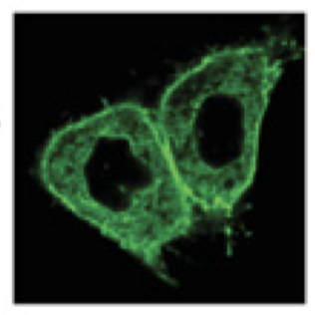
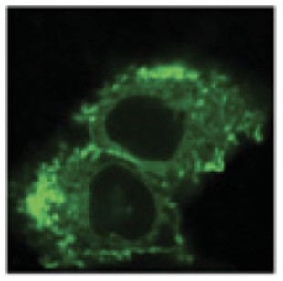
Potential Results and Discussion
Retrieved from [15] and edited
Cadherin
KCNQ1-GFP
A341V-KCNQ1-GFP
Calnexin
KCNQ1

Slide 13
Image References
[1] https://upload.wikimedia.org/wikipedia/commons/thumb/9/9e/SinusRhythmLabels.svg/1200px-SinusRhythmLabels.svg.png
[2] https://cdn.rcsb.org/images/rutgers/vm/5vms/5vms.pdb1-500.jpg
[3] https://www.vanderbilt.edu/vicb/images/discovery/2018/how_potassium_channel_mutations_heart_arrhythmias_fig1.jpg
[4] Wang, Z., Tristani-Firouzi, M., Xu, Q., Lin, M., Keating, M., & Sanguinetti, M. (1999). Functional Effects of Mutations in KvLQT1 that Cause Long QT Syndrome. Journal of Cardiovascular Electrophysiology, 10(6), 817–826. doi: 10.1111/j.1540-8167.1999.tb00262.x
[5] Mikuni, I., Torres, C. G., Bienengraeber, M. W., & Kwok, W.-M. (2011). Partial restoration of the long QT syndrome associated KCNQ1 A341V mutant by the KCNE1 β-subunit. Biochimica Et Biophysica Acta (BBA) - General Subjects, 1810(12), 1285–1293. doi: 10.1016/j.bbagen.2011.07.018
[6] https://s3-eu-west-1.amazonaws.com/pfigshare-u-previews/3105683/preview.jpg
[7] https://assets.thermofisher.com/TFS-Assets/LSG/figures/CSPBPK_Fig1smws.jpg-650.jpg
[8] https://www.polyplus-transfection.com/wp-content/uploads/2019/04/Transfection-mechanism-jetOPTIMUS.jpg
[9] https://media.scbt.com/product/35/96/b/359655.jpg
[10] Chen, J., Weber, M., Um, S. Y., Walsh, C. A., Tang, Y., & Mcdonald, T. V. (2011). A Dual Mechanism for IKs Current Reduction by the Pathogenic Mutation KCNQ1-S277L. Pacing and Clinical Electrophysiology, 34(12), 1652–1664. doi: 10.1111/j.1540-8159.2011.03190.x
[11] https://www.mdpi.com/micromachines/micromachines-08-00083/article_deploy/html/images/micromachines-08-00083-g001.png
[12] https://www.dojindo.com/Shared/Images/Product/SulfoBiotics-Biotin-HPDP(WS)%20solution/SB17-Fig.1.jpg
[13] https://www.biolegend.com/Files/Images/BioLegend/westernblot/Fig1_WB.jpg
[14] https://bioquochem.com/wp-content/uploads/2017/03/ECL-infography.jpg
[15] Harmer, S. C., Mohal, J. S., Royal, A. A., Mckenna, W. J., Lambiase, P. D., & Tinker, A. (2014). Cellular mechanisms underlying the increased disease severity seen for patients with long QT syndrome caused by compound mutations in KCNQ1. Biochemical Journal, 462(1), 133–142. doi: 10.1042/bj20140425
[16] Chen, S., Zhang, L., Bryant, R., Vincent, G., Flippin, M., Lee, J., … Wang, Q. (2003). KCNQ1 mutations in patients with a family history of lethal cardiac arrhythmias and sudden death. Clinical Genetics, 63(4), 273–282. doi: 10.1034/j.1399-0004.2003.00048.x

Slide 14
Questions?

Slide 15
[1]

Slide 16
[5]
Notes:
Mikuni et al’s experiment

Slide 17
[2]

Slide 18
