Slide 1
Measurement of Recurrence in Human TNBC cell Culture containing the BRCA1 Gene
Preksha Jerajani
BNFO 300

Slide 2
Triple Negative Breast Cancer (TNBC)
Unlike other forms of breast cancer it does not express
Estrogen Receptors (ER)
Progesterone Receptors (PR)
Human epidermal growth factor Receptor 2 (HER2)
Aggressive, hard to treat and has a higher chance for recurrence in the 1st and 3rd year after treatment
10-20% of all breast cancer cases account for TNBC

Slide 3
Breast Cancer Susceptibility Gene 1 (BRCA1)
BRCA1 gene is a tumor suppressor gene and it is responsible for repairing DNA
Gene is also known to interact with other genes for regulation and repair of DNA.
Mutation in this gene predisposes to breast cancer and not other forms of cancer.
Majority of women that have TNBC, show tumors with BRCA1 gene mutation

Slide 4
Does knocking out BRCA1 gene in human TNBC cells lead to changes in the number of cells over time (Recurrence)?

Slide 5
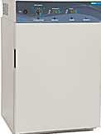
The cell line is gathered and kept in L-15 medium and incubated at 37 degrees Celsius.
The cells are then treated with Chemotherapeutics (PTX or doxorubicin) so that the cells become senescent.
The cells are now ready to go through knock out.

Slide 6
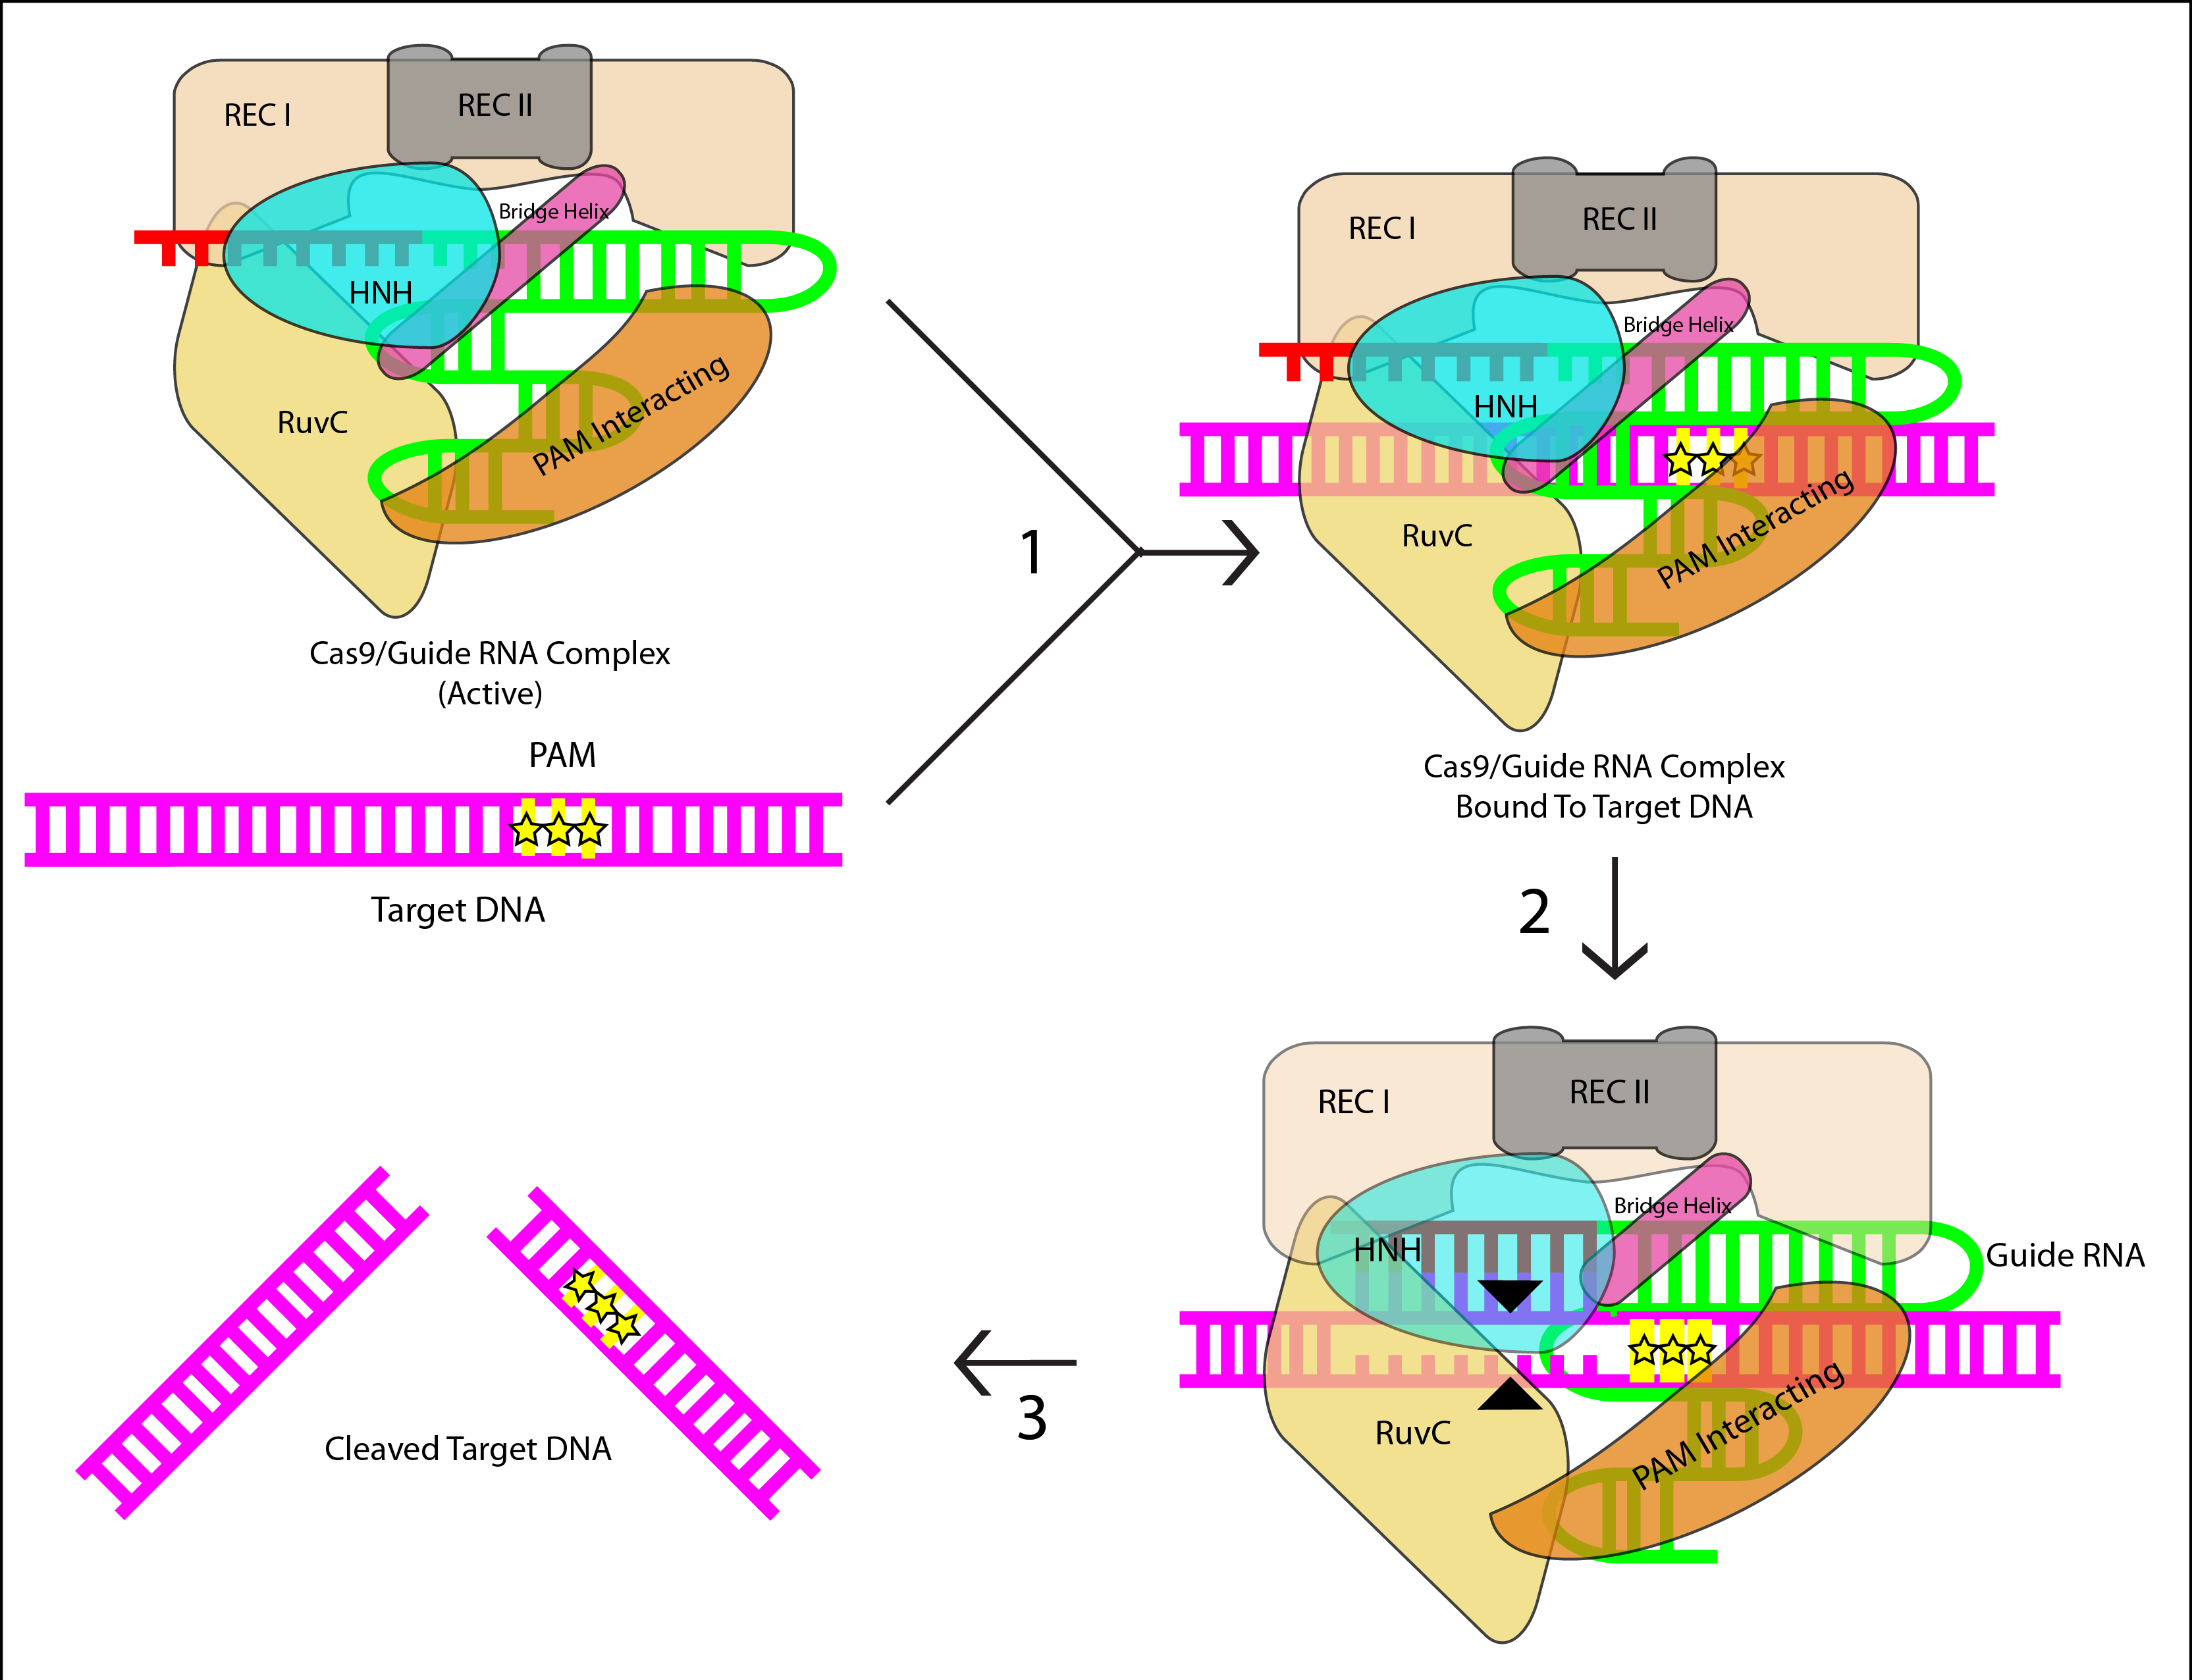
CRISPR Cas-9
Using the CRISPR Cas9 system we can knock out the BRCA1 gene.
Cas9 is an endonuclease that will bind to the sgRNA which is a simple guide RNA for the BRCA 1 gene.
Cas9 with the sgRNA will go to the target sequence. The Protospacer Adjacent Motif aka. PAM sequence is a short 3 nucleotide sequence helps Cas9 recognize the binding and the cleaving site.
The Cas9 will then confirm that the sgRNA is indeed a match for the target sequence. Once these steps are complete the Cas9 will make a double stranded cut.
The gene will be knocked out, and the other repair mechanisms will immediately come to work and fix the break.

Slide 7
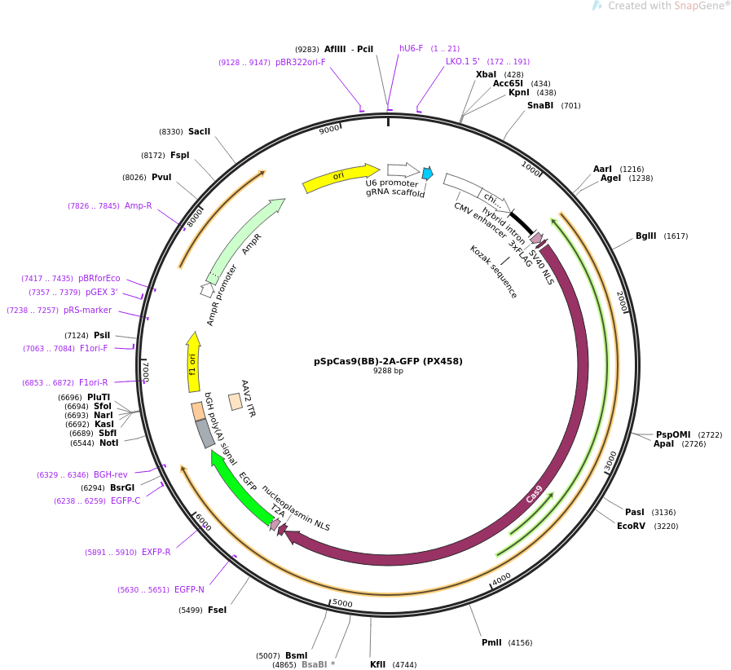
Plasmid-Based Delivery System
This is the system that will introduce the Cas9 and the sgRNA into the cell. The delivery of this plasmid can be done through microinjection.
This plasmid is used because it has specificity for the Cas9 and the sgRNA, and it can clone sgRNA very easily which is beneficial.
Microinjection
The plasmid is directly injected into the cell using a microscope and a 0.5 micrometer needle.
This system allows controlled delivery of known quantities, which improves control over off-target effects.
This method is best known for in vitro work.

Slide 8
Senescence Associated-β-Galactosidase Staining
Senescence
Senescent cells are metabolically active cells, but they cannot proliferate. TNBC cells go through this after chemotherapy instead of going through apoptosis.
The recurrence or the re-growth of cells can be seen through the loss of senescence.
Since we want to see if the cells loosing the BRCA1 mutated gene effect of the number of cells that start to proliferate again, detecting senescence is helpful.

Slide 9
How does the staining work?
Staining
Senescent cells show β-gal activity which is 3-6 folds greater than normal young cells.
Acid Β-galactosidase is localized in the lysosome and has the optimal pH of 4-4.5
The activity of lysosomal β-gal can be detected using a chromogenic substrate X-gal.
Lysosomal content increases in senescent cells which leads to increase in β-gal which will lead to higher staining
In human fibroblasts it is seen that the ideal pH for staining senescent cells is pH 6 but according to Kruz et al. 2000. There is not much known about the origin and exact function of β-gal.
X-gal is an analog of lactose and can be hydrolyzed by β-gal enzyme. When cleaved the product formed is 5-bromo-4-chloro-3- hydroxyindole which then dimerizes and oxidizes to form a compound that gives a blue-green color that is insoluble.

Slide 10
Product 1:the product from β-gal enzyme cleaving.
5-5’-dibromo-4,4’-dichloro-indigo
Product 2- this is the oxidized form which causes the blue insoluble product for the staining.

Slide 11
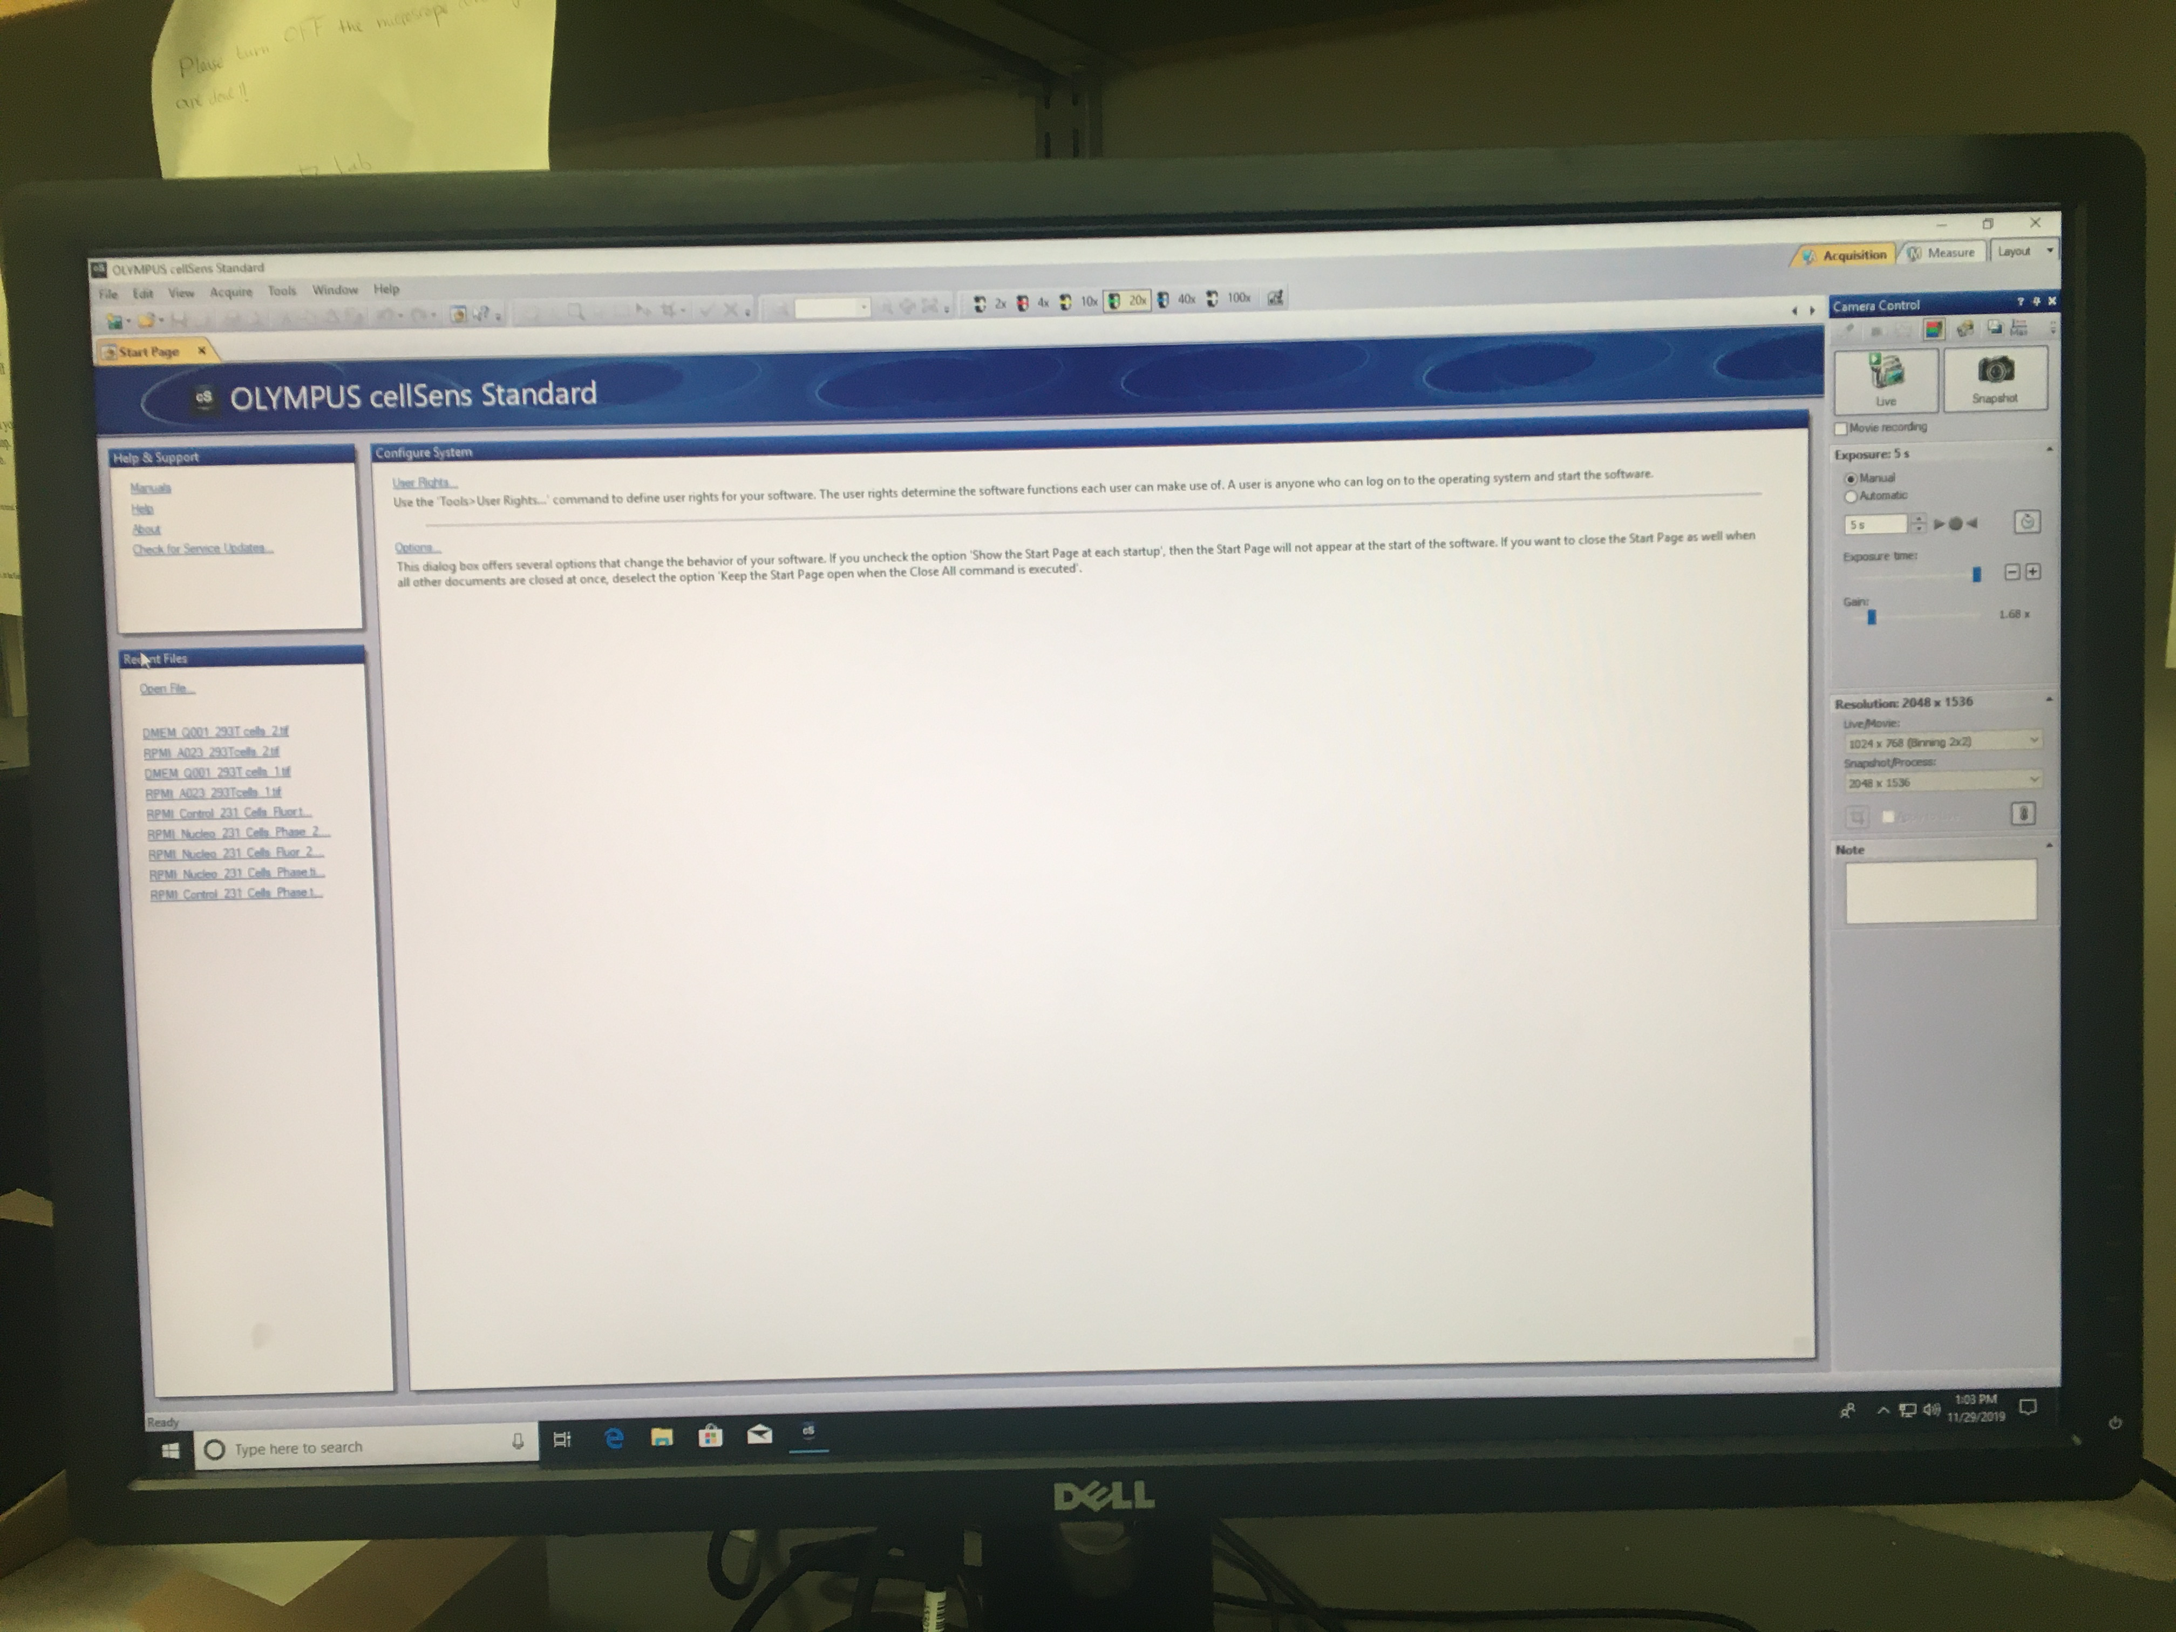
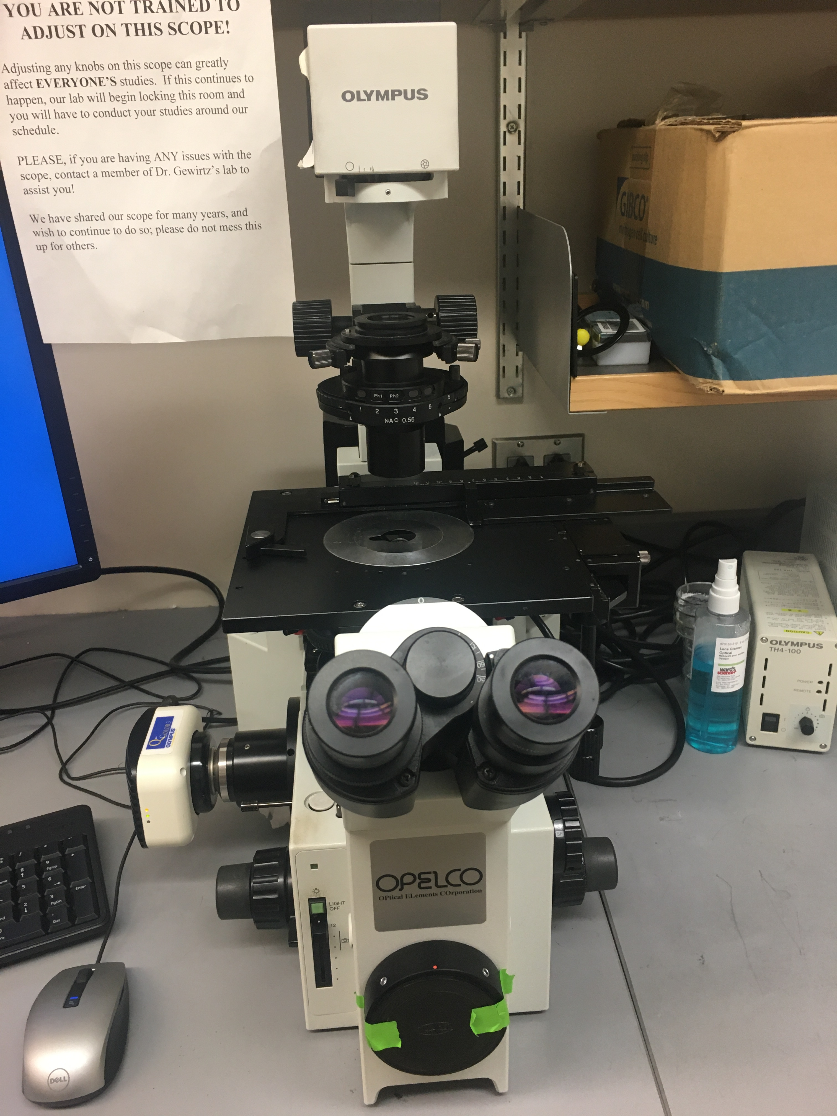
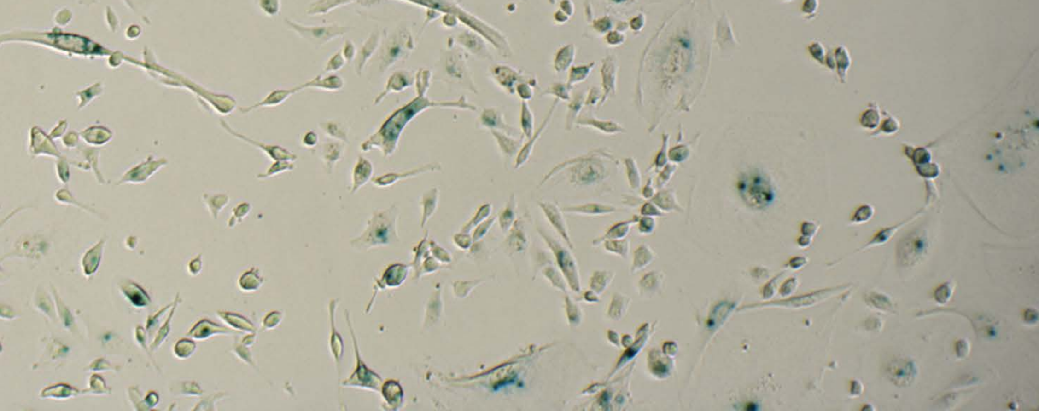

Slide 12
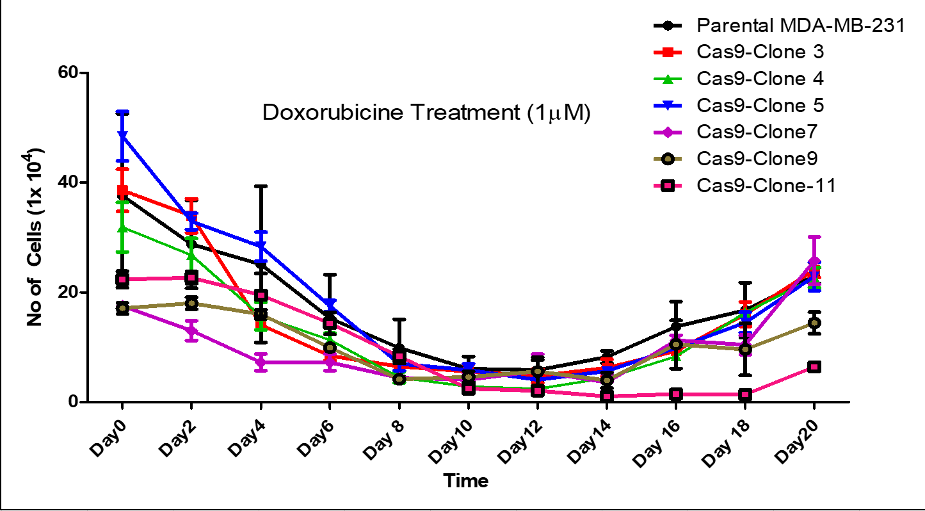
Growth Curve
The growth curve is showing the cells in the culture during chemotherapeutic treatment.
The different clones represent the cell lines that are Cas9 inducible. These cell lines are being compared to see if they can follow the pattern of the parental so that that cell line can be used in the experiment.
A similar graph will be made to see if knockout of BRCA1 gene caused the cells to grow in number or stay stable throughout the process.

Slide 13
Discussion -- Possible Results
Two possible results
The knocking out of BRCA1 gene leads to long term senescence. The cells will keep the blue stain and not proliferate.
The knocking out of BRCA1 gene leads to regular or early loss of senescence. The cells will loose the blue stain and proliferate.
The ideal result would be the first possibility because the cells are remaining in the non-proliferative stage for a longer time leading to a delay in recurrence.

Slide 14
Further Research
Applying this to other genes that are known to contribute to this form of cancer.
Seeing if attacking multiple genes at the same time shows significant difference in results
This research is so important to the understanding of genes and their impact on not only the onset of cancer but also the recurrence of cancer after treatment.

Slide 15
References
Itahana, K., Itahana, Y., & Dimri, G. P. (2013). Colorimetric detection of senescence-associated β galactosidase. Methods in molecular biology (Clifton, N.J.), 965, 143–156. doi:10.1007/978-1-62703-239-1_8
Kumar, P., & Aggarwal, R. (2016). An overview of triple-negative breast cancer. Archives of Gynecology and Obstetrics, 293(2), 247-269. https://link-springer-com.proxy.library.vcu.edu/content/pdf/10.1007/s00404-015-3859-y.pdf
Wong-Brown, M., Meldrum, W., Carpenter, C., Clarke, J., Narod, J., Jakubowska, E., . . . Scott, S. (2015). Prevalence of BRCA1 and BRCA2 germline mutations in patients with triple-negative breast cancer. Breast Cancer Research and Treatment, 150(1), 71-80.
Jiang, F., & Doudna, J. (n.d.). CRISPRCas9 Structures and Mechanisms. Annual Review of Biophysics, 46(1), 505-529.
Kavanagh, E. L., Lindsay, S., Halasz, M., Gubbins, L. C., Weiner-Gorzel, K., Guang, M., … McCann, A. (2017). Protein and chemotherapy profiling of extracellular vesicles harvested from therapeutic induced senescent triple negative breast cancer cells. Oncogenesis, 6(10), e388. doi:10.1038/oncsis.2017.82
Wang, Y. A., Jian, J. W., Hung, C. F., Peng, H. P., Yang, C. F., Cheng, H. S., & Yang, A. S. (2018). Germline breast cancer susceptibility gene mutations and breast cancer outcomes. BMC cancer, 18(1), 315. doi:10.1186/s12885-018-4229-5
F Ann Ran, Patrick D Hsu, Jason Wright, Vineeta Agarwala, David A Scott, & Feng Zhang. (2013). Genome engineering using the CRISPR-Cas9 system. Nature Protocols, 8(11), 2281-2308.
Henser-Brownhill, T., Monserrat, J., & Scaffidi, P. (2017). Generation of an arrayed CRISPR-Cas9 library targeting epigenetic regulators: from high-content screens to in vivo assays. Epigenetics, 12(12), 1065–1075. doi:10.1080/15592294.2017.1395121
Yang, M., Zeng, C., Li, P., Qian, L., Ding, B., Huang, L., … Wu, W. (2019). Impact of CXCR4 and CXCR7 knockout by CRISPR/Cas9 on the function of triple-negative breast cancer cells. OncoTargets and therapy, 12, 3849–3858. doi:10.2147/OTT.S195661
Kurz, D. J., Decary, S., Hong, Y. and Erusalimsky, J. D. (2000). Senescence-associated (beta)-galactosidase reflects an increase in lysosomal mass during replicative ageing of human endothelial cells. J Cell Sci 113 (Pt 20): 3613-3622.
Lino, C. A., Harper, J. C., Carney, J. P., & Timlin, J. A. (2018). Delivering CRISPR: a review of the challenges and approaches. Drug delivery, 25(1), 1234–1257. doi:10.1080/10717544.2018.1474964

