Slide 1
The Mechanism by which Pseudomonas chlororaphis Phage 201ϕ2-1 Proteins are Sorted within the Phage-Formed Proteinaceous Shell
Cash Frost

Slide 2
Introduction
Organelle: Specialized structure within a living cell
Eukaryotes: Defined nucleus
Prokaryotes: Lack of defined nucleus, other organelles
Bacteriophage 201𝜑2-1 codes for an organelle
Prokaryotic virus
Frame from a time-lapse microscopy of a cell infected by phage 201𝜑2-1.
Green = gp105-GFP fusion
Red = mCherry-PhuZ fusion
Adapted from movie S1 of Chaikeeratisak et al (2017)

Slide 3
Experiment
Goal: Determine if an amino acid sequence is responsible for phage protein access into the proteinaceous shell formed during infection

Slide 4
Methodology overview
Site-directed mutagenesis through inverse PCR
Inverse PCR
Nested deletions
Gibson Assembly
E. coli transformation
Chemical transformation
Plating
P. chlororaphis transformation
Chemical transformation
Plating
Infection with phage 201φ2-1

Slide 5
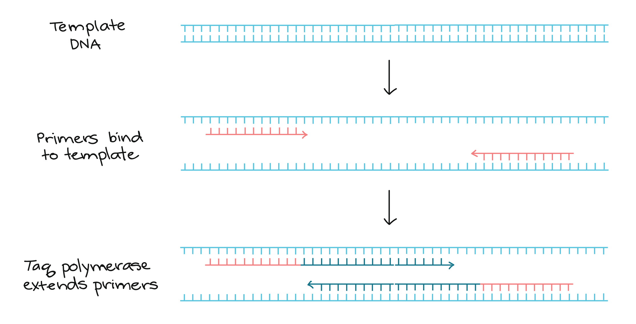
PCR
Method of DNA amplification, uses thermal cycling
Denaturation (95ºC)
Annealing
(55-65ºC)
Extension
(72ºC)
Steps of Pcr. (n.d.). Retrieved from https://www.khanacademy.org/science/biology/biotech-dna-technology/dna-sequencing-pcr-electrophoresis/a/polymerase-chain-reaction-pcr

Slide 6
Inverse PCR
Method of DNA amplification
Uses 2 primers oriented in reverse directions
Reverse: Complement of start codon + 12 nucleotide sequence upstream of gp197
Forward: Start codon + 12 nucleotide sequence upstream of gp197

Slide 7
Nested deletions
Accomplished with primer placement
5 deletions for experiment
+30 nucleotides each deletion

Slide 8
Gibson Assembly
Circularizes linear DNA

Slide 9
Transformation & infection
Chemically transform mutated DNA into E. coli cells
Competent cells obtained from Gibson Assembly kit
Plate on lysogeny broth supplemented with gentamicin sulfate (15 micrograms/mL) (Chaikeeratisak et al, 2017)
Collect DNA from surviving cells, sequence
Electroporate plasmids into P. chlororaphis strain 200-B cells
Cells grown on hard agar supplemented with gentamicin sulfate (25 micrograms/mL) (Chaikeeratisak et al, 2017)
Infect cells with phage 201𝜑2-1
5 microliter high-titer lysate added to agarose pads

Slide 10
Results & discussion
Proteins will lose access to shell or not
If they do lose access, implies a deleted sequence was involved with determining protein access to shell
If access is not lost, could mean the deletions didn’t extend far enough into nucleotide sequence

