Slide 1
Determining the role of a chemokine receptor in a T cell subset marked by the expression of GM-CSF in the mouse model for multiple sclerosis, EAE
Sophia Fehrmann

Slide 2
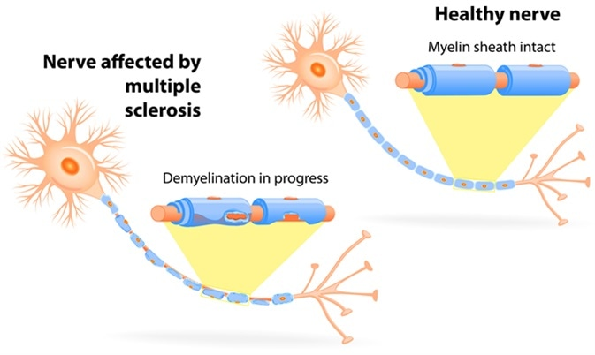
Multiple Sclerosis (MS)
Healthy nerve
Normal myelin
Myelin is destroyed
Causes loss of motor function and vision problems
Modeled in mice
MS nerve
Demyelinating

Slide 3
Model of MS
Blood Brain Barrier
Periphery
Central Nervous System
Differentiation
T Cell
Myelin

Slide 4
Does a CXCR4 deletion on GM-CSF producing T cells prevent them from entering the CNS?
GM-CSF
T Cell
CXCR4

Slide 5

Isolate Pathogenic T Cells
Day 0: Myelin Injection
Day 9: Remove Draining Lymph Nodes

Slide 6
Identify T Cell Subset
Fluorescence Activated Cell Sorting
Identify CXCR4⁺, GM-CSF

Slide 7
Gene Deletion via CRISPR/Cas9
guideRNA: TCGAGAGCATCGTGCACAAG

Slide 8
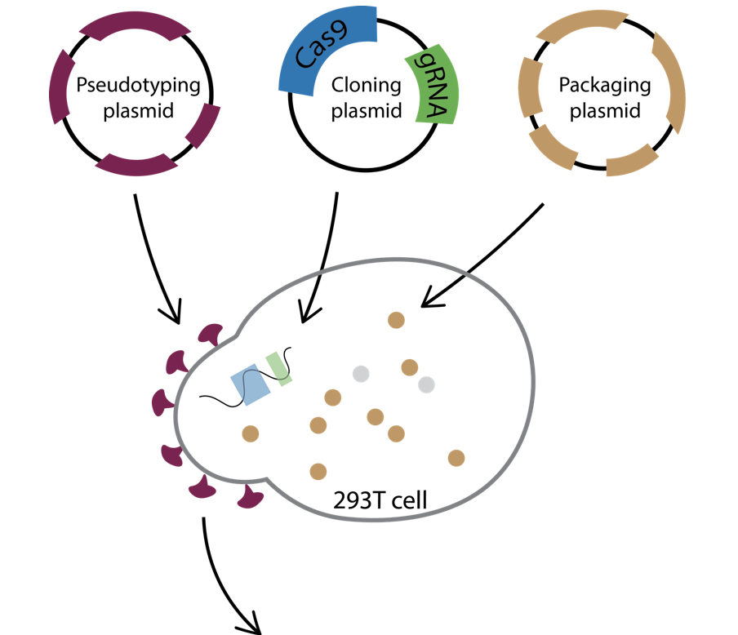
Envelope plasmid
Packaging plasmid

Slide 10
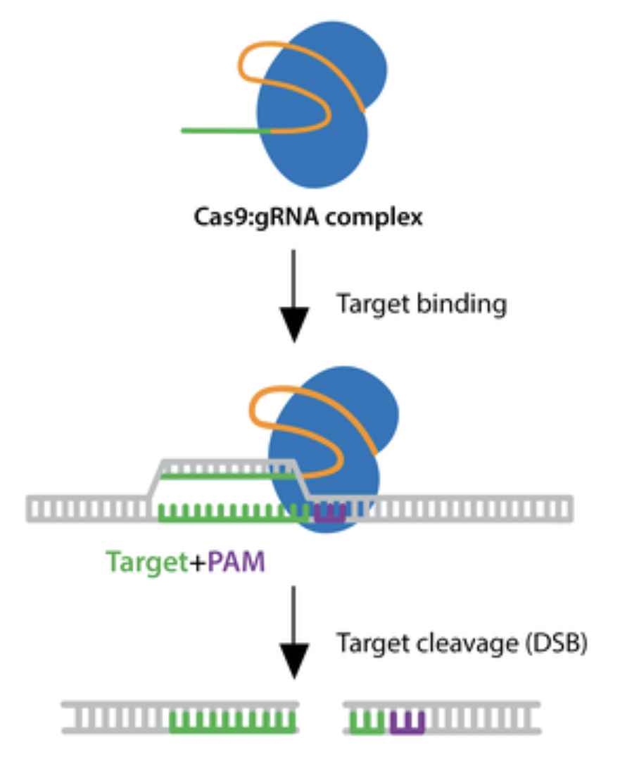
Gene Deletion

Slide 11
Verification Of Gene Deletion and Cell Phenotype
Fluorescence Activated Cell Sorting
Check for GM-CSF and CXCR4⁻

Slide 12
Inject The CXCR4⁻ T Cells
Inject T cells into recipient mice
Disease occurs 6 – 10 days later

Slide 13
Examine CNS For CXCR4⁻ T Cells
Fluorescence Activated Cell Sorting
Check for GM-CSF and CXCR4⁻

Slide 14
Discussion
Results
Expected Results
Alternate Results
Periphery
Central Nervous System
GM-CSF
GM-CSF
CXCR4
CXCR4

Slide 15
References
Who gets MS? (Epidemiology). National Multiple Sclerosis Society. Retrieved Nov. 11, 2019, from https://www.nationalmssociety.org/What-is-MS/Who-Gets-MS
Thomas, L. Optic Neuritis and Multiple Sclerosis. News Medical Life Sciences. Retrieved Dec. 4, 2019, from https://www.news-medical.net/health/Optic-Neuritis-and-Multiple-Sclerosis.aspx
Fletcher, J. M., Lalor, S. J., Sweeney, C. M., Tubridy, N., & Mills, K. H. (2010). T cells in multiple sclerosis and experimental autoimmune encephalomyelitis. Clinical and experimental immunology, 162(1), 1–11. doi:10.1111/j.1365-2249.2010.04143.x
Galli, E., Hartmann, F.J., Schreiner, B… Becher, B. (2019). GM-CSF and CXCR4 define a T helper cell signature in multiple sclerosis. Nat Med 25, 1290–1300 (2019) doi:10.1038/s41591-019-0521-4
Phelan, J. (2016) Generating EAE Mouse Models of Multiple Sclerosis. Taconic Insights. Retrieved Dec. 3, 2019, from https://www.taconic.com/taconic-insights/neuroscience/eae-mouse-models-of-multiple-sclerosis.html
Flow Cytometry Fundamental Principle, How FACS Works. BOSTER Biological Technology. Retrieved Nov 30, 2019, from https://www.bosterbio.com/protocol-and-troubleshooting/flow-cytometry-principle
Improved vectors and genome-wide libraries for CRISPR screening. Sanjana NE, Shalem O, Zhang F. Nat Methods. 2014 Aug;11(8):783-4. doi: 10.1038/nmeth.3047. 10.1038/nmeth.3047 PubMed 25075903 (Addgene plasmid # 52961)
Pellegrini, R. (2016). How to express CRISPR in your target cells. Benchtalk. Retrieved Nov. 26, 2019, from https://www.benchling.com/2016/03/24/how-to-express-crispr-in-your-target-cells/
CRISPR Guide. Addgene. Retrieved Nov. 29, 2019, from https://www.addgene.org/guides/crispr/#plan-experiment
Flow Cytometry Guide. Creative Diagnostics Technology. Retrieved Nov 30, 2019, from https://www.bosterbio.com/protocol-and-troubleshooting/flow-cytometry-principle
Zhang Lab. (n.d). LentiCRISPR lentiviral CRISPR/Cas9 and single guide RNA. Retrieved Dec. 6, 2019 from https://media.addgene.org/cms/files/Zhang_lab_LentiCRISPR_library_protocol.pdf

