Slide 1
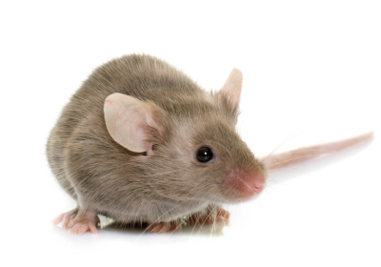
Role of a putative transcription factor Zbtb14 on production of treacle protein in mice
Linda Do, Dr. Rita Shiang

Slide 2
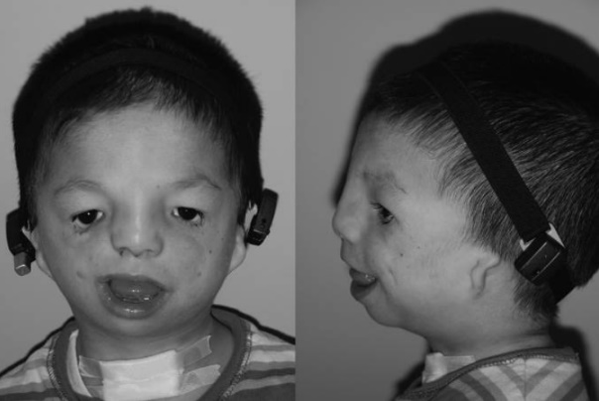
Treacher Collins Syndrome
Figure from Chang and Steinbacher (2012)
Notes:
Treacher Collins Syndrome is a genetic disorder characterized by deformities in the ears, eyes, cheeks, midface, and jaw. The severity of the deformities vary. Some may have trouble breathing, seeing, hearing, and talking. Others may not have trouble at all.
removable bone-assisted hearing aid to help speech and language development prior to definitive implantation after ear reconstruction.

Slide 3
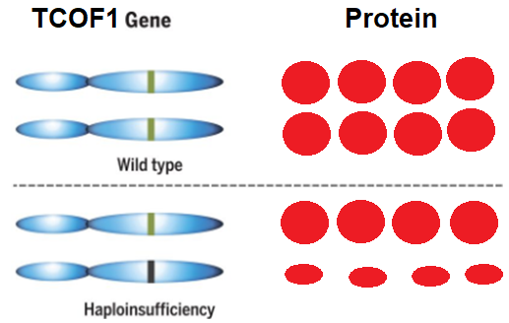
Treacher Collins Syndrome
Figure from Chang and Steinbacher (2012)
Notes:
Several studies have found support for haploinsufficiency as the cause of this syndrome in the TCOF1 gene. Haploinsufficinecy is when a single copy of the wild type allele is insufficient to produce the standard phenotype. For this gene, a nonsense mutation occurred in which resulted in a premature stop codon.

Slide 4
Regulation of Tcof1 expression
Transcription factor binding sites
Are these sites important?
Notes:
Shows and Shiang in 2008 found several putative transciprtion binding factor sites on the TCOF1 promoter which could potentially regulate the expression of this gene.

Slide 5
Regulation of Tcof1 expression
Transcription factor binding sites
Expression
Are these sites important?
Notes:
Inactivating individuals sites and measuring the levels of expression

Slide 6
Regulation of Tcof1 expression
Transcription factor binding sites
Expression
Are these sites important?

Slide 7
Regulation of Tcof1 expression
Transcription factor binding sites
Expression
Are these sites important?

Slide 8
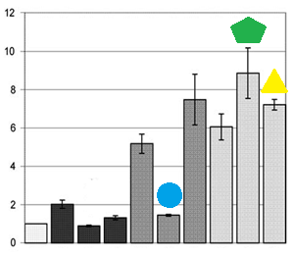
Regulation of Tcof1 expression
Transcription factor binding sites
Expression
Are these sites important?
Figures from Shows and Shiang (2008).

Slide 9
Regulation of Tcof1 expression
Transcription factor binding sites
Is ZBTB14 important?

Slide 10
Regulation of Tcof1 expression
Transcription factor binding sites
Is ZBTB14 important?

Slide 11
Regulation of Tcof1 expression
Transcription factor binding sites
Is ZBTB14 important?

Slide 12
Central question
If the expression of Zbtb14 decreases, will the level of Tcof1 expression increase?

Slide 13
CRISPR Knockout
Knockout Conditional Knockout
Mice figures from The Scientist: Nicoletta Lanese (2019).

Slide 14
CRISPR Knockout
\
Knockout Conditional Knockout
Mice figures from The Scientist: Nicoletta Lanese (2019).
Notes:
In traditional gene knockout, embryonic death from a gene mutation can occur, and this prevents scientists from studying the gene in adults. Some tissues cannot be studied properly in isolation, so the gene must be inactive in a certain tissue while remaining active in others

Slide 15
CRISPR Knockout
\
Knockout Conditional Knockout
Wnt1
Mice figures from The Scientist: Nicoletta Lanese (2019).
Notes:
Wnt1 for neural crest and craniofacial development

Slide 16
CRISPR
CRISPR to insert LoxP sites in Zbtb14 for Cre recombinase

Slide 17
CRISPR

Slide 18
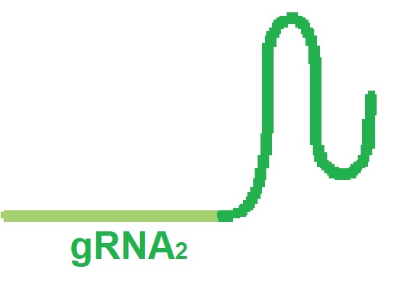
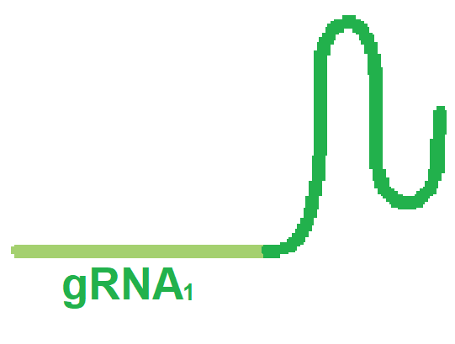
CRISPR
Notes:
Need Cas9 mRNA, 2 gRNAs, and oligo

Slide 19
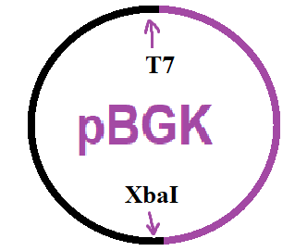
Harms et al. (2014)
Notes:
Get plasmid, linearize it, in vitro transcription

Slide 20
Harms et al. (2014)
Notes:
Find exons and introns
Use benchling to get sequences for gRNAs
sequences were chosen because they had high on-target scores, based how efficient a sgRNA is at guiding Cas9 to the correct spot [19], and high off-target scores, based on the sgRNA’s DNA targeting specificity [20] (Fig. 6 & 7).
19) Doench JG, (2016). Optimized sgRNA design to maximize activity and minimize off-target effects of CRISPR-Cas9. Nature Biotechnology 34(2): 184–191. DOI: 10.1038/nbt.3437
20) Hsu PD, (2013) DNA targeting specificity of RNA-guided Cas9 nucleases. Nature Biotechnology 31(9): 827–832. DOI: 10.1038/nbt.2647

Slide 21
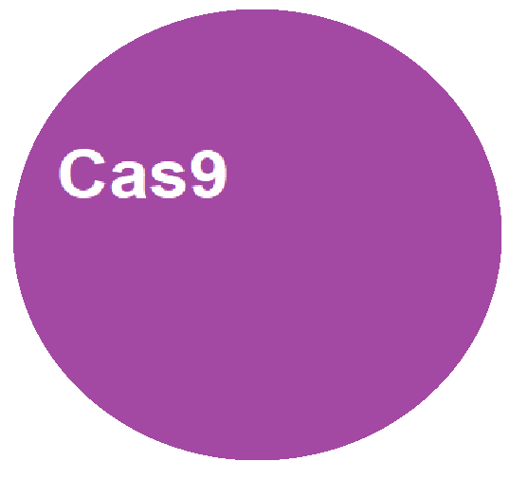
CRISPR
Notes:
Cas9 protein

Slide 22
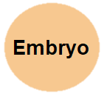
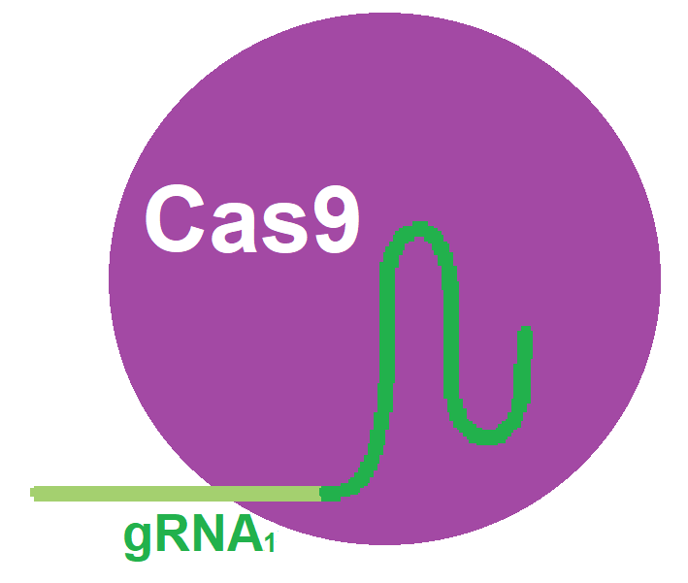
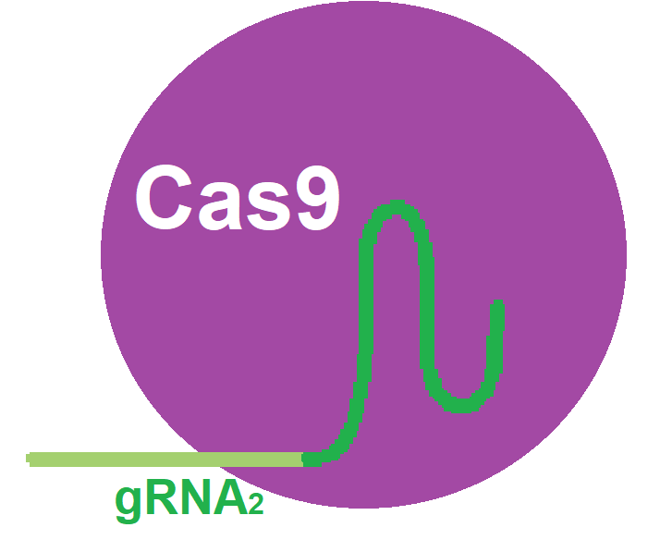
CRISPR
Notes:
Cas9 binds to gRNAs

Slide 23
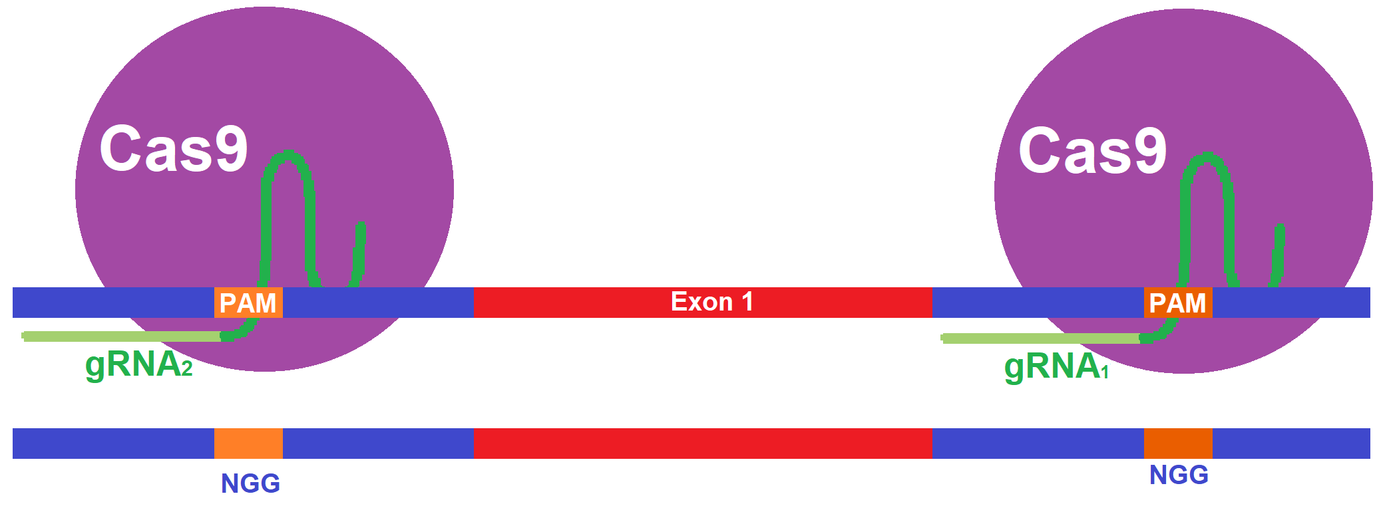
CRISPR
Notes:
Hybridize to target sequence in genome

Slide 24
CRISPR
Homology directed repair (HDR)
Notes:
Homology directed repair is homology recombinase

Slide 25
Repeat CRISPR for rest of embryos
Notes:
Repeat for each embryo and transplant into mothers

Slide 26
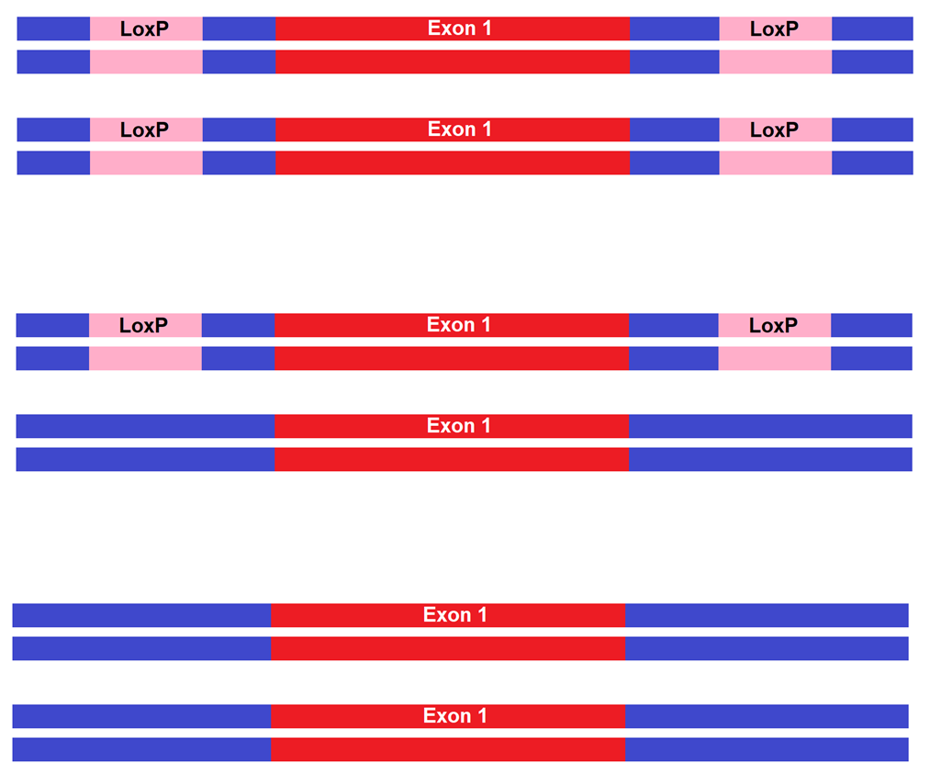
Notes:
Some will have loxP sites on both chromosomes, on 1, or none

Slide 27
PCR
Notes:
PCR will produce different lengths where sequences with loxP sites will be longer than the sequences without

Slide 28
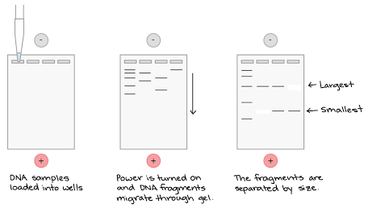
PCR
Gel Electrophoresis
Notes:
Longer strands travel slower and we want to use the mouse with loxP on both chromosomes

Slide 29
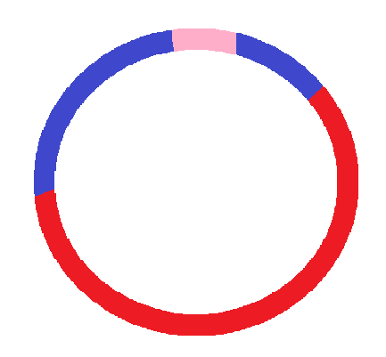
Knockout
Notes:
use the Cre recombinase protein to knockout the exon. Cre will bind to the loxP sites and form a dimer to induce recombination and result in a knockout exon
How will we get Cre into the mouse?

Slide 30
Cross for Cre
Zbtb14^{loxP/loxP} X Wnt1^{Cre/+} Zbtb14^{loxP/+,Cre/+} X Zbtb14^{loxP/loxP, +/+}
 | loxP +
+ Cre | loxP/+ Cre/+
+ + | loxP/+ +/+
50% Zbtb14^{loxP/+, Cre/+}
50% Zbtb14^{loxP/+, +/+}
Notes:
We cross it to get a mouse with a loxP sites on one chromosome and Cre expressing.

Slide 31
Cross for Cre
Zbtb14^{loxP/loxP} X Wnt1^{Cre/+} Zbtb14^{loxP/+,Cre/+} X Zbtb14^{loxP/loxP, +/+}
 | loxP +
+ Cre | loxP/+ Cre/+
+ + | loxP/+ +/+
 | loxP Cre | loxP + | + Cre | + +
loxP + | loxP/loxP Cre/+ | loxP/loxP +/+ | +/loxP Cre/+ | +/LoxP +/+
50% Zbtb14^{+/+} | normal production of Zbtb14
25% Zbtb14^{+/-} | half Zbtb14 production
25% Zbtb14^{-/-} | no Zbtb14 production
50% Zbtb14^{loxP/+, Cre/+}
50% Zbtb14^{loxP/+, +/+}
Notes:
Then we cross this mouse with the same founder mouse to get offspring will different expressions of Zbtb14.

Slide 32
Whole mount in situ hybridization
Tcof1
Making riboprobes
Figure from Millipore Sigma: DIG Labeling Methods

Slide 33
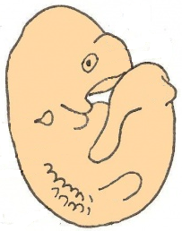
Whole mount in situ hybridization
Figure from Mouse Genomics Informatics
Formaldehyde
Cross link proteins
Proteinase K
Poke hole in cell membrane
50% Zbtb14^{+/+}
25% Zbtb14^{+/-}
25% Zbtb14^{-/-}
Riboprobes and antibody
enter cells
Add 5-bromo-4-chloro-3-indolyl phosphate (BCIP) and nitroblue tetrazolium (NBT)
Notes:
Wherever tcof1 is expressed is purple

Slide 34
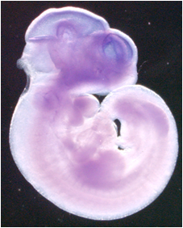
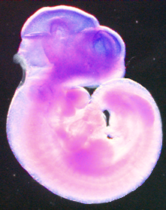
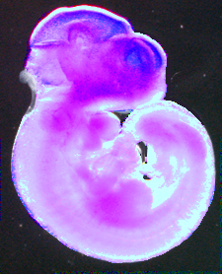
Possible Results and Discussion
Zbtb14^{+/+}
^{Normal Tcof1 expression}
Zbtb14^{+/-}
^{More Tcof1 expression}
Zbtb14^{-/-}
^{Even more Tcof1 expression}

Slide 35
References
Dixon MJ, Dixon J, Raskova D, Le Beau MM, Williamson R, Kinger K, Landes GM. (1992) Genetic and physical mapping of the Treacher Collins syndrome locus: refinement of the localization to chromosome 5q32-33.2, Human Molecular Genetics 1(4): 249–253 DOI: 10.1093/hmg/1.4.249
Sakai D, Trainor PA. (2009). Treacher Collins syndrome: unmasking the role of Tcof1/treacle. The international journal of biochemistry & cell biology, 41(6), 1229–1232. DOI:10.1016/j.biocel.2008.10.026
Chang CC, Steinbacher DM. (2012). Treacher Collins Syndrome. Seminars in Plastic Surgery 26(2): 83-90. DOI: 10.1055/s-0032-1320066
Sanchez E, Laplace-Builhé B, Mau-Them FT, Richard E, Goldenberg A, Toler TL, Guignard T, Gatinois V, Vincent M, Blanchet C, Boland A, Thérèse M, Deleuze J, Olaso R, Nephi W, Lüdecke H, Verheij J, Moreau-Lenoir F, Denoyelle F, Riviere J, Laplanche J, Willing M, Captier G, Apparailly F, Wieczorek D, Collet C, Djouad F, Genevieve D. (2019) POLR1B and neural crest cell anomalies in Treacher Collins syndrome type 4. Genetics in Medicine: 1-10 DOI:10.1038/s41436-019-0669-9
Dixon MJ, Dixon J, Raskova D, Le Beau MM, Williamson R, Klinger R, Landes GM. (1992). Genetic and physical mapping of the Treacher Collins syndrome locus: refinement of the localization to chromosome 5q32-33.2. Human Molecular Genetics 1(4): 249-253. DOI: 10.1093/hmg/1.4.249
Isaac C, Marsh KL, Paznekas WA, Dixon J, Dixon MJ, Jabs EW, Meier UT. (2000). Characterization of the Nucleolar Gene Product, Treacle, in Treacher Collins Syndrome. Molecular Biology of the Cell 11(9): 3060-3071. DOI: 10.1091/mbc.11.9.3061
Dixon J, Brakebusch C, Fässler R, Dixon MJ. (2000) Increased levels of apoptosis in the prefusion neural folds underlie the craniofacial disorder, Treacher Collins syndrome. Human Molecular Genetics 9(10):1473-80. DOI: 10.1093/hmg/9.10.1473
Dixon J, Brakebusch C, Fassler R, Dixon MJ. (2000). Increased levels of apoptosis in the prefusion neural folds underlie the craniofacial disorder, Treacher Collins syndrome. Human Molecular Genetics 9(10): 1473-1480. DOI: 10.1093/hmg/9.10.1473
Hayano T, Yanagida M, Yamauchi Y, Shinkawa T, Isobe T, Takahashi NJ. (2003) Proteomic analysis of human Nop56p-associated pre-ribosomal ribonucleoprotein complexes. Possible link between Nop56p and the nucleolar protein treacle responsible for Treacher Collins syndrome. Biological Chemistry 278(36):34309-19. DOI: 10.1074/jbc.M304304200
Valdez BC, Henning D, So RB, Dixon J, Dixon MJ. (2004). The Treacher Collins syndrome (TCOF1) gene product is involved in ribosomal DNA gene transcription by interacting with upstream binding factor. Proceedings of the National Academy of Sciences of the United States of America 101(29): 10709-10714. DOI: 10.1073/pnas.0402492101
Shows KH, Shiang R (2008). Regulation of the mouse Treacher Collins syndrome homolog (Tcof1) promoter through differential repression of constitutive expression. DNA and Cell Biology 27:589-600. DOI: 10.1089/dna.2008.0766
Kuhn R, Schwenk F. (2003). Conditional Knockout Mice. Transgenic Mouse 209: 159-185. DOI: 10.1385/1-59259-340-2:159
Chen L, Ye Y, Dai H, Zhang H, Zhang X, Wu Q, Zhu Z, Spalinskas R, Ren W, and Zhang W. (2018.) User-Friendly Genetic Conditional Knockout Strategies by CRISPR/Cas9. Stem Cells International 2018: 1-10. DOI: 10.1155/2018/9576959
Hall B, Limaye A, Kulkarni AB. (2009). Overview: Generation of Gene Knockout Mice. Current Protocols Cell Biology 44 (1): 19.12.1-19.12.17. DOI: 10.1002/0471143030.cb1912s44
Lewis AE, Vasudevan HN, O’Neill AK, Soriano P, Bush JO. (2013). The widely used Wnt1-Cre transgene causes developmental phenotypes by ectopic activation of Wnt signaling. Development Biology 379(2): 229-234. DOI: 10.1016/j.ydbio.2013.04.026.
Bi PP, McAnally JR, Shelton JM, Sanchez-Ortiz E, Bassel-Duby R, Olson EN (2018). Fusogenic micropeptide Myomixer is essential for satellite cell fusion and muscle regeneration. Proceedings Of The National Academy Of Sciences Of The United States Of America 115: 3864-3869. DOI: 10.1073/pnas.1800052115
Tan DP, Nonaka K, Nuckolls GH, Liu YH, Maxson RE, Salvkin HC, Shum L. (2002). YY1 activates Msx2 gene independent of bone morphogenetic protein signaling. Nucleic Acids Research 30 (5): 1213-1223. DOI: 10.1093/nar/30.5.1213
Percival CJ, Green R, Marcucio R, Hallgrimsson B. (2014). Surface landmark quantification of embryonic mouse craniofacial morphogenesis. BMC Developmental Biology 14(31): 1-12. DOI: 10.1186/1471-213X-14-31
Kwan K (2002). Conditional Alleles in Mice: Practical Considerations for Tissue-Speciﬁc Knockouts. Genesis 32: 49-62. DOI: 10.1002/gene.10068

