Slide 1
Comparative Docking Study of Stilbene Derivatives in the Colchicine site of β-Tubulin

Slide 2
Effectiveness of Current Treatments
Effectiveness does have large amounts of variation dependent on cancer type.
Non small cell lung cancer has 5 year survival rates of 16%³
Radiation therapy alone has a median survival rate of 9 to 13 months.
The addition of current chemotherapies increases median rate to 13.8 months
Some patients have an even lower survival rate due to high expressions of ERCC1 a repair protein that has been show to lower the effectiveness of Chemotherapies that target DNA

Slide 3
Microtubules
Provide structure to cells
Participate in anaphase by pulling the miotic spindles to poles
Made of a protein called Tubulin
By Kelvinsong - Own work, CC BY 3.0, https://commons.wikimedia.org/w/index.php?curid=23099175

Slide 4
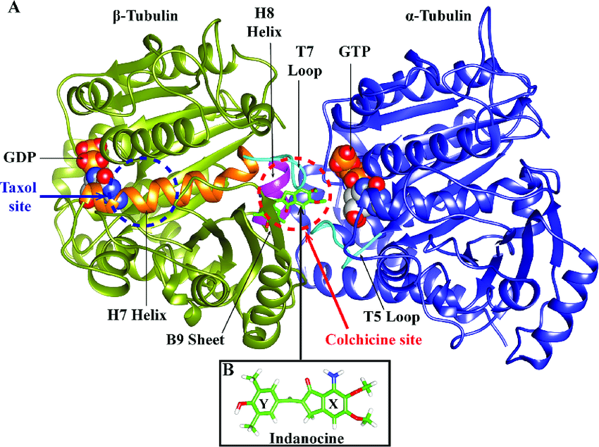
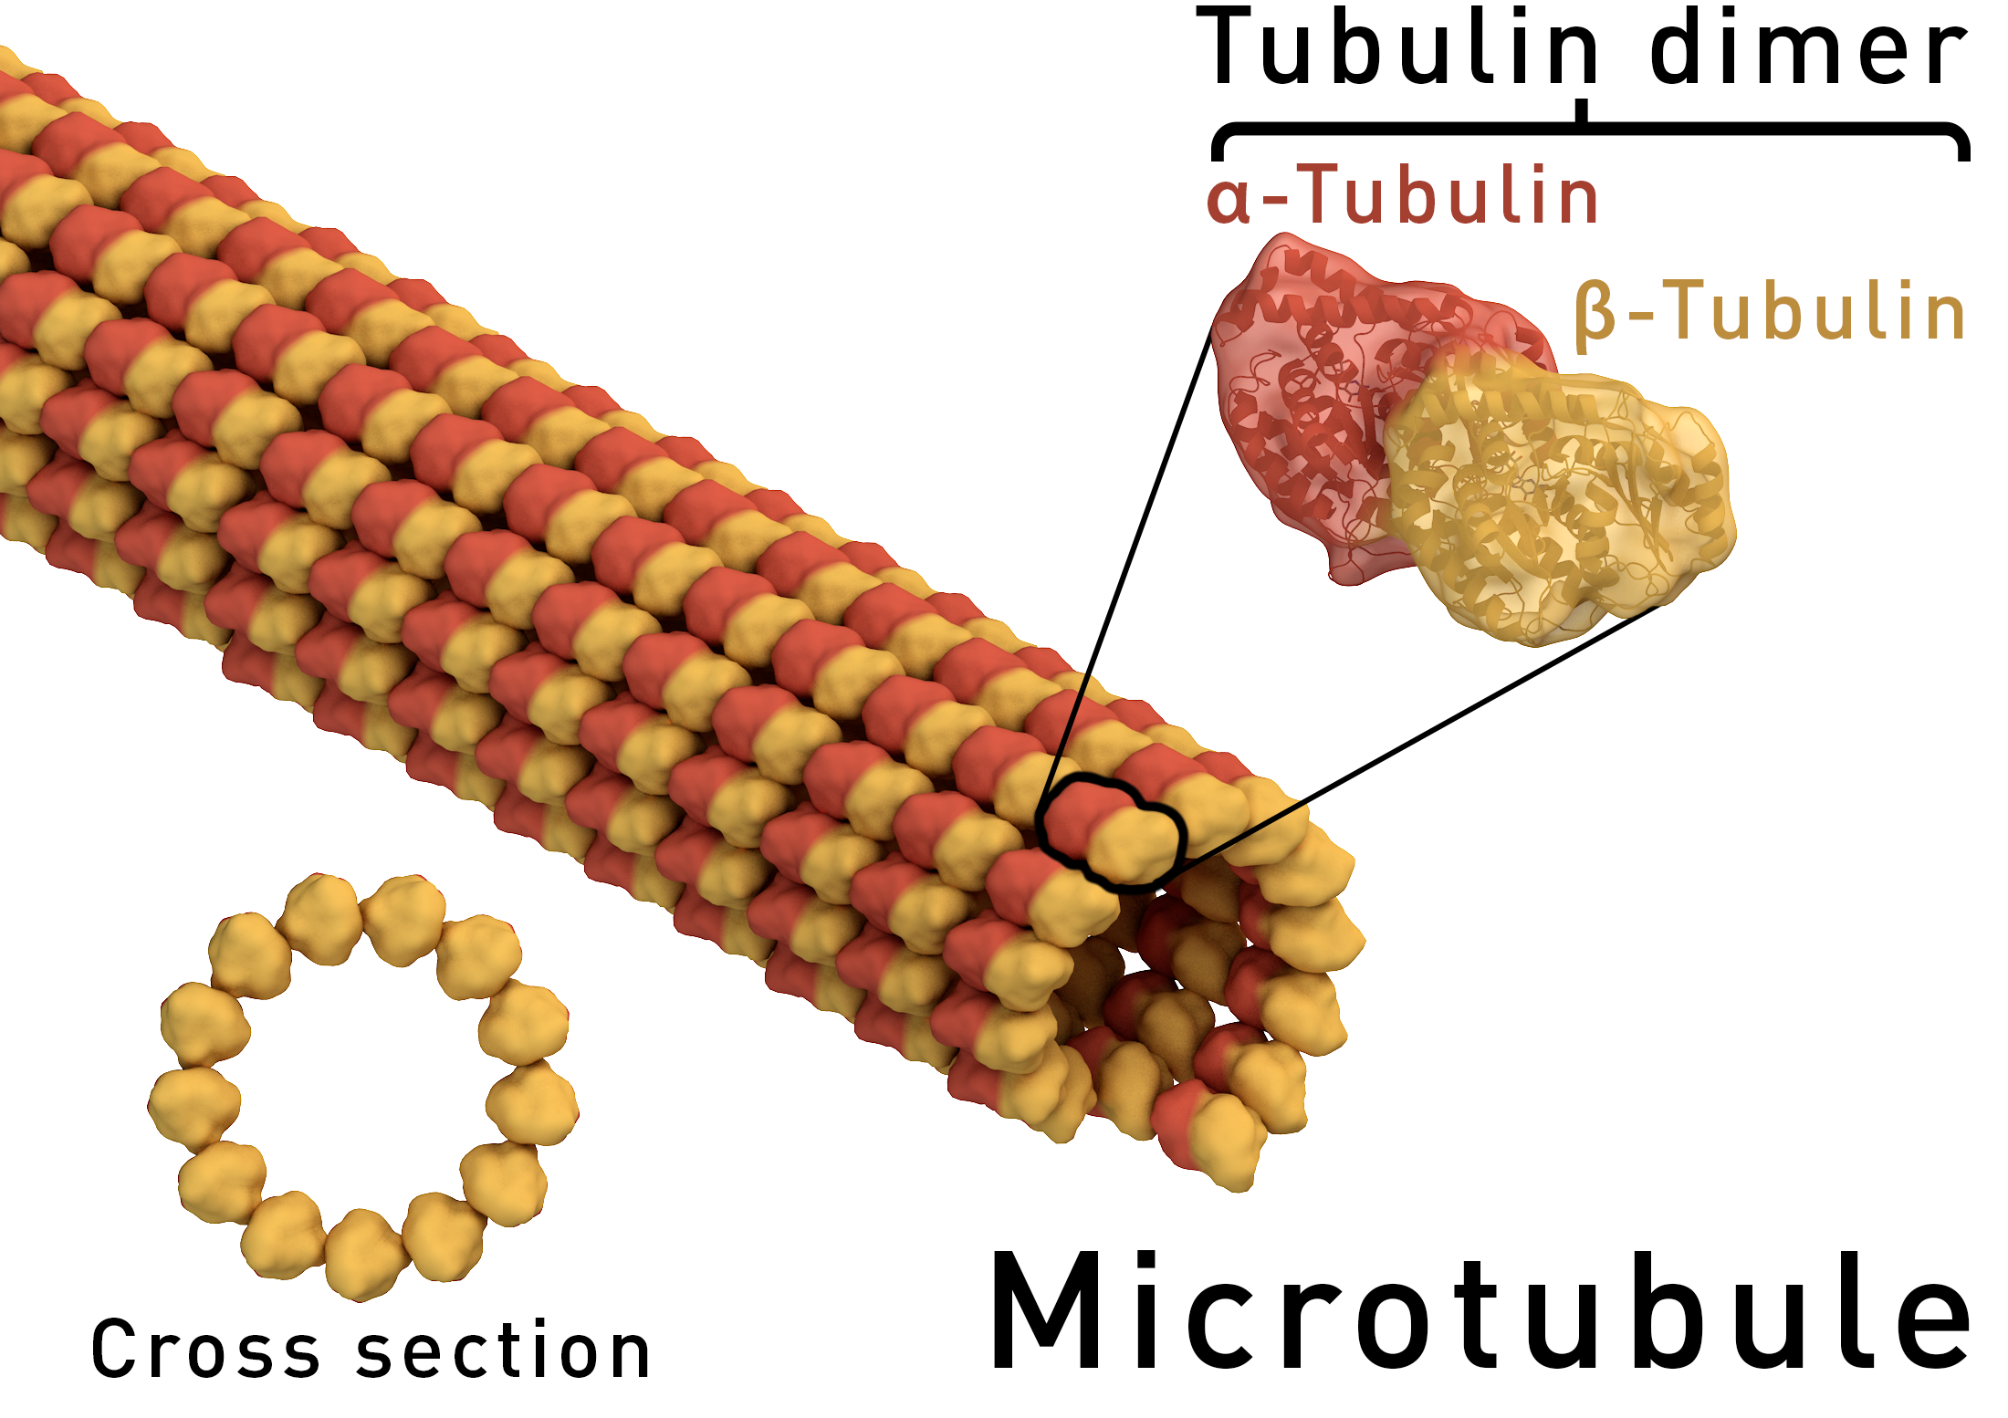
Tubulin
Building block of microtubules
Dimer consists of two similar subunits called alpha and beta tubulin
Contains multiple active sites known to effect the formation of microtubules
Depolymerization and overstabilization can prevent
By Thomas Splettstoesser (www.scistyle.com) - Own work (rendered with Maxon Cinema 4D), CC BY-SA 4.0, https://commons.wikimedia.org/w/index.php?curid=41014850

Slide 5
Colchicine Site
Can be interacted with even if tubulin is in its dimer
Promotes unwinding of already assembled microtubules
Prevents formation of microtubules

Slide 6
Computational Docking
Gives you the ability to test variations rapidly
Allows the modeling of the best interaction possible
Total control of interaction and its environment
Relatively fast and low cost

Slide 7
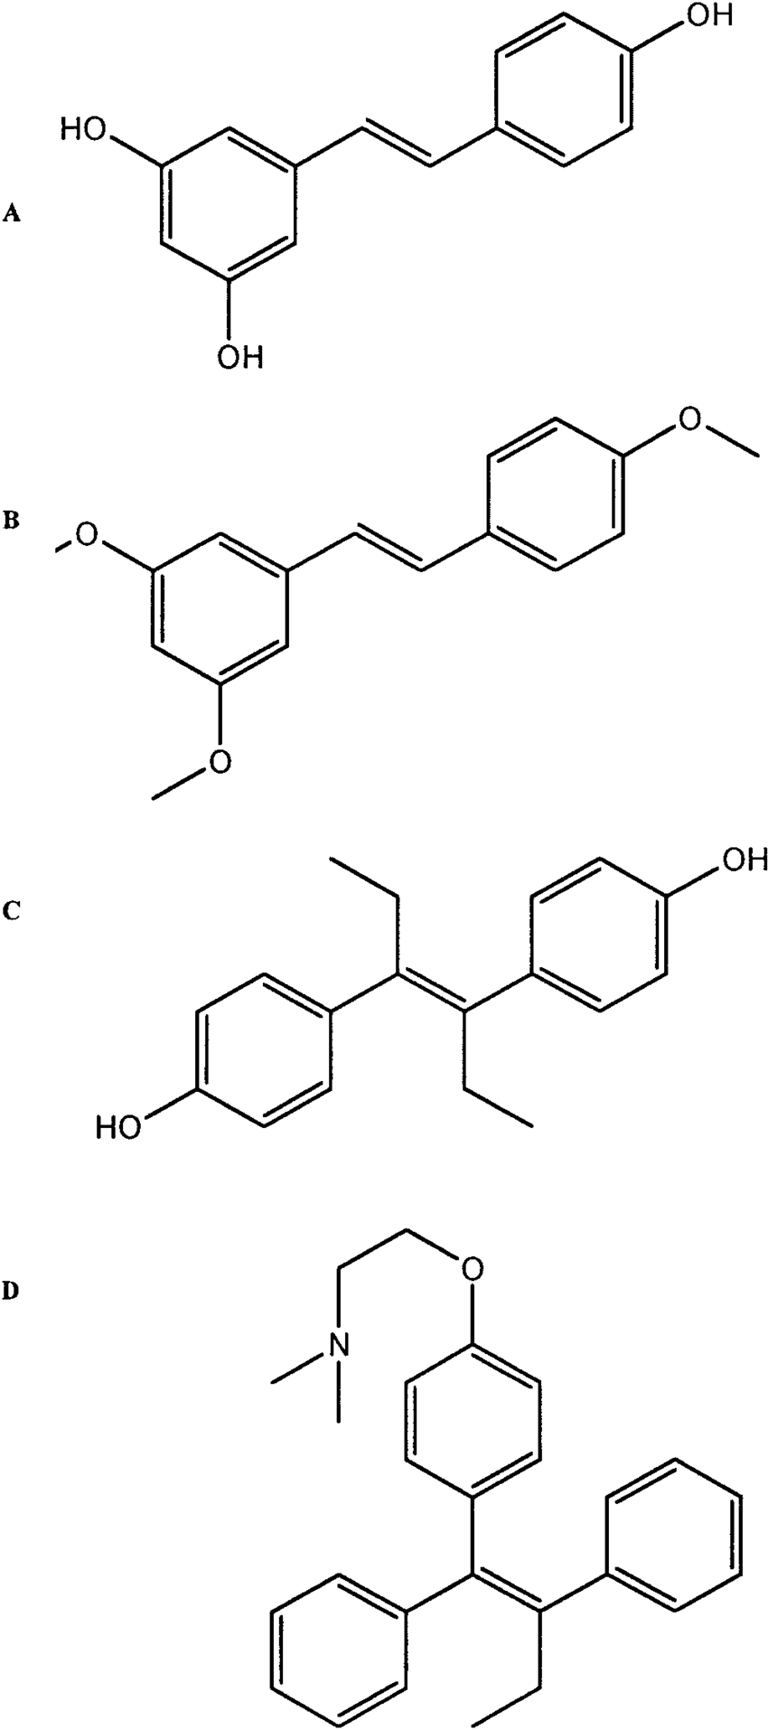
Stilbene
Proven to have interactions in the colchicine site
Has not been studied heavily
Large amounts of possible side chain variations

Slide 8
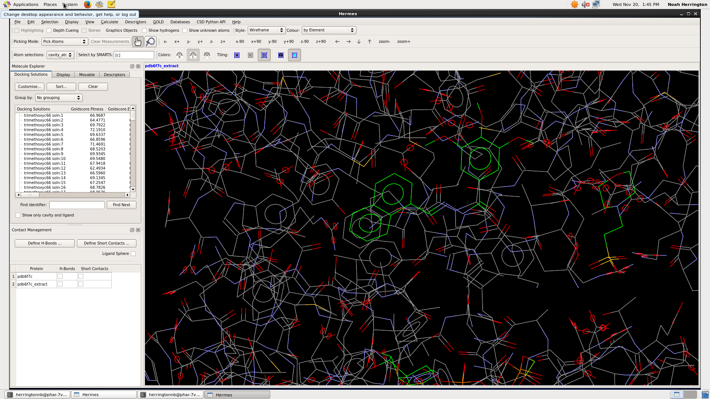
GOLD
2.3 angstrom αβ-tubulin complexed with colchicine with hydrogen atoms added and optimized.
Starting position determined by native ligand
1000 runs per ligand without early termination
Accuracy established by redocking native ligand

Slide 9
Hint scoring
B = ∑∑ bij = ∑∑ (aiSiajSjRijTij + rij)

Slide 10
HINT results

Slide 11
Things to consider
Interaction varies largely based on isotope of tubulin.
Positive results could be unrealistic to synthesize.
Experiment does not consider toxicity.
physical trials will be needed to prove computational results.
Carriers would need to be designed if medical use is the target.

Slide 12
References
1. Centers for Disease Control and Prevention. (2017). Deaths: Leading Causes for 2017. Retrieved from cdc.gov/nchs/data/nvsr/nvsr68/nvsr68_06-508.pdf
2. American cancer society. (2019). Cancer Treatment & survivorship Facts & Figures 2019-202. Retrieved from https://www.cancer.org/content/dam/cancer-org/research/cancer-facts-and-statistics/cancer-treatment-and-survivorship-facts-and-figures/cancer-treatment-and-survivorship-facts-and-figures-2019-2021.pdf
3. Huang CY, Ju DT, Chang CF, Muralidhar Reddy P, Velmurugan BK. A review on the effects of current chemotherapy drugs and natural agents in treating non-small cell lung cancer. Biomedicine (Taipei). 2017;7(4):23. doi:10.1051/bmdcn/2017070423
4. Hagiwara, H.; Sunada, Y. (2004). "Mechanism of taxane neurotoxicity". Breast Cancer (Tokyo, Japan). 11 (1): 82–85. PMID 14718798
5. Majcher U, Klejborowska G, Moshari M, et al. Antiproliferative Activity and Molecular Docking of Novel Double-Modified Colchicine Derivatives. Cells. 2018;7(11):192. Published 2018 Nov 1. doi:10.3390/cells7110192
6. Lu Y, Chen J, Xiao M, Li W, Miller DD. An overview of tubulin inhibitors that interact with the colchicine binding site. Pharm Res. 2012;29(11):2943–2971. doi:10.1007/s11095-012-0828-z
7. Prota, A.E., Danel, F., Bachmann, F., Bargsten, K., Buey, R.M., Pohlmann, J., Reinelt, S., Lane, H., Steinmetz, M.O. The Novel Microtubule-Destabilizing Drug BAL27862 Binds to the Colchicine Site of Tubulin with Distinct Effects on Microtubule Organization. (2014) J.Mol.Biol. 426: 1848-1860 DOI: 10.1016/j.jmb.2014.02.005
8. Tripathi, Ashutosh, et al. "Hydropathic analysis and biological evaluation of stilbene derivatives as colchicine site microtubule inhibitors with anti-leukemic activity." Journal of enzyme inhibition and medicinal chemistry 24.6 (2009): 1237-1244.
9. Pagadala NS, Syed K, Tuszynski J. Software for molecular docking: a review. Biophys Rev. 2017;9(2):91–102. doi:10.1007/s12551-016-0247-1
10. Nguyen TL, McGrath C, Hermone AR, Burnett JC, Zaharevitz DW, Day BW, Wipf P, Hamel E, Gussio R. A common pharmacophore for a diverse set of colchicine site inhibitors using a structure-based approach. J Med Chem 2005;48:6107–16.
11. Majcher U, Klejborowska G, Moshari M, et al. Antiproliferative Activity and Molecular Docking of Novel Double-Modified Colchicine Derivatives. Cells. 2018;7(11):192. Published 2018 Nov 1. doi:10.3390/cells7110192
12. Lee, Sang Kook, et al. "Synthesis and evaluation of cytotoxicity of stilbene analogues." Archives of pharmacal research 26.4 (2003): 253-257.
13. Ahmed, Aqeel, et al. "Colchicine glycorandomization influences cytotoxicity and mechanism of action." Journal of the American Chemical Society 128.44 (2006): 14224-14225.
14. Juliano, R. L. "The role of drug delivery systems in cancer chemotherapy." Progress in clinical and biological research 9 (1976): 21-32.
15. Yakhini Z, Jurisica I. Cancer computational biology. BMC Bioinformatics. 2011;12:120. Published 2011 Apr 26. doi:10.1186/1471-2105-12-120

