Slide 1
Regulating CRP protein levels with the use of sRNA
Jada Wilson

Slide 2
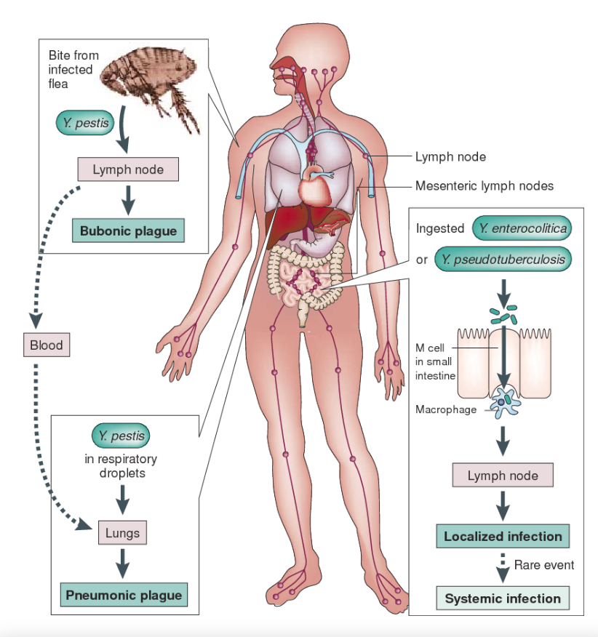
Why regulate CPR?
Bubonic plague
Yersinia pestis

Slide 3
Hfq regulation

Slide 4
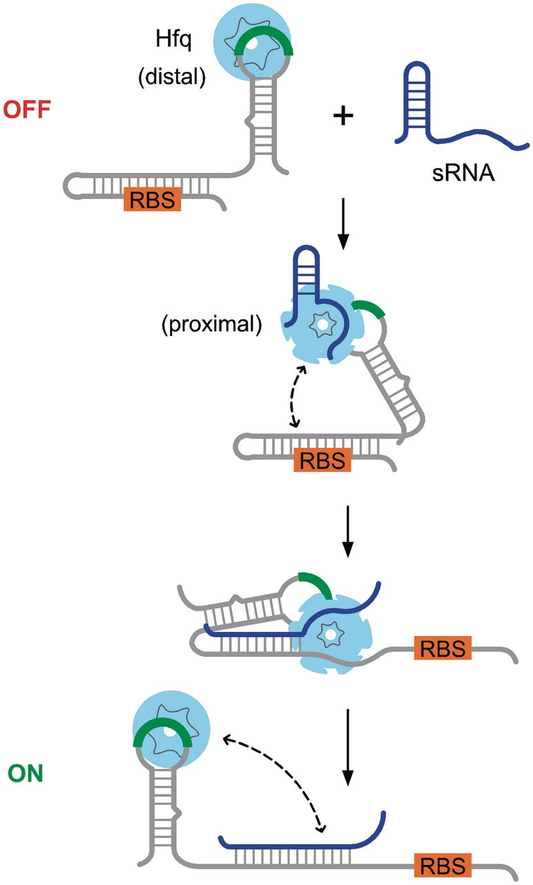
sRNA assisted regulation

Slide 5
Hfq selectivity
- The binding site for the sRNA to bind Hfq has no affect on the binding of sRNA to target region

Slide 6
Experiments
Microarray
Immunoprecipitations
Northern blot

Slide 7
Microarrays

Slide 8
Immunoprecipitations

Slide 9
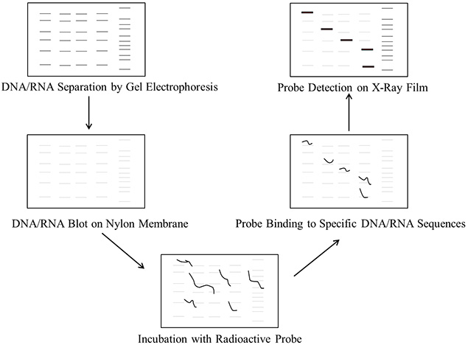
Northern Blot

