Slide 1
Disruption of Angiopoietin-1 and α_{v}β₃ Integrin Interaction in Tie1, Tie2, Ang-1 and α_{v}β₃ Integrin complexes
BY: KYLE VO
MENTOR: WILLIAM BARTON, PHD

Slide 2
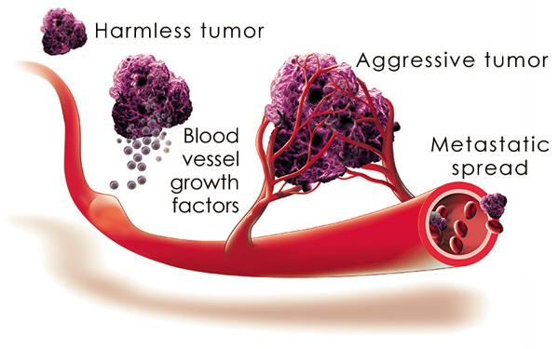
Cancer development

Slide 3
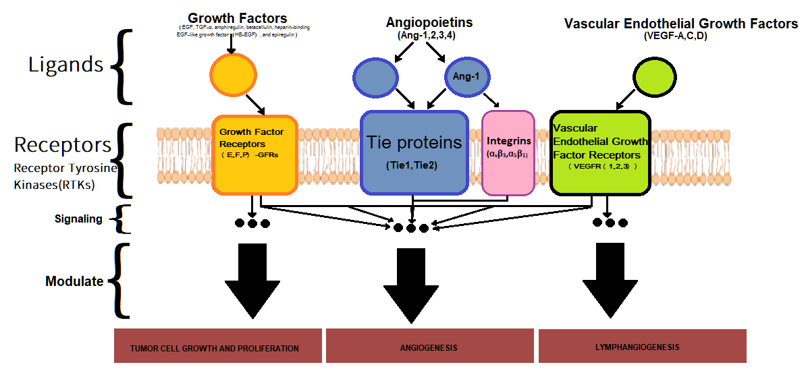
Schematic Pathway & Available Drug
Drugs that are broad-spectrum inhibitors of RTKs (including Tie2): Cabozantinib, Lenalidomide, Regorafenib…
Inhibiting Angiopoietin 1 & 2 interaction with their receptor Tie2: Trebananib.
More drug target, compound medicine?
How about Integrin role in Tie2 activation?

Slide 4
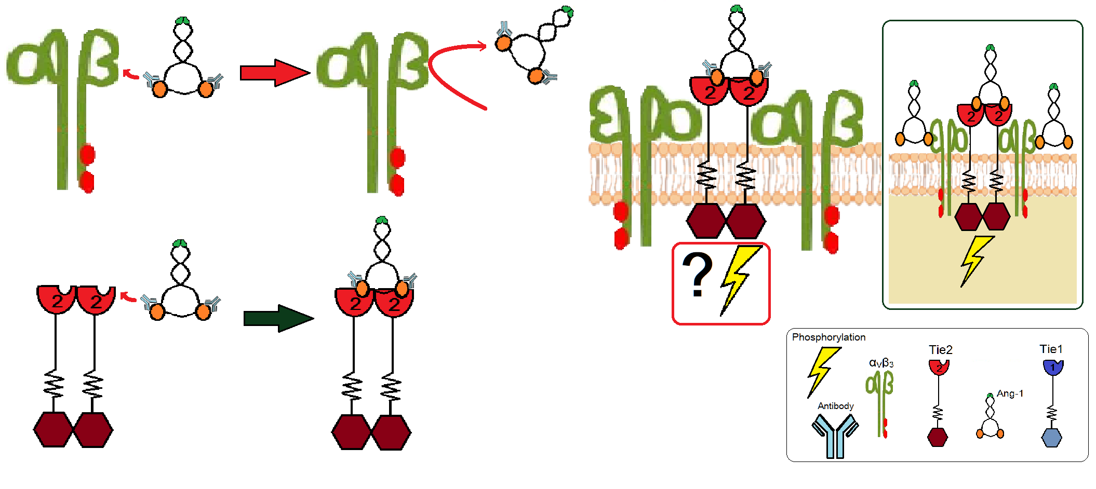
Schematic diagram of experiment

Slide 5
Making Antibodies against Ang-1

Slide 6
StepI:
Confirming Antibody – Ang-1 Binding

Slide 7
StepII:
Confirming Ang1 Binding with Tie2 in presence of Antibody

Slide 8
StepIII:
Confirming Antibody – Ang1 Non-Binding with αVß3 integrin

Slide 9
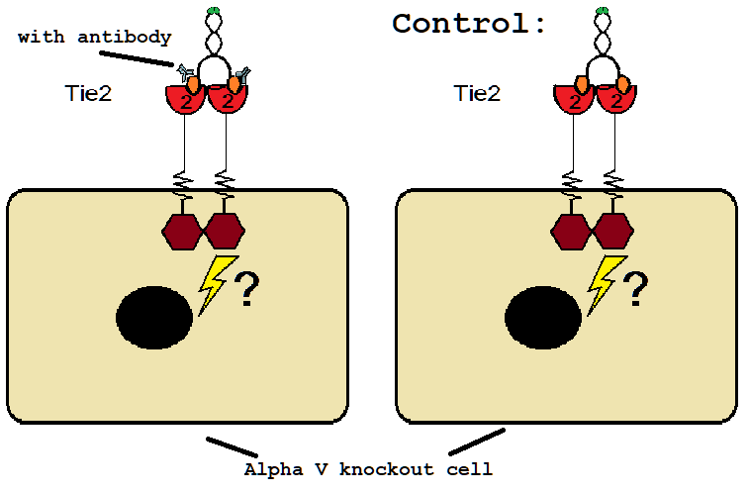
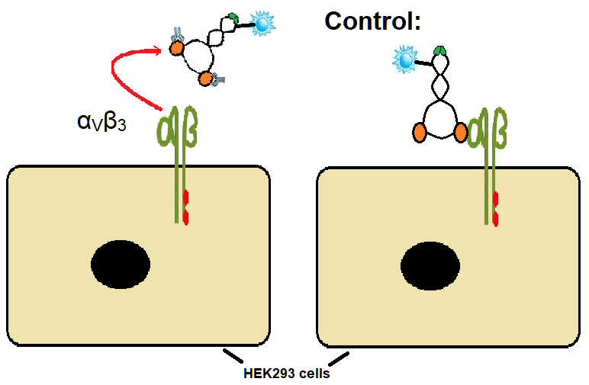
(Optional) In vivo: Association between Tie2 – Ang-1 and α_{V}ß₃ - Ang-1 with presence of antibodies.

Slide 10
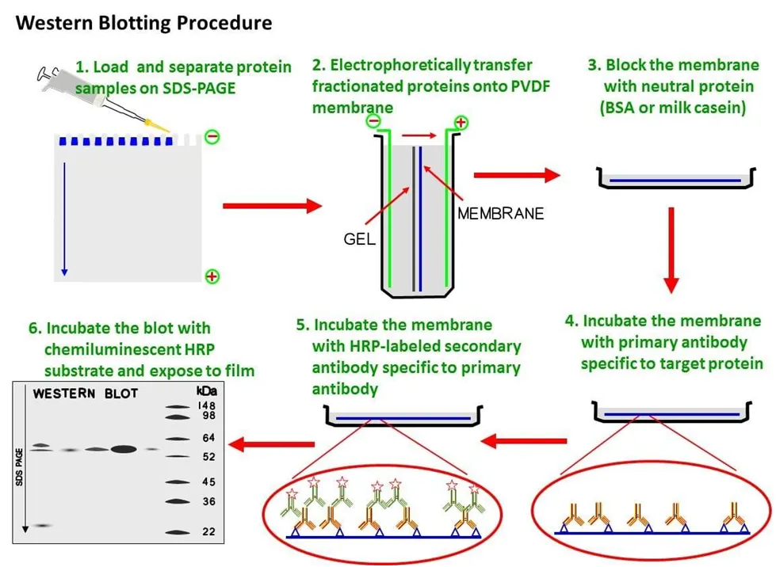
Measure Tie2 activity in presence of Ang-1 antibody and Integrin α_{V}ß₃
Control columns:
Column 1: Tie2
Column 2: α_{V}ß₃
Column 3: α_{V}ß₃ + Tie2
Column 4: Ang-1
Column 5: Ang-1 + α_{V}ß₃
Column 6: Ang-1 + Tie2
Column 7: α_{V}ß₃ +Tie2 with Ang-1
Test column:
Column 8: Integrin+Tie2 with Ang-1
and the antibody selected from step V-VI (or step III-IV )
Primary antibody:
Anti-phosphotyrosine immunoprecipitates

