Slide 1
Assessing the relative functions of two putative collagenase genes extracted from a clinically-relevant vaginal microbe
Nana Afia Twumasi-Ankrah, Jennifer Fettweis, PhD
Microbiology & Immunology
Molecular Biology Through Discovery
Fall 2019
Notes:
Hello everyone, my proposal will focus on “Assessing the relative functions of two putative collagenase genes extracted from a clinically-relevant vaginal microbe.

Slide 2
Discovery of novel vaginal microbe linked with Trichomoniasis.
Candidatus Mycoplasma girerdii
Closely associated with Trichomonas vaginalis (causative agent of Trichomoniasis).
First characterized in Fettweis et. al (2014) paper¹.
Fettweis et. al (2014). PLoS One. 9(10): e110943. Published online 2014 Oct 22. doi: 0.1371/journal.pone.0110943
Notes:
In 2014, my mentor, Dr. Jen Fettweis and a group of her colleagues published a paper which focused on characterizing the genomic attributes of a novel vaginal microbe. This microbe, which was named Ca. Mycoplasma gerirdii, is of interest to both clinicians and researchers due to its incredibly tight association with Trichomoniasis.

Slide 3
T. vaginalis and Ca. Mycoplasma girerdii
Clinically-relevant microbe
It is interesting.
Unresolved pathogenicity
What does it do?
Notes:
The close interaction between T. vaginalis and M. gerirdii functions as both a blessing and a curse because on one hand we can be confident that we are dealing with a clinically-relevant bacteria, while on the other hand it is a lot harder to obtain a clear understanding of M. gerardii’s individual clinical impact because it is so heavily overshadowed by T. vaginalis. So to work around this problem we decided to start focusing our attention on identifying potential virulence factors.
My proposal focuses on verifying the functions of two putative collagenase genes. These are genes that are found to bear some resemblance to known collagenase ezymes, however their functions have not been verified experimentally.

Slide 4
Proposal Question
Do the putative collagenase genes present in Mycoplasma girerdii encode enzymes capable of catalyzing the breakdown of collagen?
Notes:
It was with this thought that I decided to pursue the following research question.

Slide 5
Experimental Design
Genetic Synthesis
Genetic cloning
Collagenase Activity Assay
Notes:
My project comes in three stages. Each stage will be completed twice for each gene.

Slide 6
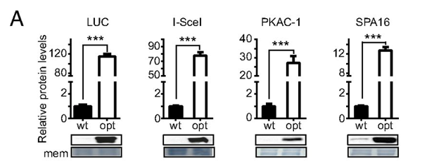
Stage 1: Why Genetic Synthesis?
Minimize translational errors
Ca. Mycoplasma girerdii utilizes a slightly different genetic code.
Codon Optimization
Maximize gene expression during cloning.
Relatively easy process.
Changes are made computationally.
Synthesized by company
Adapted from Zhou et. al (2016)².
Zhou, Z., et al. 2016. Proceedings of the National Academy of Sciences of the United States of America. Published online before print September 26, 2016, doi: 10.1073/pnas.1606724113

Slide 7
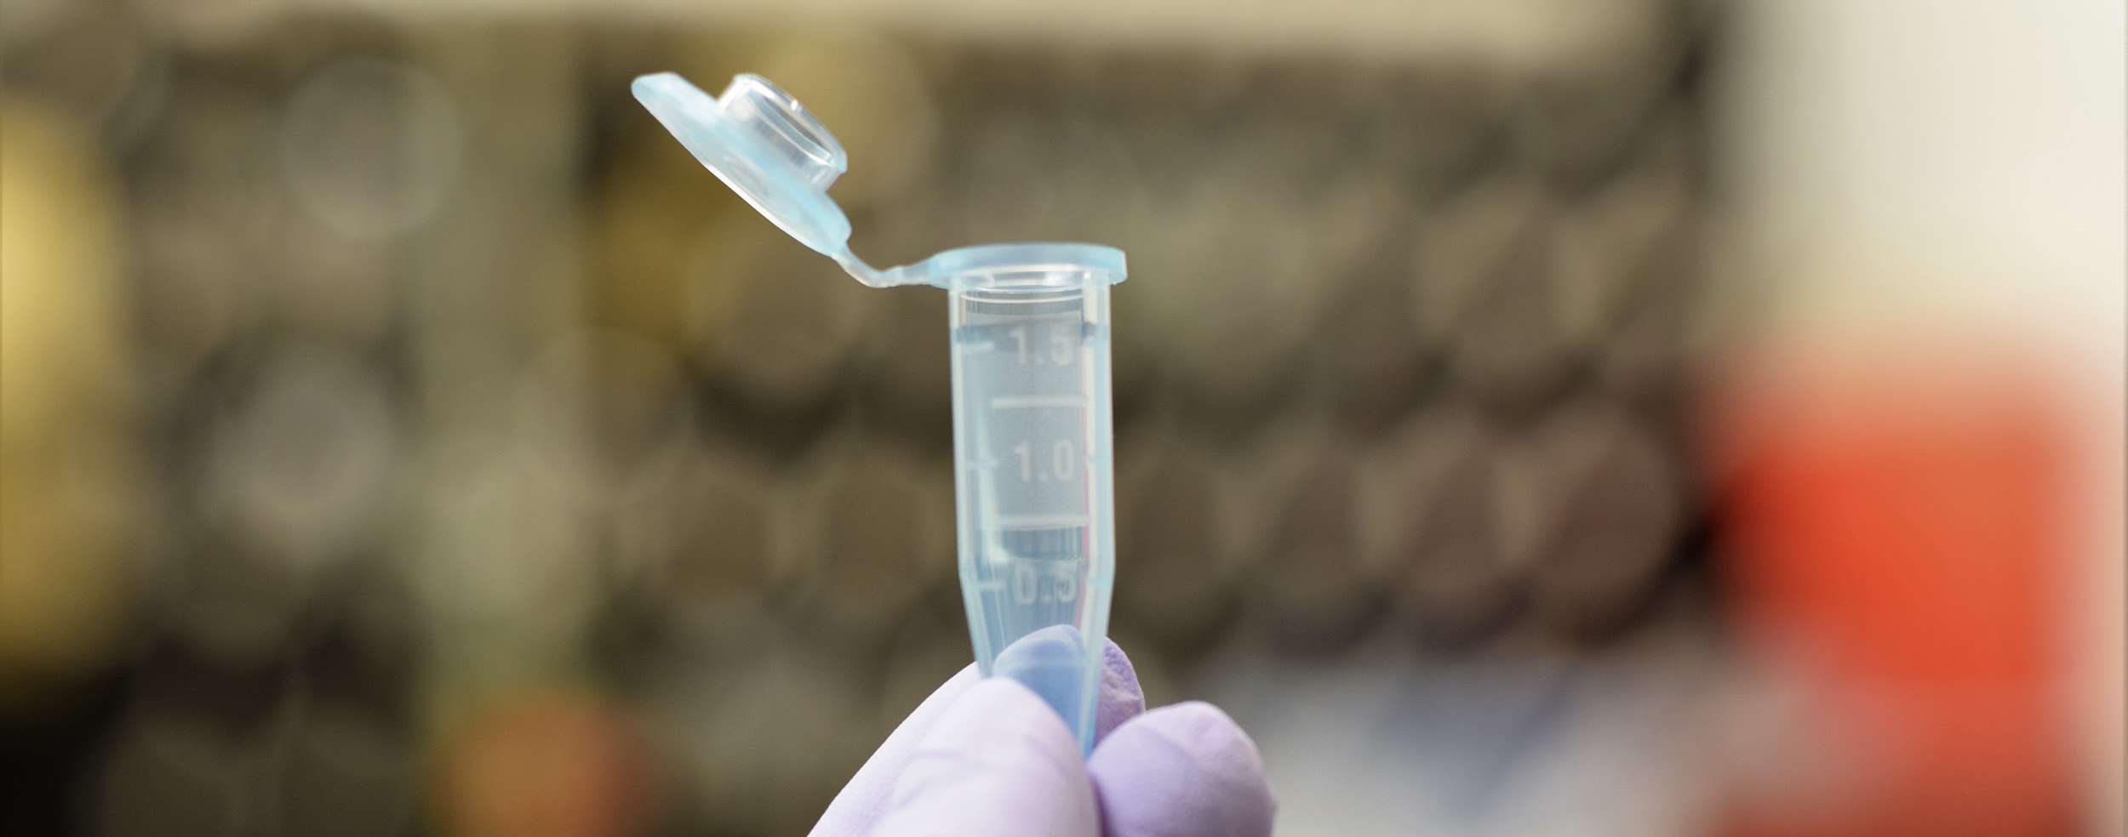
Stage 1: Genetic Synthesis Process
Diagram modified from GENEWIZ website.
Wait 8-10 business days...
Genes delivered!

Slide 8
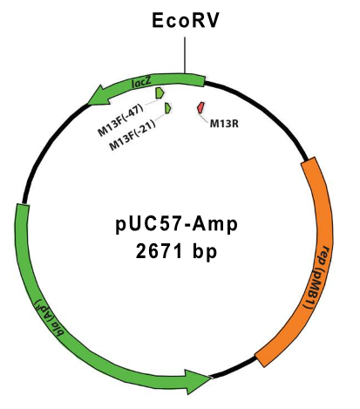
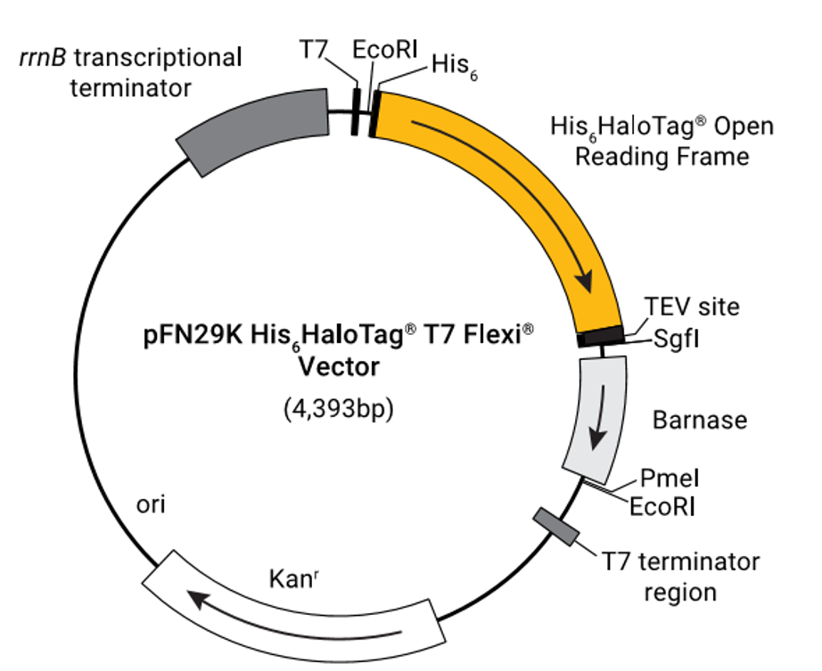
Stage 2: Cloning - Insertion of target gene into recipient vector
Recipient Vector
Original Vector
Target Gene

Slide 9
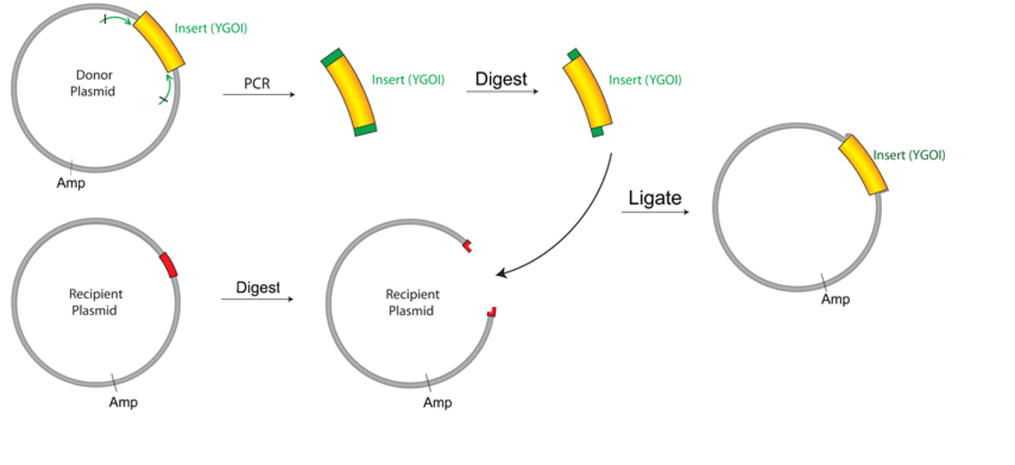
Stage 2: Cloning - Insertion of target gene into vector
Gene Amplification Using PCR
Primer Design
Purify DNA from PCR Reaction
Isolate Target Gene
Insert Target Gene into T7 Flexi Plasmid
Digest with SgfI and PmeI restriction enzymes
Ligate into vector.
Verify accurate insertion of target gene using Sanger Sequencing.
Modified from https://www.addgene.org/protocols/pcr-cloning/

Slide 10
Stage 2: Cloning - Heat Shock Transformation
Keep JM109 Competent Cells (E. coli host) on ice.
Add plasmids to cells.
Heat shock: Place tube in 42°C water bath for 45–50 seconds
Return to ice.
Add growth medium then incubate at 1.5 hours at 37°C with shaking.
Plate on agar.
Heat shock transformation. Image modified from https://www.thermofisher.com/us/en/home/life-science/cloning/cloning-learning-center/invitrogen-school-of-molecular-biology/molecular-cloning/transformation/bacterial-transformation-workflow.html

Slide 11
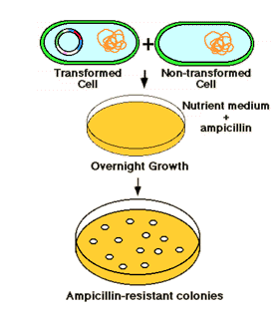
Stage 2: Cloning - Selection Process
Image obtained from: http://sivabio.50webs.com/dnacloning.htm

Slide 12
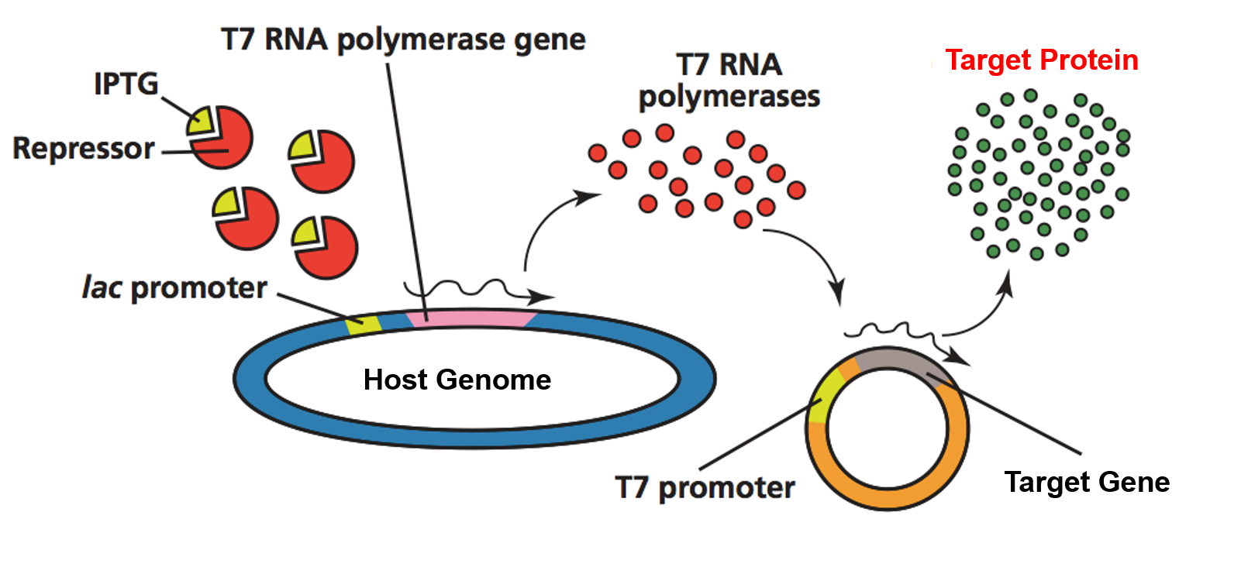
Stage 2: Cloning - IPTG Induction and Gene Expression
Begin harvesting target protein.
Image Modified from https://laney.edu/doug_bruce/mild-mannered-bacteria-by-day-glowing-jellyfish-by-night/

Slide 13
Stage 2: Cloning - Protein Purification
Purified Target Protein
Bind
Wash
Elute
Purification
TEV Protease

Slide 14
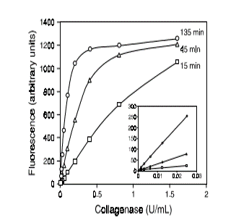
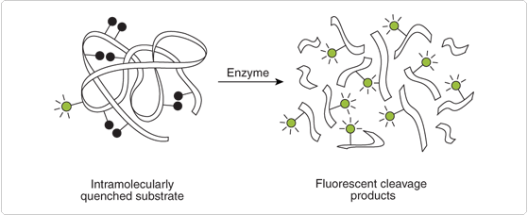
Stage 3: Collagenase Activity Assay
Purified Protein
Fluorescence microplate reader
Substrates:
collagen type I from bovine skin
collagen type III from human placenta
gelatin from pig skin

Slide 15
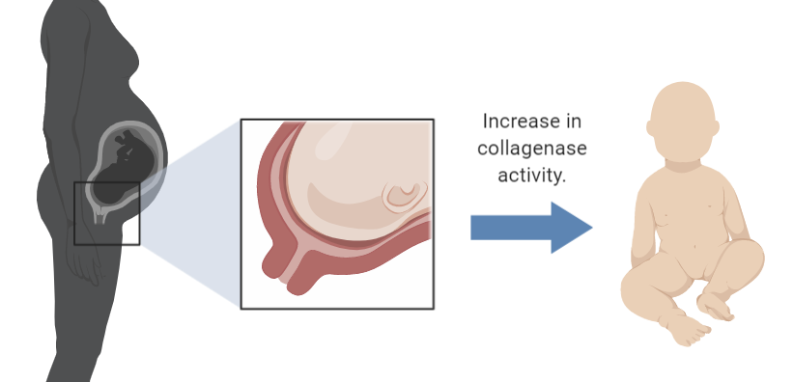
Implications of collagenase activity in vaginal microbiota
Increase in collagenase activity induces labor in pregnant woman.
Time-sensitive process.
Collagenase activity amongst vaginal microbiota may induce early labor.

