Slide 1
The long-term effects of exposure to lipopolysaccharides on the epigenetic modifications to the CXCL-8 gene from chronic wound samples
Sahana Tharakan

Slide 2
Normal Stages of Wound Healing

Slide 3
Normal Stages of Wound Healing

Slide 4
Inflammatory Stage

Slide 5
Fibroblasts
Lipopolysaccharides
Toll-like Receptor-4
Fibroblast
Cytokine

Slide 6
Inflammatory Stage
Cytokine

Slide 7
Inflammatory Stage
Cytokine
Neutrophil

Slide 8
Interleukin-8
Proinflammatory cytokine
CXCL-8
Located on Chromosome 4
Promoter region of CXCL-8

Slide 9
DNA Methylation

Slide 10
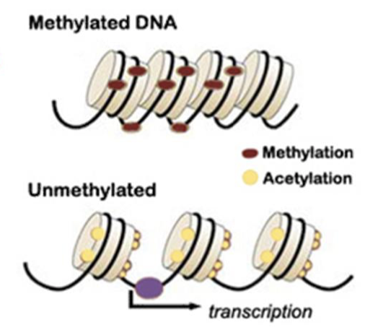
DNA Methylation

Slide 11
Experiment
Is permanent hypomethylation present in the CXCL-8 gene when chronic wounds samples are exposed to LPS?

Slide 12
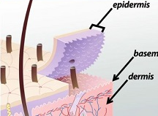
Obtaining Samples, Isolating Fibroblasts, and Exposing to LPS
Tissue Biopsies
To isolate fibroblasts:
Dispase II to separate epidermis from dermis
Crude collagenase to digest the dermis
Expose isolated fibroblasts to LPS from Escherichia coli for 24 hours, 48 hours, and 72 hours

Slide 13
DNA Extraction
Na+ +
Add NaOAc and Ethanol

Slide 14
Bisulfite Conversion

Slide 15
Methylation-Specific Polymerase Chain Reaction (MS-PCR): Methylated Primers

Slide 16
Methylation-Specific Polymerase Chain Reaction (MS-PCR): Unmethylated Primers

Slide 17
MS-PCR: Denaturation
5’
3’
5’
3’
3’
5’
3’
5’

Slide 18
MS-PCR: Annealing
5’
3’
5’
3’
3’
5’
3’
5’

Slide 19
MS-PCR: Elongation
5’
3’
5’
3’
3’
5’
3’
5’

Slide 20
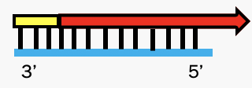
MS-PCR: Repeat
5’
3’
5’
3’
3’
5’
3’
5’

Slide 21
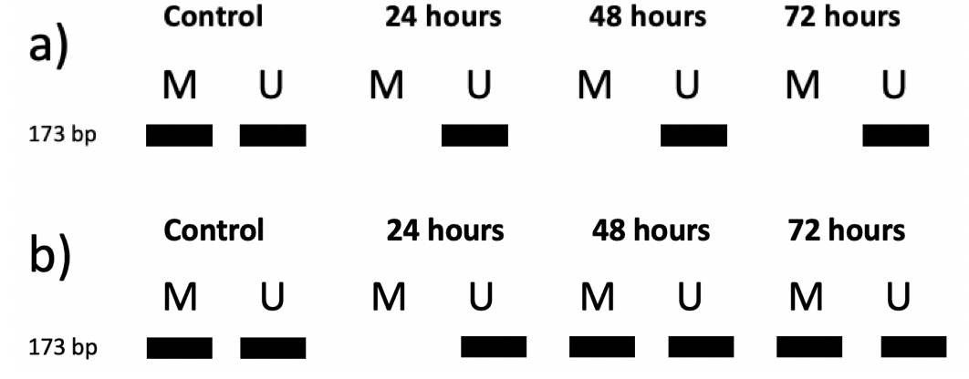
Discussion
Potential Results
Pitfalls
Further Experimentation

Slide 22
References
Maynard, J. (2015). How Wounds Heal: The 4 Main Phases of Wound Healing. http://www.shieldhealthcare.com/community/popular/2015/12/18/how-wounds-heal-the-4-main-phases-of-wound-healing/
Wallace, H. A., Basehore, B. M., & Zito, P. M. (2019). Wound Healing Phases. https://www.ncbi.nlm.nih.gov/books/NBK470443/
de Moya, M. A., Phan, H. H., Montero, P. M., Stefanidis, D., & Cahalane, M. J. (n.d.) Non-healing wounds. American College of Surgeons Division of Education, 1-36. https://www.facs.org/-/media/files/education/core-curriculum/nonhealing_wounds.ashx
Flavell, S. J., Hou, T. Z., Lax, S., Filer, A. D., Salmon, M., & Buckley, C. D. (2008). Fibroblasts as novel therapeutic targets in chronic inflammation. British Journal of Pharmacology, 153(SUPPL. 1), 241–246. https://doi.org/10.1038/sj.bjp.0707487
Jordana M., Sarnstrand, B., Sime, P. J., Ramis, I. (1994) Immune-inflammatory functions of fibroblasts. European Respiratory Journal, 7(12), 2212-2222. doi: 10.1183/09031936.94.07122212
Kandasamy, S., Green, B. B., Benjamin, A. L., & Kerr, D. E. (2011). Between-cow variation in dermal fibroblast response to lipopolysaccharide reflected in resolution of inflammation during Escherichia coli mastitis. Journal of Dairy Science, 94(12), 5963–5975. https://doi.org/10.3168/jds.2011-4288
Buckley, C. D., Pilling, D., Lord, J. M., Akbar, A. N., Scheel-Toellner, D., & Salmon, M. (2001). Fibroblasts regulate the switch from acute resolving to chronic persistent inflammation. Trends in Immunology, 22(4), 199–204. https://doi.org/10.1016/S1471-4906(01)01863-4
Bickel, M. (1993). The role of interleukin-8 in inflammation and mechanisms of regulation. Journal of Periodontology, 64(5), 456-460. https://www.ncbi.nlm.nih.gov/pubmed/8315568
Mukaida, N., Shiroo, M., & Matsushima, K. (1989). Genomic structure of the human monocyte-derived chemotactic factor IL-8. Journal of Immunology, 143(4), 1366-1371. https://www.ncbi.nlm.nih.gov/nuccore/M28130
Green, B. B. & Kerr, D. E. (2014). Epigenetic contribution to individual variation in response to lipopolysaccharide in bovine dermal fibroblasts. Veterinary Immunology and Immunopathology, 157(0), 49-58. doi:10.1016/j.vetimm.2013.10.015.
Chan, S. W., Zilberman, D., Xie, Z., Johansen, L. K., Carrington, J. C., and Jacobsen, S.E., 2004 RNA Silencing Genes Control de Novo DNA Methylation. Science. 303: 1336.
Panuncialman, J., Hammerman, S., Carson, P., & Falanga, V. (2010). Wound edge biopsy sites in chronic wounds heal rapidly and do not result in delayed overall healing of the wound. Wound Repair Regeneration, 18(1), 21-25. doi: 10.1111/j.1524-475X.2009.00559.x
Andia, D. C., de Oliveira, N. F. P., Casarin, R. C. V., Casati, M. Z., Line, S. R. P., & de Souza A. P. (2010). DNA Methylation Status of the IL8 Gene Promoter in Aggressive Periodontitis. Journal of Periodontology, 81(9), 1336-1341. doi: 10.1902/jop.2010.100082
Dispase II. (n.d.). Retrieved November 30, 2019 from https://www.sigmaaldrich.com/catalog/product/sigma/d4693?lang=en&region=US
Kanta, J. (2015). Collagen matrix as a tool in studying fibroblastic cell behavior, Cell Adhesion and Migration, 9(4), 308-316. http://dx.doi.org/10.1080/19336918.2015.1005469
Collagenase from Clostridium histolyticum. (n.d.). Retrieved November 30, 2019 from https://www.sigmaaldrich.com/catalog/product/sigma/c0130?lang=en&region=US
Pandamooz, S., Hadipour, A., Akhavan-Niaki, H., Pourghasem, M., Abedian, Z., Motevallizadeh Ardekani, A., Golpour, M., Hassan, Z. M., & Mostafazadeh, A. (2012). Short exposure to collagenase and coculture with mouse embryonic pancreas improve human dermal fibroblast culture. Biotechnology and Applied Biochemistry, 59(3), 254-261. DOI: 10.1002/bab.1020
Lipopolysaccharides from Escherichia coli O111:B4. (n.d.) Retrieved November 30, 2019 from https://www.sigmaaldrich.com/catalog/product/sigma/l4391?lang=en&region=US
Farrell, R. (2010). Resilient Ribonucleases. In RNA methodologies 4th edition (Chapter 7). https://doi.org/10.1016/B978-0-12-374727-3.00007-3
Proteinase K. (n.d.). Retrieved November 30, 2019 from https://www.sigmaaldrich.com/life-science/metabolomics/enzyme-explorer/analytical-enzymes/proteinase-k.html
McKiernan, H. E. and Danielson, P. B. (2017). Molecular Diagnostic Applications in Forensic Science. Molecular Diagnostics (Third Edition), 371-394. https://doi.org/10.1016/B978-0-12-802971-8.00021-3
InvitrogenTM SYBR™ Gold Nucleic Acid Gel Stain (10,000X Concentrate in DMSO). (n.d.). Retrieved November 30, 2019 from https://www.thermofisher.com/order/catalog/product/S11494#/S11494
Oliveira, N. F. P., Damm, G. R., Andia, D. C., Salmon, C., Nociti, F. H., Line, S. R. P., de Souza, A.P. (2009). DNA methylation status of IL8 gene promoter in oral cells of smokers and non- smokers with chronic periodontitis. Journal of Clinical Periodontology, 36, 719–725. doi: 10.1111/j.1600-051X.2009.01446.x.

