Slide 1
Mapping Functional Domains of ORP3 Required for Suppression of ER Aggregation in ALS8
Sohail Syed

Slide 2
ALS and ER Aggregation
Affects 1 per 100,000
27 types ALS8 is of interest
VAPB
(Vesicle-associated membrane protein-associated protein )
P56S mutation
Unfolded Protein response
Figure 2: Normal ER functioning Cell
Figure 1: ER aggregation caused by VAPB-P56S due to the wildtype VAPB-P56S being insoluble.
Prosser et. al
Notes:
ALS8
Relatively Rare
Causes motor neuron cells to die off
Patients lose movement in affected regions
The B isotope of VAP is the reason for ALS8
VAPB
Encodes proteins to aid the Unfolded Protein Response
Fixes misfolded/unfolded proteins with the ER to allow easy transport
P56S
Purine to Serine of the 56th Amino Acid
Causes ER aggregation by affecting the Unfolded Protein Response
Image
Images come from Prosser et. al
Fig 1: This image shows ER aggregation because of VAPB- P56S
Fig 2: Normal ER aggregation
Red regions are where VAPB has travelled through the cell
Green regions are where Calreticulin, the observer protein that was used in their experiment
Yellow regions is where the aggregates are formed

Slide 3
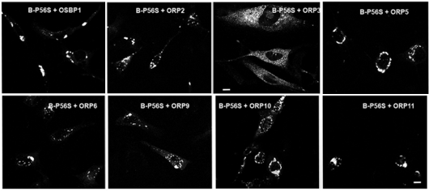
ORPs
Oxysterol-binding protein related proteins
12 different Types
ORP3 is of interest
Binds with phosphoinositides
Helps with aggregation (Darbyson et. al)
Figure 3: ORP3 Rescues ER Aggregation from Overexpression of VAPB-P56S
(Darbyson et. al).
Notes:
ORPs
Family of proteins that shuttle lipids to different compartments in the cell
12 types that help with different cell functions
ORP3 is of interest due to it rescuing aggregation
Links intercellular compartments
Binds to phosphoinositides
Binding to phosphoinositides allows ORP3 to guide protein activity through the cell
Which is beneficial to rescuing ER aggregation
Image
ER aggregation in all the other tested ORPs, but no aggregation in ORP3.

Slide 4
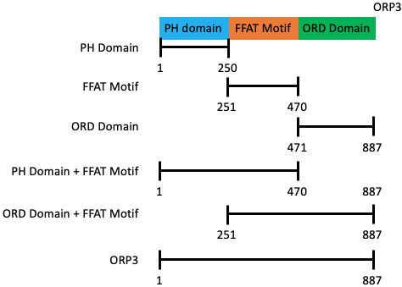
Regions of Interest
PH Domain
FFAT Motif
ORD Domain
PH + FFAT
ORD + FFAT
ORP3
Figure 4: ORP3 Split into its Regions of Interest
Notes:
6 Different regions of interest
PH 1-250
Bind to phosphoinositides
These are molecules that interact with proteins and guide them throughout the cell
FFAT 251-470
2 Phenylalanines in an acidic tract
Has been found to rescue the cell by binding to microtubules from the ER and nuclear membranes blocking VAPB-P56S from binding to these microtubes and creating aggregates
ORD 471-887
Hydrophobic region that regulate the binding of sterols and other binding regions
PH + FFAT 1-470
ORD + FFAT 251-887
ORP3 1-887
Positive control

Slide 5
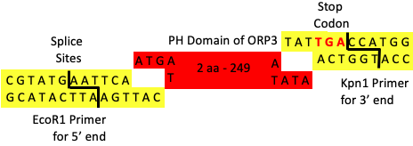
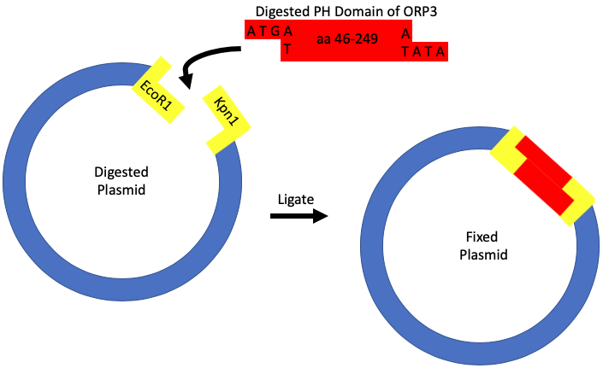
PCR and Molecular Cloning
Figure 5: Attachment of EcoR1 and Kpn1 primers
Polymerase Chain Reaction
Amplifies the regions of interest
Adds primers with restriction sites
EcoR1 and Kpn1
Preps regions for next step
Molecular Cloning
Creates Plasmids for delivery
Inserts and Vectors
Figure 6: Molecular Cloning through DNA ligation of Inserts and Vectors
Notes:
PCR – Polymerase Chain Reaction
The regions mentioned before are amplified by PCR
30-35 rounds to amplify the regions millionfold
DNA polymerase, buffer, nucleotides and primers are needed
DNA polymerase reads and creates more strands
Buffer regulates the pH and salt concentration
Primers add restriction sites that are regions to stop the polymerase from coding while also helping in the next step for creating plasmids
EcoR1 and Kpn1 are primers that do not make cuts at any point of the ORP3.
Found these through use of the Primer Express software
Molecular Cloning
Fixes plasmids so that they can be transfected by the cell
Inserts are the pieces of DNA that we wish to input into a cell while the vectors are the plasmids
The inserts are the PCR products
Plasmids contain same primers as PCR products in order for the same overhangs to be available for binding seen in the figures

Slide 6
Implications
Help with understanding the ALS8 disease
Expected that any regions with FFAT motif will help with aggregation
Chimeric Proteins for developing super gene

