Slide 1
Understanding Cleft Lip and Palate via BMP-2 Knockout in Xenopus laevis embryos
Nathaniel Smith

Slide 2
Birth Defects Cause 20% of infant death
“Birth Defects.” Birth Defects, Child Health USA 2014, 2014.

Slide 3
Birth Defects Remain a mystery
?
?
?

Slide 4
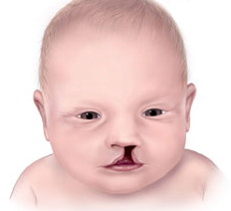
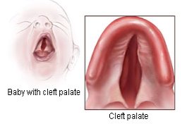
Cleft Lip and Palate One of the Most Common Birth Defects
Cleft lip
Cleft Palate
Bloomfield, V., & Liao, C.H. (2015)

Slide 5
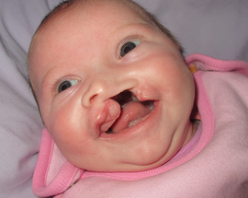
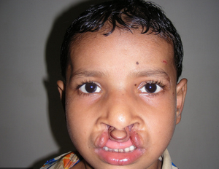
Cleft Lip and Palate NO CURE!!!
Bloomfield, V., & Liao, C.H. (2015)

Slide 6
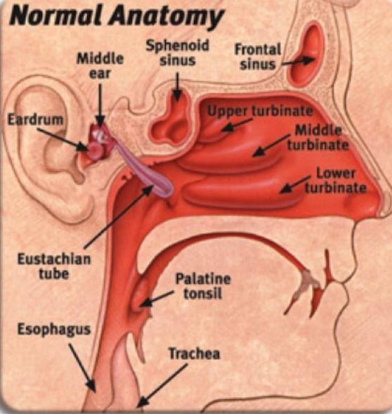
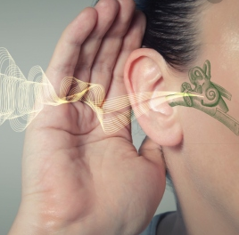
Cleft Lip and Palate Huge Implications
Jugessur, A., & Murray, J. C. (2005)

Slide 7
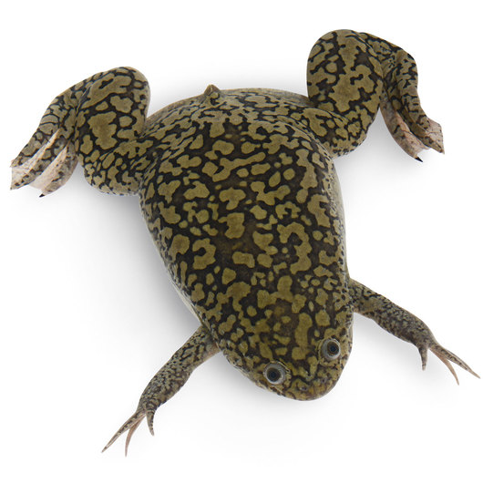
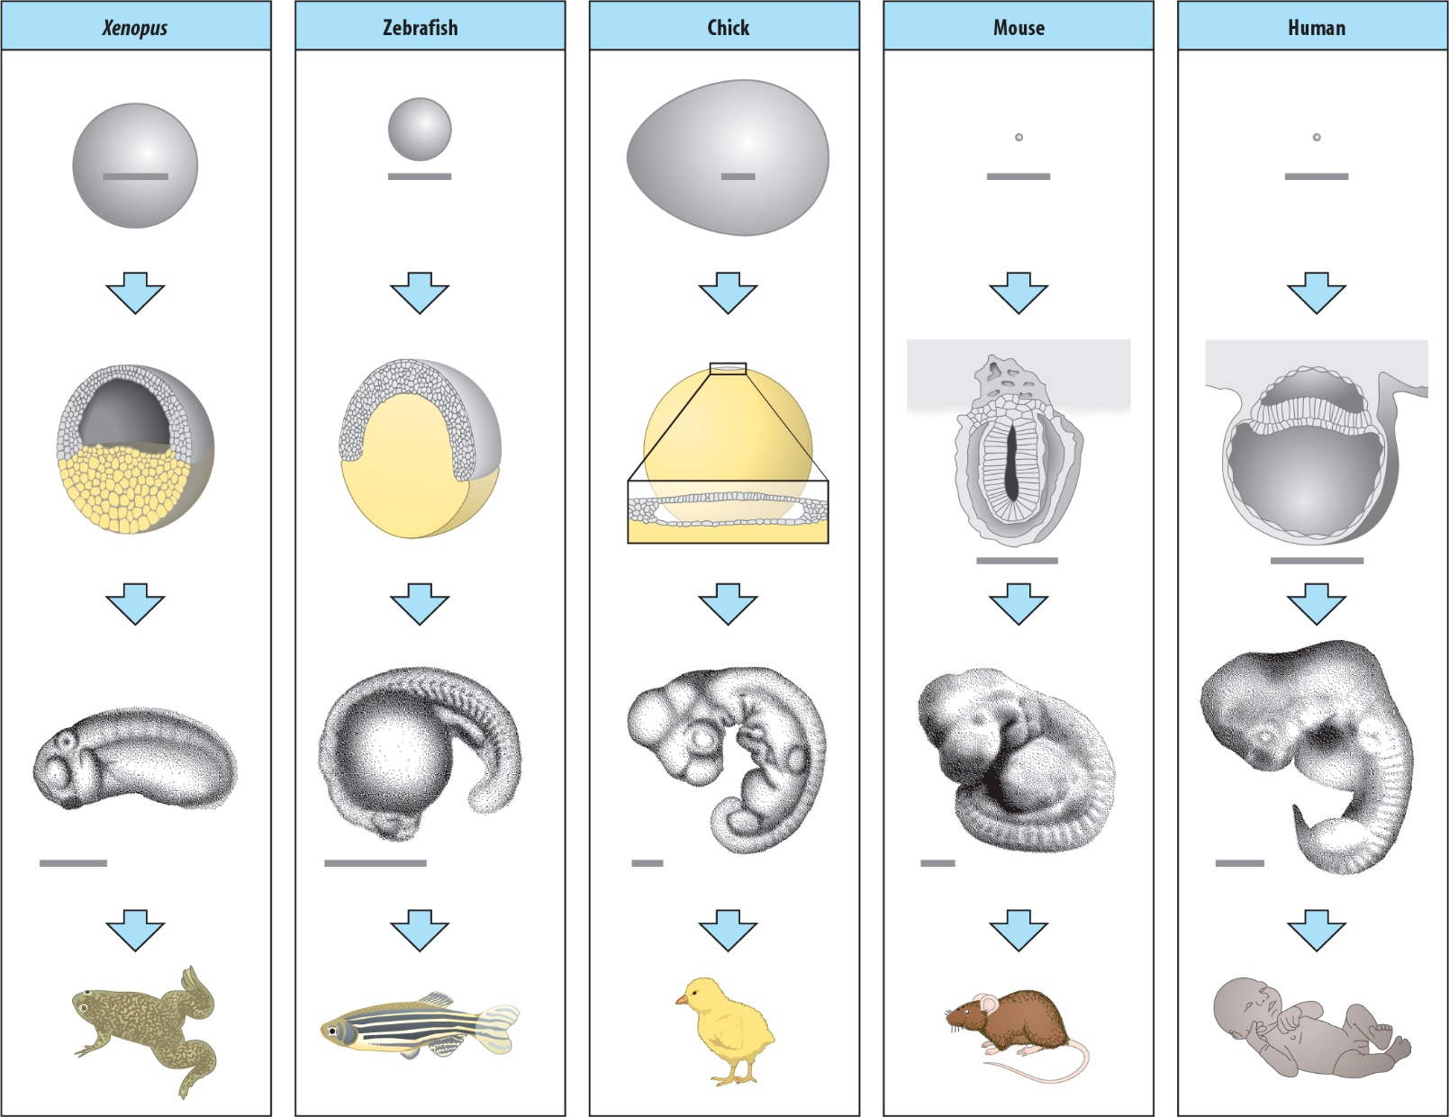
Cleft Lip and Palate Can be understood Using Xenopus laevis

Slide 8
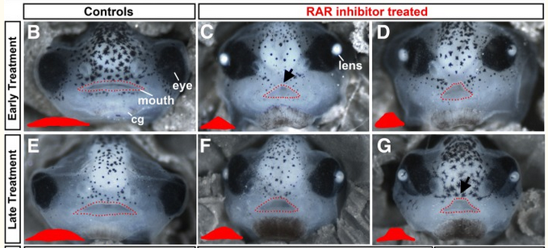
BMP-2 Gene Most altered Gene in Xenopus with cleft palate
Wahl et al (2018)

Slide 9
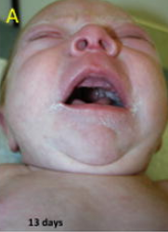
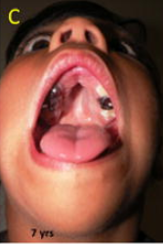
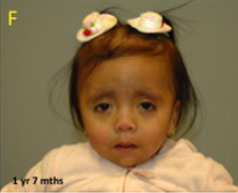
BMP-2 Gene Microdeletions of BMP2 cause cleft palate in humans
Sahoo et al (2011)

Slide 10
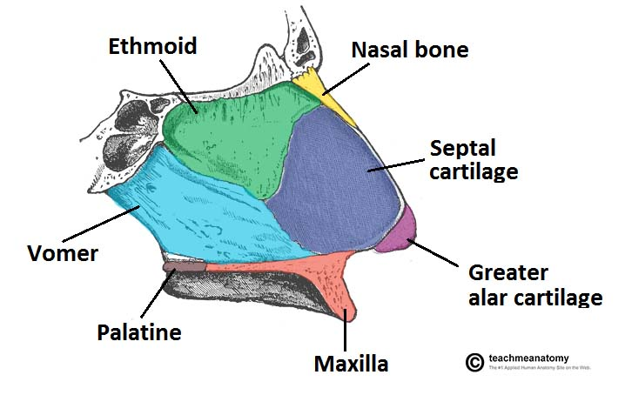
BMP-2 Gene Known for bone and cartilage formation
Sahoo et al (2011)

Slide 11
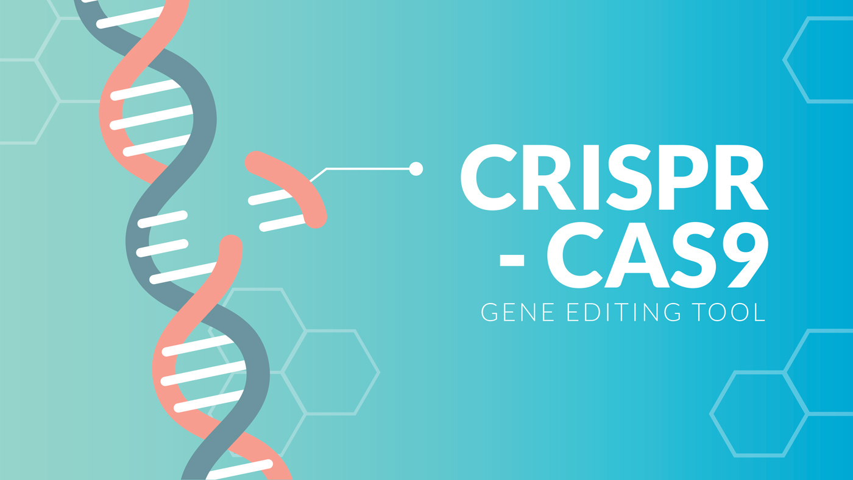
Experiment - Knockout of BMP-2 Gene Help Determine causes of Cleft Palate

Slide 12
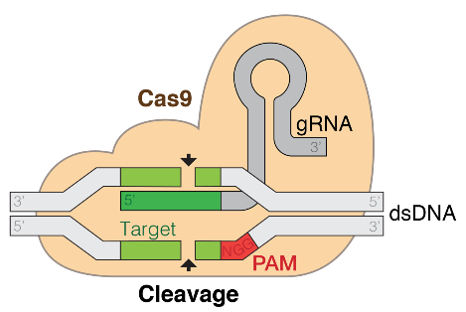
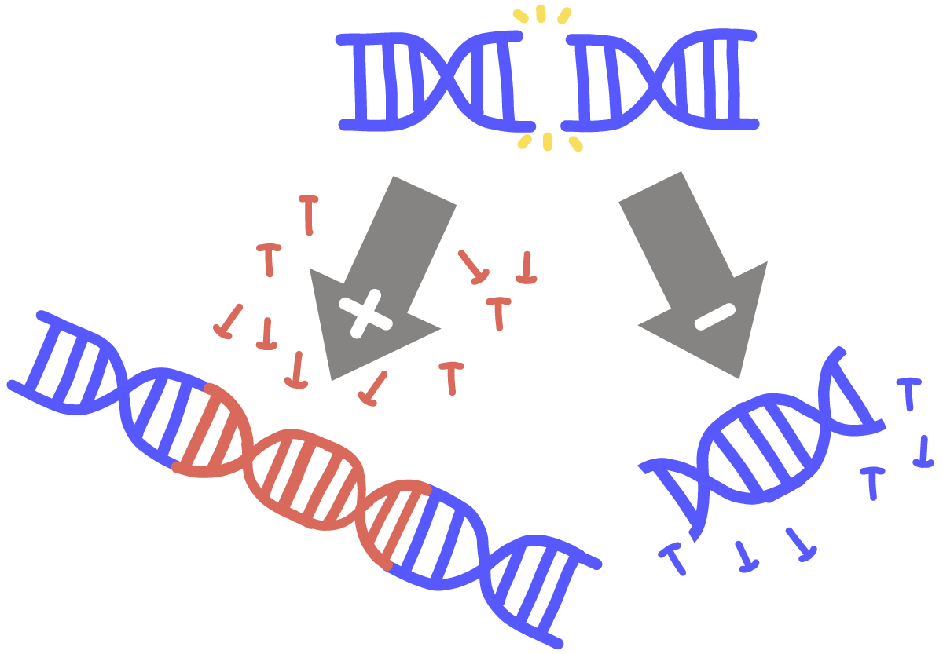
Knockout of BMP-2 Gene Using CRISPR/Cas9

Slide 13
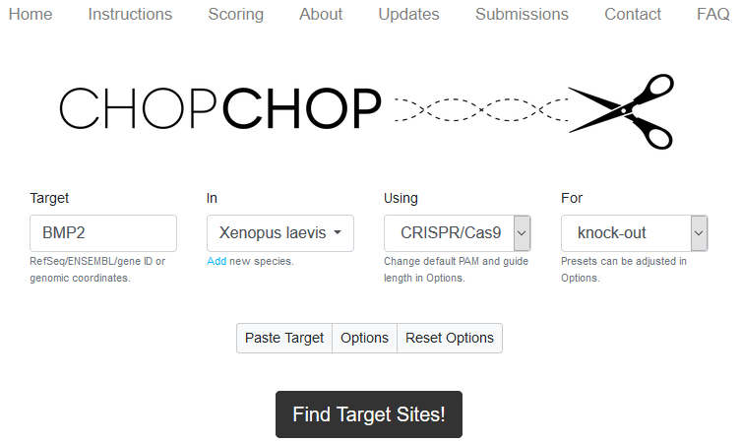
Knockout of BMP-2 Gene Designing the sgRNA

Slide 14
Knockout of BMP-2 Gene Picking a high-quality sgRNA

Slide 15
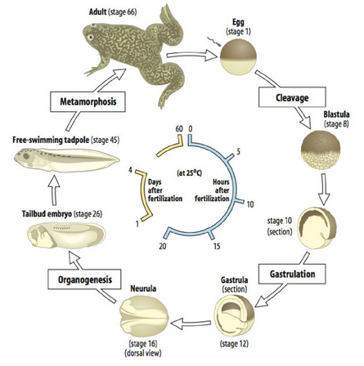
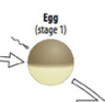
Knockout of BMP-2 Gene Performed at 1-cell stage

Slide 16
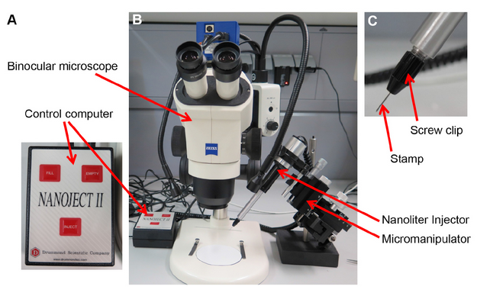
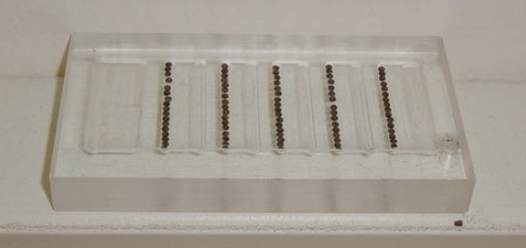
Knockout of BMP-2 Gene Microinjection of CRISPR

Slide 17
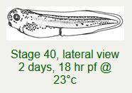
Knockout of BMP-2 Gene Embryos incubated for 3 days, until facial development occurs

Slide 18
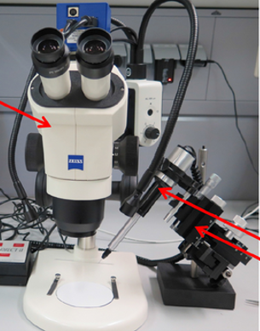
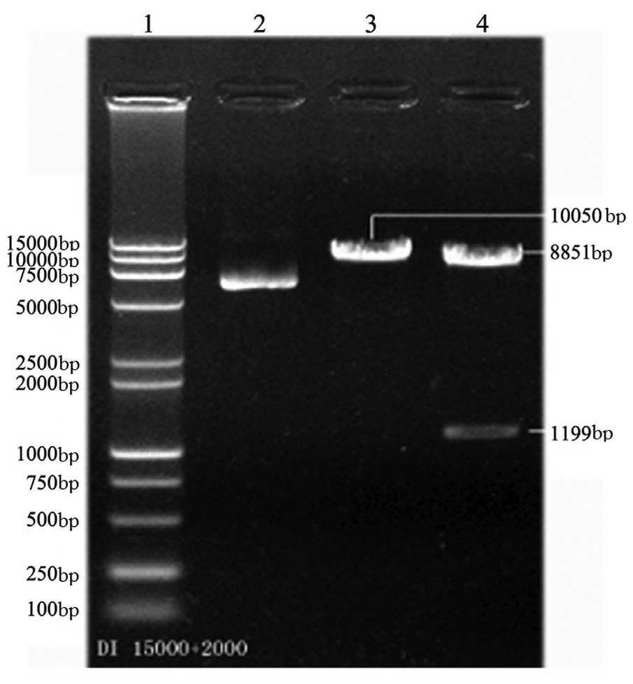
Assess Mutations in BMP-2 Done via DNA Extraction and PCR analysis

Slide 19
Measuring gene expression Wnt1 and RARg are the genes measured
Wahl et al (2018)

Slide 20
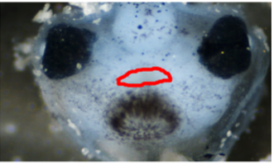
Measuring gene expression Dissection of Frogs Faces

Slide 21
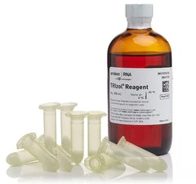
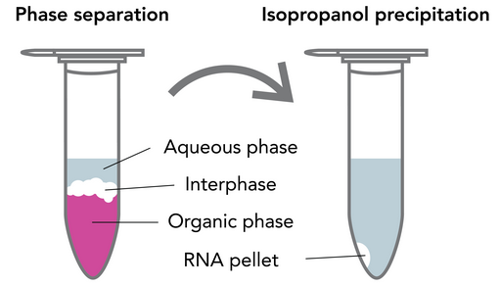
Measuring gene expression Isolating RNA from tissue sample

Slide 22
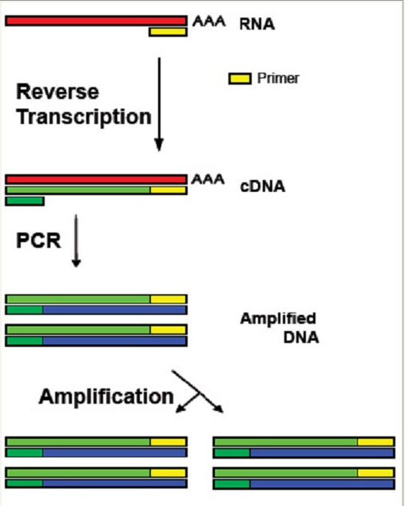
Measuring gene expression RT-PCR and qPCR can help us do this

Slide 23
RT-PCR Regular PCR, but with RNA and new enzyme

Slide 24
RT-PCR Designing high-quality primers

Slide 25
RT-PCR Designing high-quality primers

Slide 26
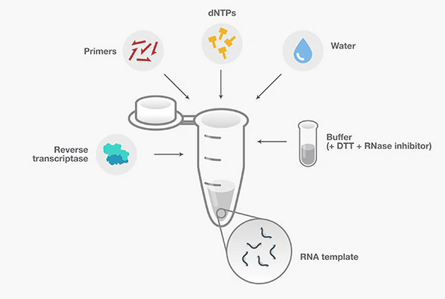
RT-PCR cDNA synthesis

Slide 27
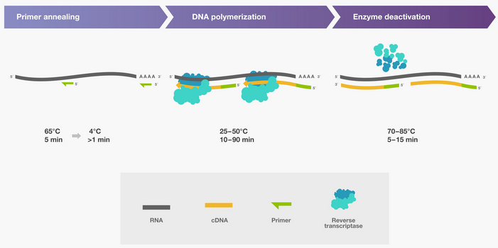
RT-PCR cDNA synthesis

Slide 28
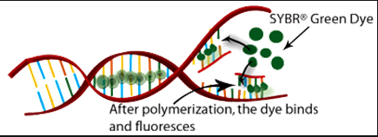
qPCR Same as PCR, but fluorescent based dye is used

Slide 29
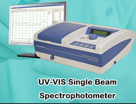
qPCR Fluorescence is measured between each thermal cycle

Slide 30
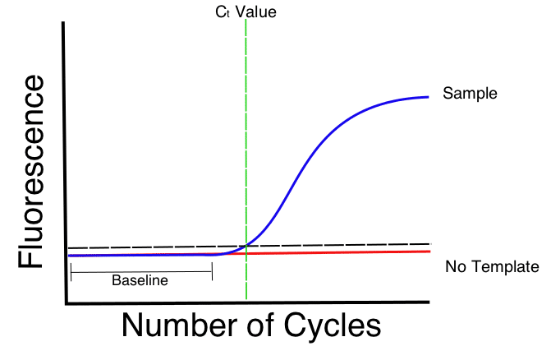
qPCR Ct value represents flourescence

Slide 31
qPCR High Ct value = Low Gene Expression Low Ct value = High Gene Expression

Slide 32
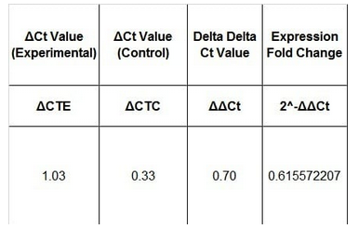
Delta-Delta Ct Analysis Uses Ct values to quantify gene expression

Slide 33
Delta-Delta Ct Analysis Uses Ct values to quantify gene expression

Slide 34
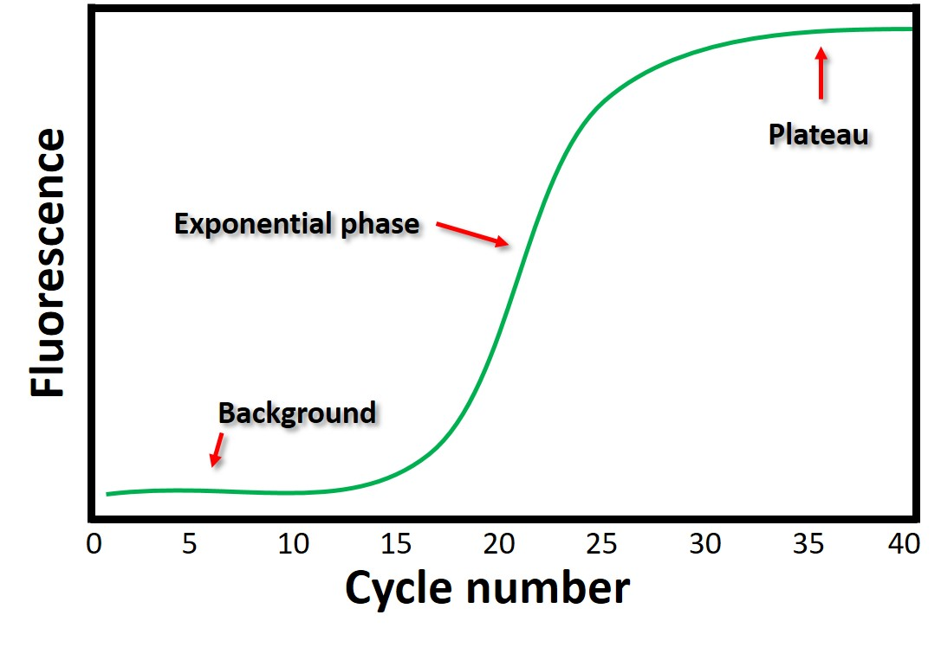
Potential results of BMP-2 Knockout Increased/Decreased Wnt1 & RARg

Slide 35
Potential results of BMP-2 Knockout Blue – Increased, Red - Decreased

Slide 36
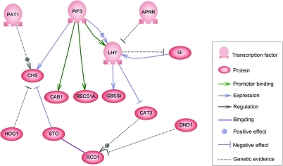
Potential results of BMP-2 Knockout Uncovers interaction of genes responsible for Cleft Lip and Palate

Slide 37
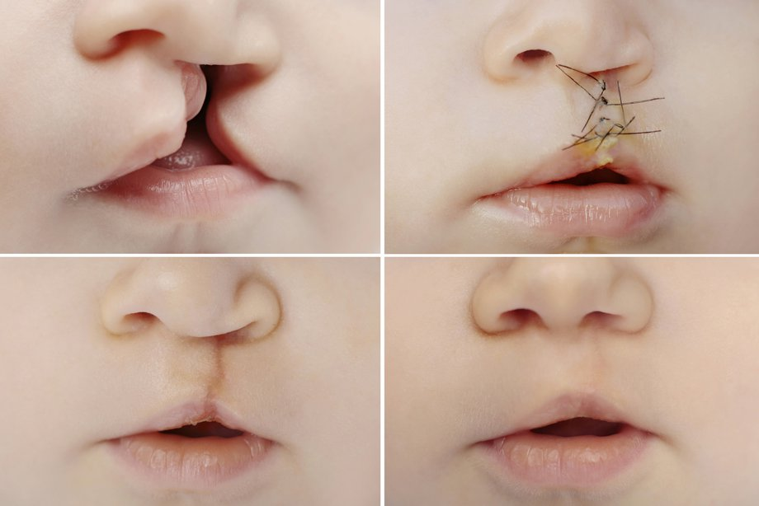
Potential results of BMP-2 Knockout Uncovers interaction of genes responsible for Cleft Lip and Palate

