Slide 1
The effects of mutations on the functionality of the HCN4 channel
Arashpreet Singh
Mentor: Lei Zhou PhD

Slide 2
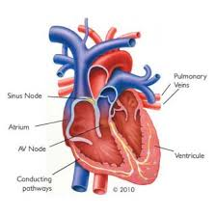
What is Bradycardia?
Is generally a sign of good physical conditioning
However symptomatic can lead to heart arrhythmias which are caused by a dysfunction in the sinus node of the heart
The sinus node is the natural pacemaker in the heart that controls heart rate
A mutation in this node’s HCN4 channel is responsible for the heart arrhythmias
heartrhymalliance.org

Slide 3
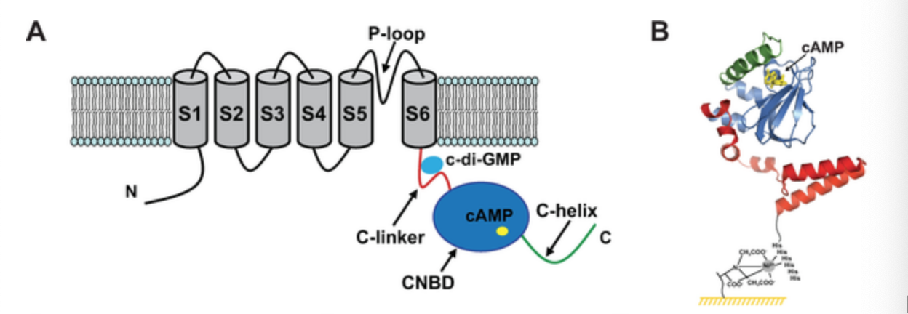
What is an HCN channel?
HCN channels are responsible for generating the pacemaker “funny” current that plays a crucial role in modulating the rhythm of the heart
Hyperpolarization-activated cyclic nucleotide-gated (HCN) ion channels are voltage gated and ligand-activated integral membrane proteins that contribute to pace-making activity in cardiac cells
HCN channels are regulated by the binding of cyclic nucleotides such as cAMP, cGMP, or cCMP. The binding of cyclic nucleotides lowers the threshold potential of HCN channels thereby activating them
Goldin, Alan L. “Expression of Ion Channels in Xenopus Oocytes.” Expression and Analysis of Recombinant Ion Channels, 2006, pp. 1–25., doi:10.1002/3527608095.ch1.

Slide 4
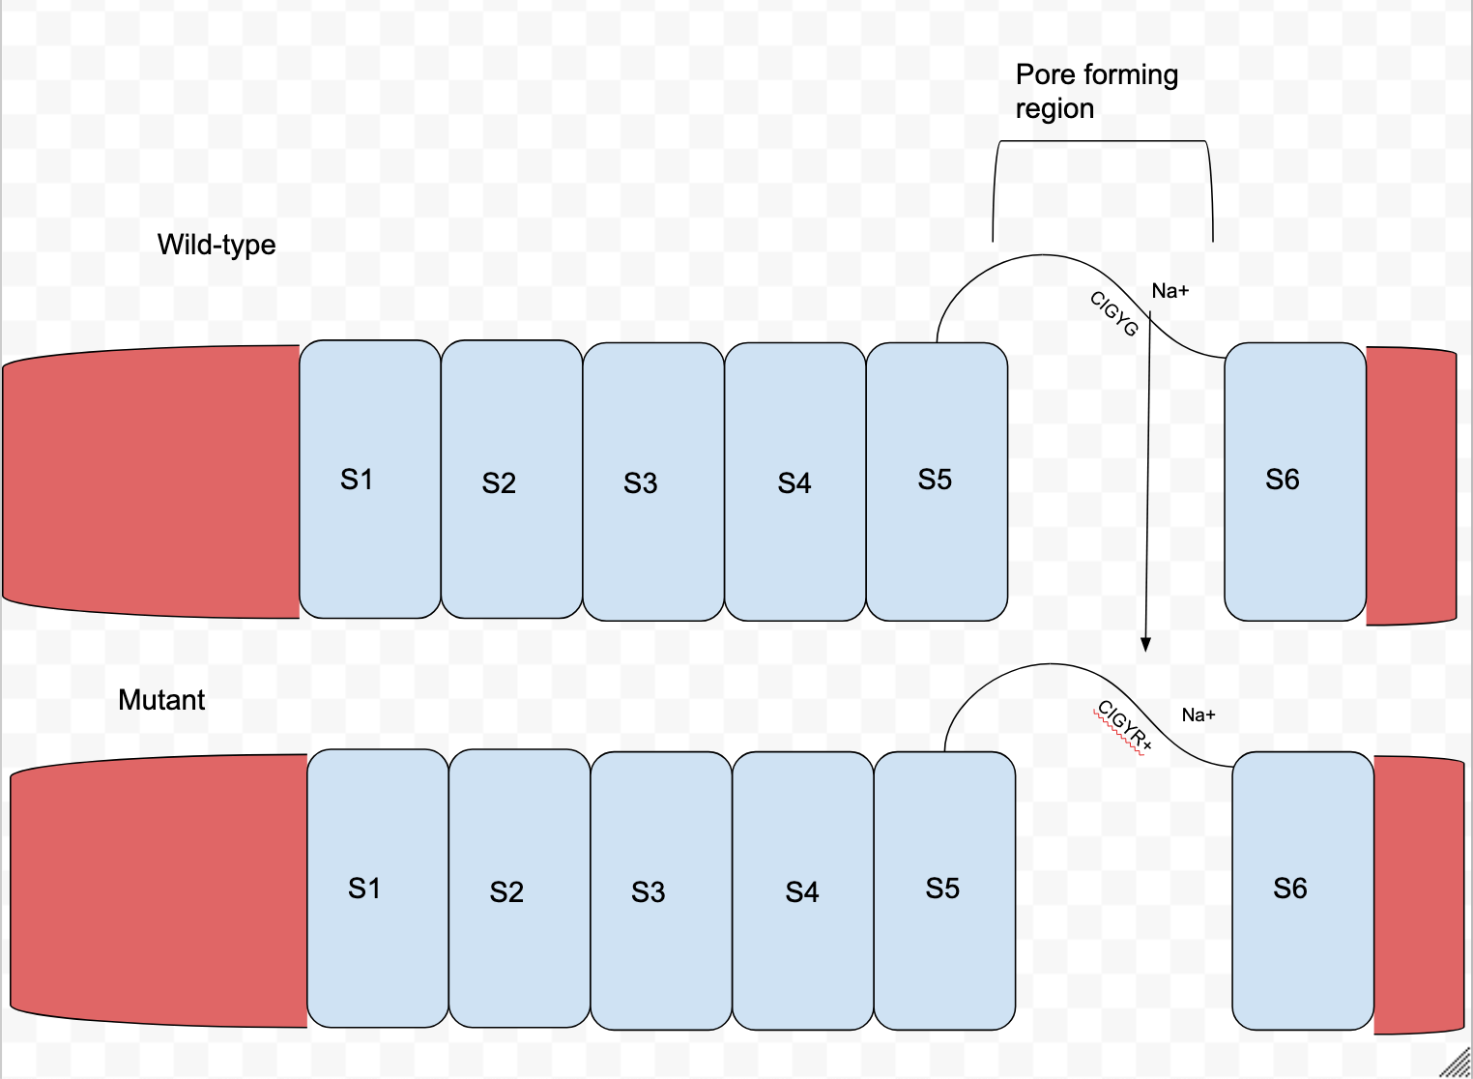
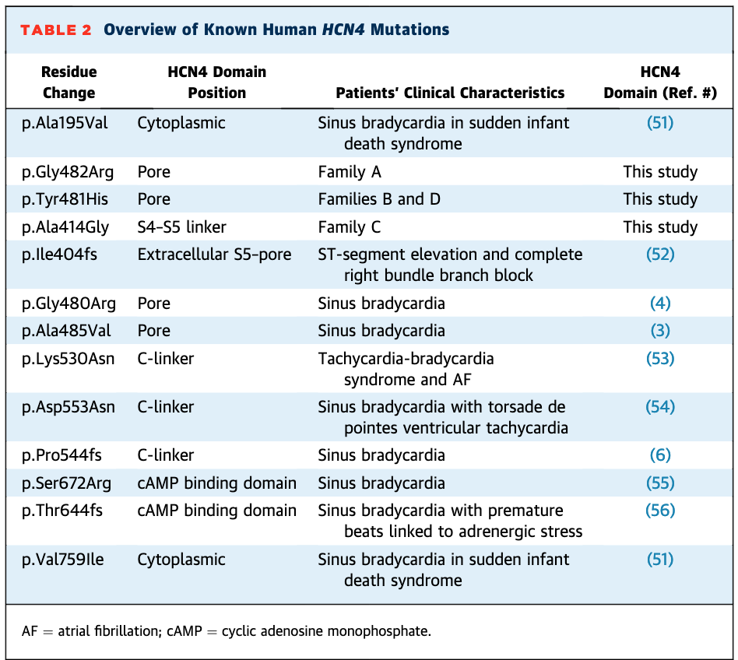
Mutations within the HCN4 channel
Focusing on the creating a similar mutation to Tyr481His and Gly482Arg
Uncharged, hydrophobic amino acids are mutated to a charged amino acid.
Charge repulsion may be occuring
Milano, Annalisa, et al. “HCN4 Mutations in Multiple Families With Bradycardia and Left Ventricular Noncompaction Cardiomyopathy.” Journal of the American College of Cardiology, vol. 64, no. 8, 2014, pp. 745–756., doi:10.1016/j.jacc.2014.05.045.

Slide 5
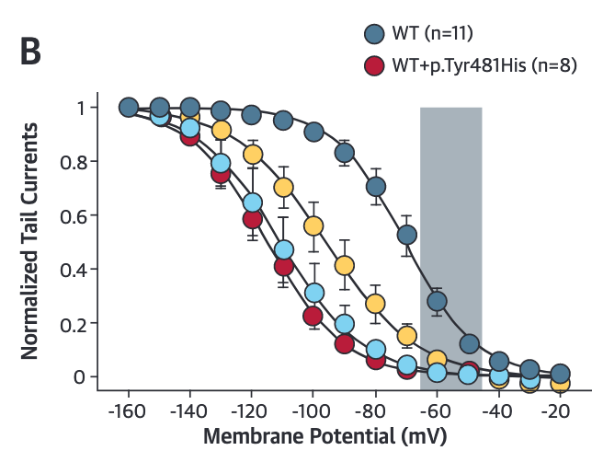
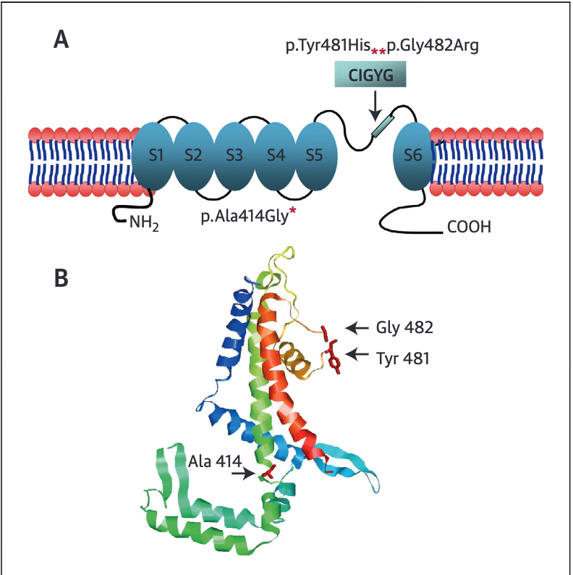
Effects of mutations on the channel
Mutant channels respond normally to cAMP binding but are activated at negative voltage when compared with wild type channels
The specific region is located within the pore forming region of S5-S6 linkage
Mutations in this region will directly impact the selectivity of the channel since the pore itself is being affected
Milano, Annalisa, et al. “HCN4 Mutations in Multiple Families With Bradycardia and Left Ventricular Noncompaction Cardiomyopathy.” Journal of the American College of Cardiology, vol. 64, no. 8, 2014, pp. 745–756., doi:10.1016/j.jacc.2014.05.045.

Slide 6
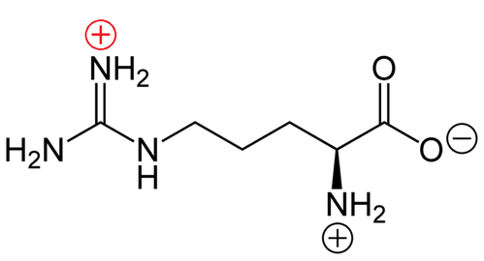
Importance of mutation from uncharged to charged amino acid
Voltage-mediated transitions the positive side chains provide a barrier to the passage of ions

Slide 7
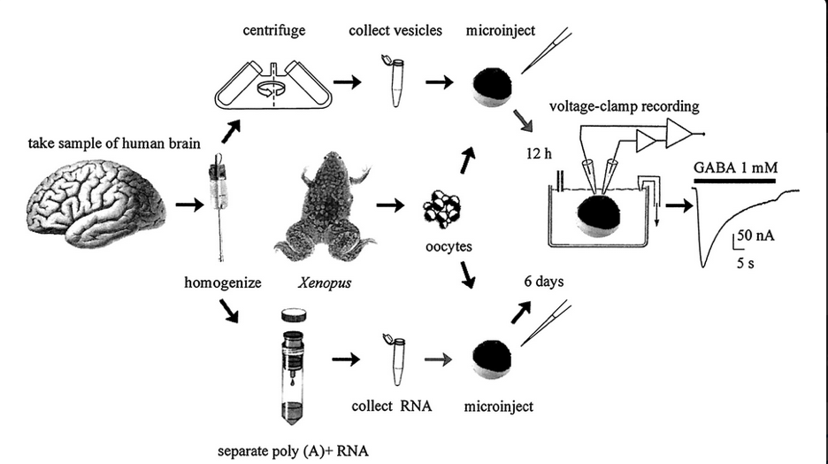
Overview of Experiment
Compare the electrophysiology of Xenopus laevis oocytes with mutated human HCN4 channels with oocytes with wild-type human HCN4 channels.

Slide 8
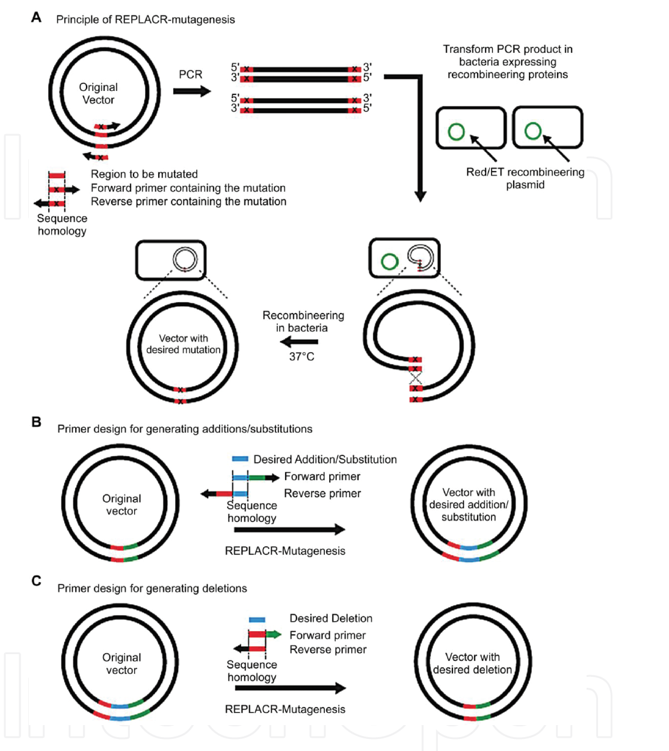
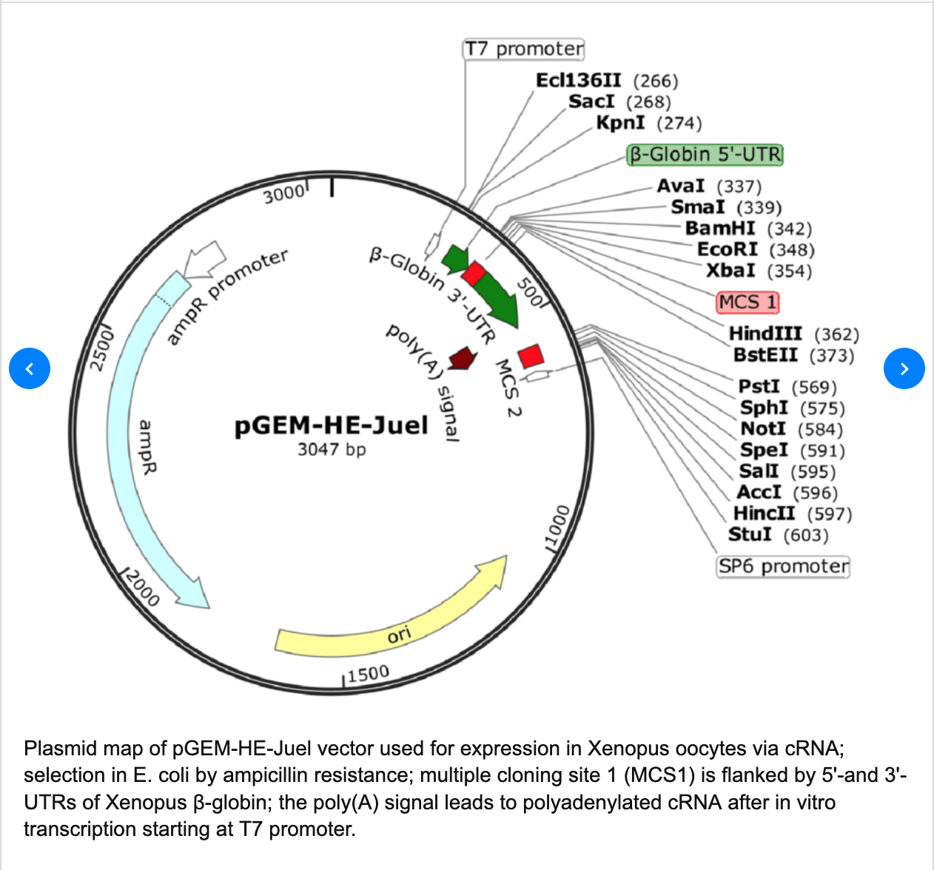
Vector and Site-directed Mutagenesis
Baum, Michael. (2016). Transmembrane carriers of cardenolide-adapted leaf beetles (Coleoptera, CHRYSOMELIDAE). 10.13140/RG.2.2.27654.37444.
Castorena‐Torres, Fabiola, et al. “Site‐Directed Mutagenesis by Polymerase Chain Reaction.” IntechOpen, IntechOpen, 14 Dec. 2016, www.intechopen.com/books/polymerase-chain-reaction-for-biomedical-applications/site-directed-mutagenesis-by-polymerase-chain-reaction.
Human HCN4 channel cDNA clone will be used as a template to engineer the mutation of cysteine to arginine by base substitution PCR that will change one uracil to a cytosine
UGU to CGU

Slide 9
PCR
Castorena‐Torres, Fabiola, et al. “Site‐Directed Mutagenesis by Polymerase Chain Reaction.” IntechOpen, IntechOpen, 14 Dec. 2016, www.intechopen.com/books/polymerase-chain-reaction-for-biomedical-applications/site-directed-mutagenesis-by-polymerase-chain-reaction
The substitution is created by incorporating the desired nucleotide change in the center of the forward primer
At least 10 complementary nucleotides must be included on the 3-prime side of the mutation.
The reverse primer must be designed so that the 5-prime ends of the two primers anneal back to back
The RNA promoter within the E.coli will then bind to the T7 region of the vector and begin transcription to create cRNA.

Slide 10
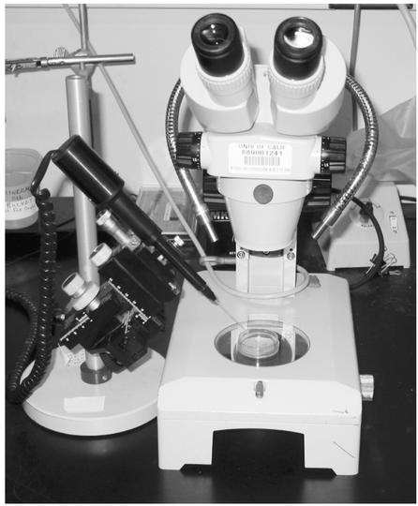
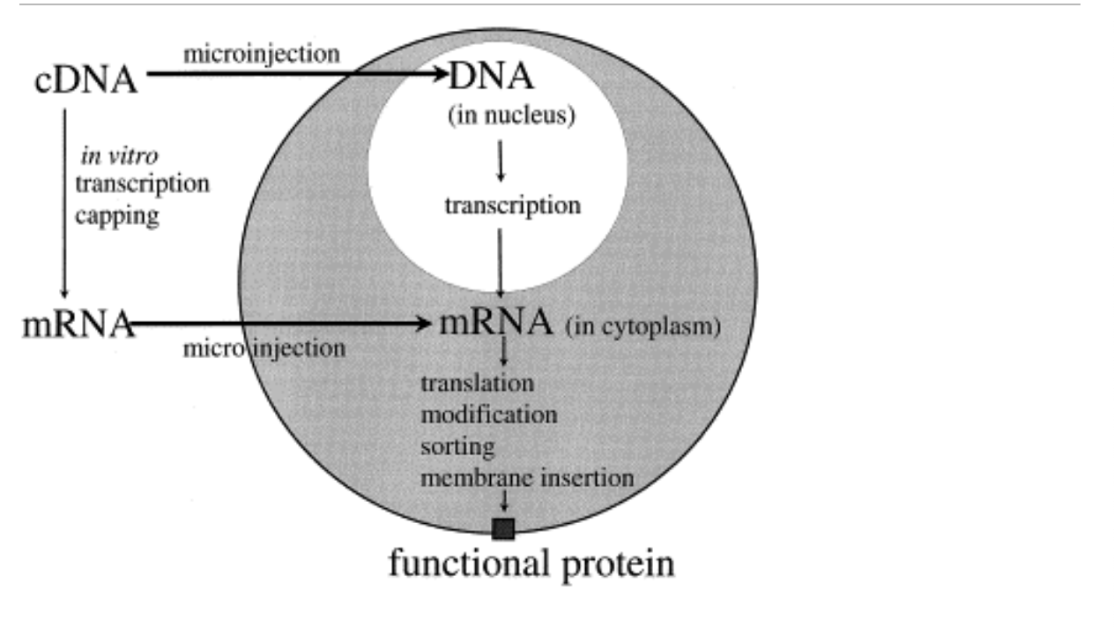
Microinjection
The result is a functioning membrane protein that is being expressed
Dissecting microscope, micromanipulator, and the injector
Goldin, Alan L. “Expression of Ion Channels in Xenopus Oocytes.” Expression and Analysis of Recombinant Ion Channels, 2006, pp. 1–25., doi:10.1002/3527608095.ch1.
Miller, A.j, and J.j Zhou. “Xenopus Oocytes as an Expression System for Plant Transporters.” Biochimica Et Biophysica Acta (BBA) - Biomembranes, vol. 1465, no. 1-2, 2000, pp. 343–358., doi:10.1016/s0005-2736(00)00148-6.

Slide 11
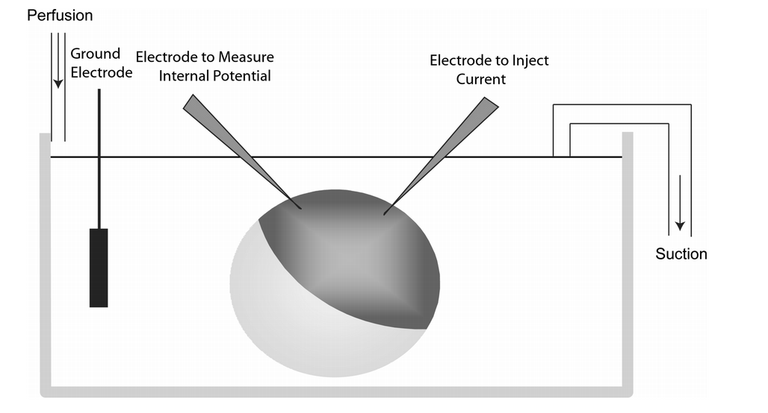
Measuring effects of mutation by TEVC
Whole cell voltage clamping of oocytes involves using two electrodes inserted into the oocyte with one measuring the internal potential of the oocyte and the other electrode being used to inject current
Currents are then filtered and recorded using a digital converter and a computer.
HCN4 currents were started by hyperpolarization (-20 to -160 mv)
To prevent cell death voltage was progressively reduced from 12s at -20 to 1.5 s at -160 mv
Goldin, Alan L. “Expression of Ion Channels in Xenopus Oocytes.” Expression and Analysis of Recombinant Ion Channels, 2006, pp. 1–25., doi:10.1002/3527608095.ch1

Slide 12
Boltzman equation figures out the activation curve
Describes the statistical behavior of a thermodynamic system not in equilibrium
y =1/{1 +exp (V-V_{1/2} /s ) (Reference 11). Where y is the fractional activation, V is the voltage in millivolts, V_{1/2} is the half-activation voltage in millivolts, and s is the inverse slope factor in millivolts
Determines the half-maximum activation voltage (V1/2) and the slope factor

Slide 13
Discussion
The results of the experiment may show whether or not the point mutation would have a detrimental impact on the HCN4 channel, or it may show that there was no impact at all on the mutation
The experiment may show that a mutation from a cystine to an arginine makes the channels behave differently when compared to the wild-type channel
A limitation of this experiment is that it since there have been no experiments looking into the effects of a negative charge to a positive charged amino acid mutation within the HCN4 it is difficult to say how the channel will respond

