Slide 1
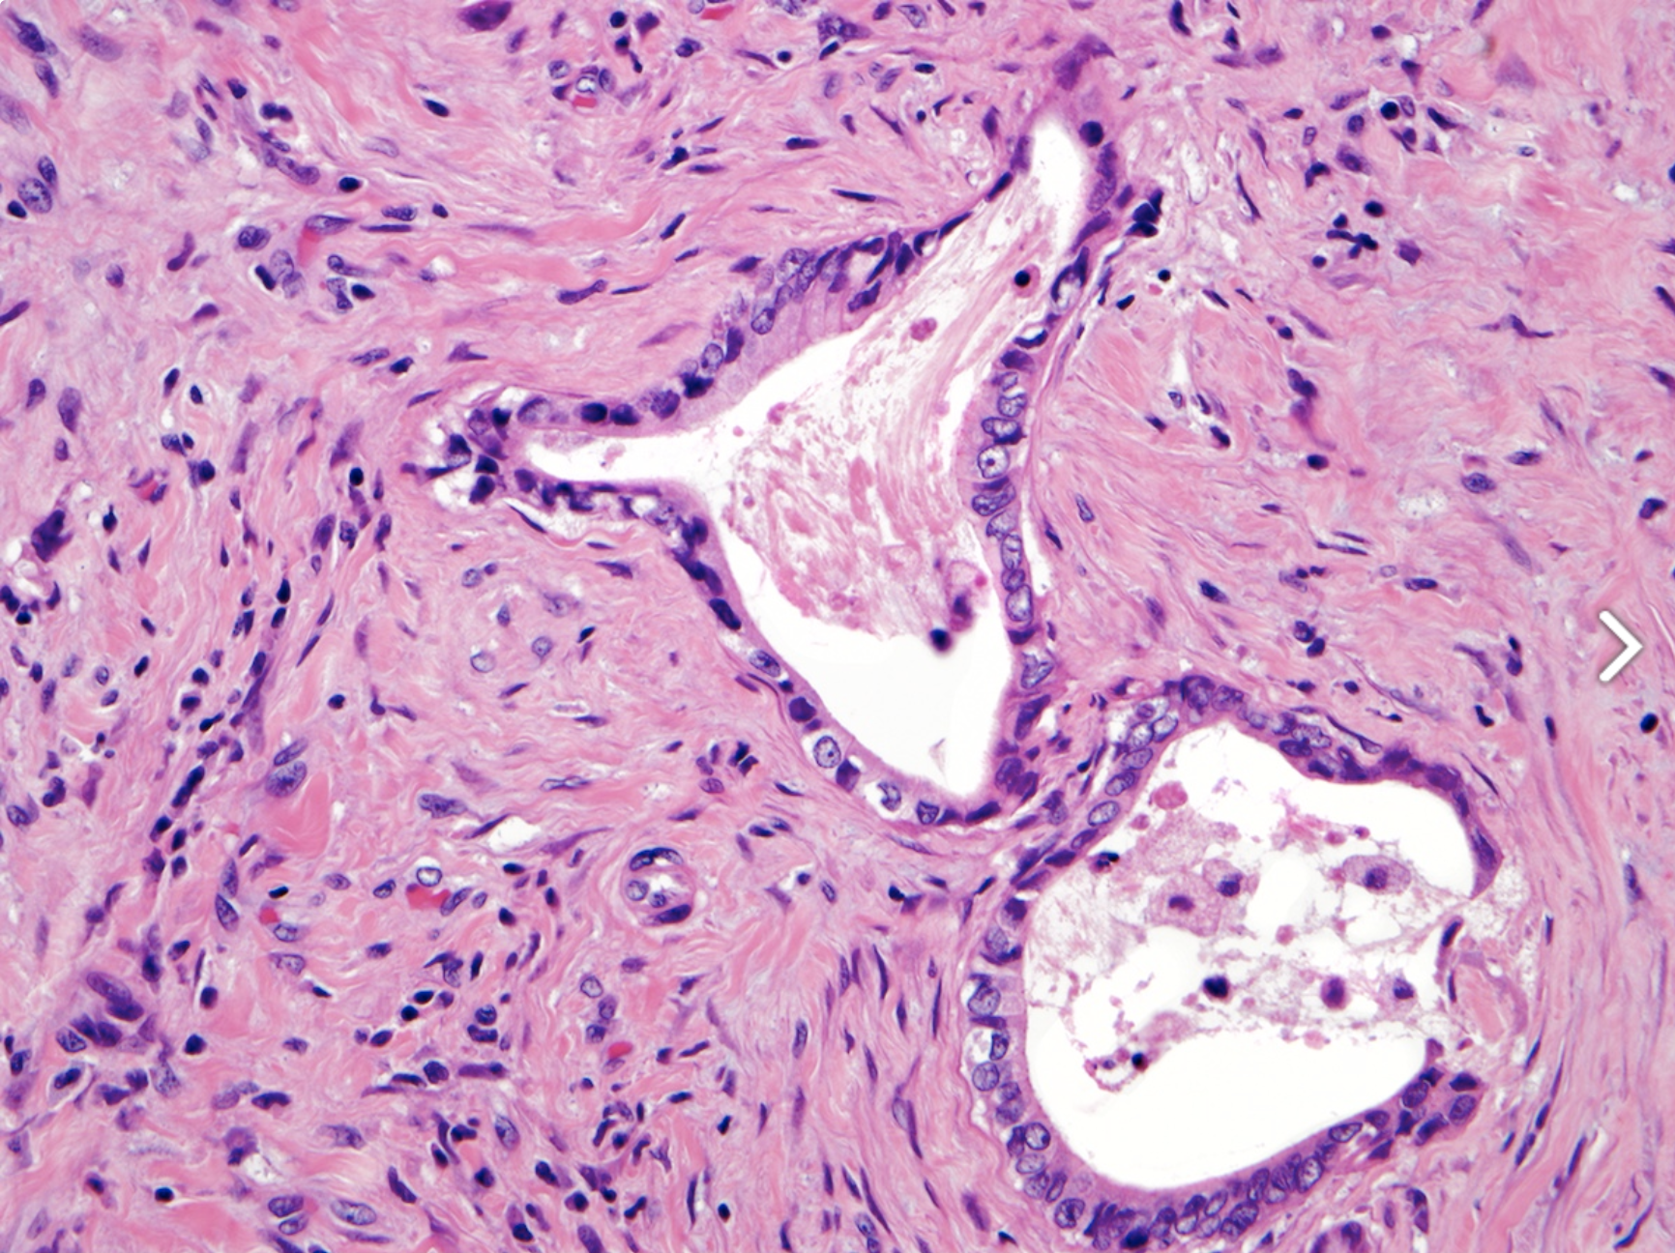
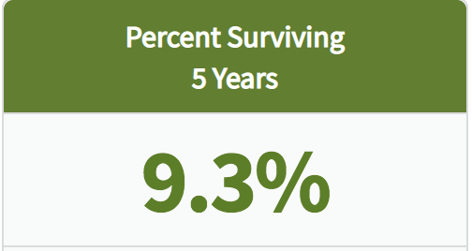
Pancreatic Ductal Adenocarcinoma (PDAC)
Notes:
Pancreatic Ductal Adenocarcinoma (PDAC), is a form of pancreatic cancer. PDAC is the fourth leading cause of cancer related death and is characterized by the formation of ducts that line the cell wall of the pancreas. PDAC patients are estimated to have a 5- year survival rate of 9.3%

Slide 2
glycine 12 to aspartic acid
MAPK phosphorylates TGIF1
TGIF1 loses its tumor suppressor function when phosphorylated
Notes:
PDAC forms when a proto oncogene, a normal cell, is mutated, making it an oncogene that can cause cancer. Kras is mutated into an oncogene when glycine 12 is switched aspartic acid. This then activates MAPK, a type of protein kinase that regulates the activity of other proteins through phosphorylation. When MAPK phosphorylates TGIF1, the function of TGIF1 as a tumor suppressor is inhibited, accelerating the formation of PDAC.

Slide 3
TGF-β
Notes:
In an experiment, Parash and others explored how TGF-β played a role in PDAC, TGF-β is a transcription factor that is involved in cell regulation. Their finding showed that TGF-β levels of expression were high during the final stages of PDAC, this indicated that it also interacts with TGIF1.

Slide 4
Does overexpression of TGF-β inhibit the expression of TGIF1?
Amplify the amount of TGF-β
Analyze TGIF1 protein content
If TGF-β were to be overexpressed, low protein levels for TGIF1 is to be expected. If TGF-β were to be overexpressed, high protein levels for TGIF1 is to be expected.
Notes:
The question that we want to answer is, does the overexpression of TGF-β inhibit the function of TGIF1 as a tumor suppressor. This can be done by amplifying the amount of TGF-β and analyzing TGIF1 protein content.

Slide 5
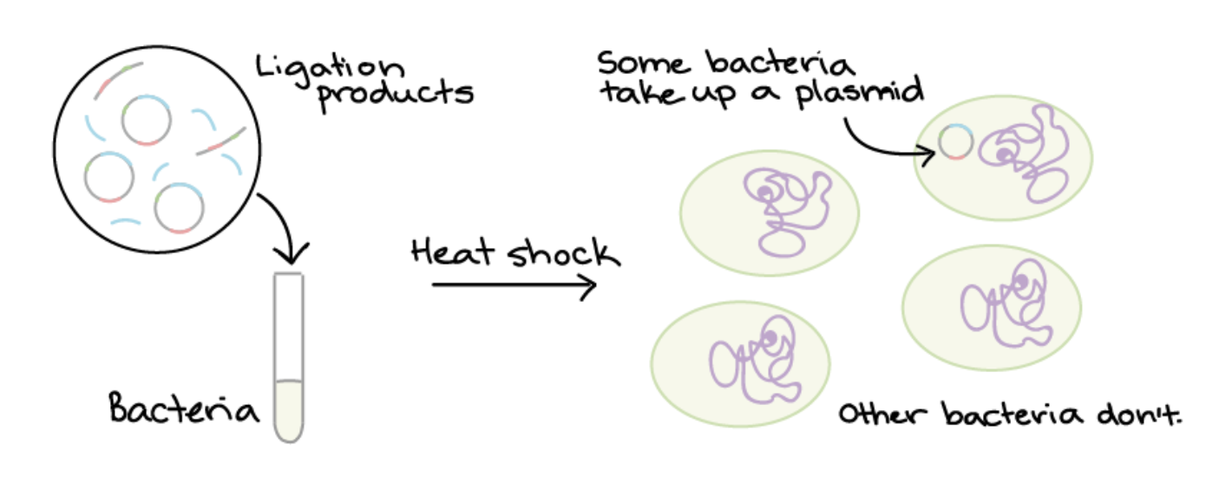
Plasmid
Notes:
In order to increase the expression of TGF-β, a plasmid needs to be created. A plasmid is a small circular double stranded piece of DNA, where a target gene can be inserted in order to create recombinant DNA (DNA assembled out of fragments), in this experiment it will be TGF-β that will be inserted into the plasmid.
The TGF-β plasmid that is going to be used in the experiment can be ordered from add gene.
The TGF-β plasmids need to be introduced into cells. This process is called bacterial transformation, it’s when the plasmids are mixed with bacteria, go through a heat shock, and then plated on antibiotic plates. Bacteria that contain plasmids will survive, because plasmids are antibiotic resistant.

Slide 6
PCR
Notes:
To amplify the amount of TGF-β, PCR can be performed. PCR is a process where the DNA sequence of interest is amplified to make millions of copies. There are three steps to this process.
Step 1: Denaturation is when the two strands in DNA are separated by increasing the temperature of the mixture, this breaks the hydrogen bonds between the strands.
Step 2: Annealing, primers attach to each strand
Step 3: Extension, new strands are made by DNA polymerase
Million copies of TGF-β can be produced during this process, this will allow for overexpression of TGF-β.

Slide 7
Tet-On inducible system
TGF-β
Notes:
In the Tet-On system, doxycycline (dox), binds to the reverse tetracycline transactivator (rtTA) binding it to the promoter, this allows for TGF-β to be expressed . When doxycycline doesn’t bind, TGF-β is not expressed.

Slide 8
Western blot
Gel electrophoresis
Proteins are transferred to a membrane
Blocking solution
Primary anti body
Secondary antibody connected to a fluorophore
Imaging system
Notes:
Western blot is technique used to detect a specific protein. It can be used to analyze the expression levels of TGIF1.
Proteins are separated by size and charge, in an electrical field, the heavier proteins travel down slowly
Proteins are transferred to a membrane, which allows for protein detection
A blocking solution is applied to prevent non-specific binding
A primary anti-TGIF1 antibody then attaches to TGIF1
A secondary antibody that’s attached to a fluorophore is connects to the primary antibody
The membrane then goes through an imaging system where it detects and documents the fluorophore signal

Slide 9
Dox (+) + TGF-β plasmid
Dox (-) + TGF-β plasmid
Dox (+) + TGF-β plasmid
Dox(-) + empty plasmid
TGIF1
Dox (+) + TGF-β plasmid
Dox (-) + TGF-β plasmid
Dox (+) + empty plasmid
Dox(-) + empty plasmid
TGIF1
Dox(+) = overexpression
Dox(-)= no overexpression
Notes:
When TGF-β is overexpressed, TGIF1 is inhibited. When TGF-β is not expressed, TGIF1 is expressed. When ther
The bands for the empty plasmids are the same, this shows that the plasmids in the experiment work.
The results show that when TGF-β is overexpressed, TGIF1 is inhibited.Knowing this, it allows for insight between the relationship TGF-β and TGIF1, and how TGIF1 functions as a tumor suppressor. Hopefully, this experiment can help researchers to further understand the mechanisms of how PDAC accelerates.

Slide 10
References
Parajuli, Parash, Purba Singh, Zhe Wang, Lianna Li, Sailaja Eragamreddi, Seval Ozkan, Olivier Ferrigno, Celine Prunier, Mohammed S Razzaque, Keli Xu, and Azeddine Atfi (2019). "TGIF1 Functions as a Tumor Suppressor in Pancreatic Ductal Adenocarcinoma." EMBO Journal 38.13
Hingorani, Sunil R, Lifu Wang, Asha S Multani, Chelsea Combs, Therese B Deramaudt, Ralph H Hruban, Anil K Rustgi, Sandy Chang, and David A Tuveson (2005). "Trp53 R172H and Kras G12D Cooperate to Promote Chromosomal Instability and Widely Metastatic Pancreatic Ductal Adenocarcinoma in Mice." Cancer Cell 7.5: 469-83. Web.
Yeh, Hsi-Wen, Hsu, En-Chi, Lee, Szu-Shuo, Lang, Yaw-Dong, Lin, Yuh-Charn, Chang, Chieh-Yu, Lee, Suz-Yi, Gu, De-Leung, Shih, Jou-Ho, Ho, Chun-Ming, Chen, Chian-Feng, Chen, Chiung-Tong, Tu, Pang-Hsien, Cheng, Ching-Feng, Chen, Ruey-Hwa, Yang, Ruey-Bing, and Jou, Yuh-Shan (2018). "PSPC1 Mediates TGF-β1 Autocrine Signalling and Smad2/3 Target Switching to Promote EMT, Stemness and Metastasis." Nature Cell Biology 20.4: 479-491. Web.
Das, Atze, Tenenbaum, Liliiane, & Berkhout, Ben (2016). Tet-On Systems For Doxycycline-inducible Gene Expression. Current gene therapy, 16(3), 156–167. doi:10.2174/1566523216666160524144041
Garibyan, L., & Avashia, N. (2013). Polymerase chain reaction. The Journal of investigative dermatology, 133(3), 1–4. doi:10.1038/jid.2013.1
Lee, P., Costumbrado, J., Hsu, C., & Kim, Y. (2012). Agarose Gel Electrophoresis for the Separation of DNA Fragments. Journal of Visualized Experiments, (62), Journal of Visualized Experiments, 2012, Issue 62.

