Slide 1
The regulation of γ- globin and LRF/ZBTB7A by Krüppel-like Transcription Factor KLF1 in Human Erythroid Cells
Rashmi Naidu
Mentor: Dr. Joyce Lloyd

Slide 2
Sickle Cell Disease (SCD)
Notes:
It is currently estimated that at least 300,000 children with these diseases are born every year, giving rise to a worldwide population of tens of millions of patients with these diseases

Slide 3
What is Sickle Cell Anemia?
A subset of Sickle Cell Disease (SCD) -- a group of inherited red blood cell disorders
Caused By: mutation which affects Chromosome 11 of HBB (encodes for beta chain of hemoglobin)
What is the result of this mutation?
Sickle cells de-oxygenate → form polymers
Rigid Polymers distort the cell (“sickle” shape)
Blockage of vessels
Infarcts
Lower Oxygen delivery to Tissues
Fig. 7.14
Victor Hoffbrand and Paul A.H. Moss. Essential Haematology. WILEY Blackmail. 2011.
Notes:
Sickle Cell Anemia is actually considered a subset of Sickle Cell Disease, the previously mentioned group of inherited red blood cell disorders.
It is caused by a mutation which affects Chromosome 11 of HBB. This mutation encodes for the beta chain of hemoglobin and furthermore synthesizes the beta globin protein.
The actual mutation is considered a point mutation that occurs in the 17th nucleotide in the beta chain, which ends up changing the amino acid at the 6th position from a Glutamic Acid to a Valine (Since Thymine → Adenine).
The now sickle cells, once they release oxygen (de-oxygenate) from peripheral tissues, they tend to adhere together and form long chains of fibers, or polymers. The rigid polymers distort the cell, giving it the marked sickle cell shape.
Some of the treatments for Sickle Cell Anemia include caring of current symptoms and even blood transfusions. However, one complication that is arising with transfusions is the overload of iron that occurs due to a high presence of iron in donated blood. This happens even when strict regimens are pursued to remove heavy metals from the body using chelating agents.
Scientists, specifically my mentor’s lab are looking to focus on the crucial developmental switch from fetal to adult hemoglobin at the time of birth.

Slide 4
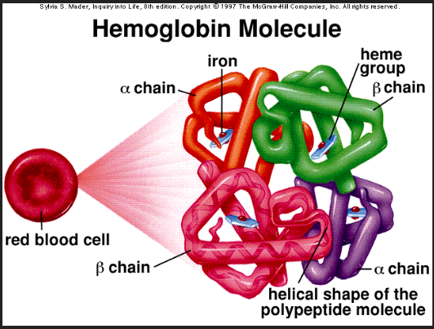
The Switch of Expression from Fetal to Adult Hemoglobin
Human beta globin locus → Chromosome 11
(regulated as development occurs)
ε-globin: embryonic form of beta-globin
Γ-globin: HbF (predominant until birth)
Β-globin: HbA
Notes:
The hemoglobin molecule is a tetramer composed of two subunits of a-like globin peptide chains and two subunits of the b-like globin peptides, along with heme moieties necessary for this molecule’s oxygen-carrying capacity
A variety of beta globin like molecules are produced due to the fact that the human beta globin locus on chromosome 11 is regulated as human development occurs.
the predominant b-like globin molecule produced is g-globin, This molecule is encoded by two duplicated g-globin genes found within the b-globin gene cluster. This ends up combining the two gamma globin chains with with adult globin forming fetal hemoglobin tetramer (HbF)
At time of birth, there is a switch of expression from fetal hemoglobin to hemoglobin as we know it (adult expression). This switch relies mainly on the transcriptional switch from gamma to beta globin.

Slide 5
Increased γ-globin expression: Could it be a solution?
Hereditary Persistence of Fetal Hemoglobin (HPFH):
Fetal hemoglobin present after developmental switch
Reduced symptoms of SCD → increased expression of fetal hemoglobin (γ-globin)
Point Mutations in the promoters of γ-globin genes
Promoters of γ-globin genes interact with factors that repress/silence expression!
Notes:
the maintenance of fetal
hemoglobin levels well beyond
the point in which hemoglobin is
switched from fetal to adult (γ- to β-
globin).
Those
diagnosed with hereditary
persistence of fetal hemoglobin,
in addition to sickle cell disease,
exhibit reduced symptoms of
the disease due to the increased
expression of fetal hemoglobin
in the form of the γ-globin.
the promoters of gamma globin genes interact
with factors that repress/silence expression so that even though gamma globin is present, it is
being modulated simultaneously with the adult beta globin.

Slide 6
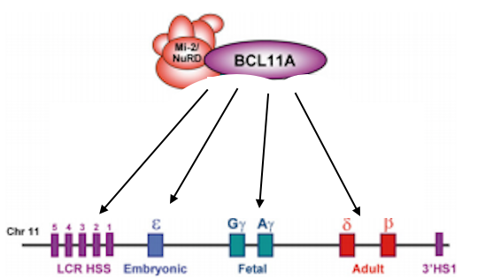
Repressors of γ- globin
BCL11A:
More studied
Binds to LCR + intergenic regions b/w fetal and adult hemoglobin genes
LRF/ZBTB7A:
Not as studied
Works independently of BCL11A
Recruits NuRD Complex
REGULATION of these γ- globin repressors

Slide 7
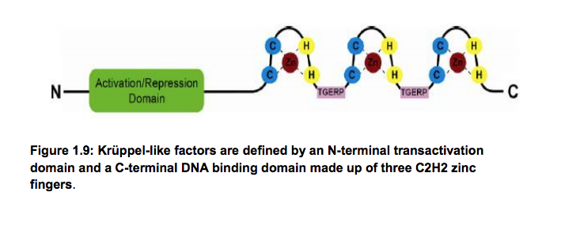
KLF1
Molecular Regulator of Hemoglobin Switching
Derived from a family of Cys2-His2 zinc finger transcription factors
Notes:
KLF1 has emerged as a key regulator of almost all aspects of erythrocyte development:
bet a globin
Cell cycle
Heme synthesis enzymes
Membrane formation
Previous studies in mouse models showed that a reduction of KLF1 resulted in lower hemoglobin (in general)

Slide 8
Experiment Rundown
Knockdown of KLF1 (achieved by Lentiviral Infection)
qRT-PCR to measure expressions levels in:
KLF1, LRF/ZBTB7A, γ- globin

Slide 9
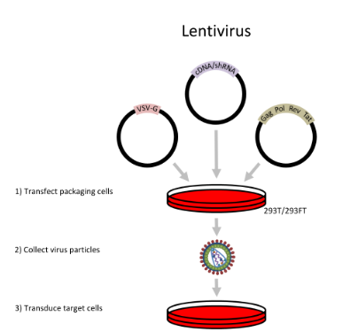
Lentiviral Infection Technique
Taken from Fig. 1 Keefe E. Nucleic Acid Delivery: Lentiviral and Retroviral Vectors. Materials and
Methods. ISSN:2329-5139. doi: //dx.doi.org/10.13070/mm.en.3.174

Slide 10
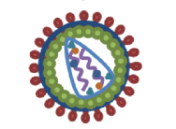
Lentiviral Knockdown of KLF1
Normalized control: Scramble
K1V1 knockdown
293T packaging cells
Collect virus particles
(use about 6 viruses to infect)
Virus infects HUDEP-2 cell Line
qRT-PCR used to measure from there
Notes:
Two KLF1-targeted shRNA vectors (pRRL_K1V1 and pRRL_K1V2) as well as a scrambled shRNA vector (pRRL_Scr) were acquired. In addition to the shRNA-coding sequence they carry a GFP-coding sequence, which aids in identification and recovery of successfully infected cells by FAC. Out of the five shRNAs tested, only two, K2sh_206 and K2sh_1529, successfully knocked down KLF2 mRNA.

Slide 11
RNA Interference with shRNAs
What was being carried in the Lentiviral Vectors to knockdown KLF1?
sHRNAs: artificial RNA molecule that can be used to silence gene expression via RNA Interference (RNAi)
RNAi:
RNA Induced Silencing Complex
SiRNAs find complementary base pairing w/ mRNA transcript and latch on
Notes:
- rna interference is used to control genes
- small interfering RNAs are derived from longer, double stranded RNAs; delivered into cells experimentally
- RNA induced silencing complex: multiprotein complex which takes one strand of the siRNA in order for RISC to recognize the target mRNA transcript.
- siRNAs find complementary base pairing with the mRNA transcript and thus latch on, and the mRNA is then cleaved and destroyed

Slide 12
qRT-PCR
Relative Quantification Method:
(E^Ctendogenous gene/E^Cttest gene)
Same steps as PCR…
Denaturation
Annealing
Extension
But qRT-PCR…
Injects a fluorescent dye
Measures changes in gene expression
Quantitative: over replication cycles...
more product = more fluorescent dye.
Used analyze changes in gene expression in KLF1-shRNA treated samples compared to Scr-shRNA controls

Slide 13
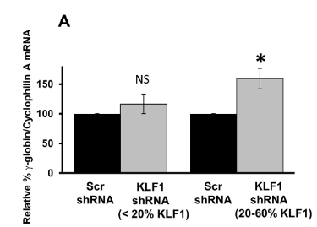
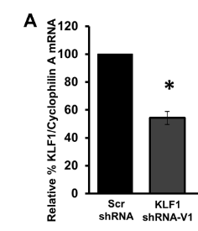
Hypothetical Results

Slide 14
Hypothetical Results Cont.
100
Relative % LRF/ZBTB7A/Cyclophilin A mRNA
?
50
Scr shRNA
KLF1 shRNA-V1

