Slide 1
The effect of RNA splicing on opioid tolerance
Suha Minai

Slide 2
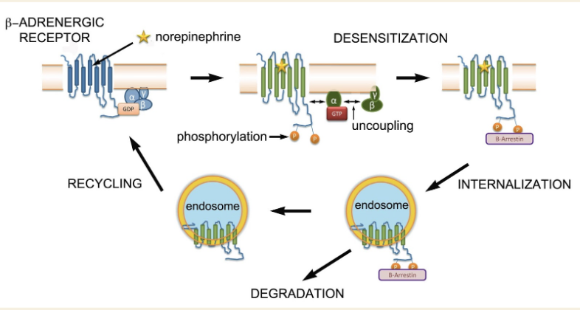
Opioid Tolerance
Opioids=strong pain relief→incentive to consume
Over time, receptors are worn down (desensitization), sink further into cell (internalization)→more opioids consumed
Notes:
Opioid receptors degraded or recycled, but not enough are recycled to compensate for so many opioids, hence tolerance

Slide 3
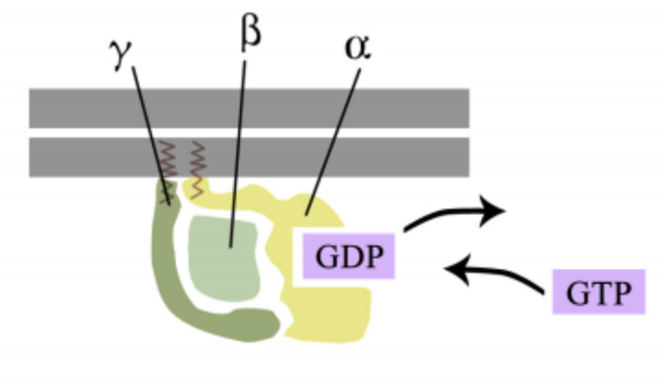
GPCRs
GPCRs=alpha, beta, gamma subunits
Activated by GTP
Opioid receptors=subunit of GPCR
Splicing mRNA of receptors→ different rate of tolerance?
Notes:
GPCRs=three subunits, alpha uncouples from beta and gamma during tolerance, stimulated by a molecule called GTP that activates the GPCR
Opioid receptors are a subset of GPCRs
GPCRs are proteins, direct translations of mRNA, so splicing could create different variants of mRNA and also impact the rate of opioid tolerance

Slide 4
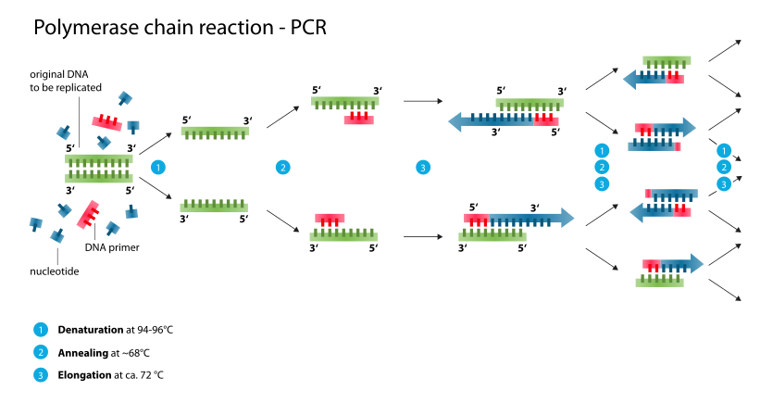
PCR
Thermostable (aka “taq”) polymerase amplifies a specific region of DNA
qPCR=PCR with fluorescence
PCR and qPCR also analyze sequences for differences
Notes:
In PCR, DNA denatured via heat, primers and nucleotides are attached, and DNA replicates in cycles that repeat very quickly, hence rapid amplification
dNTP=deoxyribonucleotide triphosphate, a type of nucleotide used often in PCR
In qPCR, amplified DNA is fluorescently labeled and fluorescence is released proportional to the amount of amplified DNA

Slide 5
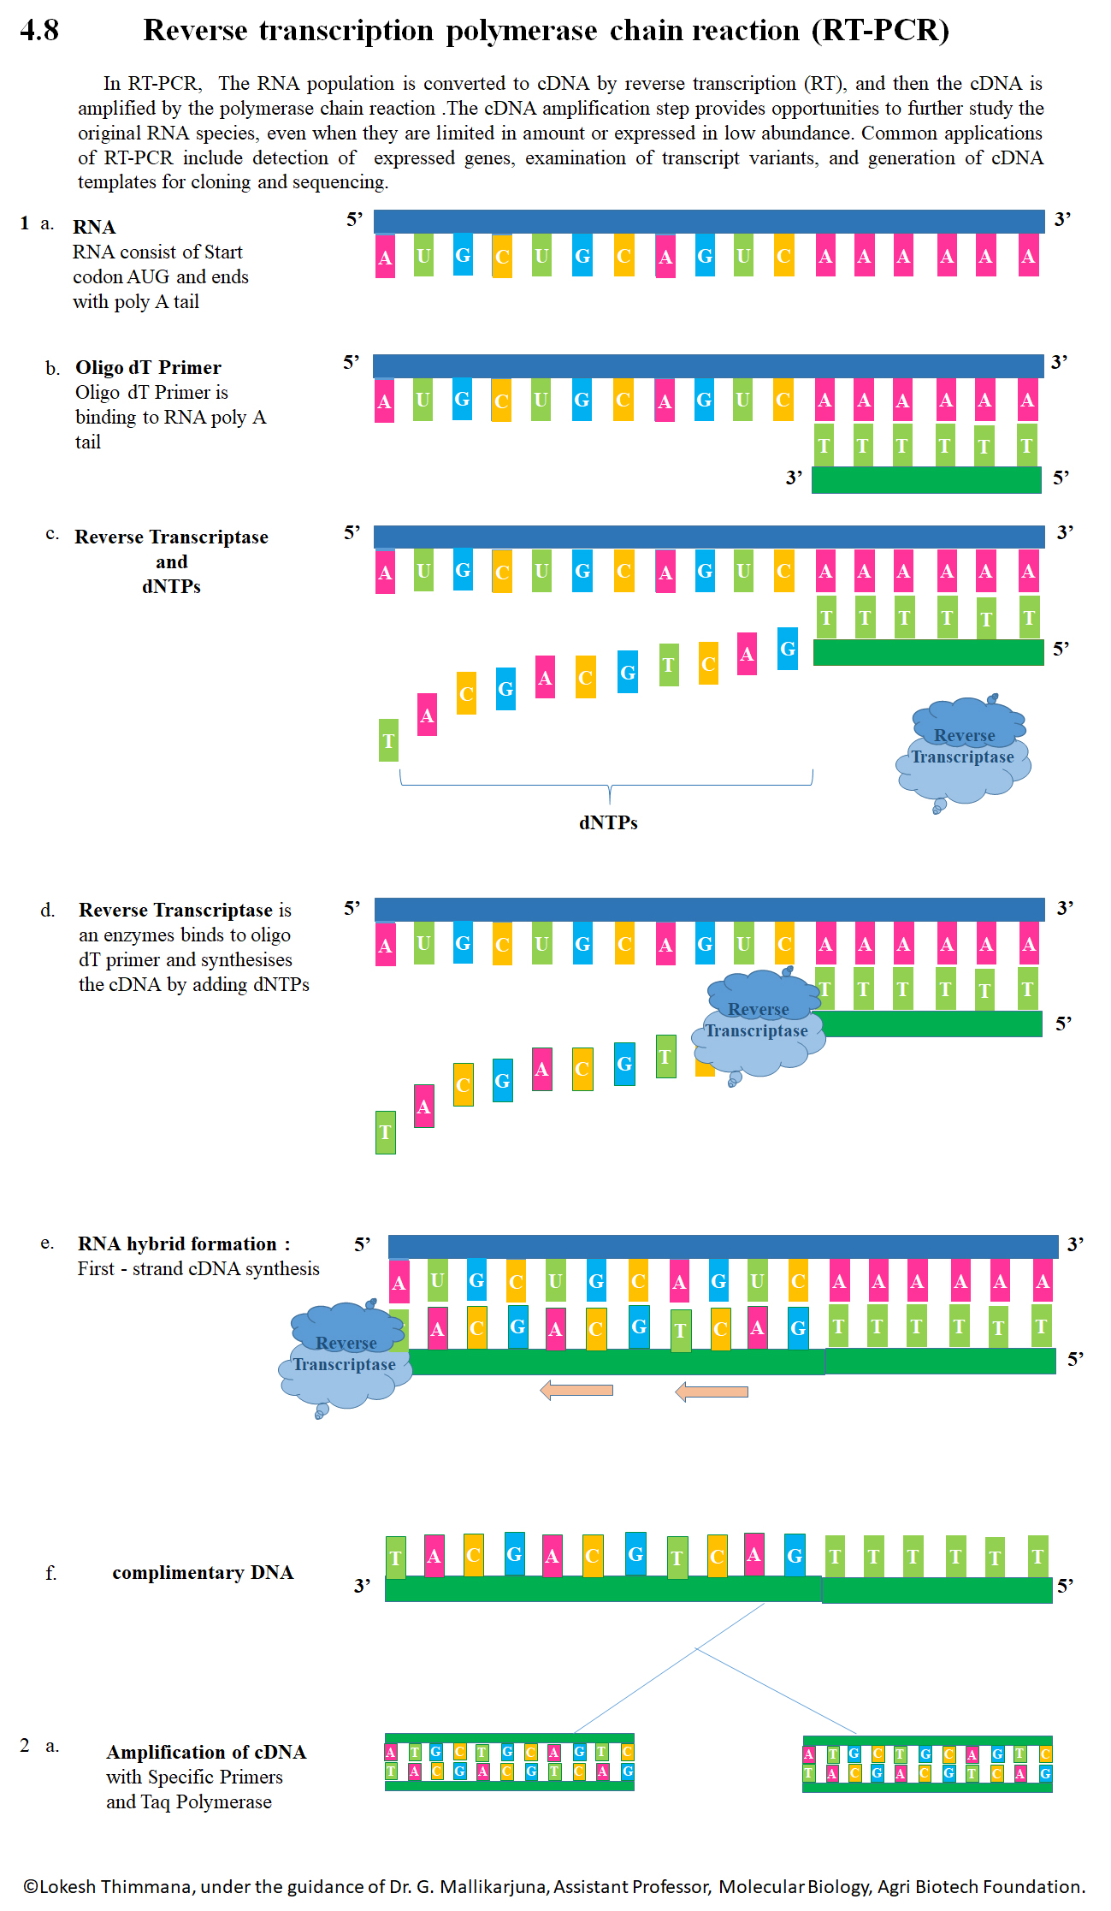
RT-PCR
Can’t use Taq to amplify RNA so reverse transcriptase instead, same procedure as regular PCR
Product=double stranded DNA segment analogous to target RNA segment

Slide 6
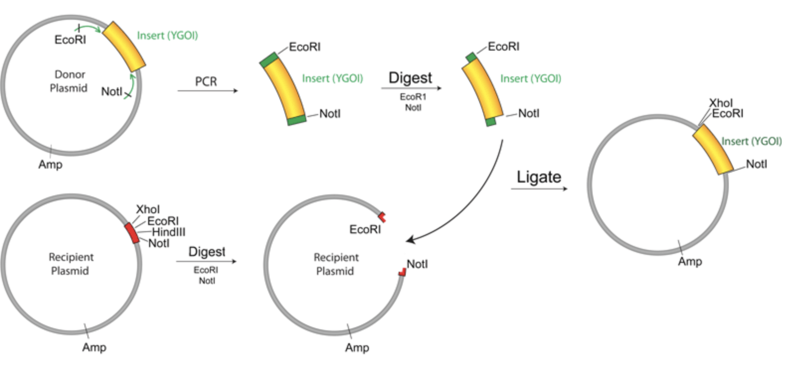
RNA Splicing (pre-tolerance)
Cloning into vector (manual method of splicing) shown in figure
Aim of the experiment and why cloning into vector won’t be done
Splices analyzed via qPCR assays for how many, composition, and possible changes
Notes:
Cloning into vector=run PCR first → use restriction digests on RNA product and receiving plasmid → isolate RNA via gel purification → fuse the RNA to the plasmid (RNA ligation) → introduce the RNA into the cell via transformation (like a transfusion)
Aim of the experiment is not to create splices but to explore how splice variants impact opioid tolerance so splices will only be analyzed
How many, composition, and how they might change

Slide 7
Opioid Tolerance Measurement
Two groups of mice: one group pelleted with morphine, the other with placebo pellets
Fecal output monitored until tolerance reached

Slide 8
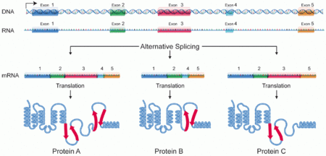
RNA Splicing (post-tolerance)
mRNA splices analyzed w/ qPCR assays similar to pre-tolerance
Post-tolerance and pre-tolerance splices compared–how, what, and why

Slide 9
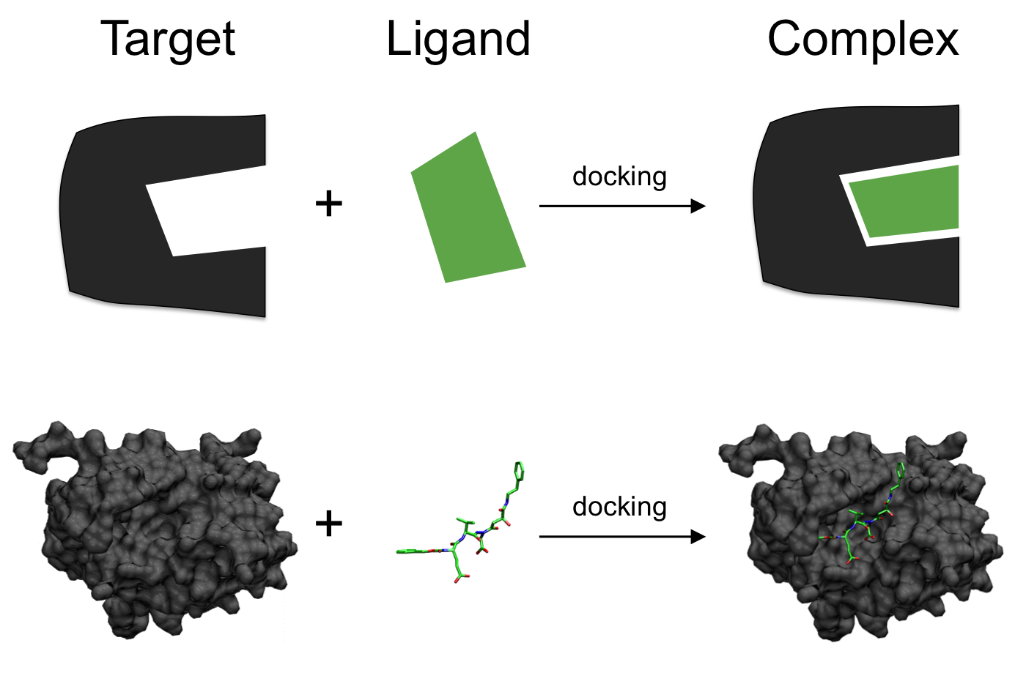
Possible Alternate Method
Molecular docking
Can assess binding affinity of ligands to receptors in different binding positions
Does not take into account splice sites
Notes:
Molecular docking=a type of drug identification computational protocol

Slide 10
Why Should We Care?
Main cause of opioid addiction=lack of knowledge of how tolerance works
Exploring the relationship between splicing and tolerance can be very helpful medically

Slide 11
References
1. Allouche, S; Noble, F; Marie, N (2014). Opioid receptor desensitization: mechanisms and its link to tolerance. Frontiers in Pharmacology, 5:280. <https://doi.org/10.3389/fphar.2014.00280>
2. Johnson, KA; Lovinger, DM (2016). Presynaptic G Protein-Coupled Receptors: Gatekeepers of Addiction? Frontiers in Pharmacology, 10:264. <https://doi.org/10.3389/fncel.2016.00264>
3. Xu, J; Lu, Z; Xu, M; Rossi, GC; Kest, B; Waxman, AR; et al (2014). Differential Expressions of the Alternatively Spliced Variant mRNAs of the µ Opioid Receptor Gene, OPRM1, in Brain Regions of Four Inbred Mouse Strains. PLoS ONE, 9(10): e111267. <https://doi.org/10.1371/journal.pone.0111267>
4. Baralle, D; Buratti, E (2017). RNA splicing in human disease and in the clinic. Clin Sci, 131 (5):355-368. <https://doi.org/10.1042/CS20160211>
5. Lee, Y; Rio, DC (2015). Mechanisms and Regulation of Alternative Pre-mRNA Splicing. Annual Review of Biochemistry, 84:291-323. <https://doi-org.proxy.library.vcu.edu/10.1146/annurev-biochem-060614-034316>
6. Ebrahimi, G; Asadikaram, G; Akbari, H; Nematollahi, MH; Abolhassani, M; Shahabinejad, G (2017). Elevated levels of DNA methylation at the OPRM1 promoter region in men with opioid use disorder. The American Journal of Drug and Alcohol Abuse: Encompassing All Addictive Disorders, 44(2). <https://doi.org/10.1080/00952990.2016.1275659>
7. Refke, M; Pasternack, SM; Fiebig, B; Wenzel, S; Ishorst, N; Ludwig, et al (2011). Functional analysis of splice site mutations in the humanhairless (HR) gene using a minigene assay. British Journal of Dematology, 165(5):1127-32. <https://doi-org.proxy.library.vcu.edu/10.1111/j.1365-2133.2011.10495.x>
8. Čepin, U. (2017). Real-Time PCR (qPCR) Technology Basics. Biosistemika. <https://biosistemika.com/blog/qpcr-technology-basics/>
9. Mischel, RA.; Dewey, WL.; Akbarali, HI. (2018) Tolerance to Morphine-Induced Inhibition of TTX-R Sodium Channels in Dorsal Root Ganglia Neurons Is Modulated by Gut-Derived Mediators. iScience, 2:193-209. <https://doi.org/10.1016/j.isci.2018.03.003>
10. Kang, M; Mischel, RA; Bhave, S; Komla, E; Cho, A; Huang, C; et al (2017). The effect of gut microbiome on tolerance to morphine mediated antinociception in mice. Scientific Reports, 7: 42658. <https://doi.org/10.1038/srep42658>
11. Ellis, CR; Kruhlak, NL; Kim, MT; Hawkins, EG; Stavitskaya, L. (2018). Predicting opioid receptor binding affinity of pharmacologically unclassified designer substances using molecular docking. PLoS ONE, 13(5): e0197734. <https://doi.org/10.1371/journal.pone.0197734>
12. Guruatma "Ji" Khalsa. (2010, April 12). PCR (polymerase chain reaction). ASU - Ask A Biologist. <https://askabiologist.asu.edu/pcr-polymerase-chain-reaction>

