Slide 1
An Ethanol Resistant Clustering Phenotype
By Dylan Lee

Slide 2
Ethanol Targets C. Elegans and The BK Channel
Alcohol abuse is a large problem in society
The intoxicating effect of ethanol are not well understood and there are a variety of ethanol targets
The BK Channel is one of those targets

Slide 3
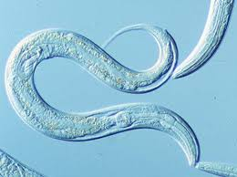
Caenorhabditis Elegans
Soil Nematode
Lives on Ecoli
Hermaphrodite and Male
Produces about 100 offspring a day
About 1000 cells long
Growable on Petri Dishes
Shares 60% of the human genome
Transparent
Affected by ethanol

Slide 4
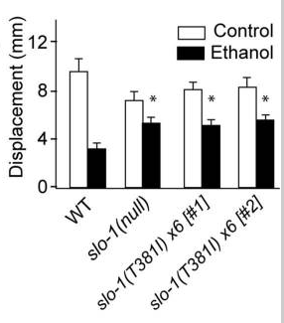
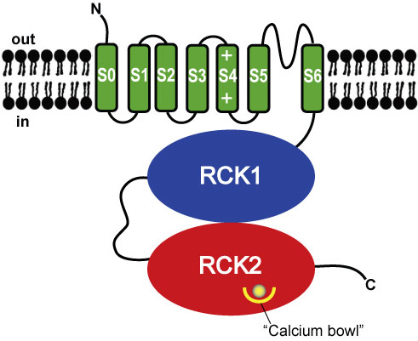
Slo-1 lf &Slo(T381)-1
The Bk Channel is encoded by the Slo-1 gene. It is a calcium and voltage gated channel
Here is where it gets confusing
Slo-1lf non functional BK is highly resistant to ethanol
There is a highly conserved cytosolic threonine at the 381st position that when mutated in a wt animal gives said animal the ethanol resistance of a slo-1 mutant.

Slide 5
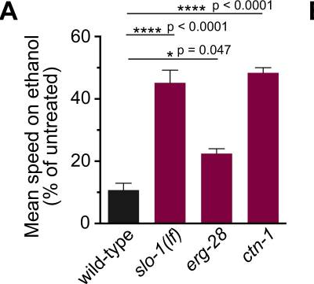
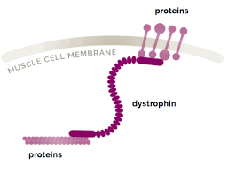
Ctn-1
There exists a dystrophin mutation Ctn-1 that is resistant to ethanol
Ctn-1 acts on the BK Channel
The BK Channel normally appears on neurons and muscles cells in a clustered phenotype
The Ctn-1 mutation causes the bk channel to form an unclustered phenotype on muscle cells and neurons
Worms with the Ctn-1 mutation express an alcohol resistant phenotype comparable to slo-1(lf).

Slide 6
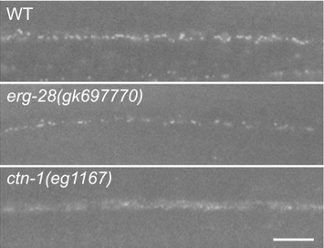

Slide 7
Hypothesis
Does the Slo(T381)-1 BK Channel form Clusters?

Slide 8
Proposed Methods
There exists a strain of worm with green fluorescent protein attached to its BK channel. I propose taking a worm and using crispr to make a T->I mutation at the 381st threonine. Then after performing the necessary steps to verify the mutant worm has been successfully created using the microscopy procedure outlined in Oh et al to take a picture and see if a clustered phenotype exists.

