Slide 1
Possibility of a stronger antibody to block Glioblastoma
Hanna Kwon

Slide 2
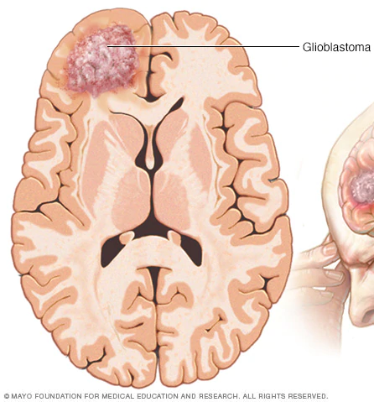
Glioblastoma

Slide 3
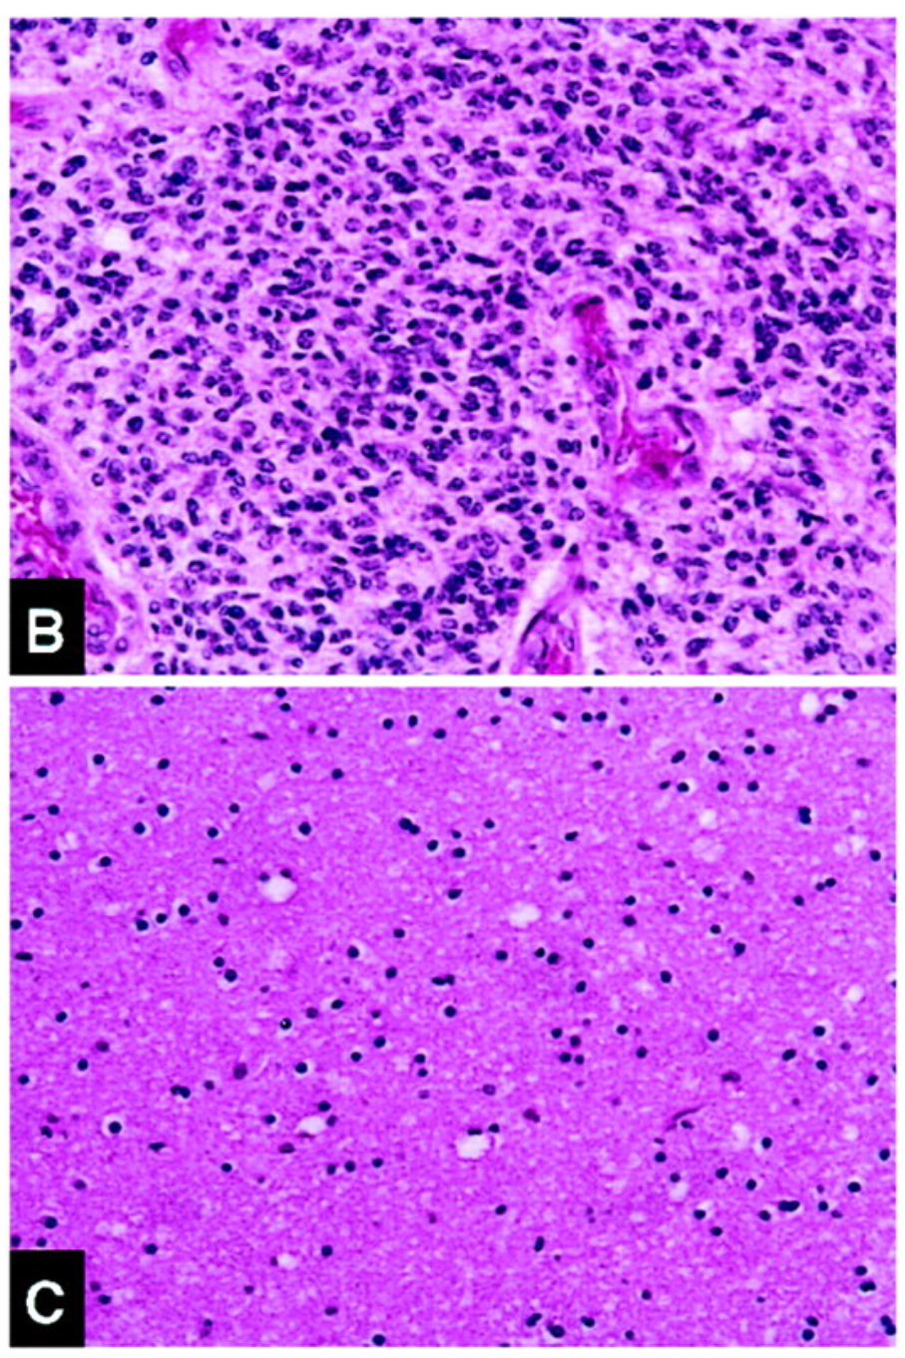

Slide 4
About FGL2 Protein

Slide 5
Goal

Slide 6
Deciding if creating an anti-IGFBP2 antibody will help stop tumor progression
Notes:
How I am deciding if it will be useful = compare to FGL2 antibody since it has been proven that it is useful

Slide 7
Effectiveness of IGFBP2

Slide 8
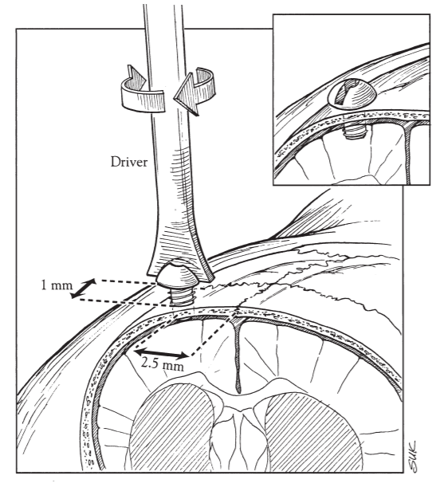
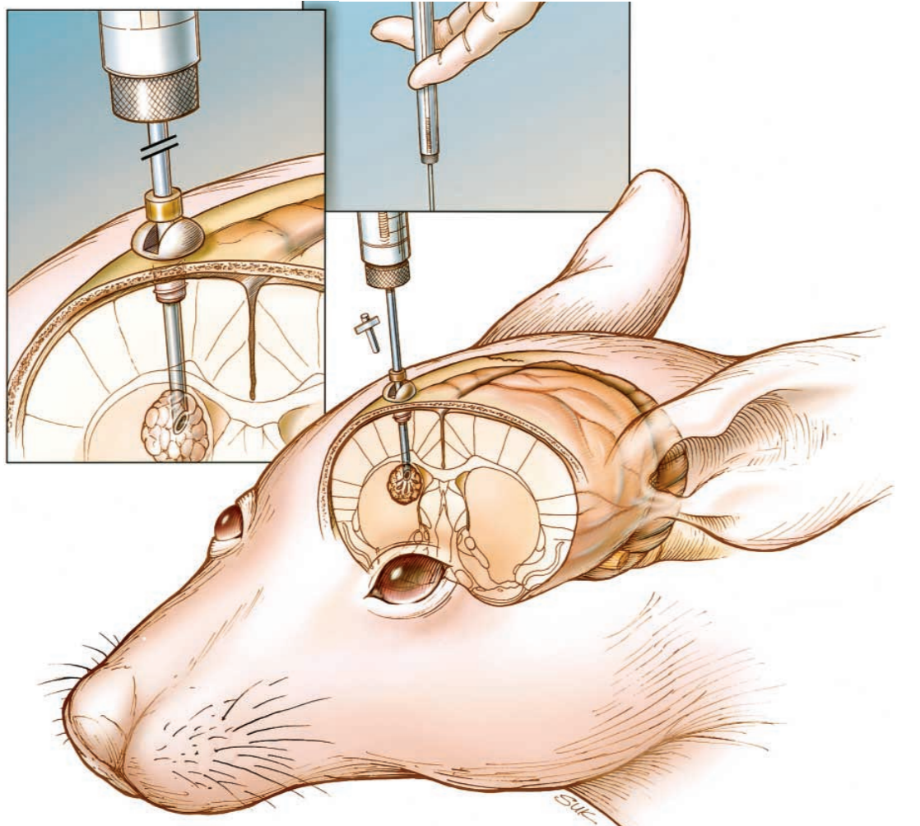
Notes:
Check if this protein boost tumor progression / how effective it is

Slide 9
CD44 Receptors

Slide 10
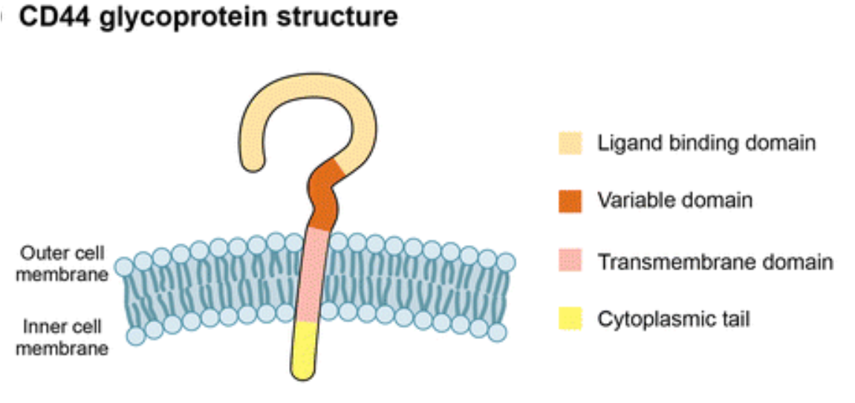

Slide 11
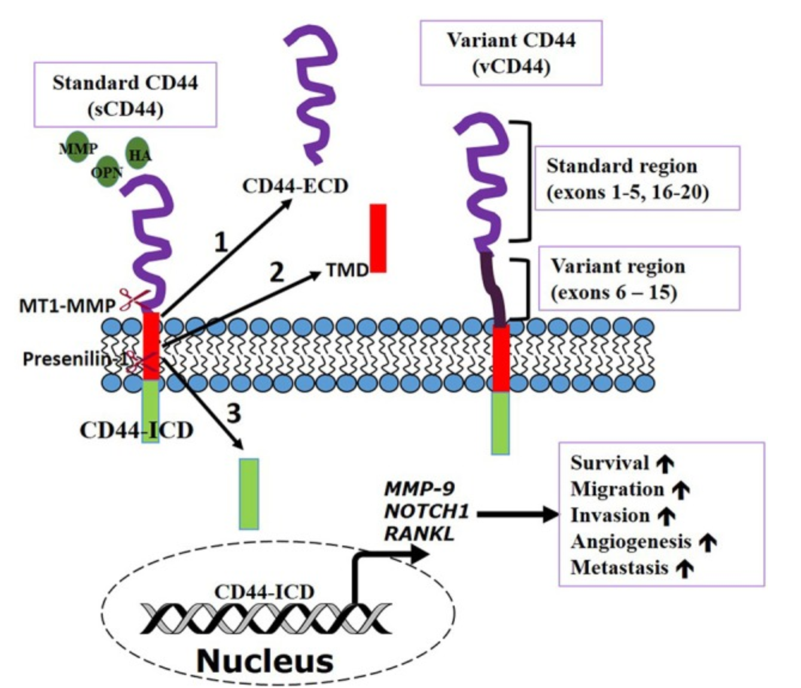
Notes:
ECD: extracellular domain / above surface
TMD: transmembrane domain / can form H bond between carbonyl oxygen and amide nitrogen / contain hydrophobic residue
ICD: translocates nucleus to activate transcription important to metastasis

Slide 12
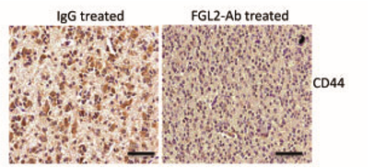

Slide 13
Treg Cells

Slide 14
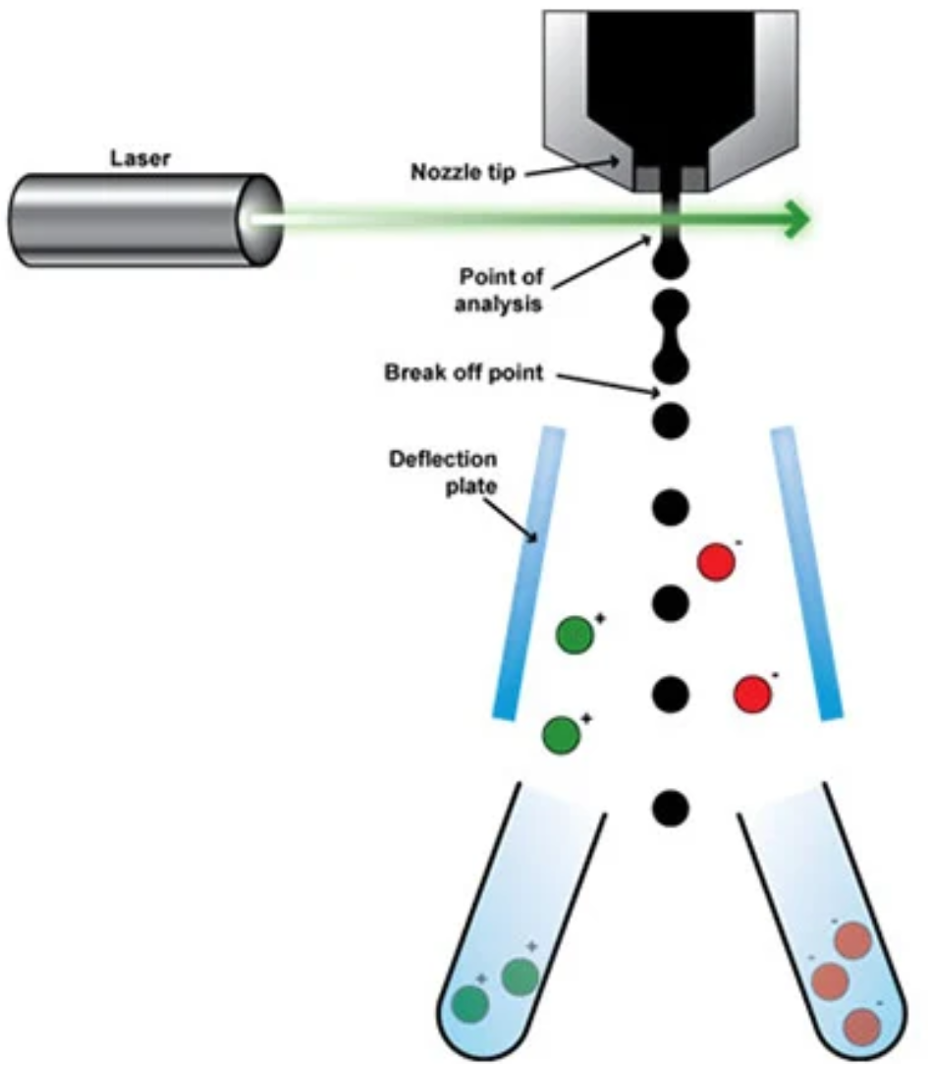

Slide 15
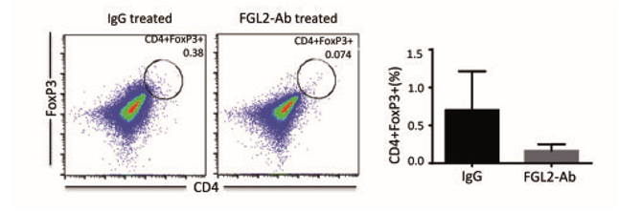

Slide 16
Conclusion
CD44 receptors & Treg cell level should be higher in the control group than the experimental group
anti-IGFBP2 antibodies will be useful to cancer therapy
Maybe combining anti-FGL2 antibodies and anti-IGFBP2 antibodies will boost the medication effect

