Slide 1
A Possible Treatment Method of Malignant Breast Cancer Using Modified Adeno-Associated Virus 2 and the Nur77 Gene.
A research proposal by Evan Korade

Slide 2
What is cancer?
Cancer cells can be defined by two main attributes:
Rapid and uncontrollable cell replication
Lack of, or insufficient, apoptosis (regulated cell death)
Both of these symptoms can be attributed to the Nur77 nuclear receptor

Slide 3
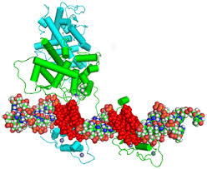
Nur77
Also known as NGFIB, TC3
Hormone-activated protein present in the nuclear envelope.
Regulates gene activation by binding to a presequence nucleotide sequence
Lang et Al, 2015

Slide 4
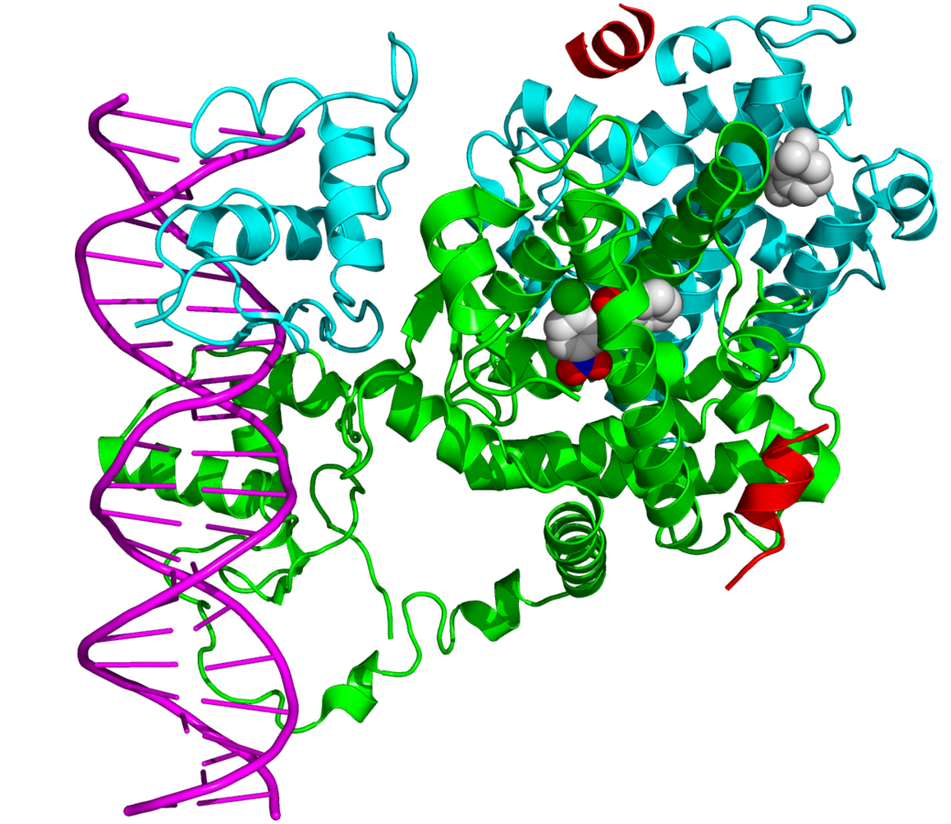
Nur77 is able to bind to different nucleotide sequences based on if it dimerizes, and with what nuclear receptor
Binding with the other receptor adds another DNA binding site, expanding the required sequence
Wikipedia, “Nuclear Receptors”

Slide 5
Dual function of Nur77
The Nur77 receptor plays a vital role in apoptosis in addition to cell replication
Under the right conditions, Nur77 leaves the nucleus and enters the mitochondria, where it initiates apoptosis
Yu et al(2012)

Slide 6
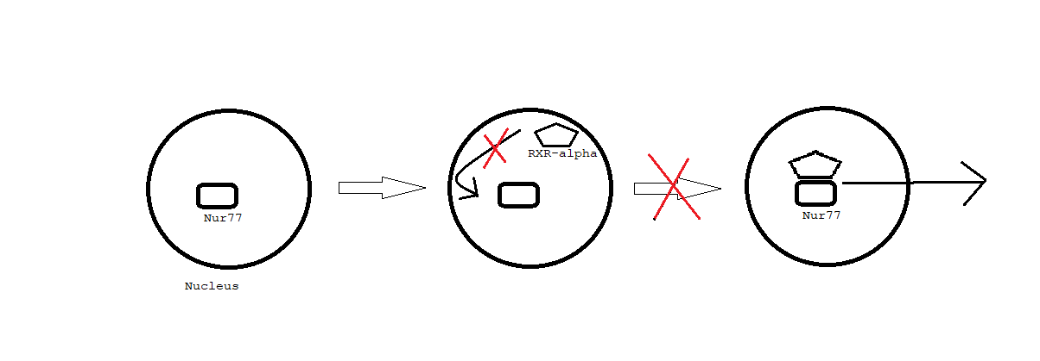
In cancerous cells, Nur77 is found in extremely high levels, yet doesn’t initiate apoptosis
This is due to the inhibition of mitogen-activated protein kinase (MAPK), which phosphorylates the receptor

Slide 7
Viruses have been modified previously to target mitochondrial DNA
The same could be done using a modified Nur77 gene to initiate apoptosis in cancerous cells.

Slide 8
Experiment
This experiment requires
a mutagenesis kit
The isolated Nur77 genome
Isolated adeno-associated virus 2 (AAV2)
Modification sequences

Slide 9
Experiment
Isolation of Nur77 Gene with centrifuging and separating from the chromosome with restriction enzymes

Slide 10
Experiment
The Nurr77 gene needs to be modified to translate properly in mitochondrial DNA
Done using custom designed oligonucleotide primers:
Need to change:
ATA to ATC or ATT
TGA to TGG
AG(A/G) to CG(A/G)

Slide 11
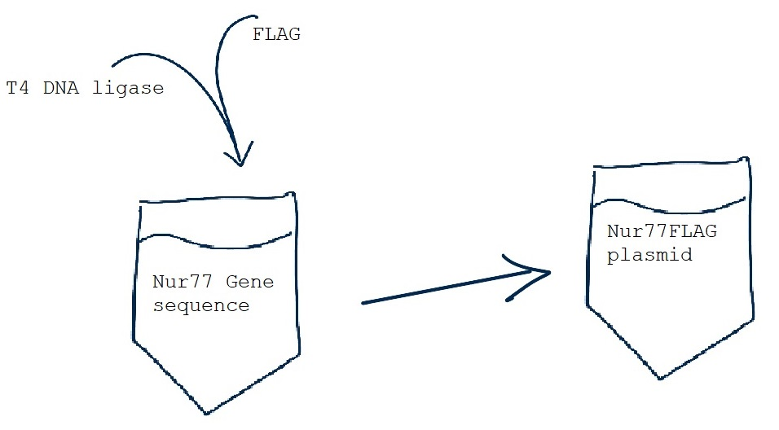
Experiment
Add FLAG sequence to C-terminal
For immunodetection

Slide 12
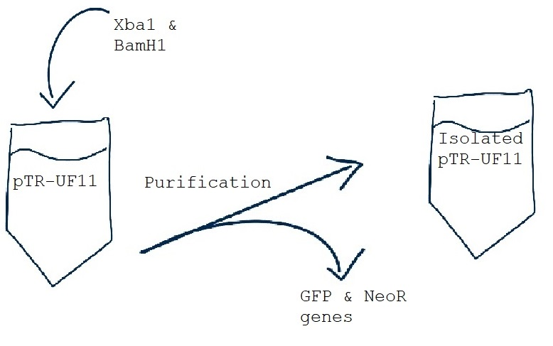
Experiment
Isolate pTR-UF11 backbone
Digest in restriction enzyme solution (Xba1 and BamH1) to remove associated genes

Slide 13
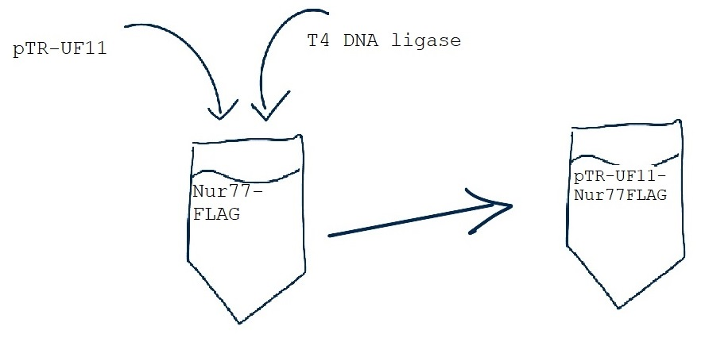
Experiment
Connect pTR-UF11 to N-terminal of Nur77FLAG
Forms pTR-UF11-Nur77FLAG

Slide 14
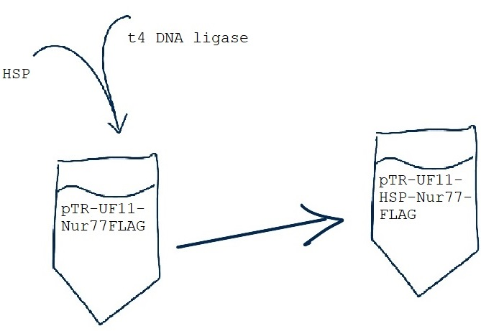
Experiment
Purchase mitochondrial promotor sequence (HSP) with mutagenesis kit
Must be flanked by inverted terminal repeat sequences (ITRs)
Ligate HSP between pTR-UF11 and Nur77FLAG

Slide 15
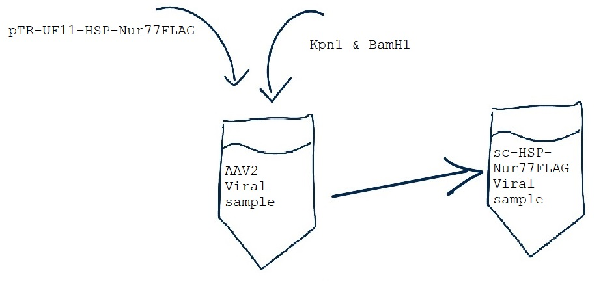
Experiment
Ligate into viral DNA by:
Adding both plasmid and virus to restriction enzyme solution
Removes CMV enhancer and beta-actin promoter from viral genome and pTR-UF11 from HSP-Nur77FLAG, allowing sc-HSP-Nur77FLAG to form

Slide 16
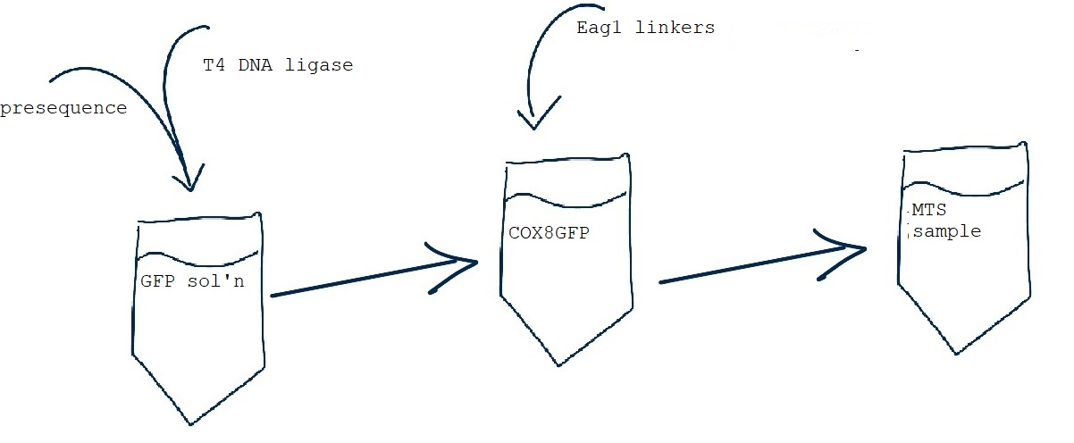
Experiment
Create mitochondrial targeting sequence (MTS)
Isolate 23 amino acid presequence of COX8 into GFP with prepared Eag1 linkers on either side
COX8: cytochrome oxidase subunit 8
GFP: Gene expression reporter

Slide 17
Experiment
Add MTS into the ORF of VP2, a protein that forms the viral protein coat with restriction enzymes and Eag1 targeted ligase

Slide 18
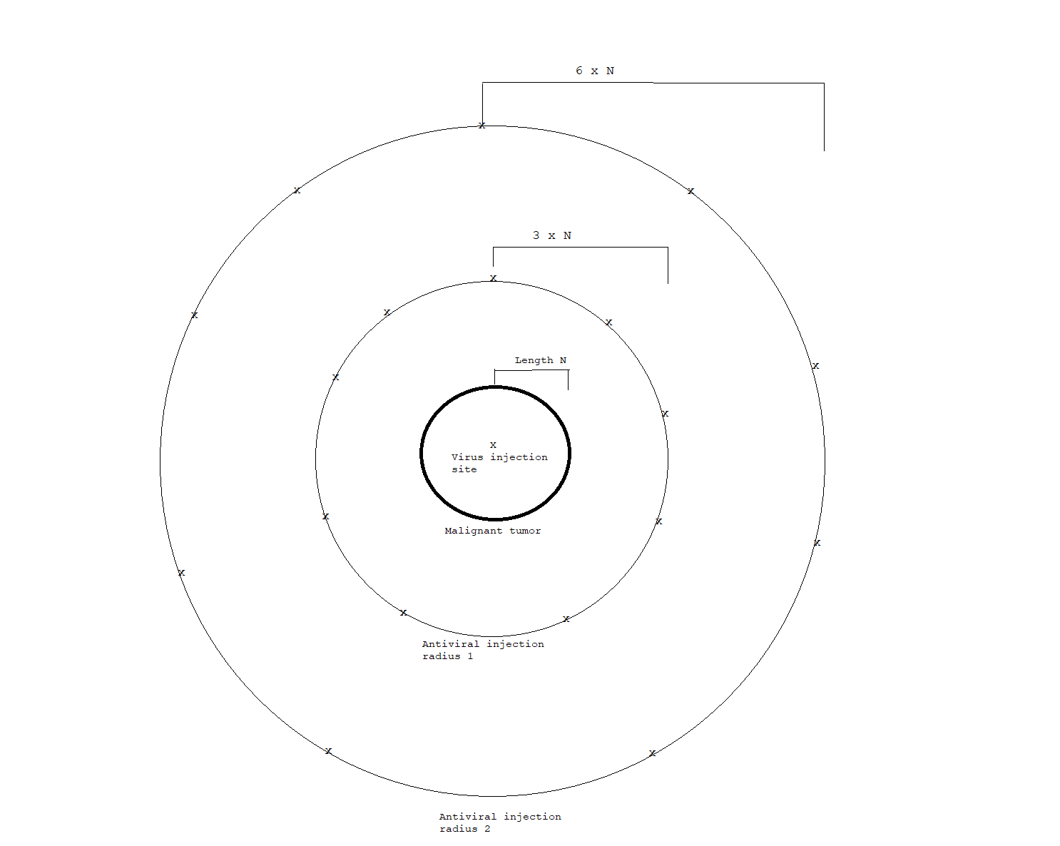
Experiment
Treatment of malignant tumors in mice will happen over multiple trials
In each trial, the amount of viral serum delivered is constant
Injection will be followed by rings of antiviral treatment to prevent viral spread
The amount of time before post-treatment procedure will vary within each trial

Slide 19
Experiment
Post-treatment procedure
An initial flush of glucocorticoids to tissue surrounding tumor inhibits Nur77
Followed by delivery of high-strength antiviral medicine

Slide 20
Analysis
To monitor effectiveness, compare before and after tumor growth rate as well as Ki-67 level changes
Ki-67 – protein produced by cells preparing to divide

