Slide 1
The Role of Defective Channel Trafficking in A341V Mutated KCNQ1 Protein which Results in Long QT Syndrome
Sukhleen Kaur

Slide 2
Background
[1]

Slide 3
Background
[3]
[2]

Slide 4
Background
[4]

Slide 5
Background
[5]
Notes:
Mikuni et al’s experiment

Slide 6
Proposed Question
Does the cell surface expression of A341V KCNQ1 differ from that of wild-type KCNQ1?

Slide 7
Experiment
[8]

Slide 8
Experiment
[7]
[6]
[6]

Slide 9
Experiment
[9]

Slide 10
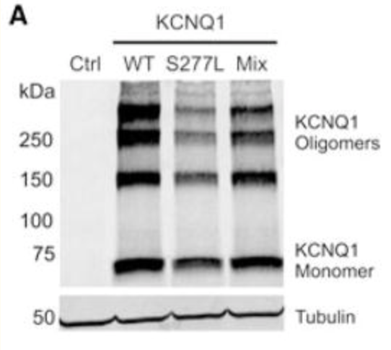
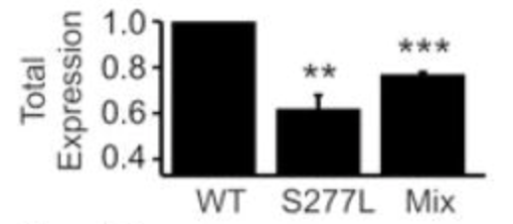
Discussion
[10]
[10]

Slide 11
References
[1] https://upload.wikimedia.org/wikipedia/commons/thumb/9/9e/SinusRhythmLabels.svg/1200px-SinusRhythmLabels.svg.png
[2] https://cdn.rcsb.org/images/rutgers/vm/5vms/5vms.pdb1-500.jpg
[3] https://www.vanderbilt.edu/vicb/images/discovery/2018/how_potassium_channel_mutations_heart_arrhythmias_fig1.jpg
[4] Wang, Z., Tristani-Firouzi, M., Xu, Q., Lin, M., Keating, M., & Sanguinetti, M. (1999). Functional Effects of Mutations in KvLQT1 that Cause Long QT Syndrome. Journal of Cardiovascular Electrophysiology, 10(6), 817–826. doi: 10.1111/j.1540-8167.1999.tb00262.x
[5] Mikuni, I., Torres, C. G., Bienengraeber, M. W., & Kwok, W.-M. (2011). Partial restoration of the long QT syndrome associated KCNQ1 A341V mutant by the KCNE1 β-subunit. Biochimica Et Biophysica Acta (BBA) - General Subjects, 1810(12), 1285–1293. doi: 10.1016/j.bbagen.2011.07.018
[6] https://s3-eu-west-1.amazonaws.com/pfigshare-u-previews/3105683/preview.jpg
[7] https://assets.thermofisher.com/TFS-Assets/LSG/figures/CSPBPK_Fig1smws.jpg-650.jpg
[8] https://www.polyplus-transfection.com/wp-content/uploads/2019/04/Transfection-mechanism-jetOPTIMUS.jpg
[9] https://media.scbt.com/product/35/96/b/359655.jpg
[10] Chen, J., Weber, M., Um, S. Y., Walsh, C. A., Tang, Y., & Mcdonald, T. V. (2011). A Dual Mechanism for IKs Current Reduction by the Pathogenic Mutation KCNQ1-S277L. Pacing and Clinical Electrophysiology, 34(12), 1652–1664. doi: 10.1111/j.1540-8159.2011.03190.x

