Slide 1
Measurement of Recurrence in human Triple Negative Breast cancer cell Culture containing the BRCA1 gene
Preksha Jerajani
BNFO 300
Notes:
Ask : what cell line of tnbc are we using?
Specify that the cell line is human

Slide 2
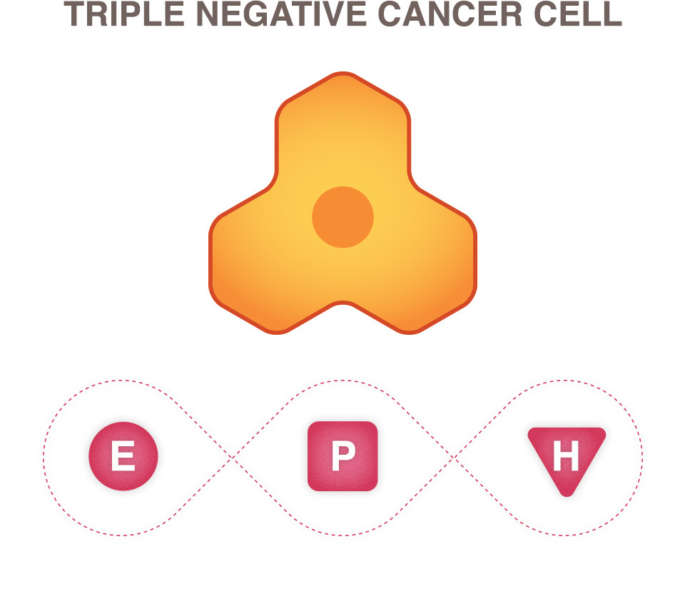
What is TNBC?
Unlike other forms of breast cancer it does not express
Estrogen Receptors (ER)
Progesterone Receptors (PR)
Human epidermal growth factor Receptor 2 (HER2)

Slide 3
23% female breast cancer cases
10-20% of all breast cancer cases account for TNBC

Slide 4
Recurrence is very HIGH between the 1st and 3rd year after treatment.
The aggressiveness of TNBC is highest compared to the other forms of breast cancer.
This is no standardized treatment for TNBC.

Slide 5
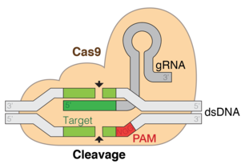
BACKGROUND
GAACTCTGAGGACAAAGCAG
BRCA1 gene
sgRNA
SA-β-Galactosidase Staining
BRCA1
CGG
Notes:
Understand the CRISPR-cas9
How do you know the guide RNA worked– what test?

Slide 6
BRCA1
BRCA – Breast Cancer Susceptibility Gene
BRCA1 is a tumor suppressor gene, it is responsible for repairing DNA.
It is not clear as to why mutations in this gene predispose BRCA1 to breast cancer and not other forms of cancer.
Notes:
Make the sgRNA for BRCA1 a different slide later

Slide 7
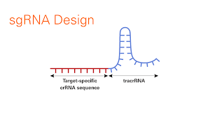
sgRNA
What is it?
It is a 20- nucleotide guide RNA sequence + tracrRNA
It is not the gRNA
It is complementary to the target sequence
Can be made in vitro and in vivo from a DNA template.
Works with the Cas9 endonuclease.
Since we are using CRISPR-Cas9 this guide RNA makes life easier.
How doe it bind to Cas9?
The tracrRNA serves as a binding scaffold for Cas9.

Slide 8
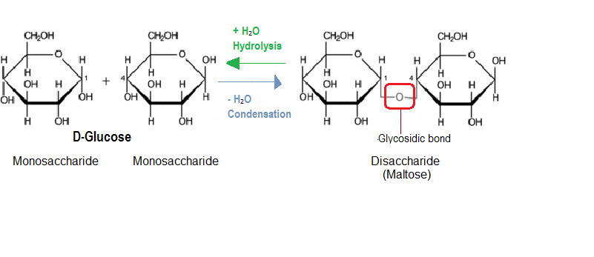
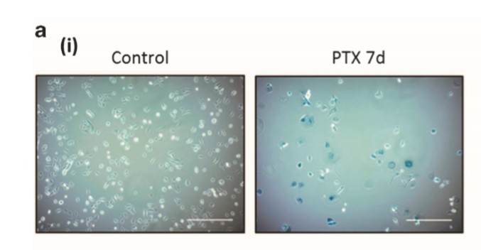
Senescence and SA-β-Galactosidase Staining
pH 6
Senescence
Metabolically active cells that cannot proliferate.
They have β-Galactosidase which is an enzyme that hydrolysis the β- glycosidic bond that is formed between the hemiacetal group and the hydroxyl group of another compound.
Staining
The cells stain blue when the hydrolysis occurs at pH6 for senescent cells.
This is a staining kit that is readly available.
Notes:
How does the staining work?
Senescent cells have Beta Galactosidase which is a lactase/ glycoside hydrolase enzyme. This catalyzes the hydrolysis of glycoside bonds in complex sugars

Slide 9
Does knocking out BRCA1 gene in human triple negative breast cancer cell culture lead to changes in the number of cells over time that express senescence?

Slide 10
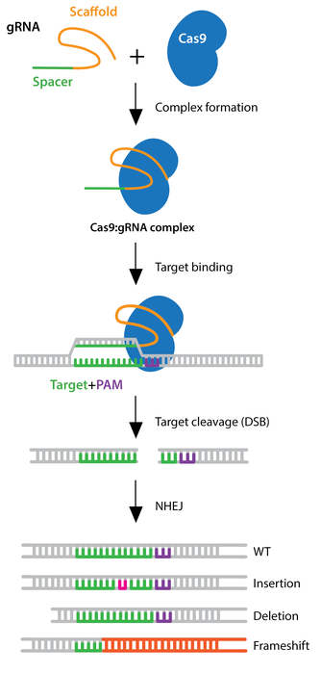
CRISPR-Cas9 w/sgRNA
Why use this method?
It is the most studied and easy to use method to knock out the gene of interest.
Cas9 endonuclease binds to target and has the sgRNA with it.
PAM– Protospacer adjacent motif
It Is a short sequence that follows the target DNA sequence
It is essential for cleavage by Cas nuclease.
This system will help knock out the BRCA1 gene using the sgRNA shown in the figure.
Notes:
WHY DID I CHOOSE TO DO THESE METHODS? WHAT WAS I TRYING TO ANSWER?
How do you check for knockout?
-- you can use PCR or western blotting
I will use PCR to amplify the product after the knockout and then the PCR can be sequenced and checked to see if the knockout of the BRCA one gene has occurred.

Slide 11
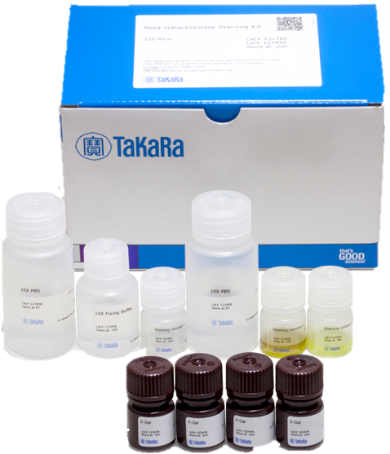
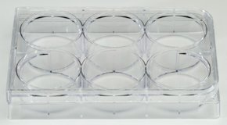
STAINING!
The staining process takes about an hour.
Keep the cell culture incubated at 37 degree Celsius for 12-16 hours.

Slide 12
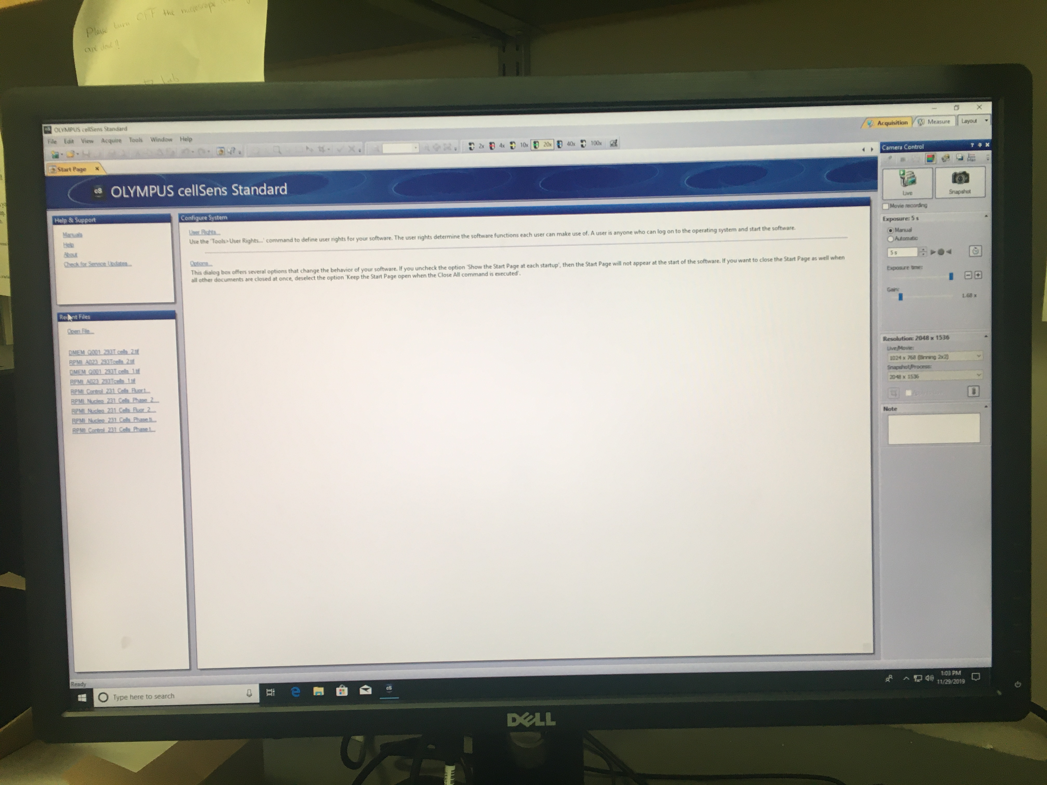
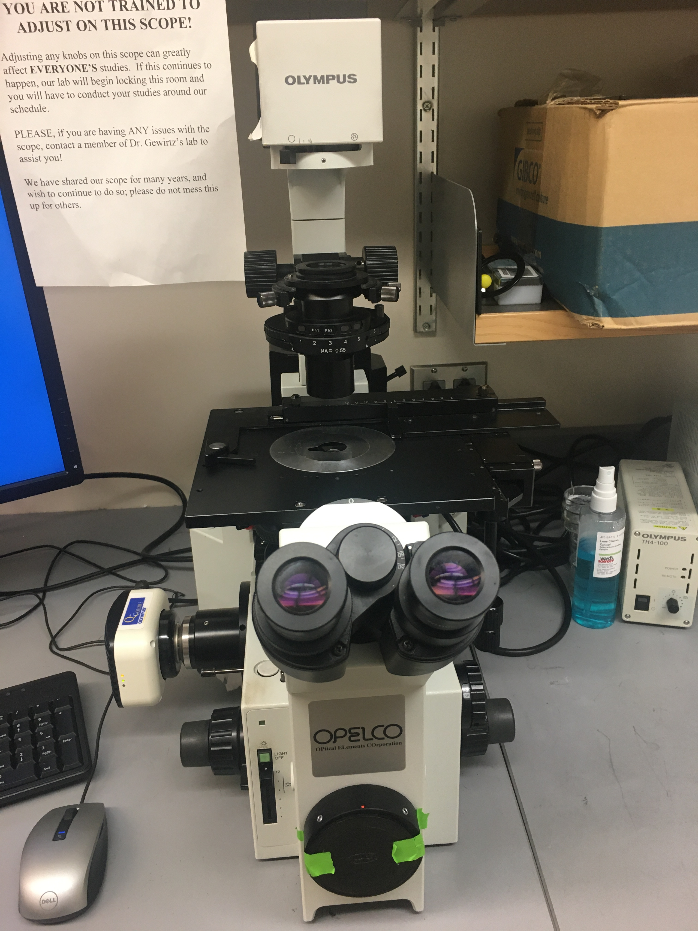
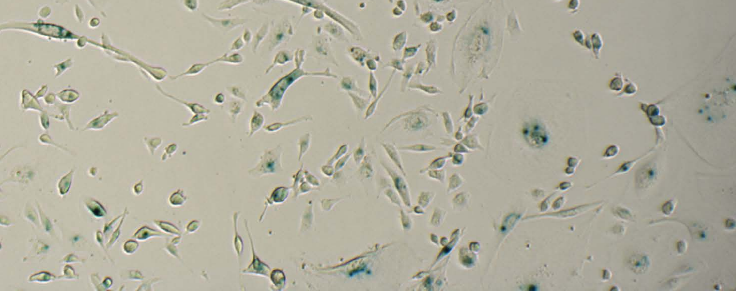
Cell Counting

Slide 13
Discussion -- Possible Results
Two possible results
The knocking out of BRCA1 gene leads to long term senescence.
The knocking out of BRCA1 gene leads to regular or early loss of senescence.
The ideal result would be the first possibility because the cells are remaining in the non-proliferative stage for a longer time leading to a delay in recurrence.

Slide 14
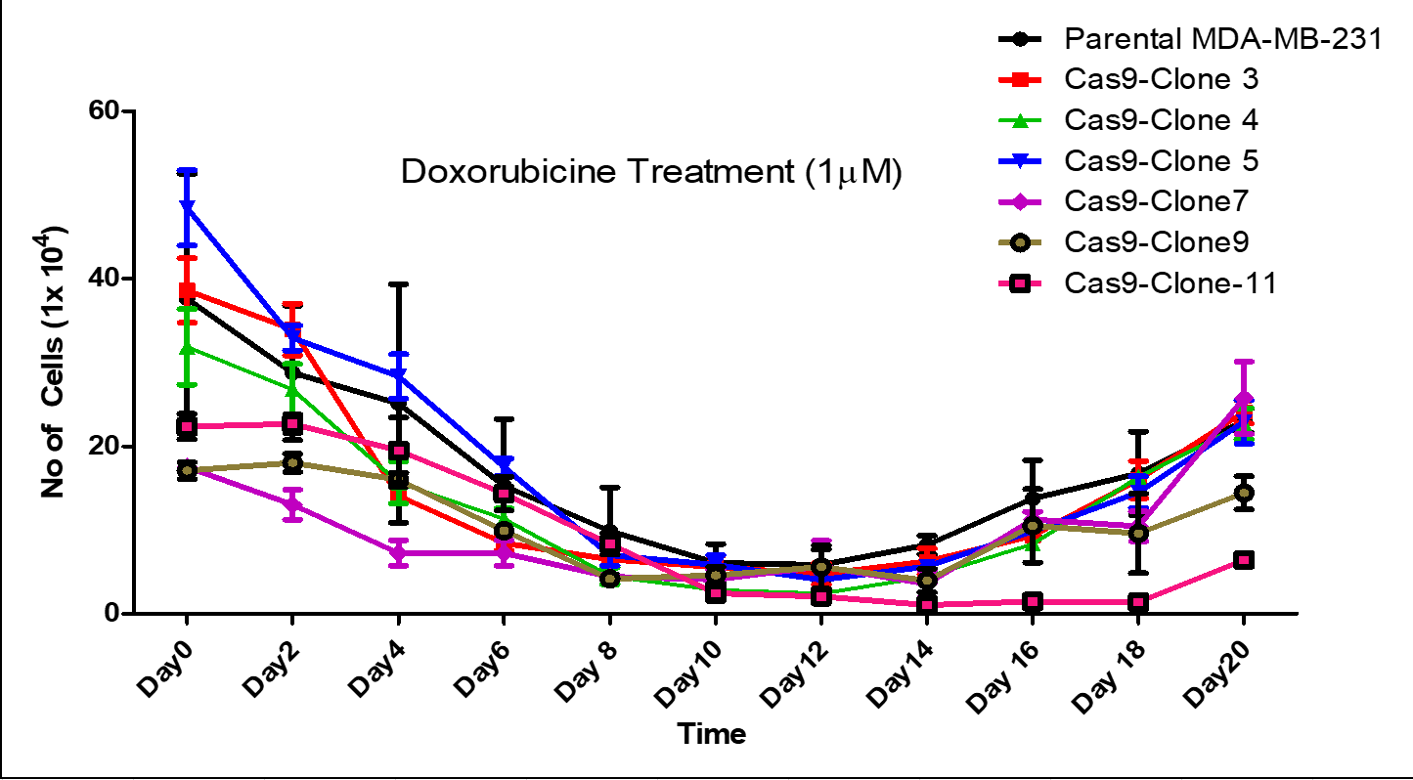
Growth Curve

Slide 15
Further Research
Applying this to other genes that are known to contribute to this form of cancer.
Seeing if attacking multiple genes at the same time shows significant difference in results
This research is so important to the understanding of genes and their impact on not only the onset of cancer but also the recurrence of cancer after treatment.

Slide 16
References
Itahana, K., Itahana, Y., & Dimri, G. P. (2013). Colorimetric detection of senescence-associated β galactosidase. Methods in molecular biology (Clifton, N.J.), 965, 143–156. doi:10.1007/978-1-62703-239-1_8
Kumar, P., & Aggarwal, R. (2016). An overview of triple-negative breast cancer. Archives of Gynecology and Obstetrics, 293(2), 247-269. https://link-springer-com.proxy.library.vcu.edu/content/pdf/10.1007/s00404-015-3859-y.pdf
Wong-Brown, M., Meldrum, W., Carpenter, C., Clarke, J., Narod, J., Jakubowska, E., . . . Scott, S. (2015). Prevalence of BRCA1 and BRCA2 germline mutations in patients with triple-negative breast cancer. Breast Cancer Research and Treatment, 150(1), 71-80.
Jiang, F., & Doudna, J. (n.d.). CRISPRCas9 Structures and Mechanisms. Annual Review of Biophysics, 46(1), 505-529.
Kavanagh, E. L., Lindsay, S., Halasz, M., Gubbins, L. C., Weiner-Gorzel, K., Guang, M., … McCann, A. (2017). Protein and chemotherapy profiling of extracellular vesicles harvested from therapeutic induced senescent triple negative breast cancer cells. Oncogenesis, 6(10), e388. doi:10.1038/oncsis.2017.82
Wang, Y. A., Jian, J. W., Hung, C. F., Peng, H. P., Yang, C. F., Cheng, H. S., & Yang, A. S. (2018). Germline breast cancer susceptibility gene mutations and breast cancer outcomes. BMC cancer, 18(1), 315. doi:10.1186/s12885-018-4229-5
F Ann Ran, Patrick D Hsu, Jason Wright, Vineeta Agarwala, David A Scott, & Feng Zhang. (2013). Genome engineering using the CRISPR-Cas9 system. Nature Protocols, 8(11), 2281-2308.
Henser-Brownhill, T., Monserrat, J., & Scaffidi, P. (2017). Generation of an arrayed CRISPR-Cas9 library targeting epigenetic regulators: from high-content screens to in vivo assays. Epigenetics, 12(12), 1065–1075. doi:10.1080/15592294.2017.1395121
Yang, M., Zeng, C., Li, P., Qian, L., Ding, B., Huang, L., … Wu, W. (2019). Impact of CXCR4 and CXCR7 knockout by CRISPR/Cas9 on the function of triple-negative breast cancer cells. OncoTargets and therapy, 12, 3849–3858. doi:10.2147/OTT.S195661

