Slide 1
Endeavoring to Find the Mechanism by which Pseudomonas chlororaphis Phage 201ϕ2-1 Proteins are Sorted within the Phage-Formed Proteinaceous Shell
Cash Frost

Slide 2
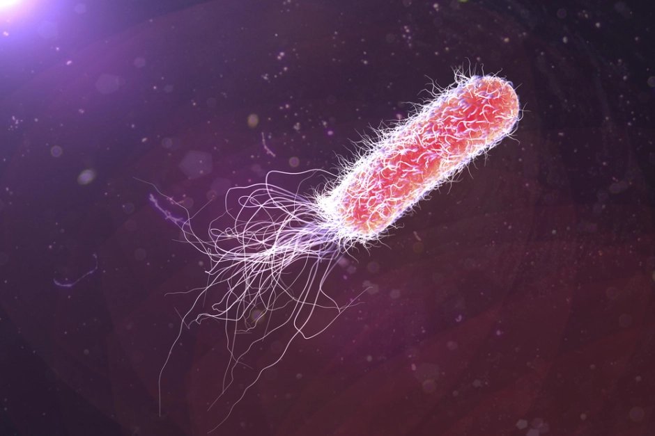
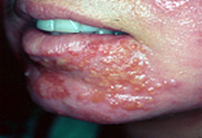
Bacteria
Pseudomonas aeruginosa
P. aeruginosa rendering. (2018). Retrieved from https://blog.frontiersin.org/2018/03/13/microbiology-bacteria-pseudomonas-aeruginosa-burn-wounds/
P. aeruginosa infection photo. (2018). Retrieved from https://emedicine.medscape.com/article/226748-overview
Notes:
Bacteria: Beautiful, diverse, but dangerous
5 x 10^30 according to scientists @ University of Georgia (1998): https://www.sciencedaily.com/releases/1998/08/980825080732.htm
According to CDC’s 2019 AR (antibiotic resistance) report:
- 2.8 million cases of antibiotic-resistant infections, 35,000 die
- P. aeruginosa = serious threat
-Targets immunocompromised; weak lungs esp.

Slide 3
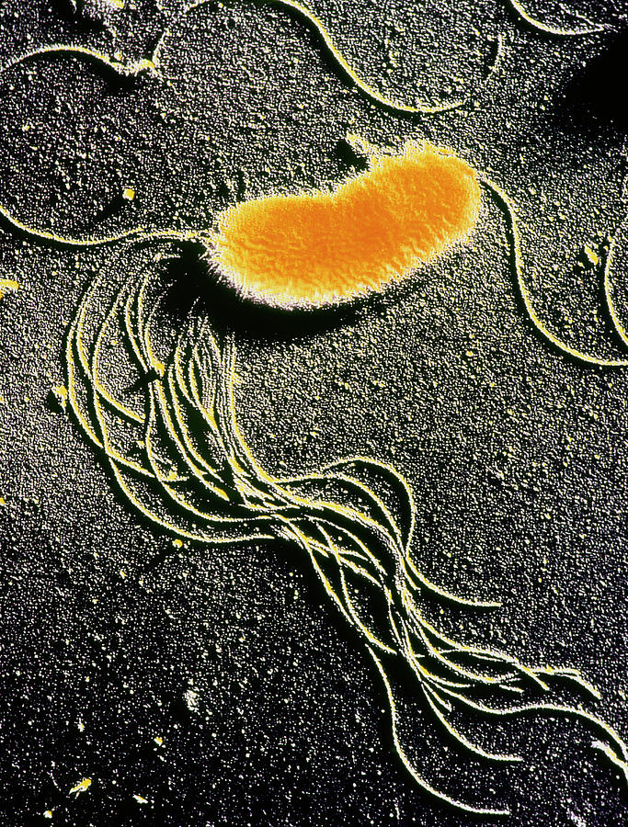
Pseudomonas chlororaphis
Same genus as P. aeruginosa
Evidence of protein conservation between Pseudomonas phage (Chaikeeratisak, Egan et al, 2017)
Soil inoculant
Used to promote plant health
Agricultural/horticultural applications
Brian, T. (2018). Retrieved from https://fineartamerica.com/featured/pseudomonas-fluorescences-bacteria-dr-tony-brainscience-photo-library.html

Slide 4
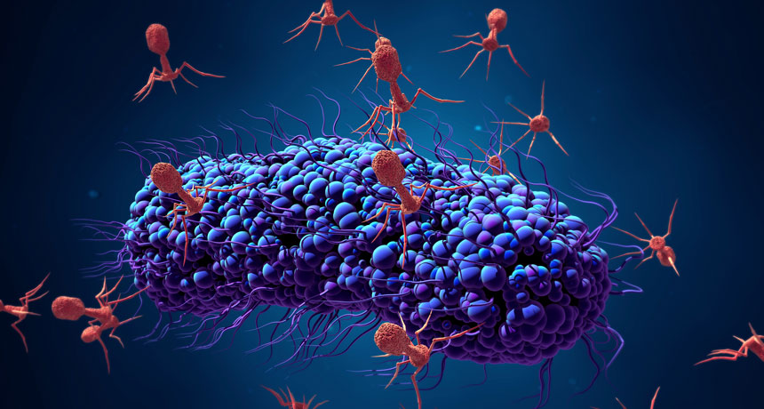
Bacteriophage
Ubiquitous viruses that only target bacteria
10³¹ estimated individuals
Transduction sometimes spreads pathogenicity
Clinical and practical uses
Treating bacterial infections
Biomarkers for harmful bacteria
(2019). Retrieved from https://www.sciencenews.org/article/perfect-predator-phages-deadly-superbug
Notes:
(and archaea) 10^31 phage on earth (= 10 x 10^30 = 1 x 10^31)

Slide 5
Pseudomonas chlororaphis phage 201𝛗2-1
Forms a proteinaceous shell within host
Phage DNA and certain proteins sorted inside shell
Some host proteins too
Possibly used to protect phage DNA from harm
Cryo-electron tomography of phage compartment
Adapted from figure 4 of Chaikeeratisak et al, 2017
Notes:
Inside shell = phage DNA, phage proteins involved with DNA replication and transcription
Ex. gp197 (=DNA helicase homolog)
Also host DNA topoisomerase I (= untangling supercoils, etc.)
Outside shell = phage proteins involved in DNA translation
Ex. 50S ribosomal proteins L20 and L28

Slide 6
Time-lapse microscopy of a cell infected by phage 201𝜑2-1.
Green = gp105-GFP fusion
Red = mCherry-PhuZ fusion
Movie S1 of Chaikeeratisak et al, 2017

Slide 7
Experiment
Goal: Determine if an amino acid sequence is responsible for phage protein access into the proteinaceous shell formed during infection
Methods:
Site-directed mutagenesis (Inverse PCR, Gibson Assembly)
Nested deletions (5 of 10 amino acids (30 nucleotides))
Chemical transformation (E. coli)
Plate on antibiotic (aacC1)
Purify, sequence (promoter → gp197 code)
Chemical transformation (P. chlororaphis)
Infection w/ phage 201𝜑2-1
Following methods specified in Chaikeeratisak et al, 2017
Notes:
Strain 200-B of P. chlororaphis
Arabinose (sugar) used to activate promoter/induce repressor
Gp197 approx. 500 amino acids
aacC1 = Gentamicin 3-N-acetyltransferase (gentamicin resistance)

Slide 8
Methods
Site-directed mutagenesis through inverse PCR
Inverse PCR: Amplifies DNA sequence using 2 primers oriented in reverse directions
Nested deletions: Removing progressively more DNA by allowing enzyme more time to react
Exonuclease III, allows for DNA to be recircularized
Notes:
Site-directed mutagenesis: Making a specific mutation intentionally

Slide 9
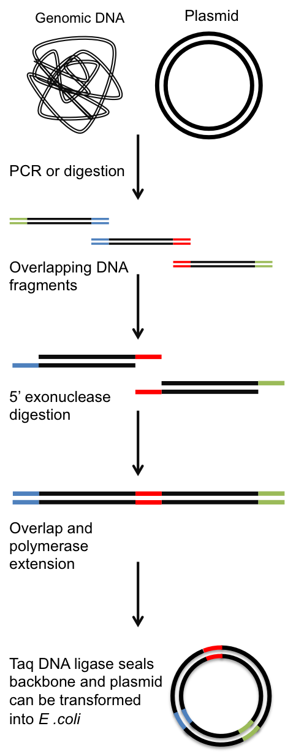
Methods cont.
Gibson Assembly
DNA fragments generated from inverse PCR placed in mixture of:
Exonuclease
DNA polymerase
DNA ligase
Buffer component
End product = circular DNA containing desired mutation
Gibson Assembly process. (n.d.). Retrieved from https://warwick.ac.uk/study/csde/gsp/eportfolio/directory/pg/lsujcw/gibsonguide/
Notes:
Exonuclease chews DNA from 5’ end
DNA polymerase fills in any gaps in DNA with nucleotides
DNA ligase circularizes DNA, removes any nicks (“covalently binds adjacent DNA”)

Slide 10
Results
At some point phage protein loses access to shell’s interior
Could indicate loss of amino acid sequence and/or secondary protein structure
Experiment would not be able to define the difference
Access may not be lost
Could indicate:
Error in methodology
Deletions did not go far enough into code to create an effect
Notes:
Secondary protein structure = folded shape of local segments

Slide 11
Going forward
Were the results to support the idea that an amino acid sequence influences phage protein access to shell
Computational analysis comparing phage protein amino acid sequences should be run using nested deletion information to focus on specific areas of code
If a specific sequence is conserved in all or most of the proteins, future experiments should focus on mutating that specific segment
If no sequence is found, experiments exploring alternate mechanisms should be conducted
Mutating mCherry-PhuZ (as in Chaikeeratisak et al, 2017) to test role of cytoskeletal protein PhuZ in phage protein sorting

