Slide 1
Determining the role of a chemokine receptor in a T cell subset marked by the expression of GM-CSF in the mouse model for multiple sclerosis, EAE
Sophia Fehrmann

Slide 2
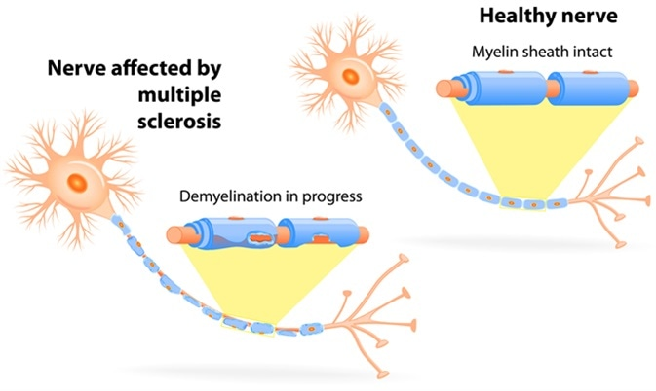
Multiple Sclerosis (MS)
Autoimmune disease¹
Myelin is destroyed preventing proper signaling¹
Causes loss of motor function and vision problems¹
Modeled in mice through EAE
Reference 2

Slide 3
T Cells In MS
Reference 3

Slide 4
Unique T Cell Subset In Relapsing/Remitting MS
T cells expressing⁴:
  CXCR4
  GM-CSF
  IL-2
  TNF-α

Slide 5
Does a CXCR4 deletion on GM-CSF producing T cells prevent them from entering the CNS?

Slide 6
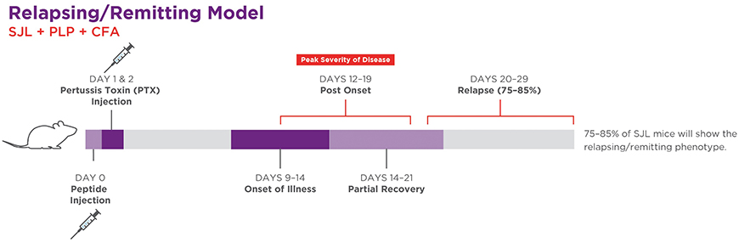
Isolate Pathogenic T Cells
Reference 5
Draining lymph nodes will be removed

Slide 7
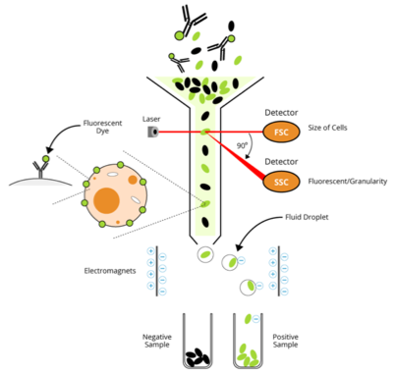
Identify T Cell Subset
Fluorescence Activated Cell Sorting⁶
Identify CXCR4⁺, GM-CSF⁺
Screen for IL-2 and TNF-α
Reference 6

Slide 8
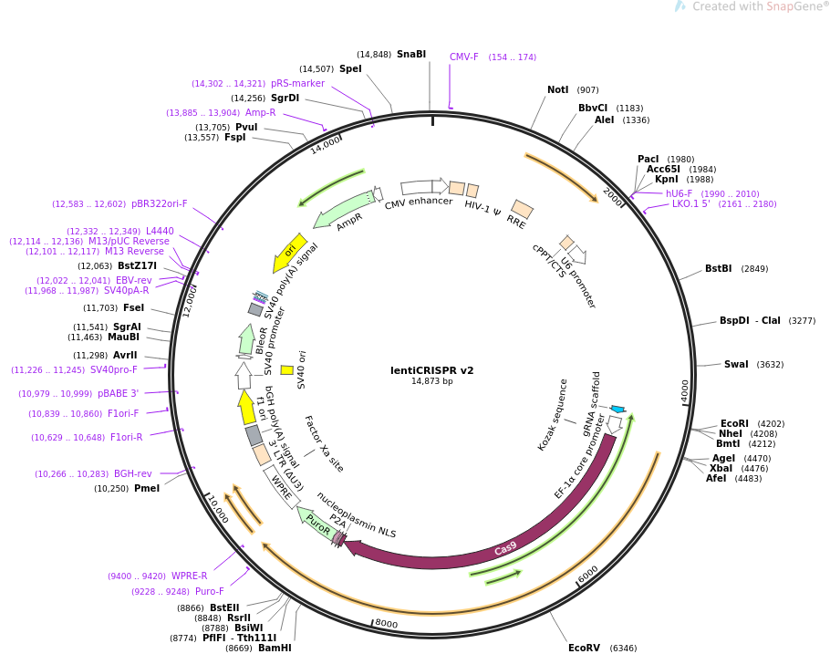
Gene Deletion via CRISPR/Cas9
guideRNA: TCGAGAGCATCGTGCACAAGTGG
Reference 7

Slide 9
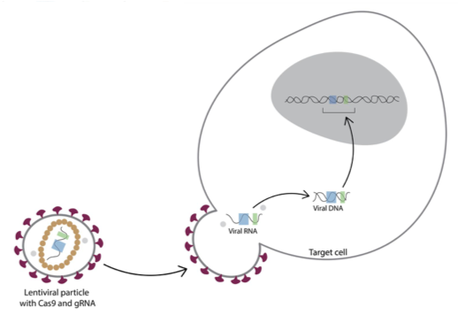
Reference 8

Slide 10
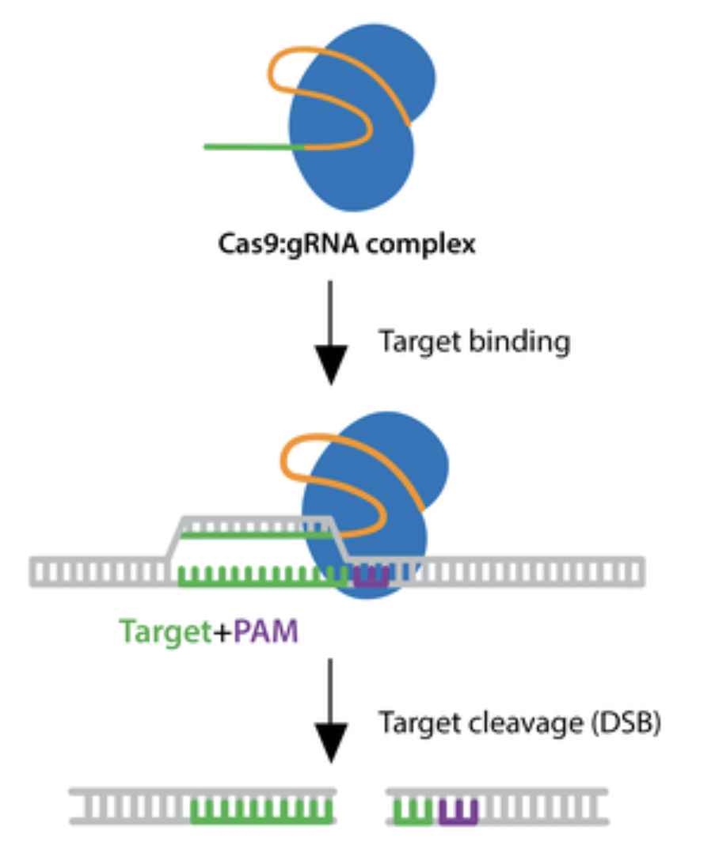
Gene Deletion
Reference 9

Slide 11
Verification Of Gene Deletion and Cell Phenotype
PCR
Fluorescence Activated Cell Sorting⁶
Measure gene expression
Identify CXCR4⁻, GM-CSF⁺
Screen for IL-2, TNF-α,

Slide 12
Inject The CXCR4⁻ T Cells
Reference 5
The cells will be restimulated with myelin and injected into the recipient mouse

Slide 13
Examine CNS For CXCR4⁻ T Cells
Fluorescence Activated Cell Sorting⁶
Identify CXCR4⁻, GM-CSF⁺
Screen for IL-2, TNF-α, Thy1.1 allele
Reference 6

Slide 14

Discussion
Expected Results
Potential Issues
Size of the subset for EAE induction
Phenotype for adoptive transfer
Reference 6

Slide 15
References
Who gets MS? (Epidemiology). National Multiple Sclerosis Society. Retrieved Nov. 11, 2019, from https://www.nationalmssociety.org/What-is-MS/Who-Gets-MS
Thomas, L. Optic Neuritis and Multiple Sclerosis. News Medical Life Sciences. Retrieved Dec. 4, 2019, from https://www.news-medical.net/health/Optic-Neuritis-and-Multiple-Sclerosis.aspx
Fletcher, J. M., Lalor, S. J., Sweeney, C. M., Tubridy, N., & Mills, K. H. (2010). T cells in multiple sclerosis and experimental autoimmune encephalomyelitis. Clinical and experimental immunology, 162(1), 1–11. doi:10.1111/j.1365-2249.2010.04143.x
Galli, E., Hartmann, F.J., Schreiner, B… Becher, B. (2019). GM-CSF and CXCR4 define a T helper cell signature in multiple sclerosis. Nat Med 25, 1290–1300 (2019) doi:10.1038/s41591-019-0521-4
Phelan, J. (2016) Generating EAE Mouse Models of Multiple Sclerosis. Taconic Insights. Retrieved Dec. 3, 2019, from https://www.taconic.com/taconic-insights/neuroscience/eae-mouse-models-of-multiple-sclerosis.html
Flow Cytometry Fundamental Principle, How FACS Works. BOSTER Biological Technology. Retrieved Nov 30, 2019, from https://www.bosterbio.com/protocol-and-troubleshooting/flow-cytometry-principle
Improved vectors and genome-wide libraries for CRISPR screening. Sanjana NE, Shalem O, Zhang F. Nat Methods. 2014 Aug;11(8):783-4. doi: 10.1038/nmeth.3047. 10.1038/nmeth.3047 PubMed 25075903 (Addgene plasmid # 52961)
Pellegrini, R. (2016). How to express CRISPR in your target cells. Benchtalk. Retrieved Nov. 26, 2019, from https://www.benchling.com/2016/03/24/how-to-express-crispr-in-your-target-cells/
CRISPR Guide. Addgene. Retrieved Nov. 29, 2019, from https://www.addgene.org/guides/crispr/#plan-experiment

