Slide 1
Understanding endothelial permeability in the blood brain barrier: Identifying potential mechanism between HIF-1 and Apold 1
Muskan Bansal
Peter Hamilton, Ph.D. Department of Anatomy and Neurobiology

Slide 2
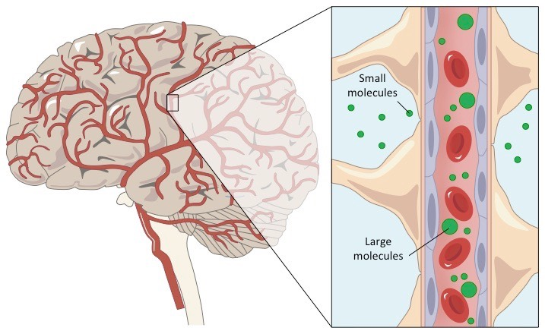
Blood Brain Barrier Overview
Notes:
Strictly selective physiological regulator between the central nervous system and circulating blood
Strict regulation is necessary to provide a chemically stable microenvironment for neurons who have an excitatory nature and are enable to divide.
Thus there is low permeability
Why do we find BBB so fascinating?

Slide 3
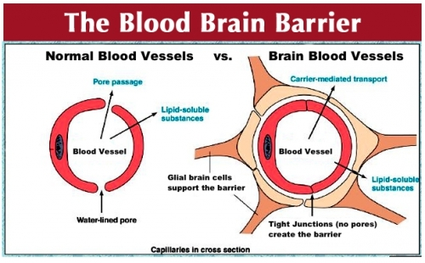
Targeting Blood Brain Barrier to Introduce Drugs to the Brain
Notes:
The blood stream is a fundamental way to introduce drugs targeting neurodegenerative diseases, though the tight regulation of the barrier allows less than 99% developed drugs to reach their targets. To increase those odds we must study the blood brain barrier.
Most of the regulations of what comes into the brain through blood is controlled by endothelial cells and tight junction complexes between the cells.
Most research on mechanisms focuses on the Tight junctions though brain endothelial permeability can be affected by the stretch and shrinkage of endothelial cells and by other inflammatory mediators.
But many of these mechanisms to increase permeability are invasive and lead to neuronal dysfunction and damage.

Slide 4
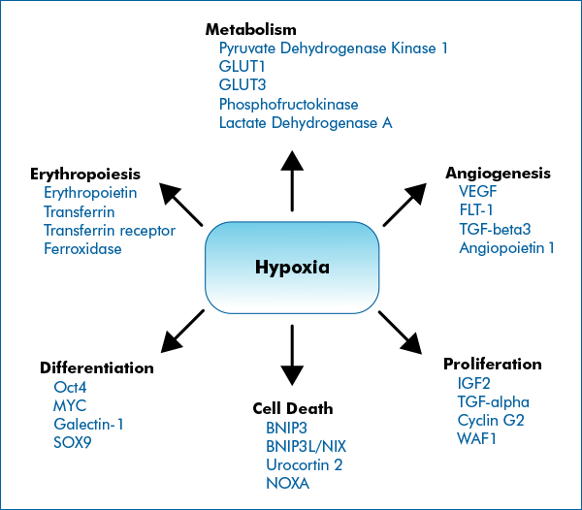
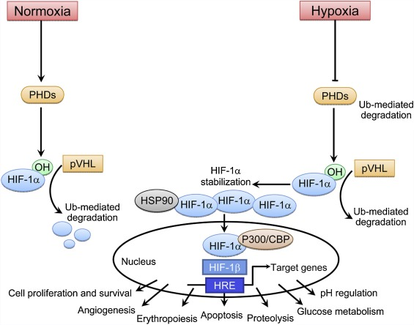
Barrier Disrupter:Hypoxia
0.117
0.00166
Notes:
Hypoxia- body is deprived of oxygen, one of the many components the brain needs to function properly.
Thus hypoxia induced factors are induced in such cases. The identified master regulator is HIF
In the case of hypoxia, the loss of oxygen inhibits PHDs and HIF-α accumulates and is transported to the nucleus to bind to ARNT
Many target genes but not all are identified.

Slide 5
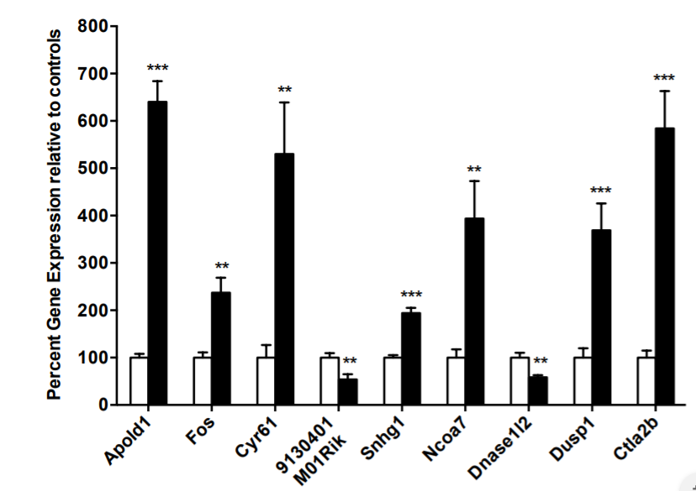
What Genes Upregulated Can cause Brain Barrier Permeability?
Notes:
Here we wish to explore Apold 1 which is a gene produced in endothelial cells that have shown to be upregulated in many hypoxia reglated research studies.
Stress Testing where mice were forced to swim in water- apold 1is one of the most upregulated gene.
Apold 1 was identified to play a critical role in orchestrating the vascular response for acute stress and regulate BBB permeability under stressful conditions. Studies show that Apold 1 could have a role in regulating cellular response to cope with reduced oxygen levels in hypoxia.
(Apoliopoprotein L domain containing 1)

Slide 6
Research Goal
Identify if there exists a potential mechanism between HIF and Apold 1 specific to cerebral epithelial cells that may impact the blood brain barrier

Slide 7
Research Design
Overexpress HIF-1in endothelial cells with and without the Apold 1gene
Conditions:
In-vitro
Hypoxic (1% Oxygen)
What do we have:
Primary endothelial mouse cells
HA tagged- HIF1-alpha- pcDNA 3 (Add Gene)
PCR Primers (BioRad)- Apold 1, Fos, VegF
Anti-Apold Antibody (Abcam)
What do we need:
Apold 1 KO Cells

Slide 8
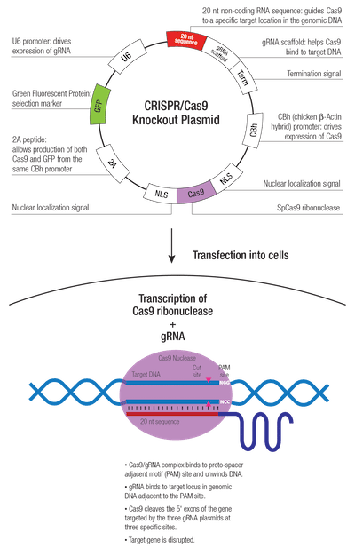
Using CRISPR Cas 9
What is this technique?
Notes:
CRISPR-associated protein 9 (Cas 9), uses a guide RNA(sgRNA), consisting of a scaffold sequence necessary for Cas-binding and a user-defined 20 nucleotide spacer, is used to induce a double stranded break in a specific gene. The DNA fuses together, which can result in a frame shift mutation making the gene disrupted and KOed

Slide 9
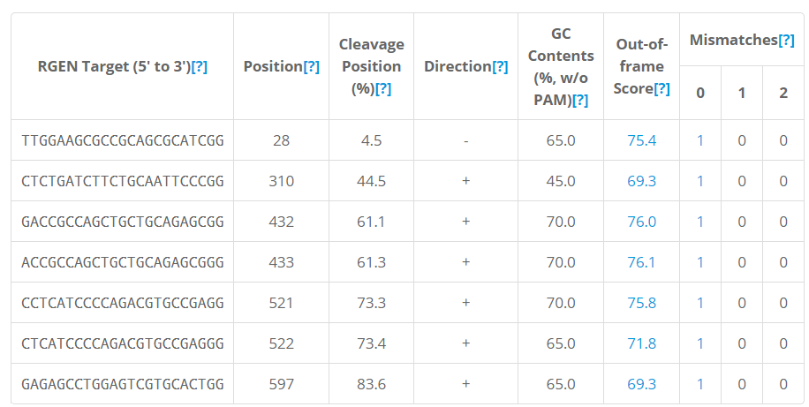
Making a Target G RNA Sequence
Notes:
A target gene is identified by PA< and protospacer adjacent motif: coded NGG.
Used cas designer to identify possible sequences with NGG which had only one target location in the Mouse Chromosomes.

Slide 10
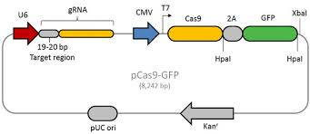
Plasmid Design: Cas9-GFP

Slide 11
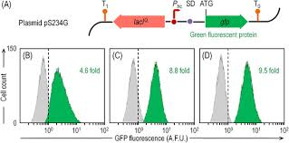
Stabilizing and Sorting Cell Line

Slide 12
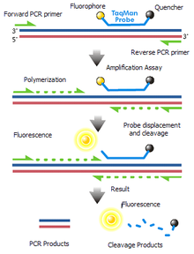
Overexpressing Hif-1:Cell Imaging and Rt-PCR Measurement
Notes:
Cell Imaging will allow us to
PCR 1 Denaturing all double stranded DNA into separate strands by heat, (2) annealing the DNA primer sequences to hybridize onto corresponding regions and (3) binding DNA polymerase and copying the strand. Thus, the sequences are amplified by repetition and quantified by using a double stranded fluorescence marker. [22] By comparing fluorescence, expression level can be determined and quantified statistically.

Slide 13
Potential Results
Loss of Apold 1 should disrupt the cerebral ECs cell and an overexpression of AVV-HIF-1-α should result in quicker cell death if Apold 1 plays a role in regulating cellular response to cope with reduced oxygen levels.
RT-PCR could tell us expression of other genes found in brain endothelial cells.
Bring us closer to understanding non-invasive mechanisms of opening the blood brain barrier
Notes:
The loss of Apold 1 should disrupt the cerebral ECs cell and an overexpression of AVV-HIF-1-α should result in quicker cell death if Apold 1 plays a role in regulating cellular response to cope with reduced oxygen levels.

Slide 14
Questions?

