Slide 1
Hormogonia Mutation of Touch Sensitive With the Removal of Pili in Cyanobacteria
Samuel Young

Slide 2
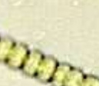
Differentiation of Cyanobacteria
Co2
sugar
Vegetative cell

Slide 3
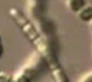
Differentiation of Cyanobacteria
Co2
sugar
Hormogonia + vegetative cells
Vegetative cell

Slide 4
Differentiation of Cyanobacteria
Co2
sugar
Hormogonia + vegetative cells
Vegetative cell
Mobiltiy
Hormogonia

Slide 5
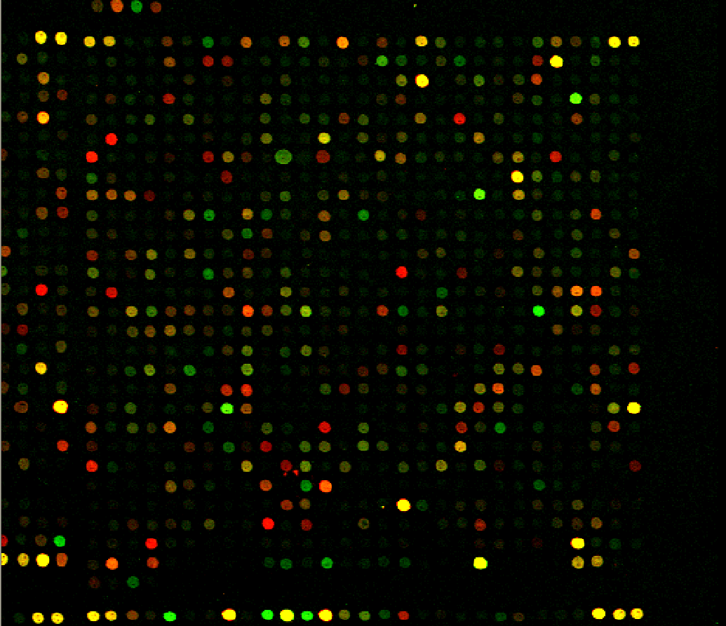
genes of hormogonia
Hormogonia
Both
Vegetative C
Neither

Slide 6
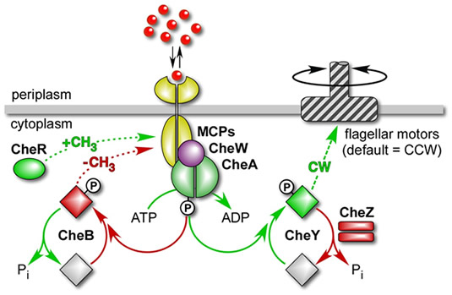
Machinery of sense in bacteria

Slide 7
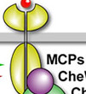
Methyl-accepting chemotaxis protein (MCPs) machinery

Slide 8
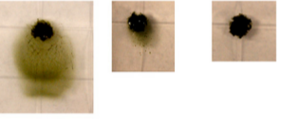
mutated versus wild-type MCPs
MCPs mutate
Wild type
Campbell et al.

Slide 9
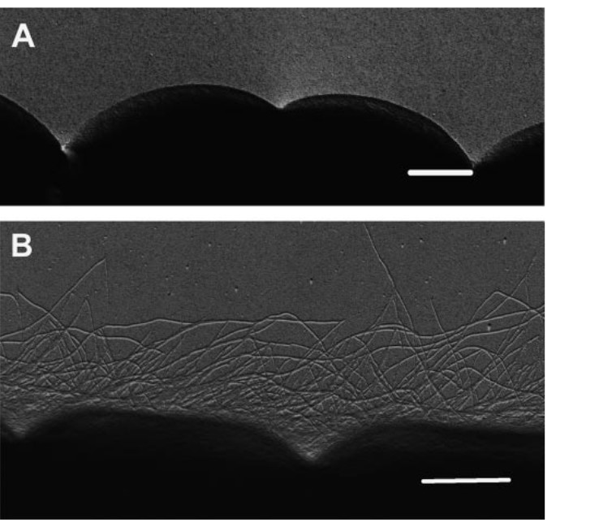
Wild-types
vegetative cells WT
Hormogonia WT
Duggan et.al

Slide 10
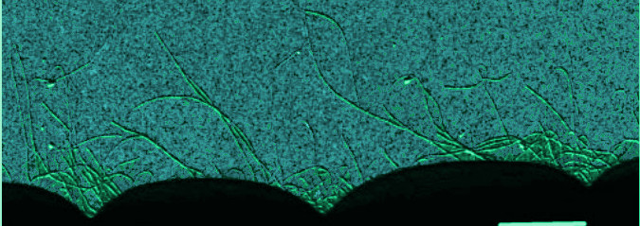
Mutated versus wild-type construct pili
PilT
Duggan et.al

Slide 11
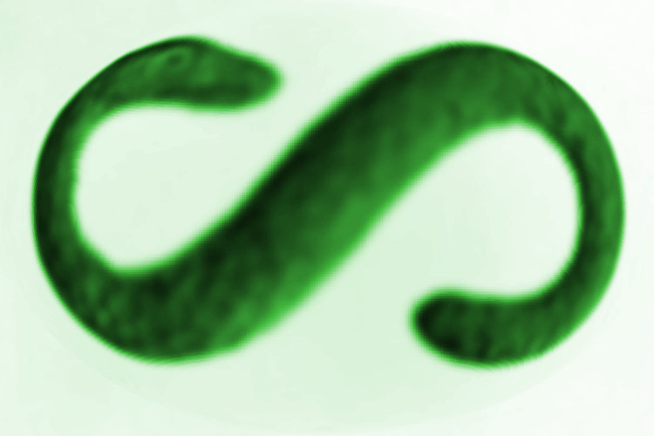
S-shaped mutate
MCPs mutate
Wild type

Slide 12
Are pili important to S-shape?

Slide 13
Overview of Experiment

Slide 14
Overview of Experiment

Slide 15
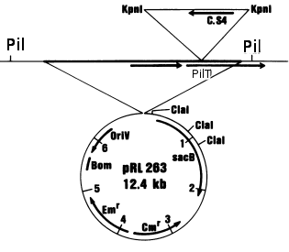
Prime construction

Slide 16
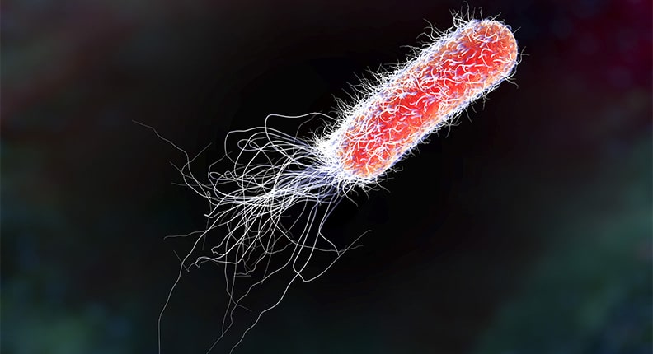
Clone vector for double recombination

Slide 17
First Insertion

Slide 18
First Insertion

Slide 19
First Insertion

Slide 20
First Insertion

Slide 21
First Insertion
Streptomycin

Slide 22
First Insertion

Slide 23
Second Insertion

Slide 24
Second Insertion

Slide 25
Second Insertion

Slide 26
Second Insertion

Slide 27
Second Insertion
Sugar

Slide 28
Second insertion

Slide 29
Reference
cai Y, and Wolks, JC. Use of a Conditionally Lethal Gene in Anabaena sp. Strain PCC 7120 To Select for Double Recombinants and To Entrap Insertion Sequences. Journal of Bacteriology, 172:3138-3145.
Campbell. EL, Hagen KD, Chen R, Risser DD, Ferreira DP,Meeks JC. 2015. Genetic Analysis Reveals the Identity of the Photoreceptorfor Phototaxis in Hormogonium Filaments of Nostoc punctiforme. Journal of Bacteriology, 196:782-791.
Cohen CF, Wallis JG, Campbell EL, Meeks JC. 1994.Transposon mutagenesis of Nostoc sp. strain ATCC 29133, a filamentous cyanobacterium with multiple cellular differentiation alternatives Mircobiology. 140:3233-3240.
Duggan PS, Gottardello P, Adams DG. 2007. Molecular Analysis of Genes in Nostoc Punctiforme Involved in pilus Biogenesis and Plant Infection.Journal of Bacteriology 189:4547-4551.

