Slide 1
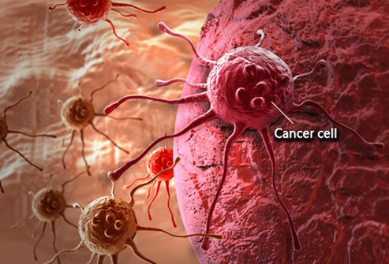
CANCER
About 16% of people die from cancer each year
Second most common cause of death in the US, 1,600 people per day
< 100 types of cancer
Uncontrolled growth and
spread of abnormal cells
No specific person

Slide 2
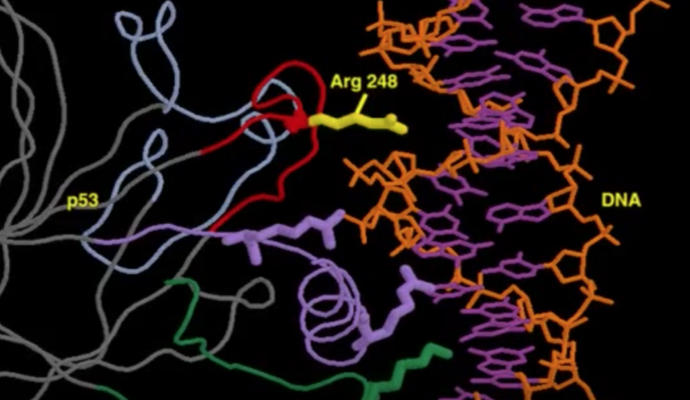
What is TP53?
Better known as p53
Codes for the regulation of the cell cycle preventing the progression of a tumor
P53 protects the integrity of the cell by regulating several cellular processes when triggered by stress signals

Slide 3
Possible Mediators
Several different ways p53 can be activated
Different mechanisms by which the tumor can be suppressed

Slide 4
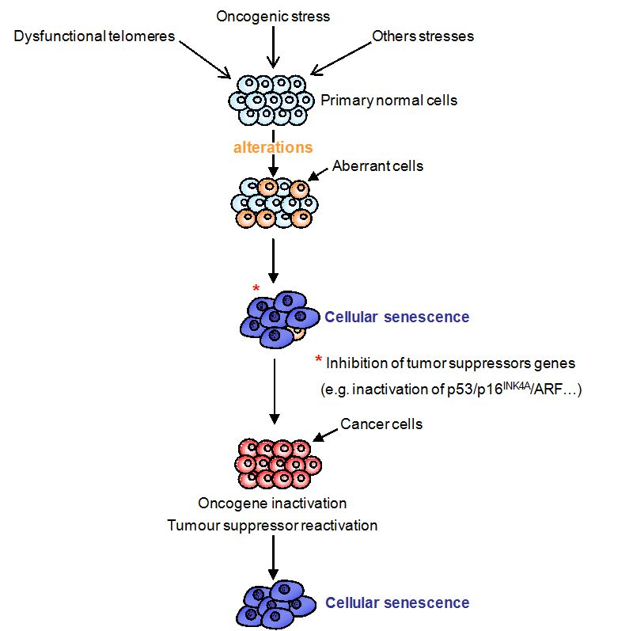
Cellular Senescence?
Irreversible arresting of cell proliferation
First studied by Hayflick and Moorhead in the 1960s
Qualitatively equal to apoptosis in that it prevents the progression of cell proliferation.
Cells that are Pro-senescent are actively anti-apoptotic, and senescent cells are resistant to apoptosis.

Slide 5
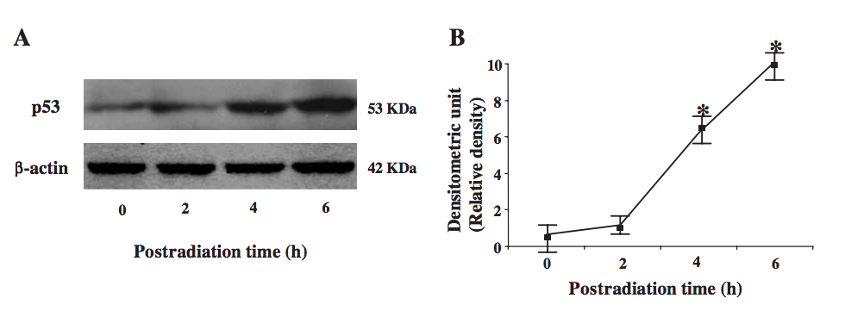
Hirao et al
Investigated the activation of p53 using Kinase Chk2.
They concluded that after exposing the cells to radiation there was an increase in levels of p53.

Slide 6
Taking a step further…
Instead of just activating p53 we want to see what mechanism it is more likely to be mediated.

Slide 7
Central Question What response is p53 mediating, more frequently, in order to suppress a tumor or DNA damage, APOPTOSIS OR CELLULAR SENESCENCE?

Slide 8
Overview of the Experiment
Goal:
What tumor suppressor mechanism is happening in most occurrences of a tumor
How?
Using ionizing radiation & biomarkers

Slide 9
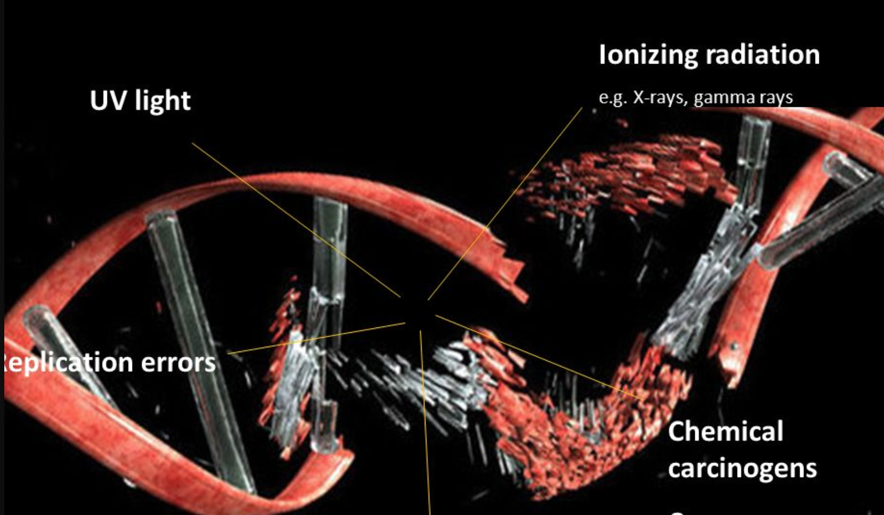
How to begin…
Obtaining Cancerous cells
-Can be made artificially or collected from cancer patients
Similar stages in development for comparative purposes, if not the same patient
Dale et al work with susceptibility

Slide 10
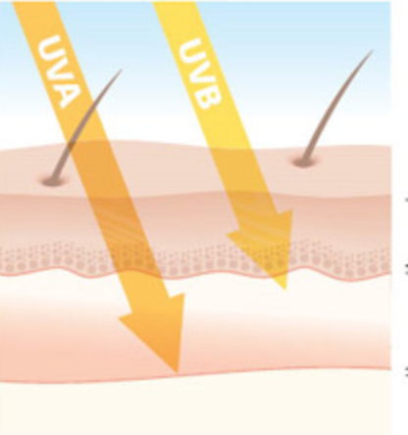
Ionizing Radiation
Damages the DNA using UV light, removing electrons from the atom, disrupting the DNA
Ions physically break the base pairs of the DNA

Slide 11
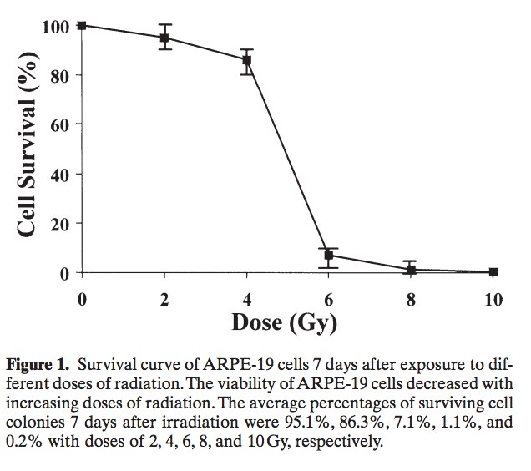
Ionizing Radiation
Damage is dependent on the dose.
The dose must be enough to damage the DNA, but not too strong that it destroys the nucleus.
Jiang et al

Slide 12
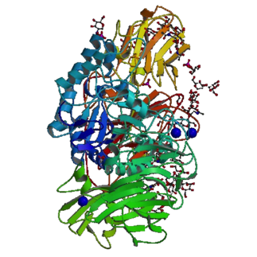
Sa-ß-Gal
Senescence-associated beta-galactosidase
Glycoside Hydrolase enzyme
Found in only senescent cells
When in contact with comes in contact with X-gal cleaves the Glycosidic bond and 5-bromo-4-chloro-3-hydroxyindole

Slide 13
Cytochemical Assay
Use of staining to identify biochemical contents in a cell
Incubated with X-gal buffer
Rinse with Phosphate Buffer Solution
Count occurrences of blue stains

Slide 14
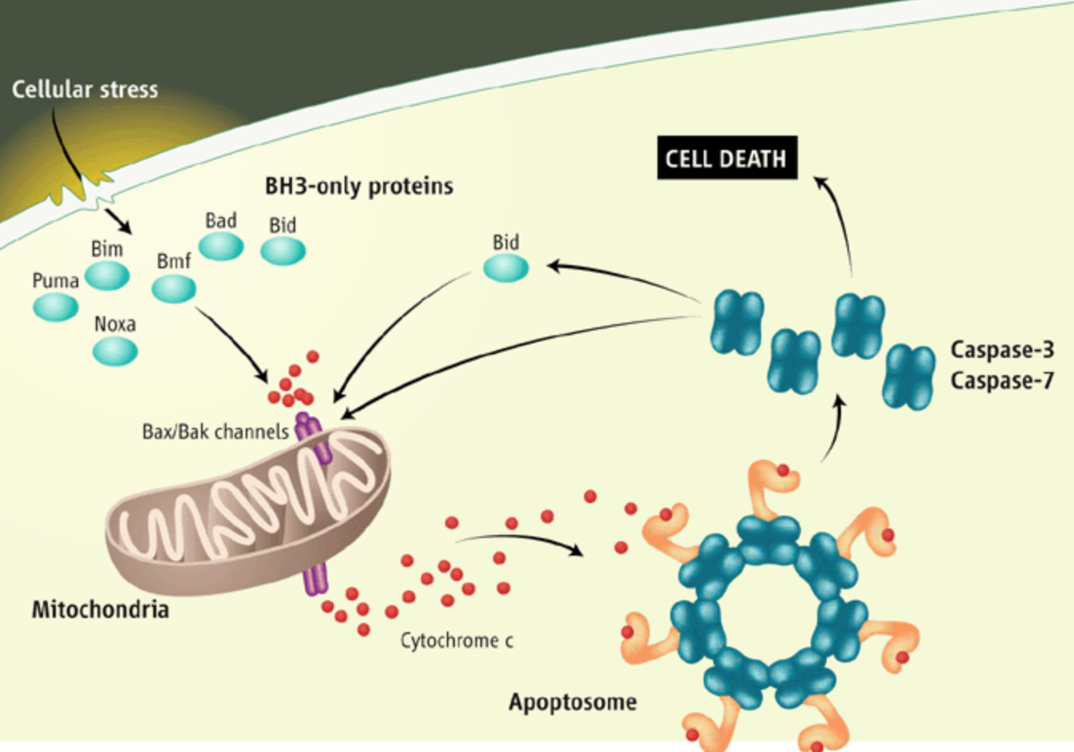
Release of Cytochrome C
Primarily in the mitochondria
Protein for life-support function of ATP synthesis
A trigger for apoptosis but when found in the cytosol is telling that apoptosis has occurred.

Slide 15
Centrifuge
Tissue Homogenizer
Three Rounds, Three different speeds, Three time intervals
-Under cold temperature
-Removing Supernatant

Slide 16
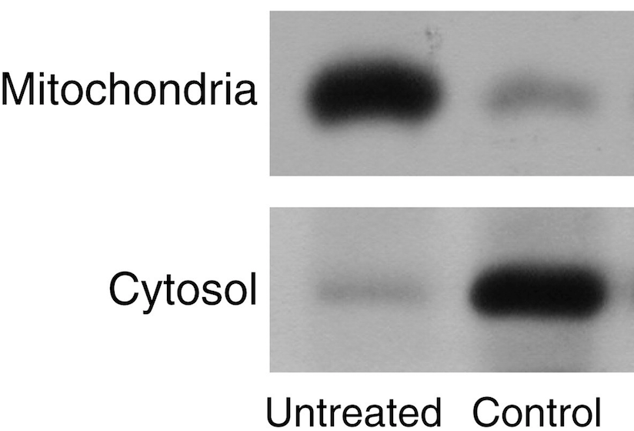
Western Blotting
Electrophoresis, with PBS, using the third
Cytochrome C antibodies
Stain in each well for detection

Slide 17
Limitations
Ionizing Radiation may lead to apoptosis
p53 may not activate
p53 may not induce either Cellular Senescence or Apoptosis.
The tumor may not be effectively suppressed

Slide 18
Conclusion
Looking to see that Cellular Senescence is more prevalent.
Senescence is a more protective mechanism
These cells are still stably viable
May have the ability to remodel cells favorably
Could lead to effective breakthroughs in cancer research
If we are able to manipulate cellular senescence more fitting result for cancer therapies

Slide 19
References:
1. “Activating p53 in Cancer Cells with Protein Therapy Shows Preclinical Promise.” PLoS Biology 2.2 (2004): e58. PMC. Web. 26 Nov. 2017. https://www.ncbi.nlm.nih.gov/pmc/articles/PMC340958/
2. A W Abu-Qare, M B Abou-Donia. “Biomarkers of Apoptosis: Release of Cytochrome c, Activation of Caspase-3, Induction of 8-Hydroxy-2'-Deoxyguanosine, Increased 3-Nitrotyrosine, and Alteration of p53 Gene.” Sigma-Aldrich: Analytical, Biology, Chemistry & Materials Science Products and Services., Journal of Toxicology and Environmental Health. Part B, Critical Reviews, 16 Aug. 2001, www.sigmaaldrich.com/catalog/papers/11503418.
3. Brooks, Christopher L, and Wei Gu. “New Insights into p53 Activation.” Nature, 20 Apr. 2010, https://www.nature.com/articles/cr201053
4. Childs, Bennett G et al. “Senescence and Apoptosis: Dueling or Complementary Cell Fates?” EMBO Reports 15.11 (2014): 1139–1153. PMC. Web. 26 Nov. 2017. https://www.ncbi.nlm.nih.gov/pmc/articles/PMC4253488/
5. Demaria, Marco, et al. “Cellular Senescence Promotes Adverse Effects of Chemotherapy and Cancer Relapse.” Cancer Discovery, American Association for Cancer Research, 1 Feb. 2017, cancerdiscovery.aacrjournals.org/content/7/2/165.
6. Dimri, Goberdhan. “What Has Senescence Got to Do with Cancer?” Cancer Cell, Cell Press, 13 June 2005, www.sciencedirect.com/science/article/pii/S1535610805001662.
7. Halama, A., et al. “Identification of Biomarkers for Apoptosis in Cancer Cell Lines Using Metabolomics: Tools for Individualized Medicine.” Journal of Internal Medicine, 16 Oct. 2013, onlinelibrary.wiley.com/doi/10.1111/joim.12117/full.
8. Hattis, Dale et al. “Age-Related Differences in Susceptibility to Carcinogenesis: A Quantitative Analysis of Empirical Animal Bioassay Data.” Environmental Health Perspectives 112.11 (2004): 1152–1158. PMC. Web. 26 Nov. 2017. https://www.ncbi.nlm.nih.gov/pmc/articles/PMC1247474/
9. Hirao A, Kong Y-Y, Matsuoka S, Wakeham A, Ruland J, Yoshida H, Liu D, Elledge SJ, Mak TW: DNA damage-induced activation of p53 by the checkpoint kinase Chk2. Science 2000, 287:1824-1827.
10. Jiang, Y L, et al. “Ionizing Radiation Induces a p53-Dependent Apoptotic Mechanism in ARPE-19 Cells.” Japanese Journal of Ophthalmology., U.S. National Library of Medicine, www.ncbi.nlm.nih.gov/pubmed/15064971.
11. Kahlem, Pascal, et al. “Cellular Senescence in Cancer Treatment: Friend or Foe?” The Journal of Clinical Investigation, American Society for Clinical Investigation, 15 Jan. 2004, www.jci.org/articles/view/20784.
12. Martin, S J, and D R Green. “Apoptosis as a Goal of Cancer Therapy.” Current Opinion in Oncology., U.S. National Library of Medicine, Nov. 1994, www.ncbi.nlm.nih.gov/pubmed/7827175.
13. National Center for Biotechnology Information (US). Genes and Disease [Internet]. Bethesda (MD): National Center for Biotechnology Information (US); 1998-. The p53 tumor suppressor protein. Available from: https://www.ncbi.nlm.nih.gov/books/NBK22268/
14. Nimse, S B, et al. “Biomarker Detection Technologies and Future Directions.” The Analyst., U.S. National Library of Medicine, 7 Feb. 2016, www.ncbi.nlm.nih.gov/pubmed/26583164.
15. Ozaki, Toshinori, and Akira Nakagawara. “Role of p53 in Cell Death and Human Cancers.” Cancers 3.1 (2011): 994–1013. PMC. Web. 26 Nov. 2017. https://www.ncbi.nlm.nih.gov/pmc/articles/PMC3756401/
16. Piechota, Malgorzata et al. “Is Senescence-Associated Β-Galactosidase a Marker of Neuronal Senescence?” Oncotarget 7.49 (2016): 81099–81109. PMC. Web. 25 Nov. 2017.
17. Qian, Yingjuan, and Xinbin Chen. “Senescence Regulation by the p53 Protein Family.” SpringerLink, Humana Press, Totowa, NJ, 1 Jan. 1970, link.springer.com/protocol/10.1007/978-1-62703-239-1_3.
18. Ward, T H, et al. “Biomarkers of Apoptosis.” British Journal of Cancer, Nature Publishing Group, 16 Sept. 2008, www.ncbi.nlm.nih.gov/pmc/articles/PMC2538762/.

