Slide 1
The Upregulation of Ceramide Synthase 3 via PGJ2, INT131, and S26948 in Psoriatic Human Epidermal Keratinocytes and Normal Human Epidermal Keratinocytes
Mouni Talari
Notes:
My proposal focuses on ceramide synthase 3 and its involvement in psoriasis.

Slide 2
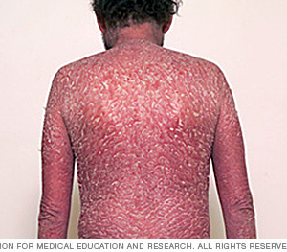
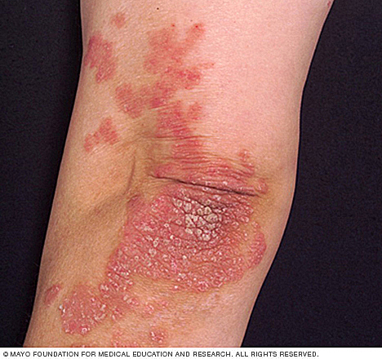
What is Psoriasis?
Chronic autoimmune inflammatory disease
Build up of skin cells
Notes:
I’ll start off with a brief overview of psoriasis. Psoriasis is a chronic autoimmune inflammatory skin disorder which occurs when skin cells are prematurely replaced with new ones, causing buildup on the surface of the skin. This buildup causes chronic itching, irritation, and pain.

Slide 3
What are ceramides and how do they relate to psoriasis?
Lipid molecule consisting of a sphingosine and fatty acid
Make up 50% of the stratum corneum layer of human epidermis
Notes:
How do ceramides relate to psoriasis? Well, ceramides are a lipid signaling molecule made up of a sphingosine and a fatty acid that varies in length. Recent dermatology research has been focusing on ceramides due to its involvement with the epidermis. Ceramides make up 50% of the stratum corneum layer of the human epidermis and may be associated with epidermal diseases, such as psoriasis.

Slide 4
Ceramide Synthase 3 (CerS3)
Ceramide synthase 3
Ceramide synthase 3 substrate
Notes:
Ceramides are synthesized from 6 different ceramide synthases. The one I will be focusing on is ceramide synthase 3, which is expressed highly in the skin and the testis. It forms ultra long chain ceramides, which are ceramides with very long fatty acid chains.

Slide 5
Psoriatic cells have decreased levels of CerS3
Psoriatic cells
CerS3
Can increasing CerS3 levels reduce the effects of psoriasis?
If so…
How can CerS3 levels be increased?
Notes:
In almost every psoriatic skin cell model tested, ceramide synthase 3 levels were always significantly decreased, while normal skin cells are shown to have normal levels of CerS3. So can increasing CerS3 levels reduce the effects of psoriasis? If so, how can CerS3 levels be increased? And this is the main question that my proposal focuses on.

Slide 6
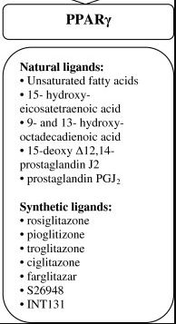
How do we increase expression of CerS3?
Peroxisome Proliferator-activated Receptor γ
Receptor for CerS3
Ligands activate receptor, which upregulate CerS3, and increase production of ULC ceramides
Notes:
PPARy is a receptor for CerS3. By activating this receptor using agonists, we can potentially upregulate CerS3? Two of the agonists I propose to study are PGJ2 and S26948, as shown on this chart.

Slide 7
Will administering agonists of the PPARγ receptor help upregulate CerS3 in epidermal keratinocytes? Which agonist upregulates CerS3 the most?
Normal epidermal keratinocytes vs. psoriatic epidermal keratinocytes
Notes:
The goal of my experiment is to determine if administering agonists of the PPARy receptor will help upregulate CerS3 in epidermal keratinocytes and to analyze which agonist upregulates CerS3 the most. And I will be testing the effects of these agonists in normal human epidermal keratinocytes as well as psoriatic human epidermal keratinocytes.

Slide 8
PGJ2
INT131
S26948
NHEK
PHEK
NHEK
PHEK
NHEK
PHEK
Real-Time PCR → mRNA
Western Blot → Protein
CerS Enzymatic Assay → Enzyme function
Notes:
An overview of my potential experiment can be seen here. I will have 3 agonists, PGJ2, INT131, and S26948. PGJ2 is a natural, endogenous ligand of the PPARy receptor, while INT131 and S26948 are synthetic drugs. All three of these drugs will be administered to normal keratinocytes and psoriatic keratinocytes. Then all of these groups will be subjected to real time PCR to detect mRNA expression levels of CerS3, Western Blotting to determine CerS3 protein levels, and an enzymatic assay to test the enzyme function of CerS3.

Slide 9
Notes:
Real Time PCR is performed by taking a sample of the drug administered tissue, isolating the RNA, converting it to cDNA using reverse transcriptase and specific primers, and then performing PCR to amplify this sequence. The PCR product is then exposed to a Taqman probe which detects how much mRNA is in the PCR product. The product then goes through relative quantification where the total mRNA can be calculated.

Slide 10
Real Time PCR | Confirms that mRNA for Ceramide Synthase 3 is being made; compares levels
2. Western Blot | Confirms that mRNA is being translated into proteins
3. CerS3 Enzymatic Assay | Confirms enzymatic activity
Notes:
This process confirms that mRNA for ceramide synthase 3 is being produced, and also quantifies the levels of mRNA production between the various drug groups.

Slide 11
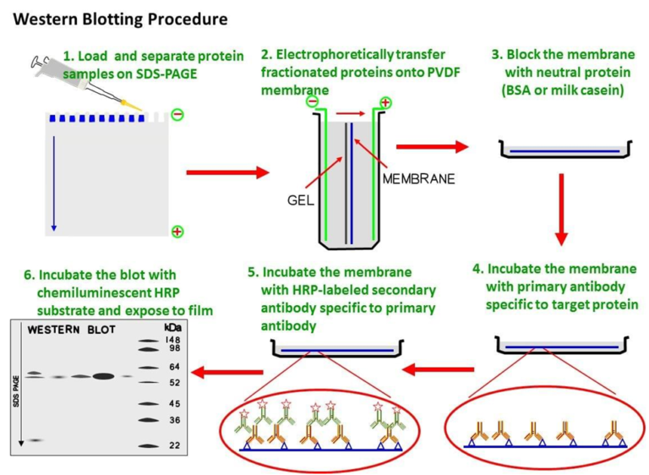
Lass 3 Polyclonal Antibody
Notes:
The next process is western blotting, which basically takes a tissue homogenate sample, runs it through an SDS page which separates the various proteins based on their molecular weight, then transfers the proteins onto a membrane. The proteins are then exposed to a primary antibody, which in this case is the Lass3 polyclonal antibody, followed by a secondary antibody to help detect the ceramide synthase protein.
https://microbeonline.com/wp-content/uploads/2017/05/Western-Blotting-Technique-Test-Procedure.png

Slide 12
Real Time PCR | Confirms that mRNA for Ceramide Synthase 3 is being made
2. Western Blot | Confirms that mRNA is being translated into proteins; compares levels
3. CerS3 Enzymatic Assay | Confirms enzymatic activity
Notes:
This analysis confirms that mRNA is being translated into proteins and also can help compare protein levels of CerS3 between the various drug groups.

Slide 13
Fluorometric Enzymatic Assay
Ceramide synthase 3
REDUCTION REACTION
=
INCREASE IN FLUORESCENCE
NBD-Sphingamine
Notes:
The last step is a fluorometric enzymatic assay which utilizes the difference in fluorescence between the enzyme and the substrate to measure enzymatic activity. The addition of a ceramide synthase 3 substrate such as NBD sphingamine to CerS3 causes a reduction reaction, which should increase fluorescence during enzymatic activity. the fluorescence during this reaction process can be monitored, and if the graph shows an increase, this confirms that there is enzymatic activity

Slide 14
Real Time PCR | Confirms that mRNA for Ceramide Synthase 3 is being made
2. Western Blot | Confirms that mRNA is being translated into proteins
3. CerS3 Enzymatic Assay | Confirms enzymatic activity; compares levels of CerS3 enzyme activity
Notes:
And it can also compare the levels of enzymatic activity between the drug groups.

Slide 15
Limitations
CerS3 is highly expressed in testis
PPARγ agonist side effects
Administration of agonists may not increase CerS3 expression
Goals
Find a new treatment of psoriasis that can be used for more severe forms of the disease.
Gene therapy cure for psoriasis
Notes:
There are a few limitations in this experiment. One is that CerS3 is highly expressed in the testis, so increasing its expression can cause some unwanted side effects. The drugs themselves can also have side effects. And a big limitation is that administration of these agonists may not induce a significant increase in CerS3 expression. However, if they do induce a significant increase in expression, then this experiment could potentially be tested in a mouse model of psoriasis to examine whether or not increasing CerS3 levels decreases the symptoms of psoriasis. It also paves a road for a potential gene therapy cure for psoriasis as well.

Slide 17
References
1. Gordon, K. B., Feldman, S. R., Koo, J. Y., Menter, A., Rolstad, T., & Krueger, G. (2005). Definitions of Measures of Effect Duration for Psoriasis Treatments. Archives of Dermatology, 141(1). doi:10.1001/archderm.141.1.82
2. Krueger, G. G., Feldman, S. R., Camisa, C., Duvic, M., Elder, J. T., Gottlieb, A. B., . . . Day, R. M. (2000). Two considerations for patients with psoriasis and their clinicians: Journal of the American Academy of Dermatology, 43(2), 281-285. doi:10.1067/mjd.2000.106374
3. Motta, S. (1994). Abnormality of water barrier function in psoriasis. Role of ceramide fractions. Archives of Dermatology, 130(4), 452-456. doi:10.1001/archderm.130.4.452
4. Levy M, Futerman AH. Mammalian ceramide synthases. IUBMB life. 2010. 62:347–356. doi: 10.1002/iub.314.
5. M.S. Wegner, S. Schiffmann, M.J. Parnham, G. Geisslinger, S. Grosch. The enigma of ceramide synthase regulation in mammalian cells. Progress in Lipid Research, 63 (2016), pp. 93-119
6. Tawada, C., Kanoh, H., Nakamura, M., Mizutani, Y., Fujisawa, T., Banno, Y., & Seishima, M. (2014). Interferon-γ Decreases Ceramides with Long-Chain Fatty Acids: Possible Involvement in Atopic Dermatitis and Psoriasis. Journal of Investigative Dermatology, 134(3), 712-718. doi:10.1038/jid.2013.364
7. Garidel P, Fölting B, Schaller I, Kerth A (2010). "The microstructure of the stratum corneum lipid barrier: mid-infrared spectroscopic studies of hydrated ceramide:palmitic acid:cholesterol model systems". Biophysical Chemistry. 150 (1–3): 144–156. doi:10.1016/j.bpc.2010.03.008.
8. Feingold KR (2007). "Thematic review series: skin lipids. The role of epidermal lipids in cutaneous permeability barrier homeostasis". Journal of Lipid Research. 48 (12): 2531–2546. doi:10.1194/jlr.R700013-JLR200.
9. Duan, J., Sugawara, T., Hirose, M., Aida, K., Sakai, S., Fujii, A., & Hirata, T. (2012). Dietary sphingolipids improve skin barrier functions via the upregulation of ceramide synthases in the epidermis. Experimental Dermatology, 21(6), 448-452. doi:10.1111/j.1600-0625.2012.01501.x

Slide 18
References
1. Mizutani, Y., Sun, H., Ohno, Y., Sassa, T., Wakashima, T., Obara, M., . . . Igarashi, Y. (2013). Cooperative Synthesis of Ultra Long-Chain Fatty Acid and Ceramide during Keratinocyte Differentiation. PLoS ONE, 8(6). doi:10.1371/journal.pone.0067317
2. Rabionet M, van der Spoel AC, Chuang CC, von Tümpling-Radosta B, Litjens M, Bouwmeester D, Hellbusch CC, Körner C, Wiegandt H, Gorgas K, Platt FM, Gröne HJ, Sandhoff R (2008). "Male germ cells require polyenoic sphingolipids with complex glycosylation for completion of meiosis: a link to ceramide synthase-3". J. Biol. Chem. 283 (19): 13357–69. doi:10.1074/jbc.M800870200.
3. Grygiel-Górniak, B. (2014). Peroxisome proliferator-activated receptors and their ligands: nutritional and clinical implications - a review. Nutrition Journal, 13(1). doi:10.1186/1475-2891-13-17
4. FDA August 4, 2011. FDA Drug Safety Communication: Updated drug labels for pioglitazone-containing medicines.
5. Ramot, Y., Mastrofrancesco, A., Camera, E., Desreumaux, P., Paus, R., & Picardo, M. (2015). The role of PPARγ-mediated signalling in skin biology and pathology: new targets and opportunities for clinical dermatology. Experimental Dermatology, 24(4), 245-251. doi:10.1111/exd.12647
6. Yew, T., Toh, S., & Millar, J. S. (2012). Selective Peroxisome Proliferator-Activated Receptor-γ Modulation to Reduce Cardiovascular Risk in Patients with Insulin Resistance. Recent Patents on Cardiovascular Drug Discovery, 7(1), 33-41. doi:10.2174/157489012799362359
7. Gudjonsson, J. E., Johnston, A., Stoll, S. W., Riblett, M. B., Xing, X., Kochkodan, J. J., . . . Elder, J. T. (2010). Evidence for Altered Wnt Signaling in Psoriatic Skin. Journal of Investigative Dermatology, 130(7), 1849-1859. doi:10.1038/jid.2010.67
8. https://www.thermofisher.com/us/en/home/life-science/pcr/real-time-pcr/qpcr-education/absolute-vs-relative-quantification-for-qpcr.html
9. https://www.thermofisher.com/order/catalog/product/AM1728?ICID=cvc-rna-cultured-cells-c3t1
10. https://www.thermofisher.com/us/en/home/life-science/pcr/real-time-pcr/real-time-pcr-applications/gene-expression-using-real-time-pcr.html
11. https://www.thermofisher.com/taqman-gene-expression/product/Hs00698859_m1?CID=&ICID=
12. Tidhar, R., Sims, K., Rosenfeld-Gur, E., Shaw, W., & Futerman, A. H. (2014). A rapid ceramide synthase activity using NBD-sphinganine and solid phase extraction. Journal of Lipid Research, 56(1), 193-199. doi:10.1194/jlr.d052001

