Slide 1
Role of hydrogen bonding in amino acid substitutions of DNA gyrase subunit A-encoding gyrA
Cove Soyars

Slide 2
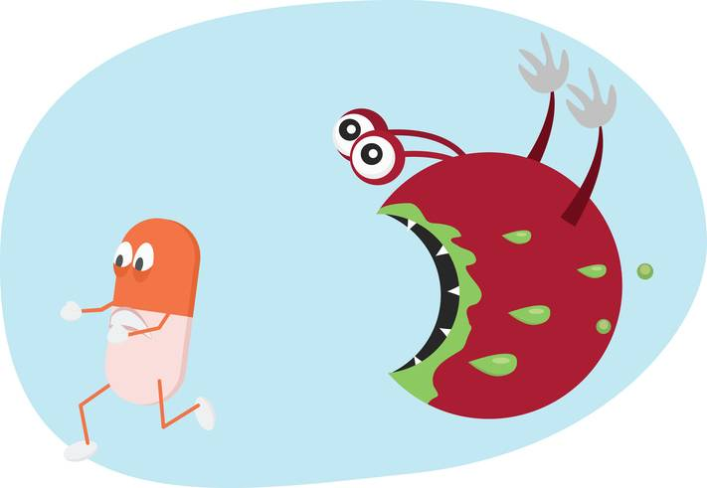
Antibiotic resistance
Problem in healthcare and food industry
25,000 people in Europe die every year
Antibiotics in livestock can pass on resistant strains

Slide 3
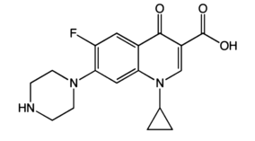
Quinolones
Widely used class of antibiotics today
Ciprofloxacin
Resistance observed in every species treated
Ciprofloxacin
Aldred et. al, 2017

Slide 4
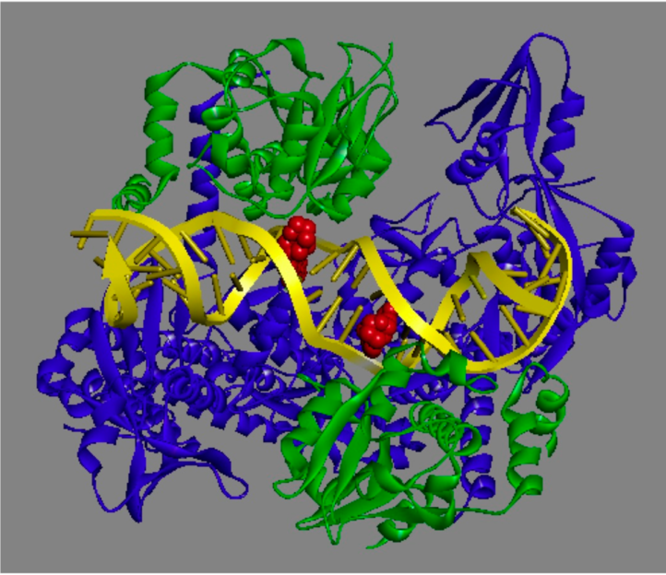
Quinolones Target DNA Gyrase
Bacterial type-II topoisomerase
Double stranded breaks to remove supercoiling
Quinolones block religating of DNA
Breaks apart genome
DNA-Quinolone-topoisomerase complex
Aldred et. al, 2017

Slide 5
Ser-83 residue
Highly conserved residue in gyrase A subunit
Mutation often found in resistant strains
Conservation of Ser-83

Slide 6
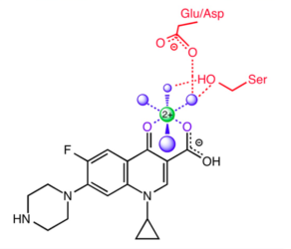
Hydrogen bonds in Ser-83
Van der Waals forces (Madurga et. al, 2008)
Water-metal ion bridge (Aldred et. al, 2014)
Water-metal ion bridge
Aldred et. al, 2014

Slide 7
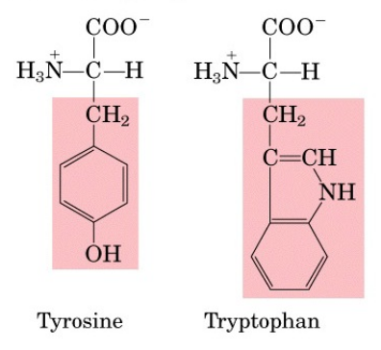
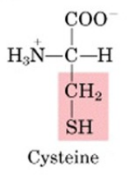
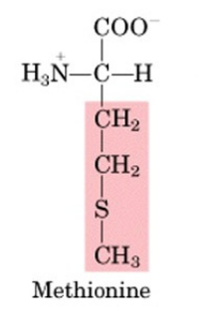
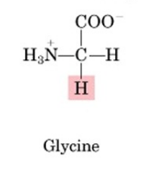
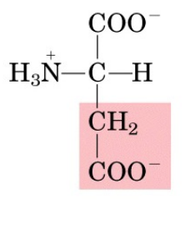
Hydrogen bonding
Substitutions without hydrogen bonding
Amino acid
Phenylalanine
Alanine
Valine
Isoleucine
Leucine
Large amino acids with hydrogen bonding groups
Table 1. Amino acid size | Difference in size (MW_{X} -MW_{Ser})
Tryptophan | 99da
Tyrosine | 76da
Glycine | -30da
Methionine | 44da
Cysteine | 16da
Aspartic Acid | 28da
Promega Corporation
Glycine and Methionine
Cysteine and Aspartic Acid
Relative size

Slide 8
Overview of experiment
Goal: test if S83G, S83M, S83C, and S83D confer resistance
How: supercoiling assay with mutated proteins

Slide 9
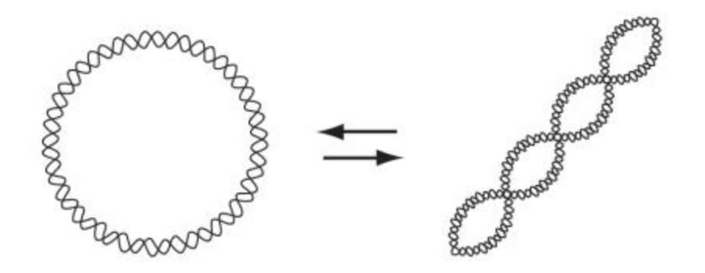
Supercoiling assay
Supercoil relaxed DNA
Supercoiled DNA travels farther on gel (more compact)
Supercoiling of DNA
Nitiss et. al 2012

Slide 10
Interpreting a Supercoiling Assay
Functioning gyrase
Nonfunctioning gyrase

Slide 11
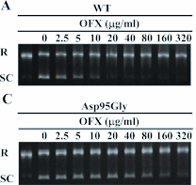
Supercoiling assay cont.
Solution containing:
Gyrase A subunit (mutated)
Gyrase B subunit
ATP
Relaxed DNA
Buffer
Allowed to incubate
Run on agarose gel
Supercoiling results
Yokoyama et. al 2011

Slide 12
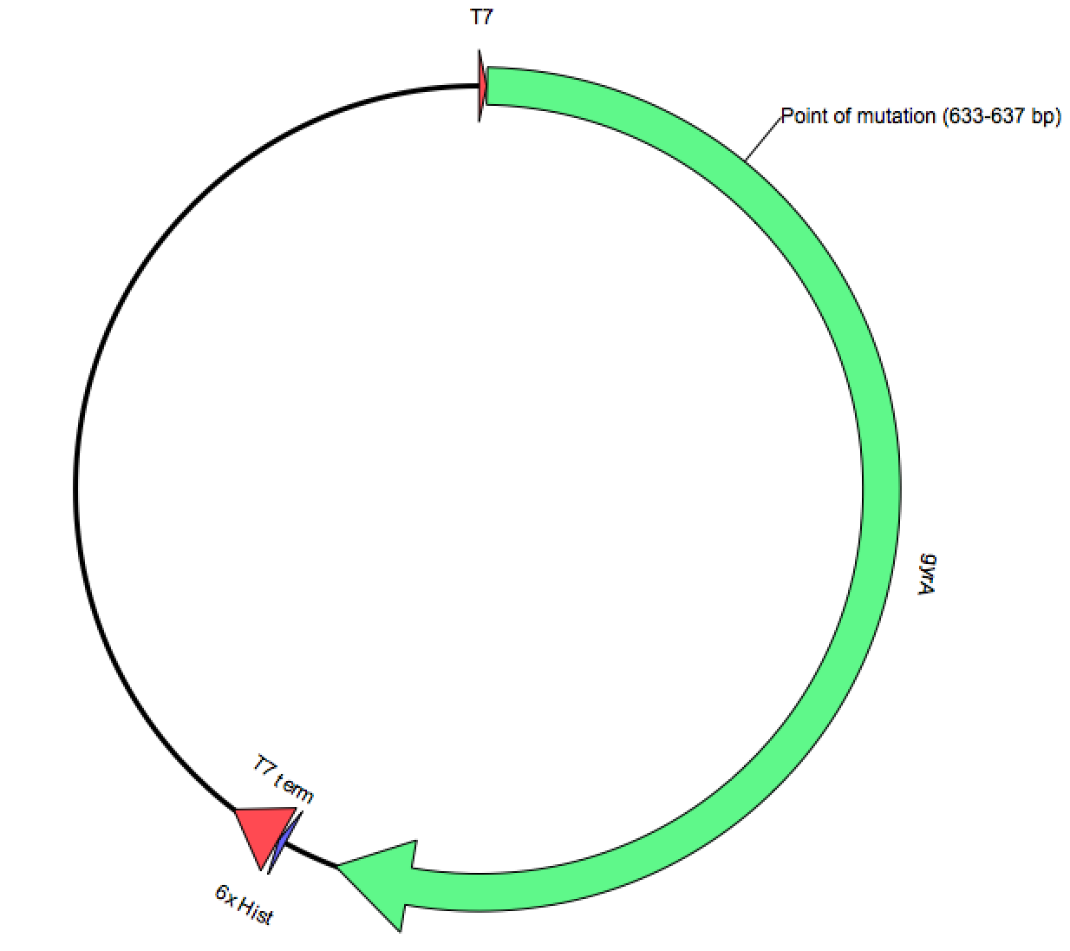
Mutant protein synthesis
gyrA expression plasmid
PCR with mutagenesis primers
Transformation and expression
GyrA expression vector
Notes:
Inducer-Isopropylβ-D-1-thiogalactopyranoside (IPTG)

Slide 13
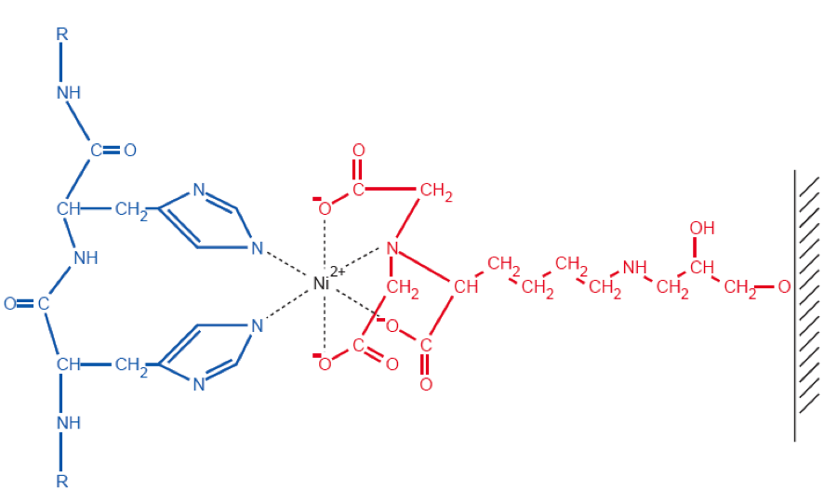
Mutant protein purification
Sonic lysis
(Ni-NTA) agarose resin chromatography
Ni-NTA agarose resin chromatography University of Oklahoma
Notes:
(Ni-NTA)-Nickel-nitrilotriacetic acid

Slide 14
Predicted Results
Methionine and Glycine-SC activity at higher concentrations
Cysteine and Aspartic Acid-SC activity similar to wild type
Cysteine-slightly higher concentrations than wild type
Support water-metal ion bridge

Slide 15
Other potential results
All mutants have SC activity similar to wild type
Ser-83 mutation is not enough
Contradict water-metal ion bridge

Slide 16
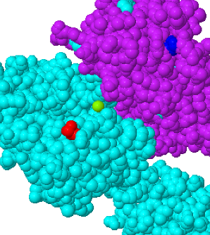
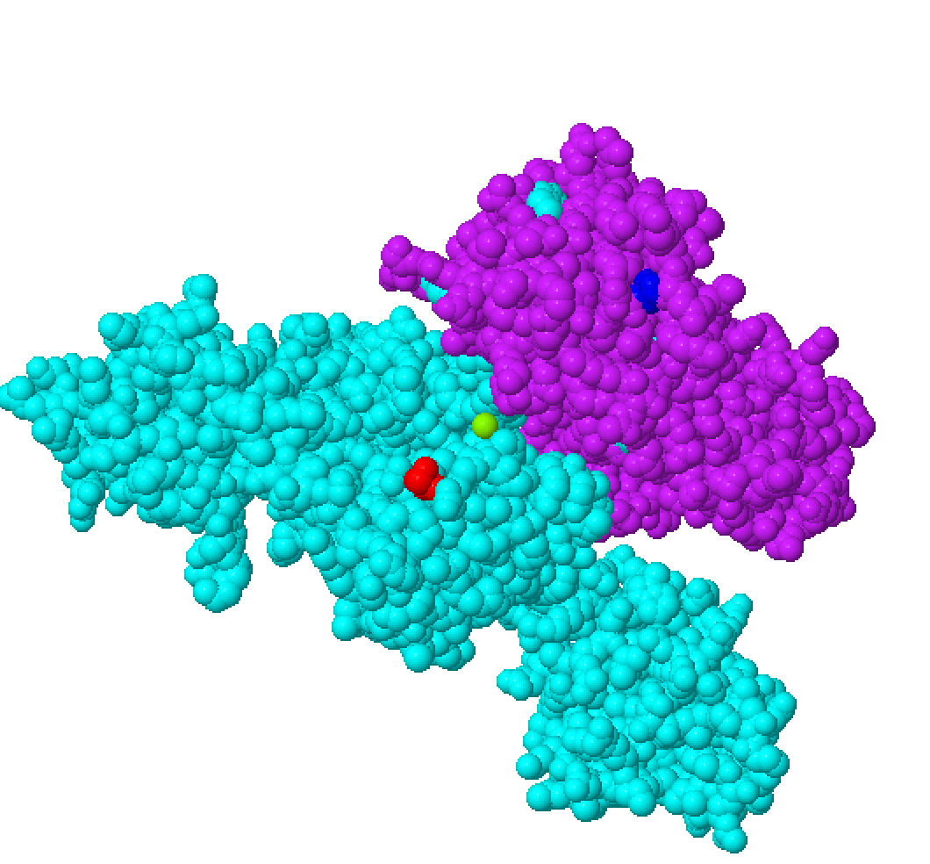
Limitations
Disulfide bridges
No nearby Cysteines
Gyrase A and B subunit complex.

