Slide 1
5-HT1B-receptor regulation by p-GSK3B due to acute ethanol exposure on mice
Akhil Ramaswamy
Notes:
My proposal

Slide 2
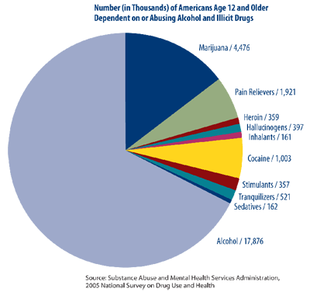
Alcoholism
Neuropsychological Disorder
Pathophysiology unclear
Notes:
Alcohol is, neuropshycolgiacal disorder that has plauged society for many generations. Due to the complexity of the brain a definte pathway for the de3vleopment of alcholism has not yet been discovered however new research has begun to unravel this mystery.

Slide 3
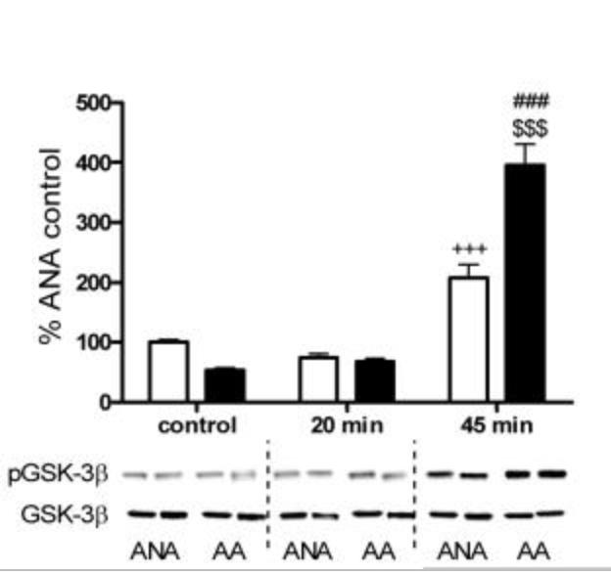
GSK3B
Serine/Threonine Protein Kinase
(Neznova et al. 2009)
Alcohol phosphorylates gsk3b
Found extensively throughout neurons in brain
Notes:
Glycogen Synthase Kinase 3 beta is a serine threonine protein kinase responsible for variety of regulatory pathways within the CNS. Research has suggested GSK3B plays an important role in the development of alcoholism. Much like other proteins GSK3B can be phosphorylated itself. A study done by Neznova and his colleagues in 2009 showed that GSK3B is phosphorylated by ethanol causing an increase in average alcohol consumption as shown in the graphic. Here you can see the two sites by which phosphorylation most commonly occurs on GSK3B the ser9 and tyr16 which are integral proposal.

Slide 4
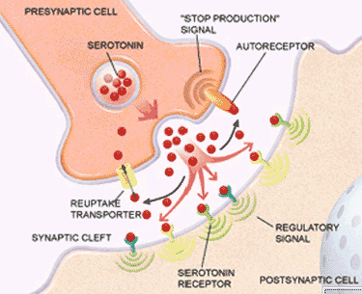
Serotonin and Alcohol
Serotonin
Regulated by 5-HT Receptors
Alcohol increases serotonin concentration within synapse of the brain (Lovinger, 1997)
Notes:
Serotonin nuerons is one of many which contains GSK3B. Serotonin is a neruotransmitter regulatin mood and cognitive behavior and also plays an important role in alcholims as well. Research shows that alcohol increases sreotonin conctneration wihtin the syanpse of the brian.

Slide 5
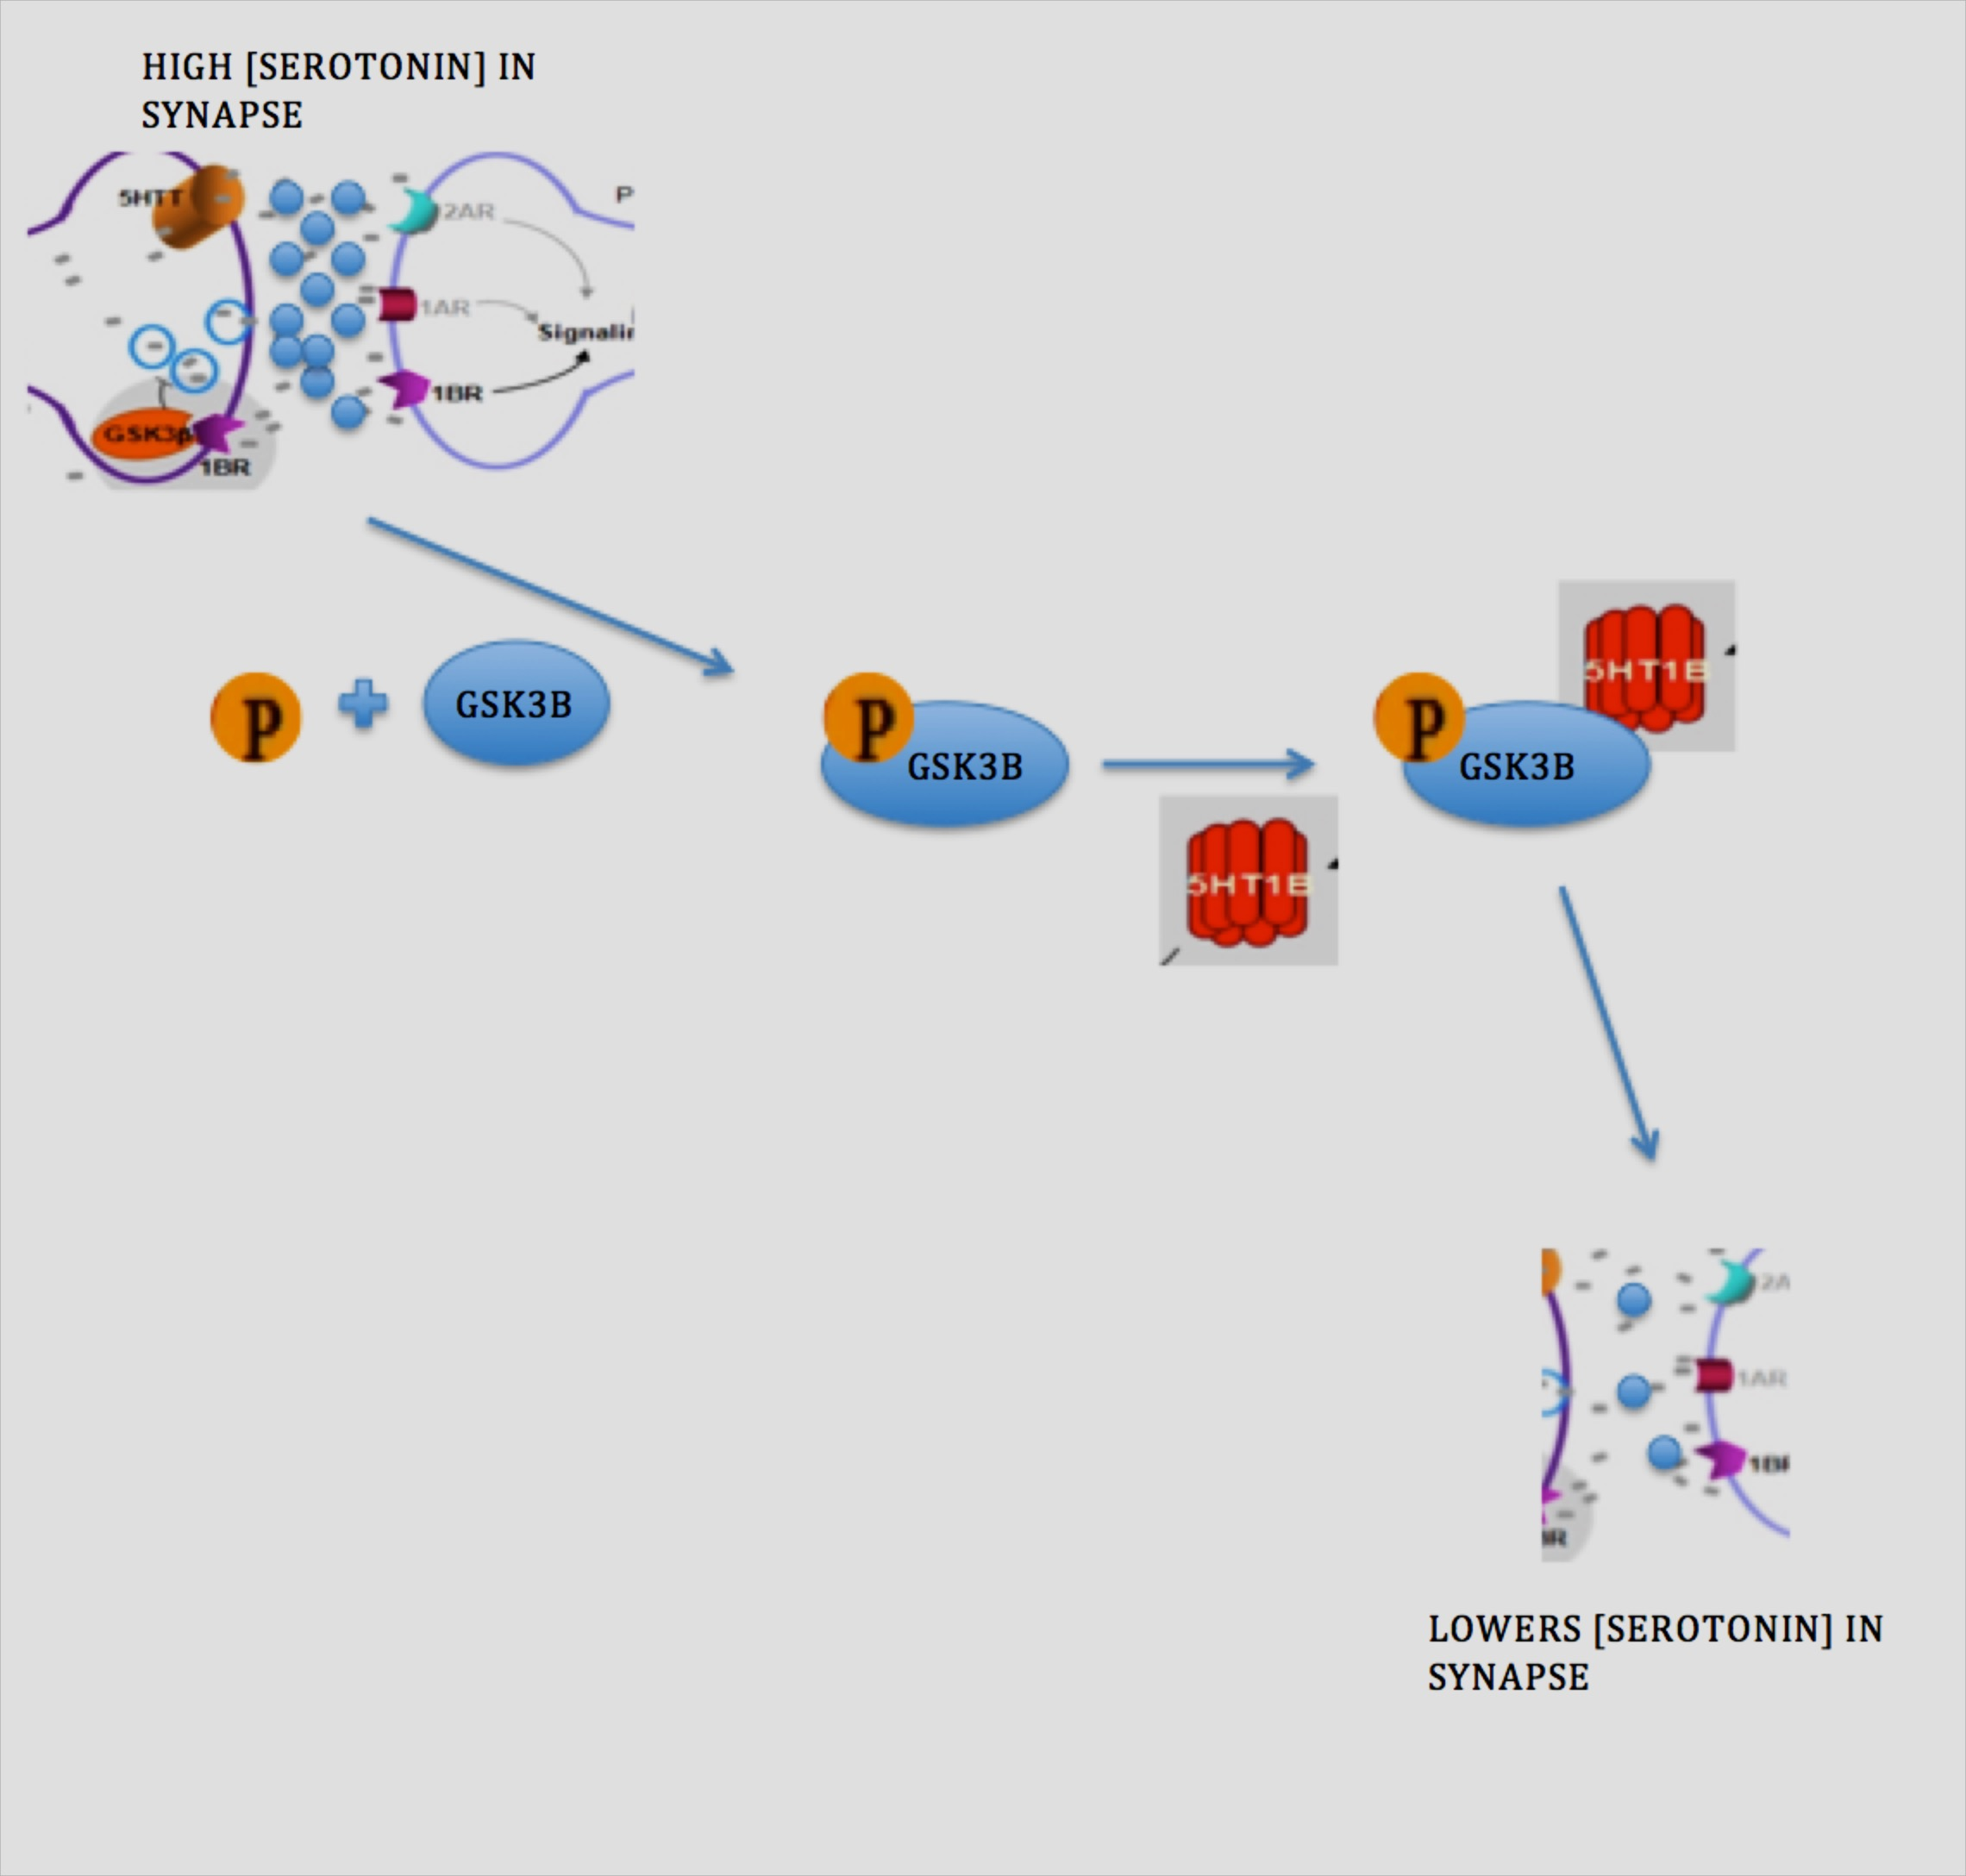
Zhou et al 2012
GSK3B regulation of Serotonin output
As serotonin in synapse increases; GSK3B is phosphorylated resulting in binding of it to 5-HT1B
Notes:
Moving on to the fundamental study my proposal based off of, a mechanism concerning the regulation of serotonin output by GSK3B was proposed in 2012. Serotonin relese into the synapse is mediated by 5-HT receptors one subclass bieng 5-HT1B. This is an inhibitory receptor that decrases serotonin levels in the brain.
that suggest GSK3B phosphorylation binds to 5-HT1B serotonin receptor to decrease serotonin output in the synapes 5-HT1b is an inhibtory recptor found in serotonin nuerons that decrease serotonin output. Excess serotonin in the synapse ellicits a siganl tha prompots the subsequent phsporylation of the SEr9 site of GSk3b. P-GSK3B then binds directly to 5-HT1B to induce serotonin uptake.

Slide 6
However…..
Ethanol phosphorylates GSK3B as well and causes an increase in serotonin within the synapse
Ethanol disrupting GSK3B binding to 5-HT1B

Slide 7
Does ethanol act to phosphorylate the tyr216 site of GSK3B preventing binding with 5-HT1B?
Thesis Question:
Notes:
However recall that ethanol phorsplyates GSK3B as well but also causes increase of serotonin in the synpase so it can be hypothesized that interaction between GSK3B and 5-HT1b is bieng disrupted due to ethanol phosphorylation. My study aims answer wtheter

Slide 8
Overview of experiment
Three groups
Tyr216 mutagenized to Phe216
Ser9 mutagenized to Ala9
No mutation
All three will be given alcohol
Separate fourth group=Control
Notes:
My experiment will consist of 4 groups three of then will be subject to alcohol while a fourth will act as a control to measure basal serotonin levles
The three groups will consist of a tyr216 knockout a ser9 knockout

Slide 9
Site-Specific mutagenesis
Mutation of a particular base in the DNA sequence of protein molecule
Ser9 replaced with Alanine
Tyr216 replaced with Phenylalanine
Notes:
The specific residues will be knocked out using site specific mutagenesis. SSM allows the user to target a specifc residue within the amino acid sequence of a protein and exchange that sequence. Ser9 will be repalced with alanine while Tyr216 will be replaced with Phenylalanine.

Slide 10
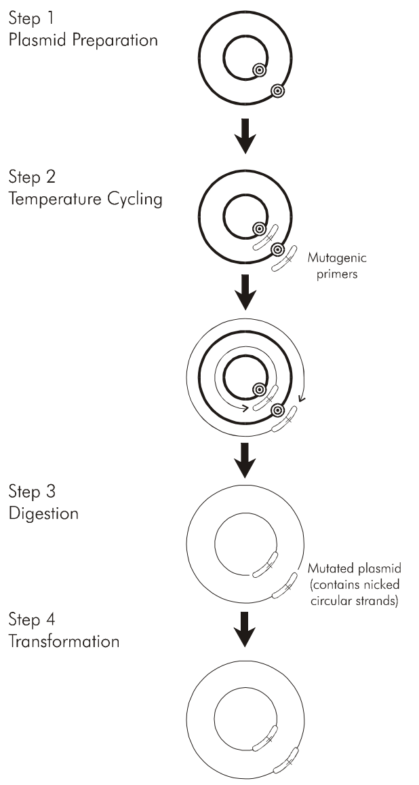
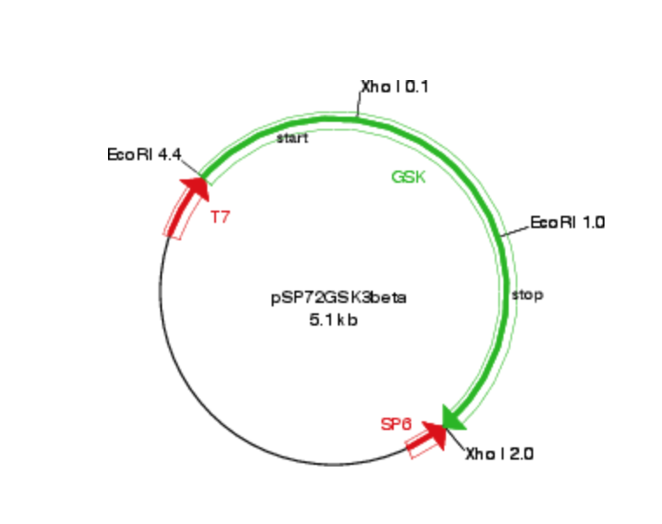
QuikChange XL Protocol
Ser 9:
Forward Primer w/mutation: 3’GGG TCT TGG TGG CGG AAA CCC CTC TCG 5’
Reverse Primer w/Mutation: 5’ GCT CTC AGA AAA GGC GGT GGT TCT GGG 3’
Tyr 216:
Forward Primer w/Mutation: 3’ GGG TTA CAA AGC ATC TAG ACA AGA GCC 5’
Reverse Primer w/Mutation: 5’ CCG AGA ACA GAT CTA CGA AAC ATT GGG 3’
Notes:
SSM will be carried out using the QuikChange XL protocol. This protocol will be run twice to create plasmids for both mutagenized embryo types discussed earlier. Essentially a plasmid containing the gene of interest will be flanked by artificially synthesized reverse and forward primers containing the mutation. Thermal cycling will allow the template plasmid to denature and as cooling proceeds the primers will anneal to the template strand. Elongation and amplification due to PCR will proceed after the addition of DNA polymerase. 18 PCR cycles will be run which will generate more than enough of daughter plamsids containing the mutation. DPN1 a nuclease will be added to the mixture in order to denature the heavily methylated Parent plasmid allowing for completle isolation of the daughter plasmids alone. Finaly trasnfomration to a compotent cell to will be done.
indepnlty mutate the ser9 and tyr216.
Essetnailly a plasmid in this case an pSP72 plasmid containing the GSK3B gene will be flanked with two primers a reverse and a forward containg the mutaiton for the specifc residue.
Temperater cycling will be used to denautre the plasmid allowing for both primers to aneal to the site a mixture containing Pfu DNA polyermase will be added to elongate the primer sequences and start PCR. Once elongation of all sequences has occurred A DPN1 nuclease will be added to digest the contents of the template plasmid. DPN1 only targets heavily methylated NA so the perantela starnd will only be subjected to digestion. The subsquent daugher genes in plasmid form will be trnasofmred into E.Coli cells.

Slide 11
Creation of Transgenic Mice
DNA after Alkaline Lysis
Microinjection to Fertilized Embryo
Insert Embryo into surrogate
Grow Mice
Notes:
The gene must then be inseted into the male pronculie of a fertilized embryo (with the GSK3B knockout ) which will then be

Slide 12
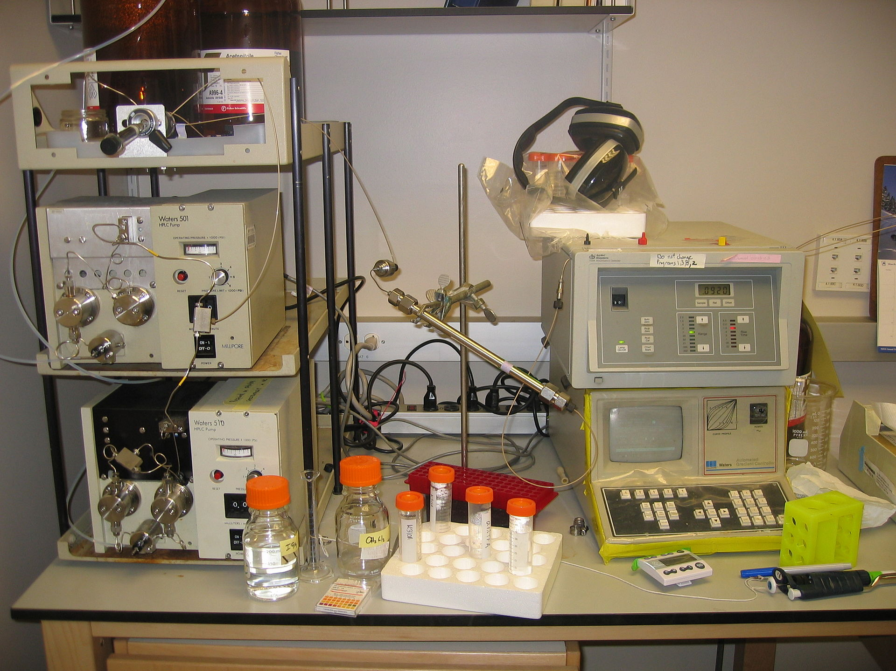
Conventional Intra-Cerebral micro dialysis
Insert sample tube into HPLC machine
Notes:
Results will be read via intra cerebral microdialiysis. This will allow for serotonin levels in the synapse to be measured as the mice are exposed to alcohol. ICMD uses a probe that is inserted inot the PFC of the mice. The probe comes with a semi permeable membrane thorugh which serotonin metabolites pass through and into the Dialsste smaple tube. Probe read via HPLC (identifies concentration and identity of solute that is inserted)

Slide 13
Results and Discussion
What to expect:
Ser9 mutagenized and mice w/no mutagenesis: HIGH SEROTONIN READINGS
no Serine site for phosphorylation resulting in build up of serotonin
Tyr216 mutagenized mice: BASAL SEROTONIN LEVLES
Ethanol cannot bind due to no Tyr216 site so readings should be similar to basal levels

Slide 14
References
Polter, Abigail M. et al. “Functional Significance of Glycogen Synthase Kinase-3 Regulation by Serotonin.” Cellular signalling 24.1 (2012): 265–271. PMC. Web. 10 Nov.
Polter, Abigail M., and Xiaohua Li. “Glycogen Synthase Kinase-3 Is an Intermediate Modulator of Serotonin Neurotransmission.” Frontiers in Molecular Neuroscience 4 (2011): 31. PMC. Web. 14 Nov. 2017.
Zhou W, Chen L, Paul J, Yang S, Li F, et al. (2012) The Effects of Glycogen Synthase Kinase-3beta in Serotonin Neurons. PLoS ONE 7(8): e43262. doi:10.1371/journal.pone.0043262
Liu, Huanting, and James H Naismith. “An Efficient One-Step Site-Directed Deletion, Insertion, Single and Multiple-Site Plasmid Mutagenesis Protocol.” BMC Biotechnology, vol. 8, no. 91, 4 Dec. 2008, doi:10.1186/1472-6750-8-91.
Neznanova, O. et al. “Acute Ethanol Challenge Inhibits Glycogen Synthase Kinase-3 Beta in the Rat Prefrontal Cortex.” The international journal of neuropsychopharmacology / official scientific journal of the Collegium Internationale Neuropsychopharmacologicum (CINP) 12.2 (2009): 275–280. PMC. Web. 26 Nov. 2017.
Prescription Drug Abuse: A Fast-Growing Problem | NIH MedlinePlus the Magazine." U.S National Library of Medicine. U.S. National Library of Medicine, n.d. Web. 05 June 2016. <https://www.nlm.nih.gov/medlineplus/magazine/issues/fall11/articles/fall11pg21.html>. (Citation for Figure 1)
Lovinger, D.M. (1997) Serotonin’s role in alcohol’s effects on the brain. Alcohol Health Res World 21, 114–120.
Gardier, Alain. (2013). Antidepressant activity: Contribution of brain microdialysis in knock-out mice to the understanding of BDNF/5-HT transporter/5-HT autoreceptor interactions. Frontiers in pharmacology. 4. 98. 10.3389/fphar.2013.00098.
Bax B et al. The structure of phosphorylated GSK-3 beta complexed with a peptide, FRATtide, that inhibits beta-catenin phosphorylation. Structure 2001, 9, 1143–115210.1016/S0969-2126(01)00679-7.

