Slide 1
Identifying the conserved residues of LapA that are required for protein-protein interactions
Aarthi Prakash
Mentor: Dr. Jitender Mehla
Devember 14, 2017

Slide 2
Antibiotic Resistance
Increased ”Superbugs” resistant to many antibiotics
Possible Causes
Morphological changes: aggregation of cells, changes in shape, etc
Physiological changes: fatty acid composition, cell surface hydrophobicity
Need for alternate targets for antibiotics
Possibly alteration of internal mechanisms
Find structural aspects to exploit
Need to understand pathway components
https://medcomic.com/medcomic/antibiotics-the-repercussions-of-overprescribing/

Slide 3
Lipopolysaccharide Assembly
Biogenesis pathway for outer membrane structure
Synthesized from inner membrane to outer membrane
Well characterized
Transport pathway
Not well characterized

Slide 4
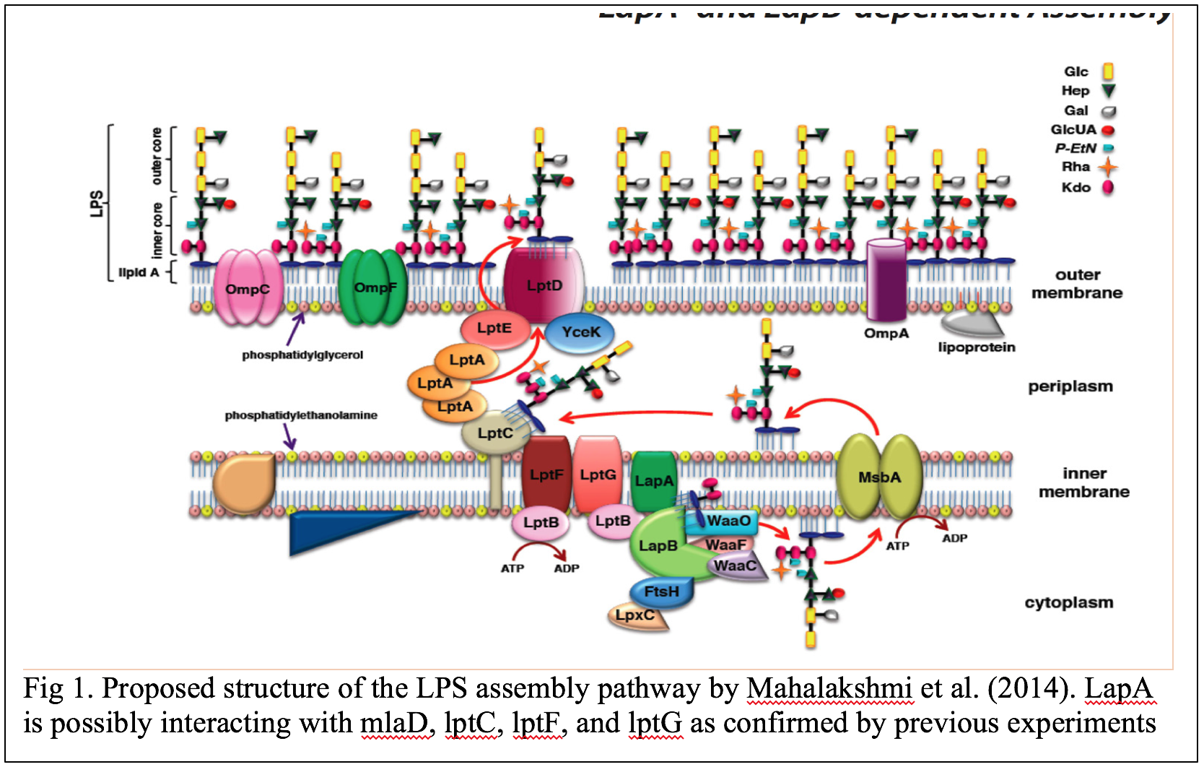
LapA
Lipopolysaccharide Assembly Protein A
Embedded inner membrane protein
Bridge from constructed proteins to outer membrane
Provides insight on LPS assembly and function

Slide 5
Objective
To determine the protein-protein interactions of LapA and the associated variants with the previously chosen proteins of MlaD, LptC, LptF, and LptG
To determine which conserved residues are essential to LapA for those protein-protein interactions

Slide 6
Experimental Outline
Mutant Generation
Gateway Cloning
Bacterial Chemical Transformation
Bacterial Two-Hybrid Screening (B2H)

Slide 7
Mutant Generation
Synthesized using GeneArt Strings (ThermoFisher pvt ltd)
1 wild type, 2 deletions, and 13 individual substitutions
Site-specific substitutions with alanine
Alanine substituted with glycine
Widely used due to no functional group
4 interacting proteins MlaD, LptC, LptF, and LptG

Slide 8
Gateway Cloning

Slide 9
Bacterial Chemical Transformation
Into BTH101 Competent E. coli cells
LapA and variants – pUT18
kanamycin
Interacting proteins – pST25
Spectinomycin
Plated on LB Agar + antibiotic plates

Slide 10
Bacterial Two-Hybrid Screening

Slide 11
Bacterial Two-Hybrid Screening

Slide 13
Discussion
Limitations
not a defined function only characterization
Only looks at 2 conserved regions but not all
Pitfalls
Tricky to pick out correct clones, false positive growth on plates
Verification via sequencing
No interactions at detected at all
Future
Quantify the strength of the interactions
Multiple Mutational Analysis – simultaneous mutant interactions

Slide 14
Questions?

Slide 15
References
Freinkman, E., Chng, S., & Kahne, D. (2011). The complex that inserts lipopolysaccharide into the bacterial outer membrane forms a two-protein plug-and-barrel. Preceedings of the National Academy of Sciences, 108(6), pp. 2486-2491. doi: 10.1073/pnas.1015617108
Frirdich, E., & Whitfield C. (2005). Lipopolysaccharide inner core oligosaccharide structure and outer membrane stability in human pathogens belonging to the Enterobacteriaceae. Journal of Endotoxin Research, 11(3), pp. 133-144. doi: 10.1179/096805105X46592
Gronow, S., & Brade, H. (2001). Lipopolysaccharide biosynthesis: which steps do bacteria need to survive?. Journal of Endotoxin Research, 7(1), pp. 3-22.
Klein, G., Kobylak, N., Lindner, B., Stupak, A., & Raina, S. (2014). Assembly of Lipopolysaccharide in Escherichia coli Requires the Essential LapB Heat Shock Protein. Journal of Biological Chemistry, 289(21), pp. 14829-14853. doi: 10.1074/jbc.M113.539494
Kotra, L.P., Golemi, D., Amro, N.A., Liu, G., Mobashery, S. (1999). Dynamics of Lipopolysaccharide Assembly on the Surface of Escherichia coli. Journal of American Chemical Society, 121(38), pp. 8707-8711. doi: 10.1021/ja991374z
Mahalakshmi, S., Sunayan, M.R., SaiSree, L., & Reddy, M. (2014). yciM is an essential gene required for regulation of lipopolysaccharide synthesis in Escherichia coli. Molecular Microbiology, 91(1), pp. 145-157. doi: 10.1111/mmi.12452
Mehla, J., Caufield, J.H., Sakhawalker, N., & Uetz, P. (2017). A Comparison of Two-Hybrid Approached for Detecting Protein-Protein Interactions. Methods in Enzymology, 586, pp. 333-358. doi: 10.1016/bs.mle.10.020.
Mehla, J., & Sood, S.K. (2010) Substantiation in Entercoccus faecalis of Dose-Dependent Resistance and Cross Resistance to Pore-Forming Antimicrobial Peptides by Use of a Polydiacetylene-Based Colorimetric Assay. Applied and Environmental Microbiology, 77(3), pp. 786-793. doi:10.1128/AEM.01496-10
Missiakas, D., Betton, J.M., & Raina, S. (1996). New components of protein folding in extracytoplasmic compartments of Escherichia coli SurA, FkpA, and Skp/OmpH. Molecular Microbiology, 21(4), pp. 871-884. doi: 10.1046/j.1365-2958.1996.561412.x
Polissi, A., & Sperandeo, P. (2014). The Lipopolysaccharide Export Pathway in Escherichia coli: Structure, Organization and Regulated Assembly of the Lpt Machinery. Marine Drugs, 12, pp. 1023-1042. doi: 10.3390/md12021023
Raetz, C.R.H., & Whitfield, C. (2002). Lipopolysaccharide Endotoxins. Annual Review of Biochemistry, 71, pp. 635-700. doi: 10.1146/annurev.biochem.71.1106001.135414
Ruiz, N., Kahna, D., & Silhavy, T.J. (2009). Transport of lipopolysaccharide across the cell envelope: the long road of discovery. Nature Reviews Microbiology, 7(9), pp. 677-683. doi: 10.1038/nrmicro2184
Sampson, B.A., Misra, R., & Benson, S.A. (1989). Identification and Characterization of a New Gene of Escherichia Coli K-12 Involved in Outer Membrane Permeability. Genetics, 122(3), pp. 491-501.

